Slide 1

Revision-3
Presented By Clinical Psychologist Sadaf Sajjad

Slide 2
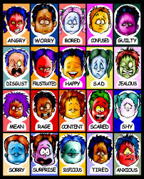
Emotional Intelligence

Slide 3
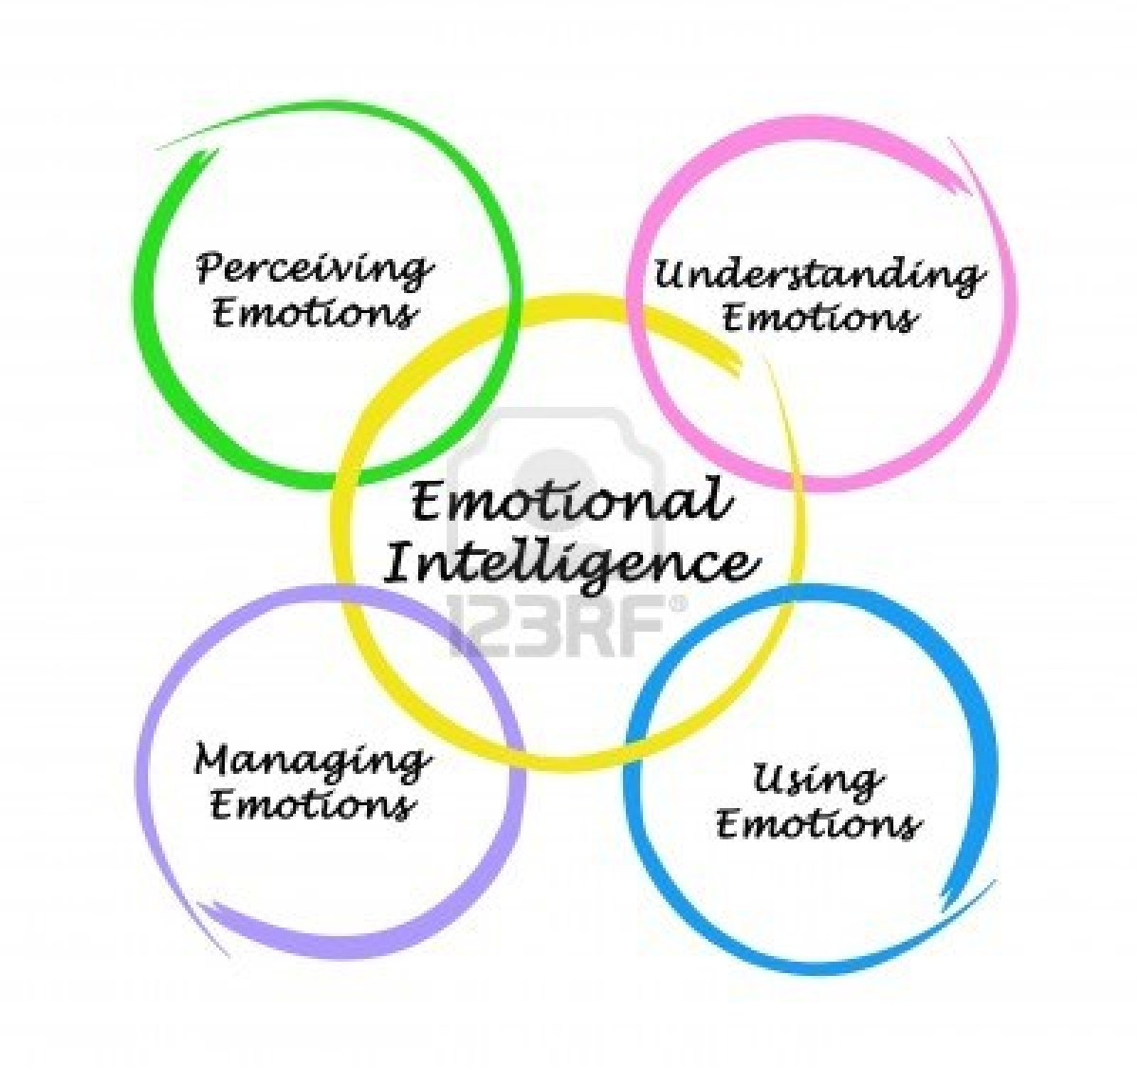
Emotional Intelligence
Definition:
Emotional intelligence (EI) refers to the ability to perceive, control and evaluate emotions. Some researchers suggest that emotional intelligence can be learned and strengthened, while others claim it is an inborn characteristic.
Effects of Emotional Intelligence:
Emotional intelligence affects:
Your performance at work
Your physical health
Your mental health
Your relationships

Slide 4
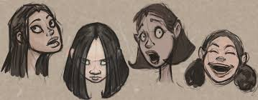
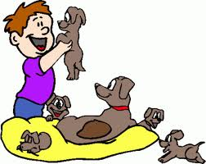
Mental ability model of Emotional Intelligence
Perceiving Emotions: The first step in understanding emotions is to accurately perceive them. This might involve understanding nonverbal signals such as body language and facial expressions.
Reasoning With Emotions: The next step involves using emotions to promote thinking and cognitive activity. Emotions help prioritize what we pay attention and react to
Understanding Emotions: The emotions that we perceive can carry a wide variety of meanings. If someone is expressing angry emotions, the observer must interpret the cause of their anger and what it might mean.
Managing Emotions: The ability to manage emotions effectively is a key part of emotional intelligence. Regulating emotions, responding appropriately and responding to the emotions of others are all important aspect of emotional management.

Slide 5


Four Skills of Emotional Intelligence
Emotional intelligence is made up of four core skills that comes under two primary competencies:
Personal competence is made up of your self-awareness and self-management skills
  Self-Awareness is your ability to accurately perceive your emotions and stay aware of them as they happen.
  Self-Management is your ability to use awareness of your emotions to stay flexible and positively direct your behavior.
Social competence is made up of your social awareness and relationship management skills
    Social Awareness is your ability to accurately pick up on emotions in other people and understand what is really going on.
    Relationship Management is your ability to use awareness of your emotions and the others’ emotions to manage interactions successfully.

Slide 6
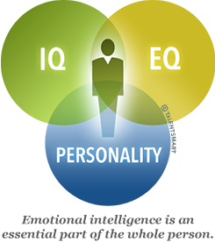
How can one improve emotional intelligence?
Pay attention to self and other’s body language
Listen more; speak less- develops empathy
Get curious, not furious- Watch what you say especially when frustrated or annoyed. Reframe negative emotions into curiosity. “..this makes absolutely no sense to me" can be replaced with, "Do you see something in this that I must be missing”
Elicit pride in others – Reason for working together
Remember that emotions are contagious - A dominant person's emotions (negative or positive) always influences others. Leaders should be careful to show only those emotions, which they want to see in others

Slide 7

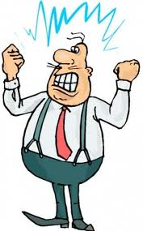
Measuring emotional intelligence
Measuring emotional intelligence
There are two types of generally valid tests for the measure of emotional intelligence:
Specific ability tests measure a key specific ability related to emotional intelligence such as the capacity to accurately identify emotion in faces.
General integrative tests measure across a number of specific emotional intelligence skills to provide an overall picture of an individual's emotional intelligence.
Emotional Intelligence, or EI, describes an ability or capacity to perceive, assess, and manage the emotions of one's self, and of others. EQ, or Emotional Quotient, is how one measures Emotional Intelligence.

Slide 8

Video

Slide 9
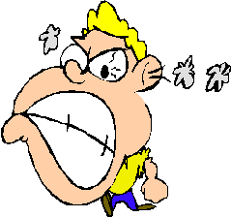
Aggression

Slide 10
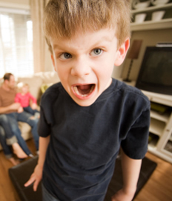
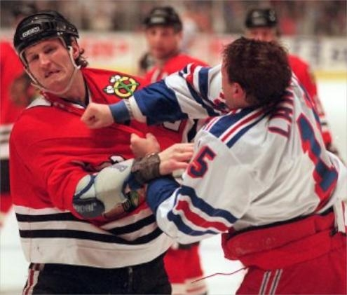
What is Aggression?
Behavior intended to injure another individual
Types of Aggression:
  Indirect Aggression: Attempt to hurt another without obvious face-to-face conflict.
  Direct Aggression: Behavior intended to hurt someone, to his or her face
  Emotional Aggression: Hurtful behavior that stems from angry feelings.
  Instrumental Aggression: Harm inflicted as a means to some goal other than causing pain
Aggression varies greatly across cultures.
Aggression is Innate or Learned.

Slide 11
Factors that influence aggression
Neural Influences
Genetic Influences
Psychological Influences
Environmental Influences
Blood Chemistry

Slide 12


Factors that influence aggression
Natural Influence: includes the activation of certain regions in the neural system. (example: hypothalamus)
Genetic Influence: Heredity influence the neural system’s sensitivity to aggressive cues. Animals can be bred for aggressive purposes, as in cock fighting
Blood Chemistry: Levels of certain hormones in the blood can provide indication to a patient's condition and aggression.

Slide 13
Factors that influence aggression
Psychological Influence:
  The classic frustration-aggression theory: states that frustration always leads to some form of aggression like displacement or suicide etc.
  Operant Conditioning (B.F. Skinner) theory: states that If after performing an aggressive act an animal or human receives a positive reinforcement, they are likely to repeat the behavior in order to gain more rewards.
  Social Learning Theory/Observational Learning (Albert Bandura): states that aggressive acts are motivated by a variety of aversive experiences—frustration, pain, insults.

Slide 14
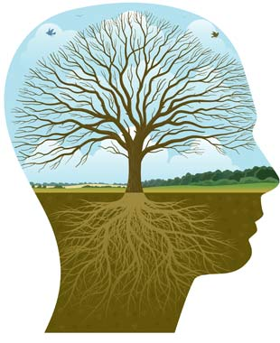
Psychotherapy

Slide 15
Definition
Psychotherapy is a general term referring to therapeutic interaction or treatment contracted between a trained professional and a client, patient, family, couple, or group.
The problems addressed are psychological in nature and can vary in terms of their causes, influences, triggers, and potential resolutions.
Accurate assessment of these and other variables is dependent on the practitioner's capability and can change or evolve as the practitioner acquires greater experience, knowledge, and insight.
Treatment through Psychotherapy
Most psychotherapy tends to focus on problem solving and is goal-oriented. That means at the onset of treatment, you and your therapist decide upon which specific changes you would like to make in your life.
Most psychotherapists today work on and focus on helping you to achieve those goals. This is done simply through talking and discussing techniques that the therapist can suggest that may help you better navigate those difficult areas within your life.

Slide 16
Why do people consider using psychotherapy?
Psychotherapy is a partnership between an individual and a professional such as a psychologist who is licensed and trained to help people understand their feelings and assist them with changing their behavior.
They feel an overwhelming and prolonged sense of sadness and helplessness, and they lack hope in their lives.
Their emotional difficulties make it hard for them to function from day to day. For example, they are unable to concentrate on assignments and their job performance suffers as a result.
Their actions are harmful to themselves or to others. For instance, they drink too much alcohol and become overly aggressive.
They are troubled by emotional difficulties facing family members or close friends.

Slide 17
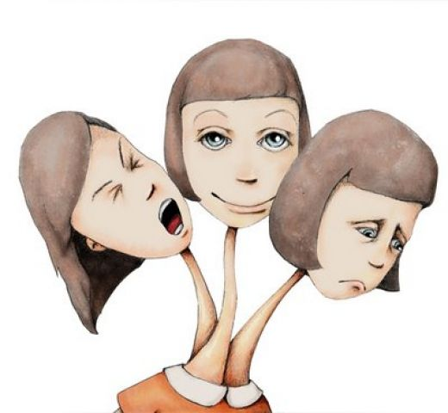
What does psychotherapy treat?
Psychotherapy is used for treating many different problems. Some alone, and some in combination with drugs. The most commons ones are listed below:
Depression
Anxiety
Post-traumatic stress disorder
Low self-esteem
Anxiety disorder, including phobias
Emotional crises
Marital problems
Family disputes
Obsessive-compulsive disorder
Personality disorders
Alcoholism
Addiction
Problems stemming from child abuse
Behavioral problems
Bipolar disorder
Schizophrenia

Slide 18

Approaches of Psychotherapy
Psychodynamic Therapy
Interpersonal Therapy
Types of Psychotherapy
Behavioural therapy
Cognitive analytical therapy
Cognitive behavioral therapy (CBT)
Gestalt therapy
Group psychotherapy
Psychoanalysis
Humanistic-Existential Psychotherapy
Modes of Psychotherapy
Individual Therapy
Couples Therapy
Family Therapy
Group Therapy

Slide 19
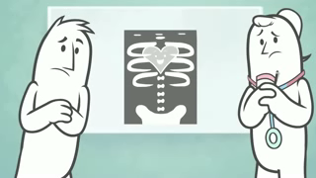
Video

Slide 20

Dreams

Slide 21
Dreams
Dream is a word used to describe the subconscious experience of a sequence of images, sounds, ideas, emotions, or other sensations usually during sleep, especially REM sleep”.
There is no neurologically agreed upon, biological definition for dreaming .
A dream is a coherent whole using the universal language of imagery to convey our internal and external life issues and how to deal with them, including our limitations in facing their reality.
REM stands for “rapid eye movement”. REM sleep is a state of sleep in which brain activity is most like wakefulness.

Slide 22
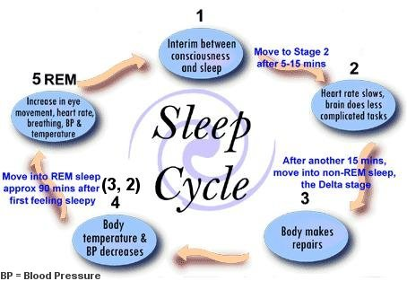
Dreams
When one falls asleep, the body and mind experience different levels of sleep throughout the night. Your sleep cycles consist of REM sleep (Rapid Eye Movement) and NREM (Non Rapid Eye Movement) which cycle consistently in five stages throughout the night.

Slide 23
Stages of Sleep Video

Slide 24
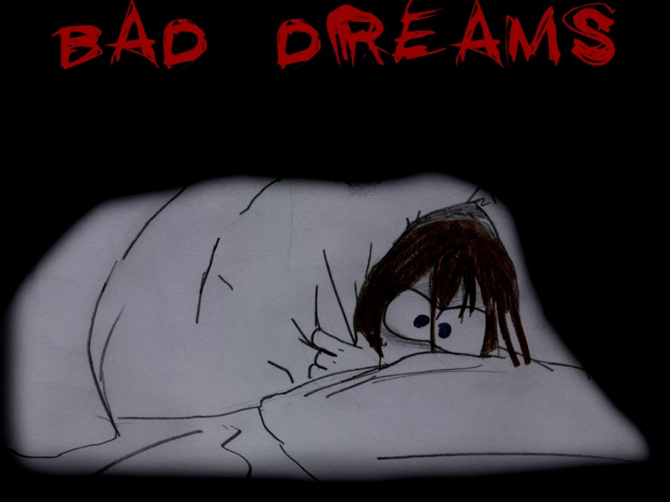
Dreams
Lucid dreaming, occurs when dreamers realize that they are dreaming (lucid dreaming can occur with varying levels of awareness and dream control).
A nightmare is a disturbing dream that causes the dreamer to wake up feeling anxious and frightened. Nightmares may be a response to real life trauma and situations.

Slide 25
Dreams
Recurring dreams repeat themselves with little variation in story or theme. These dreams may be positive, but most often they are nightmarish in content.
Some researchers suggest that dreams serve no real purpose, while others believe that dreaming is essential to mental, emotional and physical well-being.
Children are also more likely to have "fantastic" dreams, while adults' dreams tend to contain more elements of reality.
Common types of dreams are: falling, being chased, being in an exam, solving issues, being with the people who have passed, by loving others secretly, snakes, killing others or being killed etc.

Slide 26
Dreams
Common theories on dreams are:
Freud’s Wish-Fulfillment theory, saying that Dreams are an attempt to satisfy sexual and aggressive impulses that we cannot satisfy when we are awake.
Activation- Synthesis Theory: Dreams result from random activation of brain cells responsible for eye movement, muscle movement, balance, and vision.
Problem Solving Theory: Dreams give people a chance to review and address problems they face during the day.
Mental Housekeeping Theory: During sleep, the brain shuts out sensory input so it can process what was stored in memory during the day

Slide 27
Some Facts about Dreams
Humans spend about 6 years dreaming.
Dreams are generated in the forebrain.
Most common emotion experienced during dreaming is anxiety.
This parallel much of the current research on gender and gender role comparisons in aggressive behavior.
In general, more introverted, psychologically oriented people naturally remember their dreams and practical, concrete thinkers don’t.
Approximately 70% of women have recurring dreams and 65% of men.

Slide 28
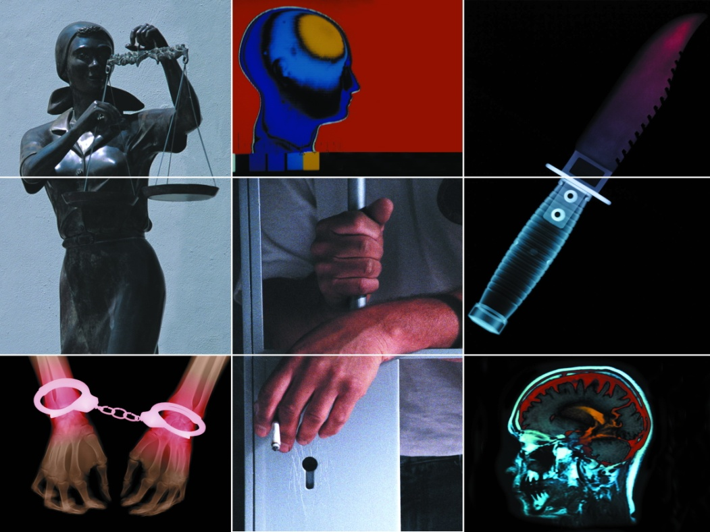
Criminal Psychology

Slide 29
Crime
Crime is a violation of one or more rules or laws for which some governing authority or force may ultimately prescribe a punishment.
Example: robbery, murder
Types of Crime:
Types of Crime
Offences against the person
Economic Offences
Offences against the State
Drug Offences
Public Order Offences
Traffic Offences
Victimless crimes
Preliminary Crimes

Slide 30

Criminal Psychology
Criminal or forensic psychology is a field of psychology which focuses on criminals.
To study the psychological factor of the criminal e.g: motivation; to examine the character, environment of the criminal and the process of the criminal behavior.
Motivation of crime:
    Desire
    Ability
    Opportunity
Criminal behaviour is designated according to age and intention – thus the same behaviour can be seen as criminal in one case and not in another.
Individuals are deemed to have committed a criminal act only if they can be shown to have had the intention of doing so.

Slide 31
Theories of Criminal Psychology
Psychoanalytic Theory: Freud claimed that all human beings are born with certain instincts, i.e. with a natural tendency to satisfy their biologically determined needs for food, shelter and warmth, thus all human have criminal tendency.
Intelligence and Crime: The brighter might get arrested less. Goddard used intelligence tests on institutionalized populations such as prisoners in the early 20th century. He concluded that most prisoners were “unintelligent”
Learning Theories: (Albert Bandura) presented theory that Criminal behavior is learned through direct and indirect reinforcement.
    Example: by interacting with anti-social peers, watching violence on television e.t.c.
Social Learning Theory: according to the theory Aggression is learned, not innate. It requires personal observation of aggression or rewards for aggression.

Slide 32
Theories of Criminal Psychology
Albert Bandura Bobo Doll Experiment: He had children witness a model aggressively attacking a plastic clown called the Bobo doll.
  Bandura showed his film to groups of children and let them out to play, and found that Kids imitated the young lady in the film.
Personality Theory:
  Hans Eysenck presented a PEN model according to which People high on Neuroticism and Extraversion are more likely to become involved in crime
Biological Theory:
  Research has shown a relationship between high blood testosterone levels and increase male aggression.
  A study of Scottish prisoners found that a small number of human had an XYY chromosome. These were identified as potentially violent and labeled “supermale”

Slide 33
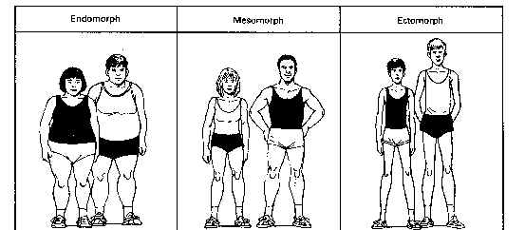
Physical Appearance of Criminal
    Lombroso’s Theory : Bodily constitution indicates whether a person is a “born criminal”
Lombroso presented a long list of physical characteristics used to identify criminals, for example: Asymmetry of the face or head, twisted nose, long arms, Large forehead e.t.c.
Body Type: there are three body types:
    Ectomorph
    Endomorph
    Mesomorph

Slide 34
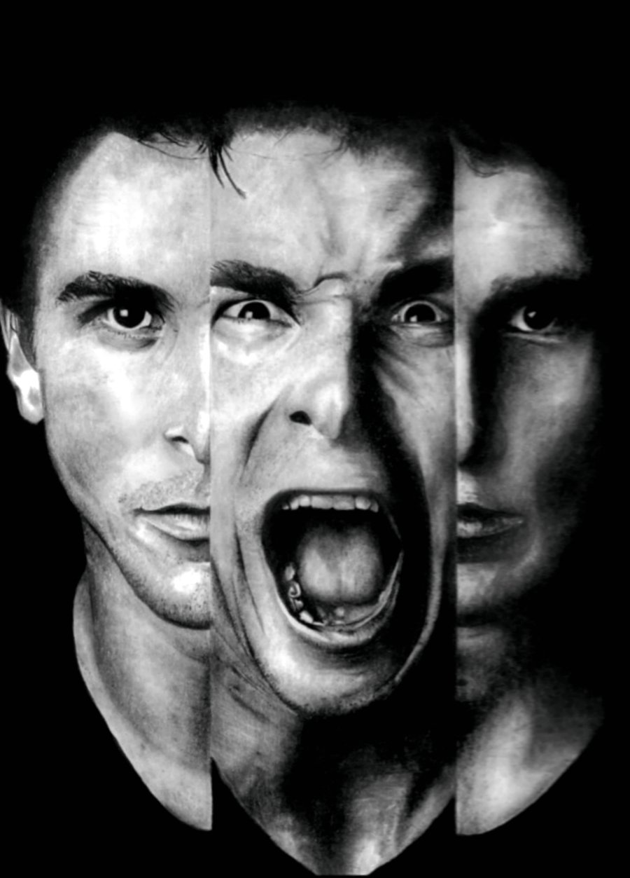
Abnormal Behavior

Slide 35
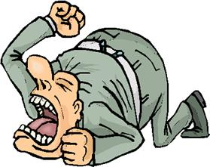

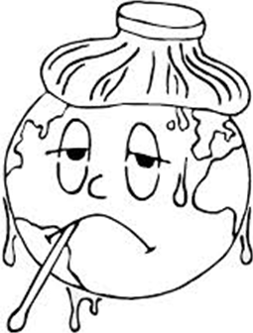
Abnormal Behavior
Actions, thoughts, and feelings harmful to a person or others; experiencing discomfort enough to not function
The abnormal behavior leads to psychological disorder that is a “harmful dysfunction” in which behavior is judged to be:
    atypical--not enough in itself
    disturbing--varies with time and culture
    maladaptive--harmful
    unjustifiable--sometimes there’s a good reason
What is Psychologically Abnormal?
    Showing Deviance from or violation of a society’s ideas about proper function.
    Distress: If behaviors cause the pain or discomfort (psychological or physical), then they are abnormal.
    Dysfunctional: Inability/loss of ability to perform one’s normal roles.
    Showing behavior that becomes dangerous to self or others.

Slide 36
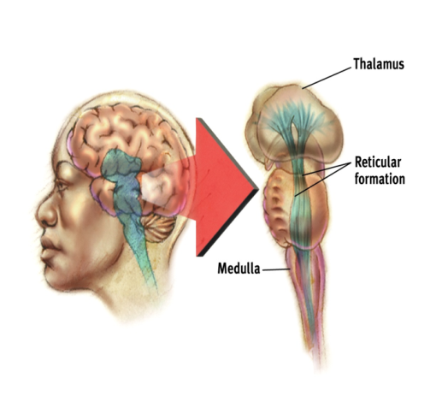
Models of Abnormality
  Biomedical Model
    Abnormal behavior, thinking and emotion are caused by biological dysfunctions
    Possible causes of abnormal behavior are
      Biochemistry – an imbalance of certain neurotransmitters or hormones
      Structural damage or abnormality
  Behavioral Model
    Abnormal behavior is the consequence of abnormal learning from the environment
    There is no qualitative difference between normal and abnormal behavior – they are learned in the same ways:
  Cognitive Model
    Abnormal behavior is caused by abnormal thinking processes
    Factors in abnormal behavior:
      Inaccurate perception
      Poor reasoning and problem solving
  Psychodynamic Model
    Psychological disorders are caused by emotional problems in the unconscious mind.
    The causes of these emotional problems can usually be traced back to early childhood.

Slide 37
Different Psychological Disorders
Two major classification of Psychological Disorders
  Neurotic Disorders: Distressing but one can still function in society and act rationally.
  Psychotic Disorders: Person loses contact with reality, experiences distorted perceptions.
Psychological Disorders
  Anxiety Disorders: The patient fears something awful will happen to them.
    Generalized Anxiety Disorder
    Panic Disorder
  Phobias: A person experiences sudden episodes of intense dread.
    Obsessive-compulsive disorder
  Post-traumatic Stress Disorder: Memories of the event cause anxiety.

Slide 38
Psychological Disorders Cont..
  Dissociative Disorders: These disorders involve a disruption in the conscious process.
    Psychogenic Amnesia: A person cannot remember things
    Dissociative Fugue: People find themselves in an unfamiliar environment.
    Dissociative Identity Disorder: A person has integrated personality.
  Mood Disorders: Experience extreme or inappropriate emotion.
  Major Depression: Unhappy for at least two weeks with no apparent cause
    Seasonal Affective Disorder
    Bipolar Disorder
  Schizophrenic Disorders
    Disorganized Schizophrenia
    Paranoid Schizophrenia
    Catatonic Schizophrenia

Slide 39

Educational Psychology

Slide 40

Educational Psychology
A distinct scientific discipline within psychology that includes both methods of study and a knowledge base.
Concerned primarily with understanding the processes of teaching and learning that take place within formal environments and developing ways of improving those methods.
An academic definition would perhaps say that educational psychology is the study of learners, learning, and teaching.

Slide 41
Scope of Educational Psychology
This field is vast as it deals with the behavioral and social development of an individual. It also helps in the structuring of individual perspective, which in turn leads to the development individualities ad personality traits.
Educational Psychology states that the development of the human brain can be traced and classified in four stages, which are levels of the child's relationship with the surroundings.
In these four stages a child develops cognitive abilities and social understanding. These four stages also determine the abilities of creativity, intelligence, morality and motivation in a child

Slide 42
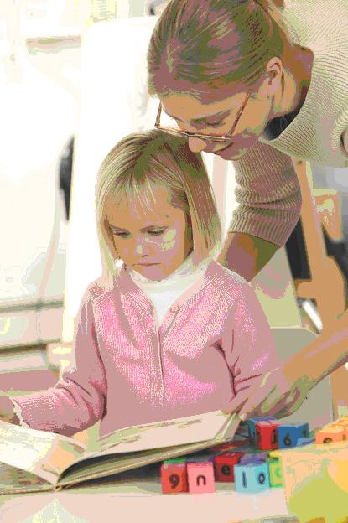
Goals of Educational Psychology
Exploring the Field of Educational Psychology
Exploring and finding out the nature of teaching
- Teaching is multi-dimensional
- Teaching Involves Uncertainty
- Teaching Involves Social and Ethical Matters.
- Teaching Involves a Diverse Mosaic of Students
Carry out Effective Teaching
- Professional Knowledge and Skills.
- Commitment
- Professional Growth

Slide 43

Divisions of Educational Psychology
The field of educational psychology consists roughly of:
- Human Development
- Learning and Cognition
- Educational research Methods
- Testing/Measurement
Essentially any facet of human behavior that affects the educational process can be considered as educational psychology

Slide 44

Contribution of Educational Psychology
To understand developmental characteristics
To understand the nature of class room learning
To understand individual differences
To understand effective teaching methods
Knowledge of mental health
Curriculum construction
Measurement of learning out-comes
Guidance for the education of exceptional children

Slide 45

Child Psychology
Presented By Clinical Psychologist Sadaf Sajjad

Slide 46

Definition
Child psychology, also called child development, the study of the psychological processes of children and, specifically, how these processes differ from those of adults, how they develop from birth to the end of adolescence, and how and why they differ from one child to the next.
Child Psychology deals with
A child psychologist is a type of psychologist who studies the mental, social and emotional development of children.
Child psychologists look at development from the prenatal period through adolescence.
This field of psychology include genetics, language development, personality, gender roles, cognitive development, sexual development and social growth.
Child psychologists may work with a range of clients including infants, toddlers, children and teens, or they may specialize in working with a particular age group. No matter what population a child psychologist chooses, his or her focus will be on helping understand, prevent, diagnose and treat developmental, cognitive, social and emotional issues.

Slide 47
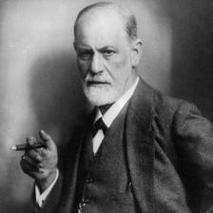
Sigmund Freud Theory
The theories proposed by Sigmund Freud stressed the importance of childhood events and experiences, but almost exclusively focused on mental disorders rather that normal functioning.
According to Freud, child development is described as a series of 'psychosexual stages.' In "Three Essays on Sexuality" (1915), Freud outlined these stages as oral, anal, phallic, latency and genital. Each stage involves the satisfaction of a libidinal desire and can later play a role in adult personality.
Stages of Development
Oral Stage: (Birth to 18 months)
Anal Stage: (18 months to three years)
The Phallic Stage: (ages three to six)
The Latent Period: (age six to puberty)
The Genital Stage: (puberty on)

Slide 48
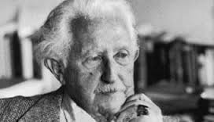
Erik Erikson Theory
Proposed a stage theory of development, but his theory encompassed human growth throughout the entire human lifespan.
Erikson believed that each stage of development was focused on overcoming a conflict.
For example, the primary conflict during the adolescent period involves establishing a sense of personal identity.
Success or failure in dealing with the conflicts at each stage can impact overall functioning. During the adolescent stage, for example, failure to develop an identity results in role confusion.
Stages of Development
Trust vs. Mistrust
Autonomy vs. Shame
Initiative vs. Guilt
Industry vs. Inferiority
Identity vs. Role
Intimacy vs. Isolation
Generativity vs. Stagnation
Integrity vs. Despair

Slide 49
Jean Piaget Theory
Suggested that children think differently than adults and proposed a stage theory of cognitive development.
He was the first to note that children play an active role in gaining knowledge of the world.
According to his theory, children can be thought of as "little scientists" who actively construct their knowledge and understanding of the world.
Stages of Development
Sensory Motor Stage (Birth - 2yrs)
Pre-Operations Stage (2yrs-7yrs)
Concrete Operations Stage (7yrs-11yrs)
Formal Operations Stage (11yrs-16yrs)

Slide 50
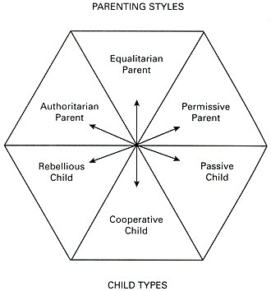
Other theories
Behavioral theories of child development focus on how environmental interaction influences behavior and are based upon the theories of theorists such as John B. Watson, Ivan Pavlov and B. F. Skinner.
Albert Bandura proposed what is known as social learning theory, children learn new behaviors from observing other people.
John Bowlby suggested that early relationships with caregivers play a major role in child development and continue to influence social relationships throughout life.
Parenting Styles

Slide 51
How to outsmart a kid with child psychology ---- Video

Slide 52

THE END

