Slide 1
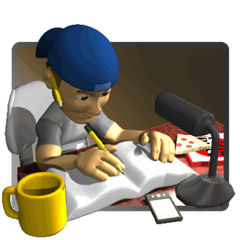
Revision
Presented By Clinical Psychologist Sadaf Sajjad

Slide 2
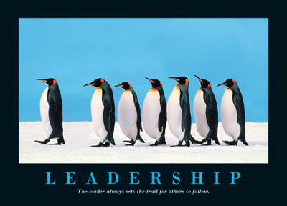
LEADERSHIP

Slide 3

Leadership?
Leadership is “a process of social influence in which one person can enlist the aid and support of others in the accomplishment of a common task".
Leadership is "organizing a group of people to achieve a common goal". The leader may or may not have any formal authority.
Leader: is a person who has a vision, a drive and a commitment to achieve that vision, and the skills to make it happen.

Slide 4

Leadership is about:
Motivating
Inspiring
Taking people to greater heights
Working with participants on the how and helping them figure out what and why
Encouraging them to push themselves to achieve the highest possible performance
Action
Enabling, not telling
Talking the talk and walking the walk...walking alongside
What are the three primary tasks of a leader?
Set direction: mission, goals, vision
Build commitment: motivate & inspire
Confront challenges: innovation, deal with change, turbulence, take risks

Slide 5
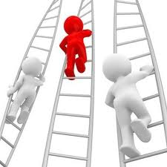
How people become leaders (Bass' Theory of Leadership)
Bass' theory of leadership notes there are three basic ways to explain how people become leaders:
A crisis or important event may cause a person to rise to the occasion, which brings out extraordinary leadership qualities in an ordinary person.
Some personality traits may lead people naturally into leadership roles.
People can choose to become leaders. People can learn leadership skills. This is the Transformational or Process Leadership Theory. It is the most widely accepted theory today and the premise on which this guide is based.

Slide 6

Leadership styles
Leadership style is the manner and approach of providing direction, implementing plans, and motivating people. Kurt Lewin (1939) led a group of researchers to identify different styles of leadership. This early study has been very influential and established three major leadership styles. The three major styles of leadership are:
Authoritarian or autocratic
Participative or democratic
Delegative or Free Reign

Slide 7
Leadership theories
Great Man Theory: assumes that the capacity for leadership is inherent
Trait Theory: assumes that people inherit certain qualities and traits that make them better suited to leadership
Contingency Theory: focuses on particular variables related to the environment
Situational Theory: leaders choose the best course of action based upon situational variables
Behavioral Theory: based upon the belief that great leaders are made, not born
Participative Theory: suggests that the ideal leadership style is one that takes the input of others into account.
Management Theory: focuses on the role of supervision, organization and group performance
Relationship Theory: focus upon the connections formed between leaders and followers

Slide 8

Video 1

Slide 9
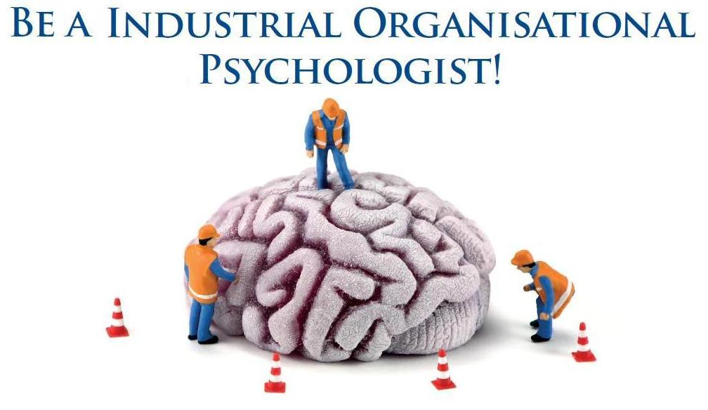
Industrial Psychology

Slide 10

Industrial Psychology Definition
The branch of applied psychology that is concerned with efficient management of an industrial labor force and especially with problems encountered by workers in a mechanized environment.
Industrial psychology looks at behavior that occurs within the workplace. Also called industrial-organizational (I/O) psychology, people who work in this field might study worker personalities and performances, or the interactions between the individuals within a business or organization.

Slide 11
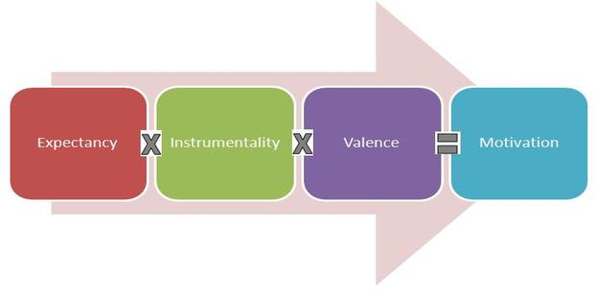
Expectancy Theory
The Expectancy theory states that employee’s motivation is an outcome of how much an individual wants a reward (Valence), the assessment that the likelihood that the effort will lead to expected performance (Expectancy) and the belief that the performance will lead to reward (Instrumentality).
In short, Valence is the significance associated by an individual about the expected outcome. It is an expected and not the actual satisfaction that an employee expects to receive after achieving the goals.

Slide 12


Goal Settings Theory
Goal-setting theory refers to the effects of setting goals on subsequent performance.
Researcher Edwin Locke found that individuals who set specific, difficult goals performed better than those who set general, easy goals.
Locke proposed five basic principles of goal-setting: clarity, challenge, commitment, feedback, and task complexity.
One of the most effective ways to stay motivated is to set goals for yourself. However, the type and quality of goals you set affects how well they will work.

Slide 13
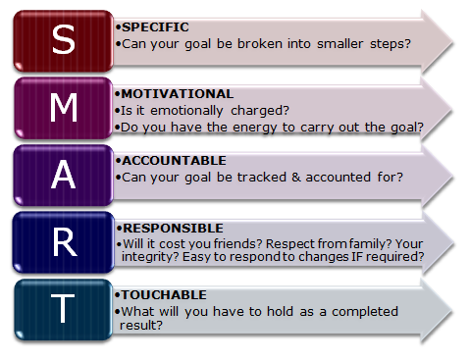
S.M.A.R.T. Method
The S.M.A.R.T. method assumes that if you set a goal that is:
Specific
Measurable
Attainable
Relevant
Time bound

Slide 14
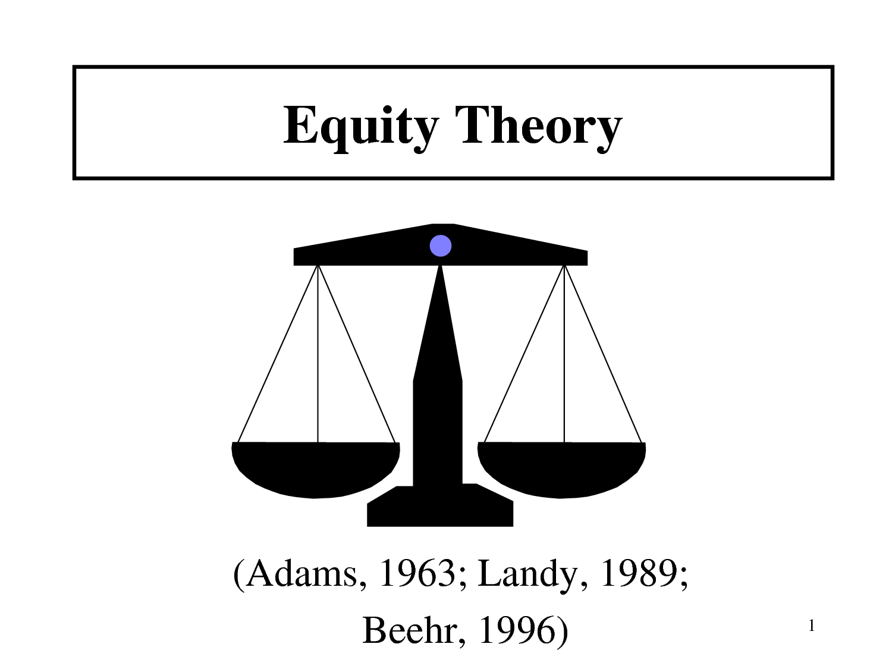
Equity theory
Equity theory is a theory that attempts to explain relational satisfaction in terms of perceptions of fair/unfair distributions of resources within interpersonal relationships.
The core of the equity theory is the principle of balance or equity. As per this motivation theory, an individual’s motivation level is correlated to his perception of equity, fairness and justice practiced by the management. Higher is individual’s perception of fairness, greater is the motivation level and vice versa.

Slide 15


Psychology of Workplace
Positive psychology in the workplace is about shifting attention away from negative aspects such as work violence, stress, burnout, and job insecurity.
Positive psychology can help create a working environment goal of promoting positive affect in its employees.
Work-Life Balance
Employee Recognition
Human resources
Job Satisfaction
Work Behavior
Management
Workplace Interactions
Motivation

Slide 16

Video 2

Slide 17

Personality
Presented By Clinical Psychologist Sadaf Sajjad

Slide 18
Equity theory
“An individual’s unique and relatively consistent patterns of thinking, feeling, and behaving.”
Personality – an attempt to describe and explain how people are similar, how they are different, and why every individual is unique.
Personality - A relatively stable set of characteristics that influences an individual’s behavior.

Slide 19
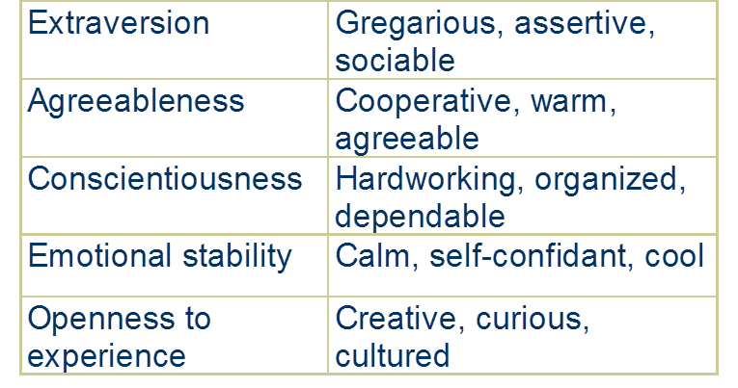
Big Five Personality Traits

Slide 20
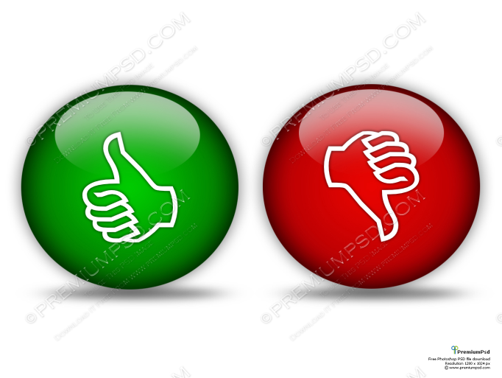
Personality Characteristics
Positive Affect - an individual’s tendency to accentuate the positive aspects of oneself, other people, and the world in general
Negative Affect - an individual’s tendency to accentuate the negative aspects of oneself, other people, and the world in general

Slide 21
Personality structure
Id: the collection of unconscious urges and desires that continually seek expression.
Pleasure principle : the way in which the id seeks immediate gratification of an instinct.
Ego : the part of the personality that mediates between environmental demands, conscious, and instinctual need; now often used as a synonym for self.
Reality principle : the way in which the ego seeks to satisfy instinctual demands safely and effectively in the real world.
Super ego : According to Freud, the social and parental standards the individual has internalized; the conscious and the ego ideal.
Ego ideal: The part of the superego that consists of standards of what one would like to be.

Slide 22
Personality Theories
Trait Theory - understand individuals by breaking down behavior patterns into observable traits
Psychodynamic Theory - emphasizes the unconscious determinants of behavior
Humanistic Theory - emphasizes individual growth and improvement
Behavioral Theory – emphasizes Focus on external environment and on effects of conditioning and learning

Slide 23
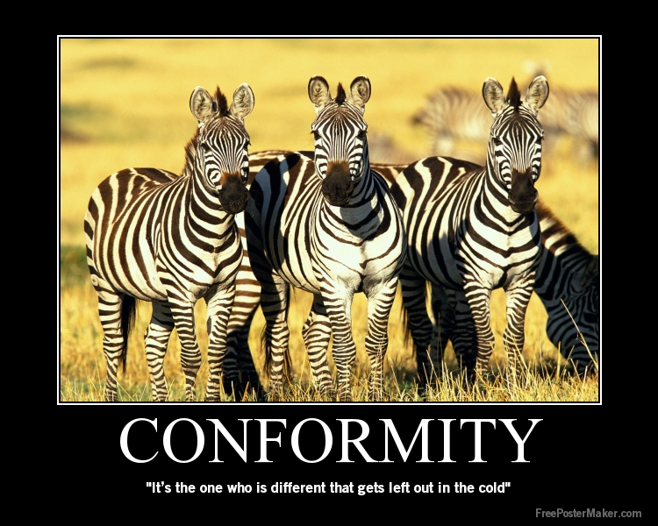
Conformity
Presented By Clinical Psychologist Sadaf Sajjad

Slide 24
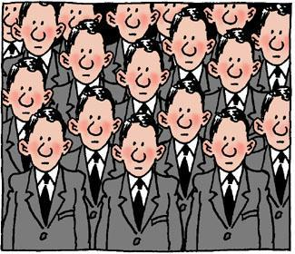
What is Conformity?
Conformity is a type of social influence involving a change in belief or behavior in order to fit in with a group.
This change is in response to real (involving the physical presence of others) or imagined (involving the pressure of social norms / expectations) group pressure.
Conformity is also known as majority influence (or group pressure).
What causes people to conform?
People conform for two main reasons:
because they want to fit in with the group
(normative influence) and because they
believe the group is better informed than
they are (informational influence).

Slide 25

Forms of Conformity
Compliance: Motivated by rewards and the avoidance of punishment.
Identification: Desire to be like the influencer
Internalization: The desire to be right is the motive
Ingratiation Conformity: Where a person conforms to impress or gain favor/acceptance from other people
Types of Social Conformity
Man (1969) states that “the essence of conformity is yielding to group pressure”. He identified three types of conformity: Normative, informational and ingratiation.
Kelman (1958) distinguished between three different types of conformity: Compliance, Internalization and identification.

Slide 26
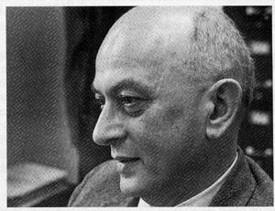

Sherif’s Study
Sherif (1935) made use of the auto kinetic effect to perform a classic conformity study. If you look at a stationary light in an otherwise dark room the light will appear to move, because your eyes have no other reference point.
Sherif found that a subject's reports of movement were highly influenced by other people's estimates.

Slide 27
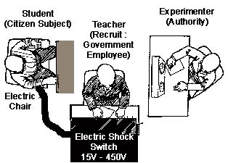
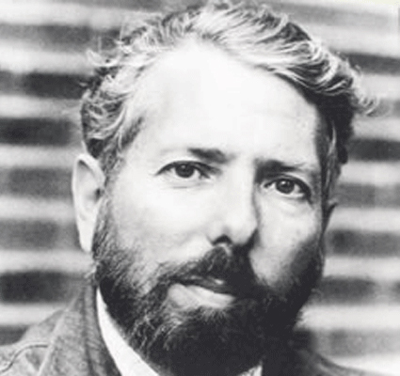
Milgram’s Study
He assigned each of the subjects to the role of teacher. Each subject was told that his task was to help another subject like himself learn a list of word pairs.
Each time the learner made a mistake, the teacher was to give the learner an electric shock by flipping a switch.
The teacher was told to increase the shock level each time the learner made a mistake, until a dangerous shock level was reached.

Slide 28
Video 3

Slide 29
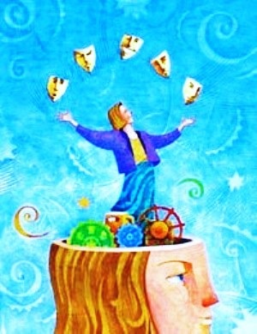
Intelligence and assessment of intelligence

Slide 30
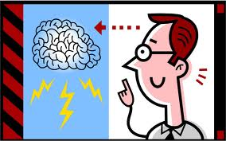
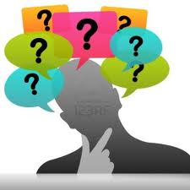
Intelligence
A very general mental capability that involves the ability to reason, plan, solve problems, think abstractly, comprehend complex ideas, learn quickly and learn from experience.
It is not merely book learning, a narrow academic skill, or test-taking smarts. Rather, it reflects a broader and deeper capability for comprehending our surroundings—"catching on," "making sense" of things, or "figuring out" what to do.
Abstract thought
Understanding
Self-awareness
Reasoning
Learning
Emotional intelligence
Retaining
Plan
Problem-solving
Communication

Slide 31
Types of intelligence
Naturalist Intelligence (“Nature Smart”): Designates the human ability to discriminate among living things (plants, animals) as well as sensitivity to other features of the natural world (clouds, rock configurations).
Musical Intelligence (“Musical Smart”): Musical intelligence is the capacity to discern pitch, rhythm, timbre, and tone.
Logical-Mathematical Intelligence (Number/Reasoning Smart): Logical-mathematical intelligence is the ability to calculate, quantify, consider propositions and hypotheses, and carry out complete mathematical operations.
Existential Intelligence: Sensitivity and capacity to tackle deep questions about human existence, such as the meaning of life, why do we die, and how did we get here.
Interpersonal Intelligence (People Smart”): Interpersonal intelligence is the ability to understand and interact effectively with others.

Slide 32
Types of intelligence Cont..
Bodily-Kinesthetic Intelligence (“Body Smart”): Bodily kinesthetic intelligence is the capacity to manipulate objects and use a variety of physical skills.
Linguistic Intelligence (Word Smart): Linguistic intelligence is the ability to think in words and to use language to express and appreciate complex meanings.
Intra-personal Intelligence (Self Smart”): Intra-personal intelligence is the capacity to understand oneself and one’s thoughts and feelings, and to use such knowledge in planning and directioning one’s life.
Spatial Intelligence (“Picture Smart”): Spatial intelligence is the ability to think in three dimensions. Core capacities include mental imagery, spatial reasoning, image manipulation, graphic and artistic skills, and an active imagination.

Slide 33
Theories of intelligence
Two-factor theory: Spearman proposed Two factor theory of intelligence in 1904. As the name implies, the theory involves two factors namely General(G) and Specific(S) factors.
Multi-factor theory of Thorndike: Thorndike opposed the theory of General intelligence. He proposed that they are Specific stimuli and Specific response. According to him, Intelligence is nothing more than a convenient name for almost infinite number of actual or potential specific connections between these stimuli and responses.
Group-factor theory of Thurston: Thurston and his associates proposed the Group factor theory. According to this theory, Intelligent activity is not an expression of innumerable highly specific factor as Thorndike claimed. Nor it is the expression primarily of a general factor as Spearman held.

Slide 34
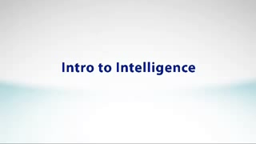
Video 4

Slide 35
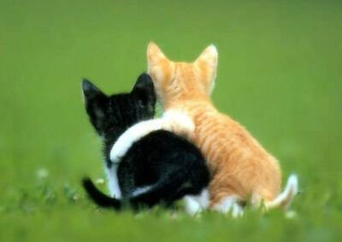
Liking and Friendship

Slide 36

Social Psychology
Social Psychology: Study of how others influence our thoughts, feelings, and actions. Our behavior is affected by our inner attitudes as well as by external social influences
  Social Relations- Liking and Attraction
  The Need to Belong is a basic human motive
  Ostracism
    Acts of excluding or ignoring.
    Often used as social punishment.
  Need for Affiliation
    The desire to establish social contact with others.
    Benefits of Affiliation
        Sense of attachment
        Social integration
        Reassurance of worth
        Sense of reliable alliance
        Guidance

Slide 37


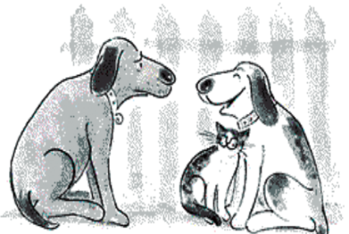
Factors Involved in Interpersonal Attraction
  Familiarity: Being There
    Proximity: The physical closeness of two people is the single best predictor of the development of a social relationship.
    Mere Exposure :The more often we are exposed to a stimulus, the more we come to like that stimulus.
  Physical Attractiveness
    We react more favorably to others who are physically attractive than to those who are not
  Similarity
    a match between our interests, attitudes, values, background, or personality and those of another person.
  Reciprocal Liking
    One of the most potent determinants of our liking someone is if we believe that that person likes us.

Slide 38
Theories Of Liking and Attraction
  Social exchange Theory-everyone tries to maximise the rewards they obtain form a relationship and try to minimise the costs.
    There are 4 basic steps:
      Reward: positive, gratifying aspects of the relationship that make it worthwhile and reinforcing
      Cost : The other side of the coin, and all relationships have some costs attached to them.
      Outcome: Reward – cost = outcome
      Comparison level: People’s expectations about the level of rewards and punishments they are likely to receive in a particular relationship
  Equity Theory- Proponents of equity theory describe equitable relationships as the happiest and most stable.
  Gain- loss Theory-According to this theory changes in another person evaluation of us will have more impact on our liking for him/ her then if the evaluation were constant.

Slide 39
Video 5

Slide 40

Altruism
“living for others”

Slide 41
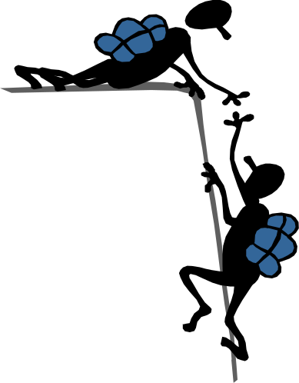
Altruism
Altruism refers to an individual acting in a way that will decrease its own survival chances, but improve the survival chances of another individual.
Three Characteristics of Altruistic Behavior
    Perceiving the need of another person
    Being motivated by empathy to help the other person
    Addressing the need by taking action without expecting a reward or recognition in return

Slide 42
Theories Of Altruism
Theories of Altruism
  Biological altruism (Based in Instinct and Genes)
    Kin selection theory
      Predicts that the extent of altruism depends on genetic relatedness.
    Reciprocal Altruism Theory
      The expectation that helping others will increase the likelihood that they will help us in the future.
      If the benefit received is larger than the cost incurred, then individuals who engage in such behaviour will out-reproduce those who do not.
  Psychological Altruism (based more on cognitive psychology)
    Psychological explanations of altruism arise as a result of cognition. That is, this type of altruism relies on the ‘helper’ understanding the situation. This kind of altruism is not innate.
    Negative-state relief model- We help others in order to relieve the stress we feel when encountering a bad situation.
    Empathy-altruism model- if you feel empathy towards a person, you will help, regardless of what you may gain from it.

Slide 43
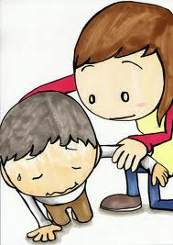
Theories Of Altruism
  Psychological Altruism (based more on cognitive psychology)
    Psychological explanations of altruism arise as a result of cognition. That is, this type of altruism relies on the ‘helper’ understanding the situation. This kind of altruism is not innate.
    Negative-state relief model- We help others in order to relieve the stress we feel when encountering a bad situation.
    Empathy-altruism model- if you feel empathy towards a person, you will help, regardless of what you may gain from it.

Slide 44
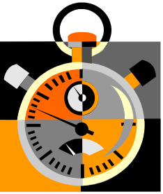
Factors that Influence Helping
  Number of bystanders
    How does a large crowd influence noticing an emergency?
  Presence of Prosocial models: Salvation Army contributions increase if person has just seen someone else give.
  Time pressure: Someone in a hurry are less likely to notice an emergency
  Emotions
    Guilt: More likely to help if our guilt is public knowledge.
    Negative mood: For adults, not children, a bad mood increases the likelihood of helping behavior.
    Positive mood: Happy people are helpful people.
  Personality Traits: Network of traits (emotionality, empathy, self-efficacy) are linked to helping.

Slide 45
Thank You

