Slide 1
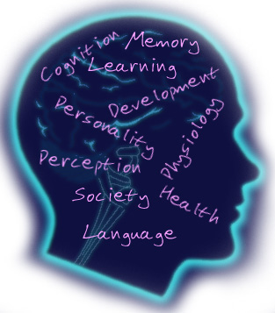
Introduction to Psychology SUMMARY
Presented By Clinical Psychologist Sadaf Sajjad

Slide 2
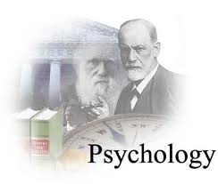
What is Psychology
Derived from two Greek words
  Psyche means soul
  logos means to talk.
  literal meaning of Psychology is: to talk about soul.
  Definition
Psychology is a biological science which deals with the behaviour and minds of animals and human beings, both.

Slide 3
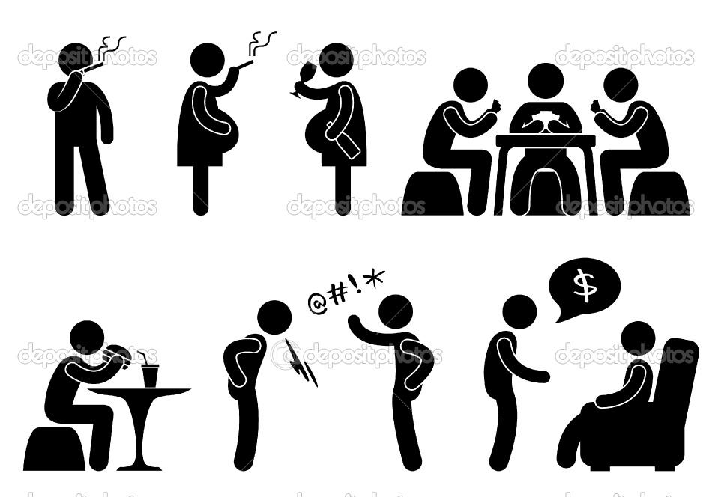
Psychology and Behavior
Behavior is learned and can be unlearned
Social learning perspectives are used in practice (social-skills, modeling, etc)
Behavior Modification is done according to condition

Slide 4
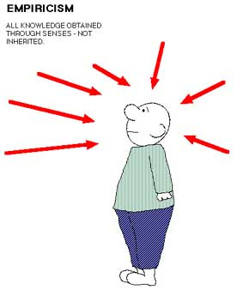
Psychology and Science
Psychology is Empirical
Knowledge acquired through observation
It is a systematic approach to the understanding of people, their thoughts, emotions and behavior. The application of this understanding helps to solve
human problems

Slide 5
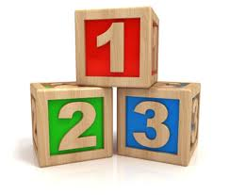
Different Perspectives in Psychology
Biological Psychology
Behavioral/Clinical Psychology
Cognitive Psychology
Social-Cultural Psychology
Personality Psychology
Experimental Psychology
Educational Psychology
Industrial Psychology
Criminal Psychology
Computational Psychology

Slide 6
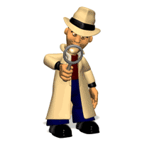
Research Methods in psychology
Presented By Clinical Psychologist Sadaf Sajjad

Slide 7
Research methods in psychology
Descriptive research
Simply gathers information and gives detailed description
Experimental research
Investigates specific variables (attributes)
Correlational research

Slide 8
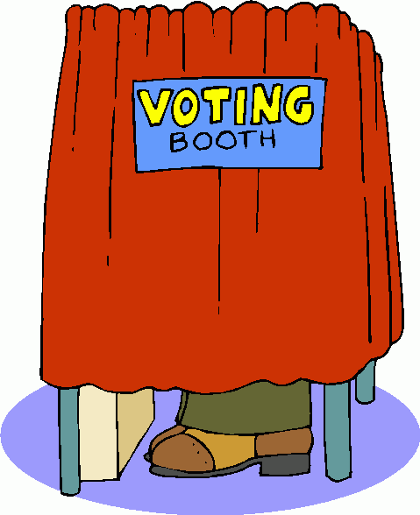
Descriptive Research
  Descriptive research methods describe situations. This type describes data and characteristics of a particular phenomenon being studied.
  The data description is factual, accurate and systematic but the research cannot describe what caused a situation.
  The description is used for frequencies, averages and other statistical calculations.
  The goal is to portray what already exists in a group.
  For-example:
  An opinion poll to find which political candidate
  people plan to vote for in an upcoming election.

Slide 9
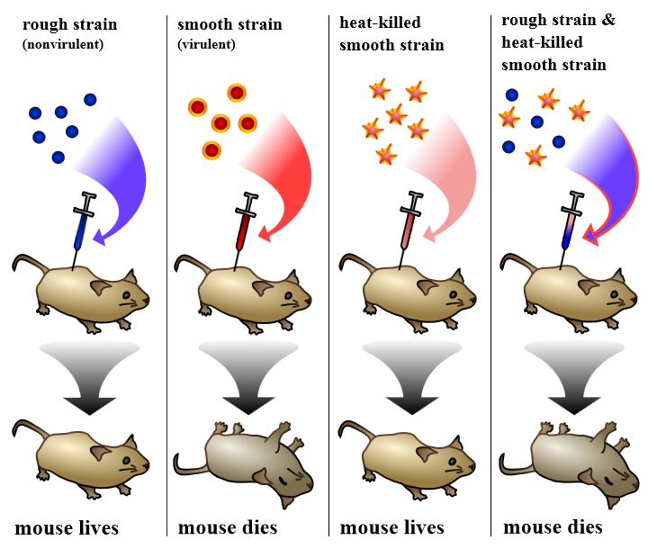
Experimental Research
An experiment is a study of cause and effect. It differs from non-experimental methods in that it involves the deliberate manipulation of one variable, while trying to keep all other variables constant.
What is a variable actually?
A variable is something that can be changed, such as a characteristic or value. Variables are generally used in psychology experiments to determine if changes to one thing result in changes to another.

Slide 10
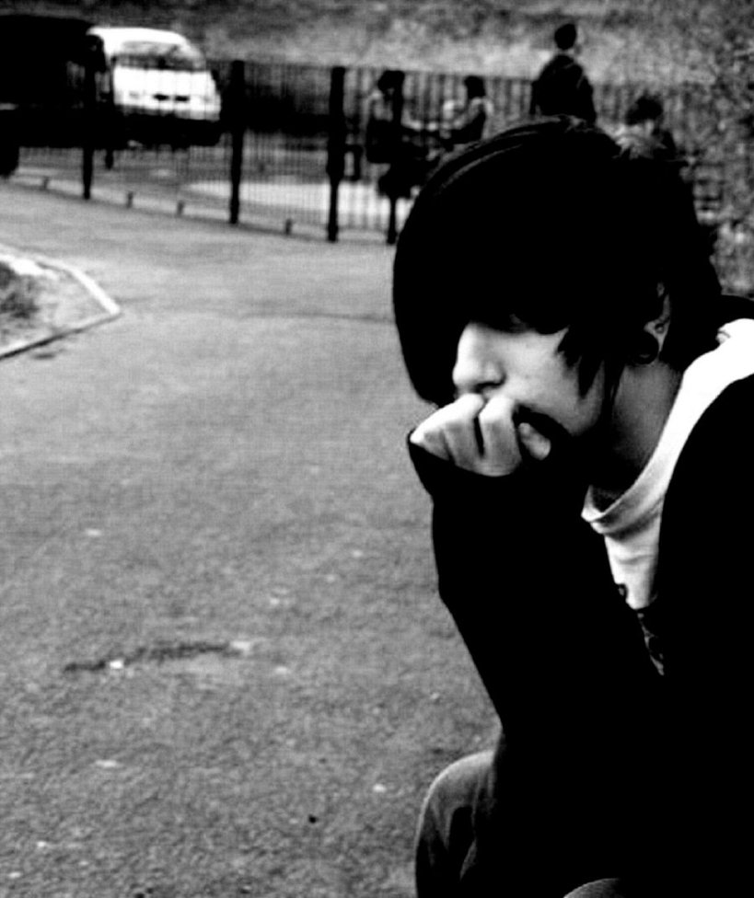
Correlational Research
  A Research tool that finds a relationship between two variables that are to be studied. It gives an indication of how one variable may predict another.
  It finds the ”strength of relationship” between two variables.
  For-example:
  Self esteem Vs Loneliness
  Are you lonely because you have a low self-esteem?
  OR
  You have low self-esteem because you are alone?

Slide 11
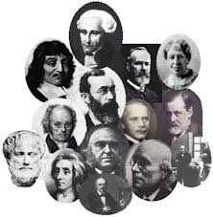
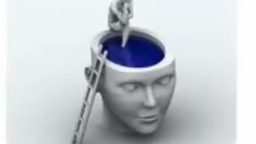
History of Psychology
Video 1

Slide 12
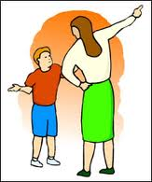
Learning and Behavior
Presented By Clinical Psychologist Sadaf Sajjad

Slide 13
Learning and Behavior
Learning is often defined as a relatively lasting change in behavior that is the result of experience.
Behavior is the school of thought in psychology that sought to measure only observable actions.
Learning and behavior is the process by which a relatively lasting change in potential behavior occurs as a result of practice or experience.

Slide 14
Types of Learning
Classical Conditioning: The type of learning in which a stimulus acquires the capacity to evoke a reflexive response that was originally evoked by a different stimulus.
Example, Pavlov, a scientist, became curious about the fact that some of his laboratory dogs began salivating before food actually was in their mouths. He then found that if he used the appropriate sequence of events, a dog would salivate at the sound of a buzzer or the appearance of a light. Further experimentation established the conditions essential in producing such a phenomenon, hence a complete example of classical conditioning.

Slide 15
Cont.….
Operant Conditioning: Operant conditioning is a learning process in which the probability of response occurring is increased or decreased due to reinforcement or punishment.
Example: Skinner performed an experiment on pigeons by inventing a Skinner box. There is a device in the box, which can deliver food pellets into a tray at random. Inside the box is a lever which when pressed activates the device for delivering food pellets. A hungry pigeon is left inside the box which exhibits random activities while exploring the box. Accidentally the pigeon presses the lever and a pellet of food is delivered. The first time it happens, the pigeon does not learn the connection between the response of lever pressing and food pellets. Sooner or later, the pigeon learns that the consequence of lever pressing is positive; lever pressing brings food.

Slide 16
Cont.….
Cognitive Learning: Learning a relationship between two stimuli and thus is also called S-S learning. Types of cognitive learning include latent learning and the formation of insights.
Example, a psychologist demonstrated that chimpanzees can solve problems using insight. Chimps placed in a cage, with bananas beyond their reach, learned that they could pile up boxes or attach one stick to another to reach and obtain the food. The chimps had not been reinforced for these specific behaviors but learned how to get the food through insight. Once insight has occurred, no further instruction or training is required.

Slide 17
Cont.….
Observational Learning: Replicating others’ novel behavior through observation and imitation; also known as vicarious learning, modeling, or social learning.
Example, Bandura performed an experiment on children, in which they would watch a video where the man would aggressively hit a doll and pummel it on the head, punch and kick it everywhere across the room. After the video, the children were placed in a room with attractive toys, but they could not touch them. Therefore, the children became angry and frustrated. Then the children were led to another room where there were identical toys used in the Bobo video (with Bobo dolls). Bandura founded that 88% of the children imitated the aggressive behavior.

Slide 18
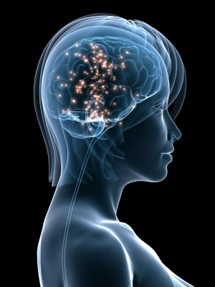
Biological Basis of behavior
Presented By Clinical Psychologist Sadaf Sajjad

Slide 19
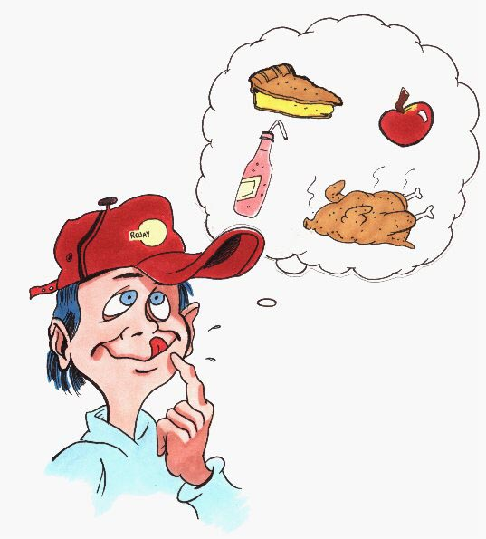
  How biology effects behavior
Brain, nerves and hormones are responsible for your thoughts feelings and actions.
Biological processes are involved in every human action:
  You feel hungry
  You remember your favorite restaurant
  You smell the food
  Or take a bite
  Biological systems that effect behavior
Nervous system
Endocrine system

Slide 20
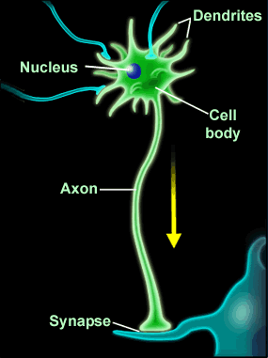
  Neural Structure
  Neuron is a nerve cell --- the basic unit of the nervous system. That are constantly sending signals to your brain muscles and glands.
  Types of Neurons:
  Example: You are able to feel the mosquitoes sitting on your arm and you sense that its dangerous so you hit it immediately.
sensory neurons: respond to input from sensory organs (skin, eyes, etc.)
motor neurons: send signals to muscles to control movement
interneuron: connect the sensory neurons and motor neurons

Slide 21
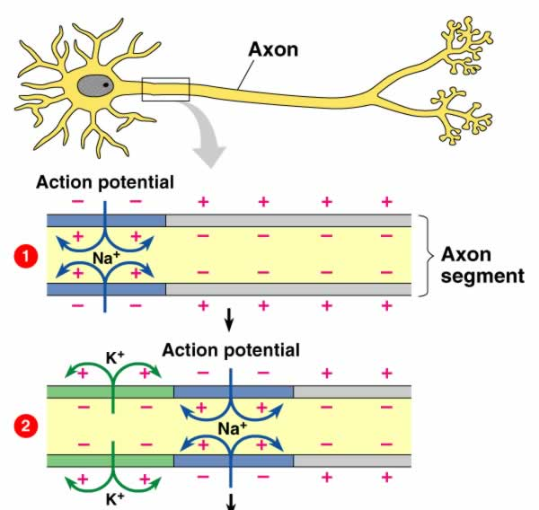
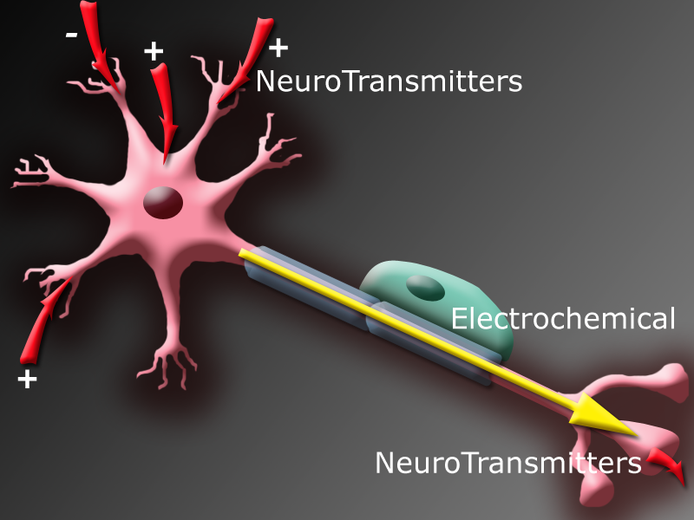
Synaptic Transmission
Nerves propagate signals in the form of action potentials.
  Resting potential
  Action potential
All or non law:
  Once the neuron receives the signal it has to fire it off and generates an action potential.

Slide 22
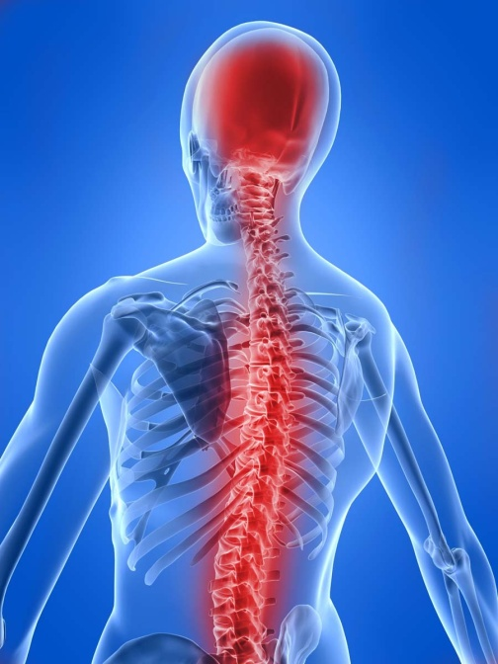
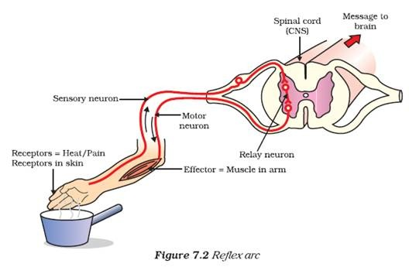
Nervous System
The human nervous system is comprised of the central nervous system and the peripheral nervous system.
Central nervous system: brain and spinal cord.
Example: sensory neuron detects pain/hot, send signal to spinal cord, spinal cord signal to motor neurons.
Peripheral Nervous System: links central nervous system to organs.
Skeletal nervous system: controls voluntary movements of our skeletal muscles.

Slide 23
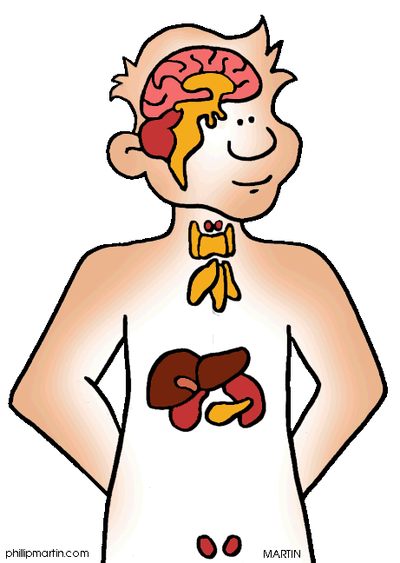
  Endocrine system
Communication from the brain is sent to the rest of the body by the endocrine system as well as by the nervous system.
The endocrine system links the brain to the organs that control body metabolism, growth and development, and reproduction.
The endocrine system is a series of glands throughout the body that secrete chemicals (hormones) into the bloodstream.

Slide 24
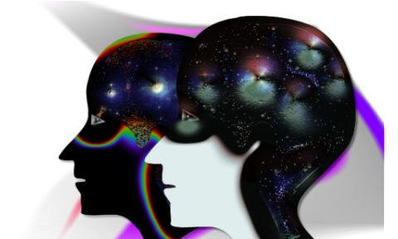
Sensation
Presented By Clinical Psychologist Sadaf Sajjad

Slide 25
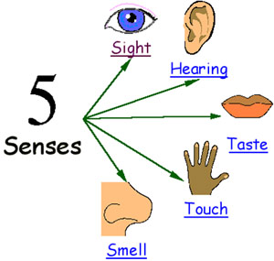
Sensation
The process through which the senses pick up visual, auditory, and other sensory stimuli and transmit them to the brain; sensory information that has registered in the brain but has not been interpreted.
  Sensation refers to sensing our environment through touch, taste, sight, sound, and smell.
  This information is sent to our brain and that's when perception comes into play.

Slide 26
Five Senses
1
The Sense of Touch, or Feeling
2
The Sense of Sight
3
The Sense of Taste
4
The Sense of Smell
5
The Sense of Hearing

Slide 27
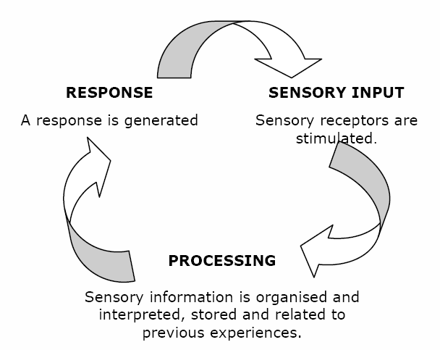
Sensory Processing

Slide 28
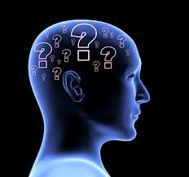
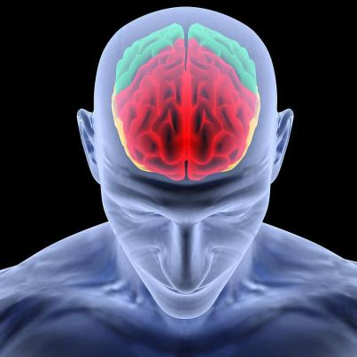
Sensory Processing Conti…
Sensory processing involves the brains ability to organize and make sense of different kinds of sensation entering the brain at the same time.
Sensory processing underlies the development of all motor and social skills and the ability to learn and perform complex adaptive behaviors.
It relies on effective functioning of the brainstem, which lies between the spinal cord and higher centers of the brain.

Slide 29
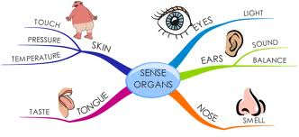
Sensory Processing Conti…
We are all aware of the senses of sight, hearing, taste and smell, but sensory processing involves three additional specialized sensory systems which are very powerful and influence how effectively we detect and make sense of information to enable us to feel safe and secure, to direct and sustain our attention, to move without fear, and to use our bodies automatically to perform the myriad of motor tasks we take for granted throughout a normal daily routine.

Slide 30

Vision
The stimulus for vision is light, which travels in waves. The amplitude(wave height) is associated with the sensory experience of brightness.
The wavelength determines the hue (color) of the light; and the wave purity(whether there is more than one type of wave) produces the psychological experience of saturation.

Slide 31
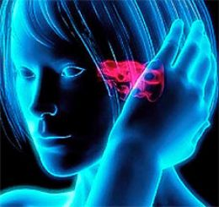
Audition
The sense of hearing
Audition comes from the root word, “audio” which means “sounds.” It may be passive (hearing) or active (listening). Audition is important in providing feedback for the mind, as well balance of the body.

Slide 32
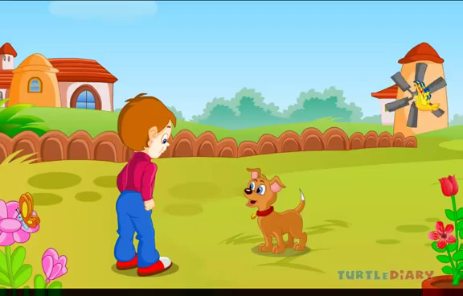
Video 2

Slide 33
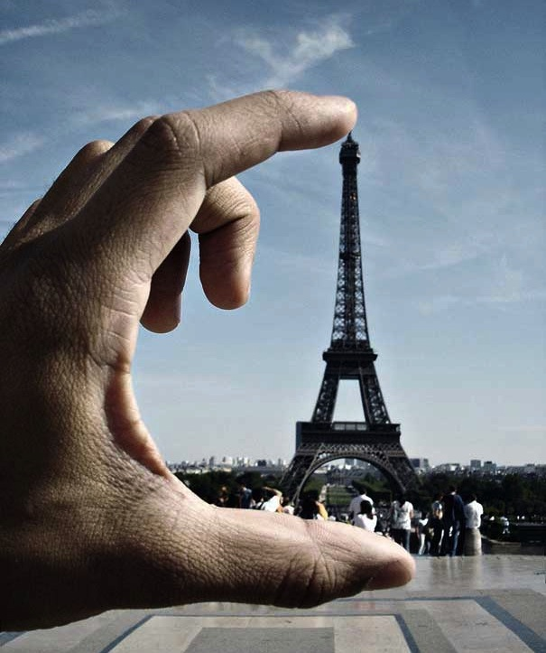
Perception
Presented By Clinical Psychologist Sadaf Sajjad

Slide 34
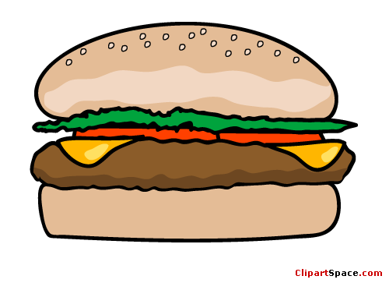
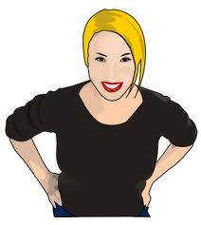

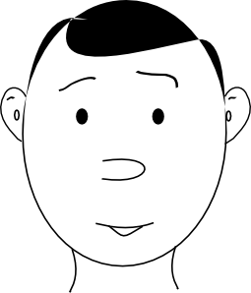
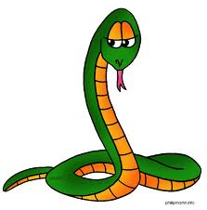

What is Perception?
Perception is our sensory experience of the world around us. It refers to the interpretation of what we take in through our senses.
It involves both the recognition of environmental stimuli and actions in response to these stimuli.
We gain information about properties and elements of the environment that are critical to our survival.

Slide 35

The Perceptual Process
The perceptual process is a sequence of steps that begins with the environment and leads to our perception of a stimulus and an action in response to the stimulus. This process is continual, but you do not spend a great deal of time thinking about the actual process that occurs when you perceive the many stimuli that surround you at any given moment.
Steps are:
    The Environmental Stimulus
    The Attended Stimulus
    The Image on the Retina
    Transduction
    Neural Processing
    Perception
    Recognition
    Action

Slide 36
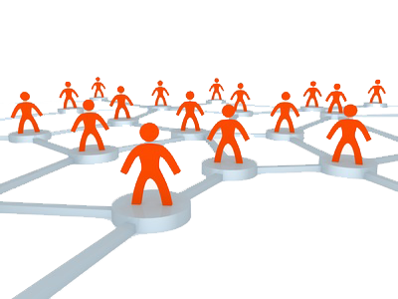
Organization of Perceptions
The manner in which stimuli are arranged, that is, grouped, (in addition to their individual characteristics) also affects their perception.
Important stimulus characteristics that affect the organization of stimuli and their perception include the following:
  Similarity
  Nearness
  Closure
  Continuity
  Common fate

Slide 37
Types of Perceptions
The manner in which stimuli are arranged, that is, grouped, (in addition to their individual characteristics) also affects their perception.
Important stimulus characteristics that affect the organization of stimuli and their perception include the following:
  Self Perception
  Depth Perception
  Movement Perception
  Person perception
  Object perception

Slide 38
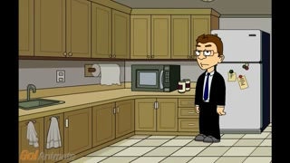
Video 3

Slide 39
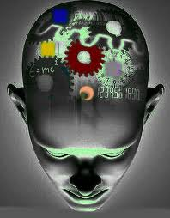
Memory
Presented By Clinical Psychologist Sadaf Sajjad

Slide 40
MEMORY
Memory is the persistence of learning over time. It is our ability to store and retrieve information.
Memory works by involving three processes
  Encoding
    The set of mental operations that people perform on sensory information to convert that information into a form that is usable in the brain’s storage systems.
  Storage
    Holding onto information for some period of time.
  Retrieval
    Getting information that is in storage into a form that can be used
Three types of Memory
  Sensory Memory
    Stimuli are recorded by our senses and held briefly in sensory memory.
  Short-term Memory
    Some of this information is processed into short-term memory and encoded through rehearsal .
  Long-term Memory
    Information then moves into long-term memory where it can be retrieved later.

Slide 41
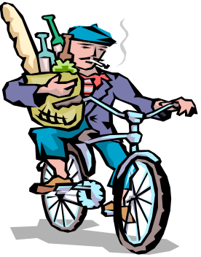

Ways to extend short term memory
  Maintenance Rehearsal: The process of repeatedly verbalizing or thinking.
  Slots/Chunking: bits of information are combined into meaningful units, or chunks.
  Primacy and Recency
    Primacy - when you are receiving information, the information perceived first is more likely to be remembered.
    Recency - information perceived toward the end of an event is also more likely to be remembered.
  Elaborative Rehearsal: connecting new information with previously stored, already existing associative structures

Slide 42
Types of Long Term Memory
  Declarative: memory for facts
    Semantic memory - containing general knowledge
    Episodic memory - containing personal information
  Non-declarative: memory for skills and procedure
Level of Processing Model
  Shallow Processing: emphasizes the physical structure of stimulus
  Intermediate Processing: emphasizes what a word sounds like
  Deep Processing: emphasizes the meaning of verbal input

Slide 43
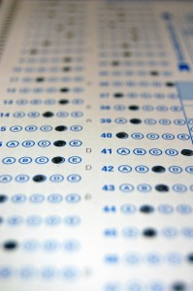

Remembering
  Recall: A measure of retention that requires a person to
  remember material with few or no retrieval cues
  Recognition: A measure of retention that requires a person
  to identify material as familiar, or as having been encountered before
  Relearning: Measuring retention in terms of the percentage
  of time or learning trials saved in relearning material compared
  with the time required to learn it originally

Slide 44
Forgetting
  Encoding failure: failure to process information into memory.
  Memory Trace Theory: loss of memory due to the passage of time,
  during which the memory trace is not used.
  Interference Theory
    Proactive interference
      memory retrieval problem that occurs when older information prevents or interferes with the retrieval of newer information.
    Retroactive interference
      memory retrieval problem that occurs when newer information prevents or interferes with the retrieval of older information.
Some ways to improve memory are
  Knowledge of Results, Recitation, Rehearsal, Selection, Organization

Slide 45
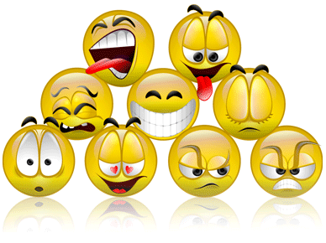
Motivation and Emotion
Presented By Clinical Psychologist Sadaf Sajjad

Slide 46
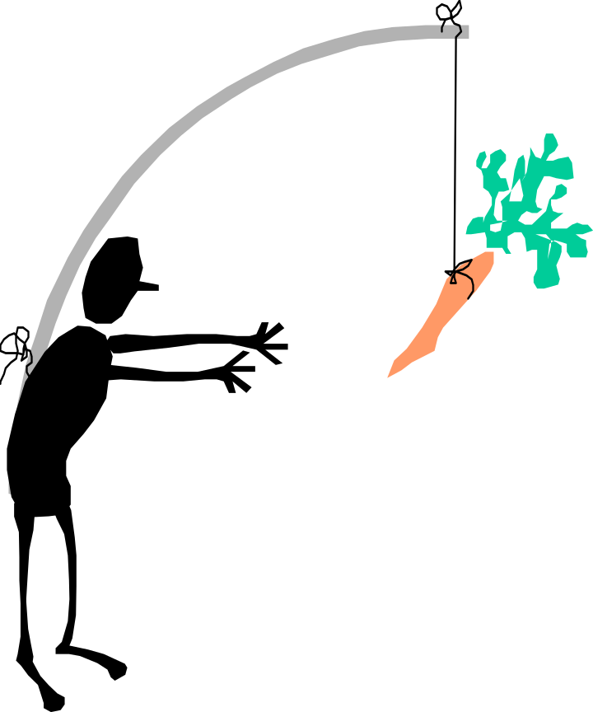
Motivation
Motivation: A psychological process that directs and maintains your behavior toward a goal/motive.
Motives are the needs, wants, interests, and desires that propel or drive people in certain directions.
Theories on motivation:
  Learned
  Instinct
  Drive deduction theory
  Arousal theory
  Incentive Approaches: Motivation’s Pull
  Cognitive Approaches: The Thoughts Behind Motivation
  The Need for Achievement: Striving for Success
  Maslow's Hierarchy Of Needs

Slide 47
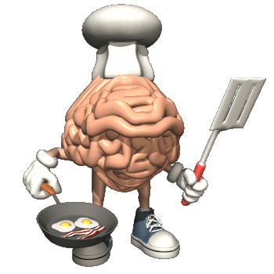
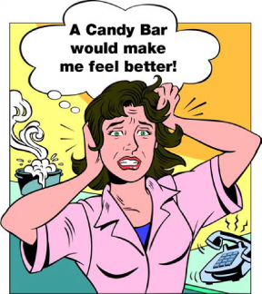
Motivation In A Particular Instance
Motivation of Hunger: hunger comes from our brain (hypothalamus)
Biological basis of hunger: varying level of glucose.
Environmental basis of hunger:
  Availability of food
  Learned preference and habits
  Stress
  Social factors
Eating Disorders:
  Anorexia nervosa
  Bulimia
  Obesity

Slide 48
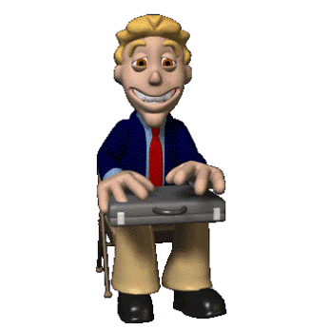
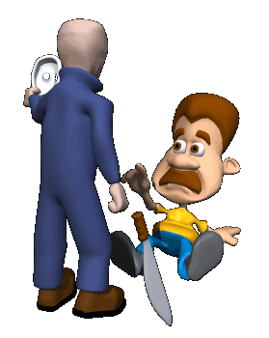
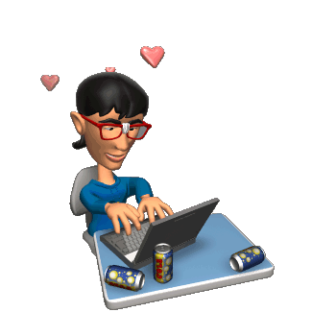
Emotions
Emotions
  Feelings that generally have both physiological and cognitive elements and that influence behavior
Example: Fear, surprise, anger, disgust, happiness, sadness.
Emotion prepare us for an action.
Theories of emotion:
  Schachter-Singer theory of emotion: that we identify the emotion we are experiencing by observing our environment and comparing ourselves with others.
  James-Lange theory of emotion: we experience emotions as a result of physiological changes that produce specific sensations.

Slide 49

Video 4

Slide 50

Life-styles, stress and health
Presented By Clinical Psychologist Sadaf Sajjad

Slide 51
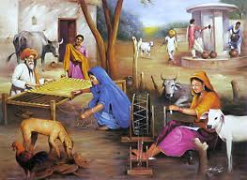
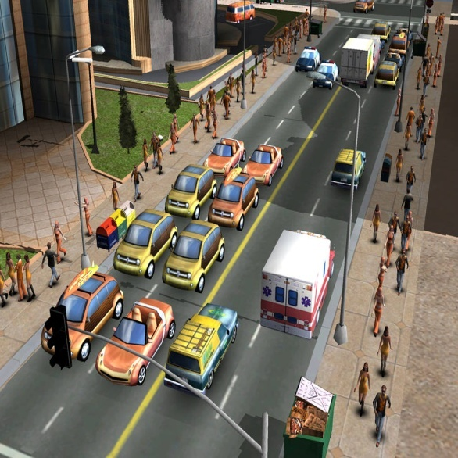
What is a life style?
A lifestyle is the way a person (or a group) lives.
This includes patterns of daily activites, health behavior, social relations, consumption, and leisure time use.
A lifestyle typically also reflects an individual's attitudes, values or worldview.
Daily activities:
Health behavior
Consumption
Leisure time use
Individual’s attitude
Values
Worldview

Slide 52
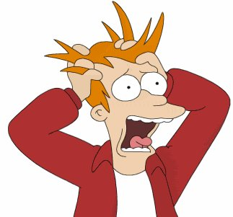
What is stress?
Stress is a feeling of strain and pressure. A state of psychological tension or strain.
Symptoms may include a sense of being overwhelmed, feelings of anxiety, overall irritability, insecurity, nervousness, social withdrawal, loss of appetite, depression, panic attacks, and exhaustion.

Slide 53
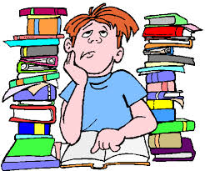
Sources of Stress
Stressor: Any environmental demand that creates a state of tension or threat and requires change or adaptation. Stressors have physical, chemical and mental responses inside of the body.
  Physical stressor produce mechanical stresses on skin, bones, ligaments, tendons, muscles and nerves that cause tissue deformation and in extreme cases tissue failure.
  Chemical stresses also produce biomechanical responses associated with metabolism and tissue repair. Physical stressors may produce pain and impair work performance. Chronic pain and impairment requiring medical attention may result from extreme physical stressor or if there is not sufficient recovery time between successive exposures.
  Stressors may also affect mental function and performance.
Change: The change in life or life activities may cause stress for some people.

Slide 54
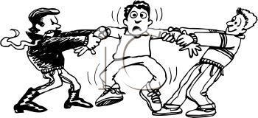

Sources of Stress (continued…)
3. Everyday hassles
During daily interaction with your environment (which means: living your life) people can run into all sorts of situations that can give stress.
Pressure: A feeling that one must speed up, intensify, or change the direction of one’s behavior or live up to a higher standard of performance.
Frustration: The feeling that occurs when a person is prevented from reaching a goal.
Conflict: Simultaneous existence of incompatible demands, opportunities, needs, or goals.

Slide 55


Causes of stress
Financial Problems – You and your family are not be able to do what you want to due to lack of money.
Workplace Stress – Stress at workplace is another of the main causes of stress. You may be worried about your next promotion. You might be facing the negative or bullying behavior of your boss.
Personal Relationships – Studies of children, attitude of relatives, arguments with spouse or children, change of place due to requirements of your job, illness of a family member.
Health – Heart diseases, hypertension, problems with eye sight and sugar afflict many people becoming a major cause of life stress for them.
Irritants - Besides the ones that are mentioned earlier there are those annoyances and irritations that you encounter in your daily lives which go on to become biggest causes of stress for you.

Slide 56

Effects of stress
Memory Loss
Moodiness
Sweating the Small Stuff
Undiagnosed Illness
Carbohydrate Cravings

Slide 57


What is health?
Health is the level of functional or metabolic efficiency of a living being. In humans, it is the general condition of a person's mind and body, usually meaning to be free from illness, injury or pain.
Physical health deals with the body’s ability to function. Physical health has many components including: exercise, nutrition, sleep, drugs, and weight management.
Mental heath deals with how we think, feel and cope with daily life. Mental health encompasses learning, stress management, and mental illnesses or disorders.

Slide 58
What are health behaviours?
Kasl and Cobb (1966) defined three types of health related behaviours. They suggested that;
A health behaviour is a behaviour aimed at preventing disease (e.g. eating a healthy diet).
An illness behaviour is a behaviour aimed at seeking a remedy (e.g. going to the doctor).
A sick role behaviour is an activity aimed at getting well (e.g. taking prescribed medication or resting).

Slide 59

Video 5

Slide 60

Cognitive Processes
Presented By Clinical Psychologist Sadaf Sajjad

Slide 61

Cognition
Perception, thinking, problem solving, memory, language and attention
The collection of mental processes and activities used in perceiving, thinking and understanding, as well as the act of using these processes.
  Thinking
  Knowing
  Remembering
  Communicating

Slide 62

Psychology and Cognition
Approach to human behaviour that focuses on how we think, with the belief that such thought processes affect the way in which we behave (other approaches take other factors into account, such as the biological approach, which acknowledges the influences of genetics and chemical imbalances on our behaviour).
Cognitive (meaning "knowing") psychologists attempt to create rules and explanations of human behavior and eventually generalize them to everyone's behaviour.
The Humanist approach opposes this, taking into account individual differences that make us each behave differently. The cognitive approach attempts to apply a scientific approach to human behaviour, which is reductionist in that it doesn't necessarily take into account such differences.

Slide 63

Cognitive categories
Processing Speed
Auditory Processing
Visual Processing
Long-Term Memory
Short-Term Memory
Logic and Reasoning
Attention Skills

Slide 64

Logic and Reasoning
This is the ability to reason, form concepts, and solve problems using unfamiliar information or new procedures.
It enables you to create correlations, solve problems, plan ahead and draw conclusions.
Deductive reasoning determines whether the truth of a conclusion can be determined for that rule, based solely on the truth of the premises.
Inductive reasoning attempts to support a determination of the rule.

Slide 65

The behaviourist approach
Behaviourist researchers argued that problem solving was a reproductive process; that is, organisms faced with a problem applied behaviour that had been successful on a previous occasion.
Successful behaviour was itself believed to have been arrived at through a process of trial-and-error.
Behaviorism is primarily concerned with observable behavior, as opposed to internal events like thinking and emotion. Observable (i.e. external) behavior can be objectively and scientifically measured. Internal events, such as thinking should be explained through behavioral terms (or eliminated altogether).

Slide 66


The Gestalt approach
Gestalt psychologists argued that problem solving was a productive process. In particular, in the process of thinking about a problem individuals sometimes "restructured" their representation of the problem, leading to a flash of insight that enabled them to reach a solution.
The Gestalt psychologists described several aspects of thought that acted as barriers to successful problem solving. One of these was called the Einstellung effect, now more commonly referred to as mental set or entrenchment. This occurs when a problem solver becomes fixated on applying a strategy that has previously worked, but is less helpful for the current problem.

Slide 67

Video 6

Slide 68
Thank you

