Slide 1
Relationship of Psychology with other disciplines
Presented by Clinical Psychologist
Sadaf Sajjad

Slide 2
Links with other disciplines
Psychology and its link with other disciplines is distributed into 3 volumes associated with different knowledge domains such as:
Volume I treats Psychology and the humanities, including art, linguistics, literature, music, philosophy and religion.
Volume II treats Psychology and the Social Sciences, including anthropology, behavior therapy, economics, education, environmental disciplines, history, political science, and sociology.
Volume III treats Psychology and the Natural Sciences, including biology, engineering, genetics, mathematics, medicine, pharmacology and physics.

Slide 3
Science
Science relies on testing ideas with evidence gained from the natural and physical worlds. Scientific explanations are accepted as valid only when they have been subjected to rigorous testing. Scientific investigation makes use of multiple approaches, creative as well as logical. Creative scientists ‘think outside the box’, shift perspective as they view problems, and examine different views of the same problem.
Like psychology, science values methodology: questioning, investigating, understanding, and explaining; generating and testing ideas; gathering evidence; and communicating and debating with others in order to develop scientific knowledge, understanding, and explanation.

Slide 4
Mathematics and statistics
Psychological study requires the analysis of data, and the exploration and use of patterns and relationships in data. Like mathematics and statistics, it emphasizes thinking and problem solving and investigating, interpreting, explaining, and making sense of the world we live in.
Students can use psychology research projects as contexts for the practical application of their statistical skills, for example, comparing different sets of results. Applying their knowledge of statistics to a real and interesting context is likely to engage the student and build their confidence.

Slide 5
Health & Media studies
Psychology, like health, is interested in concepts, hauora (the dimensions of well-being), attitudes and values, social justice, socio-ecological perspectives, and the interrelationships between individuals, others, and society.
Psychology and media studies both have a strong interest in how people’s thinking is influenced by media.

Slide 6
English
Students need sound English language skills (both written and verbal) to cope with the content of psychology, as many of the resources they will work with are at tertiary level. Similarly, they need to be able to use different text forms as they gather and process information from various sources. Psychology also introduces students to APA (American Psychological Association) referencing.

Slide 7
Psychology and Science
Psychology is the scientific study of human mind and behavior: how we think, feel, act and interact individually and in groups.
Science (from Latin scientia, meaning "knowledge") is a systematic enterprise that builds and organizes knowledge in the form of testable explanations and predictions about the universe.
Psychology is concerned with all aspects of behavior and with the thoughts, feelings and motivations underlying that behavior. It is both a thriving academic discipline and a vital professional practice.
In an older and closely related meaning, "science" refers to the body of reliable knowledge itself, of the type that can be logically and rationally explained.

Slide 8
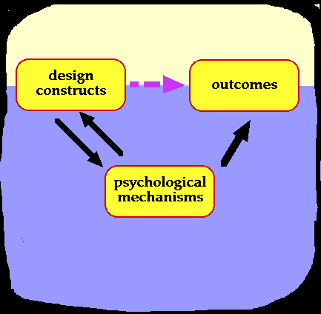
Psychology and Science
Psychology has close relationship with science.
Knowledge of psychology helps
the physicians in the treatment
of certain diseases like peptic
ulcer, asthma, migraine
headache etc., which are called
psycho-physiological disorders.
In this modern age, physicians
admit that most physical diseases emanate from psychological disturbances, and are therefore, psycho­physiological in nature.

Slide 9
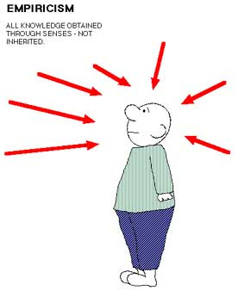
Psychology and Science
We cannot understand and treat a disease without recognizing the emotional conflicts
that patients go through. Certain
degree of psychological help and
counseling are necessary for helping
patients face their physical problems
and recover from their illness.
Similarly the knowledge of certain
physical diseases and the functioning of
bodily organs help the psychologists to
understand human behaviors.
A psychiatrist, who treats the psychological diseases, examines the physical health conditions of the patients. So psychology and medical science are closely related.

Slide 10

Psychology and Science
Video 1

Slide 11
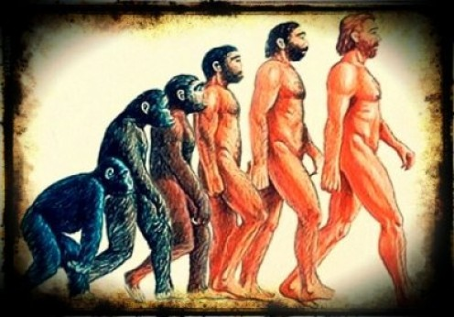
Psychology and Anthropology
Psychology = the science of the mind or of mental states and processes.
Anthropology = the science of humans and their works OR the science that deals with the origins, physical and cultural development, biological characteristics, and social customs and beliefs of humankind.
The relationship would be they
both 'work' with humans.

Slide 12

Psychology and Anthropology
Psychology deals with the individual. His thoughts, what factors motivated him, why he is who he is.
Anthropology looks at humanity (generally) from the perspective of examining the past in terms of what we can infer from the historical and archeological record.
Psychology seeks to identify the causes and
reactions based upon the individual, and
commonalities and differences in groups of
individuals; but it all revolves around the
internal function of the mind.
Anthropology has origins in the humanities,
the natural sciences, and the social sciences
and deals
with the science of humanity.

Slide 13

Psychology and Anthropology
To understand the full sweep and complexity of cultures across all of human history, anthropology draws and builds upon knowledge from psychology and social sciences.
The origin of different civilizations has been accessed along with the behavior those individuals
use to possess, which make anthropology
taking a big deal of advantage from the
psychological beliefs and findings.
Hence both of these co-relate to each
other to quite an extent.

Slide 14
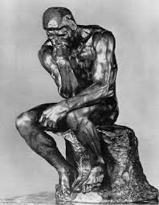
Psychology and Philosophy
Philosophy got separated from psychology in the nineteenth century, under the need to put logic and logical analysis on a mathematical basis.
Hence effective thinking in philosophy
requires both rational and psychological forms
of analytical ability.
Psychology limits philosophy : psychology sets
the boundaries within which philosophy can
range. The narrower the range of a person's
psychological understanding of life,
correspondingly will be the authentic range of
his philosophy also be narrow. Without an adequate understanding of life, so the thinker is dependent on imagination and prejudice when trying to stretch his ideas to fit aspects of reality that he has never experienced.

Slide 15
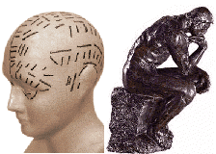
Psychology and Philosophy
Within a perspective that emphasizes the qualitative features of life we will find that philosophy provides most of the framework and psychology provides much of the content. The effectiveness of philosophy to define a qualitative approach to life rests on its
analysis of psychology : this enables the
individual to create himself within the
context of his historical situation.
More generally, the purpose of philosophy
is to abstract what is valid from all realms of value so as to enable the person to create his or her own identity ; the historical situation determines what is holistically possible.
The results of such philosophical analysis should be consistent with the empirical results of psychology.

Slide 16

Psychology and Education
Education and Psychology are correlated subjects. Psychology is a broader area in which education searches to give a practical shape of the psychology findings in the teaching-learning
situation.
J. B. Watson, the father of
behavioristic school of psychology,
termed psychology as the science of
behavior. The meaning of education is
modification of behavior for one’s adjustment. When we study the behavior of the child and teacher in the educational situations, for solving educational problems, we take the help of educational psychology.

Slide 17
Psychology and Education
Educational psychology covers to entire range of behavior and personality as related to education.
Psychology and education has a major link between them, which can be elaborated in the form of points as:
- Psychology and aims of education: The aims of education can be fixed by taking the help of psychology changes of the child.
- Psychology and curriculum: At the time of curriculum planning and construction, proper care should be taken for the development rate of the child.
- Psychology and methods: A teacher has to give instructions through different methods, which should be linked with psychological problems, needs and development of the child.

Slide 18

Psychology and Education
- Psychology and discipline: The problems of discipline can be checked through proper psychological techniques.
- Psychology and administration:
The process of administration should
be based on the psychological
techniques. In administration, proper
care should be given on the basis of individual differences.
- Psychology and teacher: Teacher should be a master of psychology to deal with a complex educational situation.

Slide 19

Engineering and Psychology
Psychology is the science of human behavior and capability.
Engineering is the application of scientific, economic, social, and practical knowledge, in order to design, build, and maintain structures, machines, devices, systems, materials and processes.
Engineering psychologists utilize
psychological principles to solve
real world problems.

Slide 20
Engineering and Psychology
The relationship between engineering and psychology can be viewed in the form of engineering psychology, which deals with:
- Engineering psychology is the science of human behavior and capability, applied to the design and operation of systems and technology.
- As an applied field of psychology and an interdisciplinary part of ergonomics, it aims to improve the relationships between people and machines by redesigning equipment, interactions, or the environment in which they take place. The work of an engineering psychologist is often described as making the relationship more "user-friendly."

Slide 21
Engineering and Psychology
Engineering Psychology draws upon theories and principles from many fields of psychology, as well as engineering, statistics, linguistics, biomechanics, and computer science.
Engineering Psychology can be found in military, industrial, and academic settings. They can function as members of teams that design new systems. They often conduct both field and laboratory research designed to develop new theories and principles that can be applied to improving human machines.

Slide 22

Psychology and Mathematics
Mathematical psychology is an approach to psychological research that is based on mathematical modeling of perceptual, cognitive and motor
processes, and on the establishment
of law-like rules that relate quantifiable
stimulus characteristics with
quantifiable behavior.
Mathematical psychology more or less
utterly has its focus on the modeling
of data obtained by means of
experimental paradigms and is consequently still more very much related to experimental psychology/cognitive psychology.

Slide 23
Psychology and Mathematics
Psychology is the scientific study of the relationships between mental processes, emotions, and behavior. Mathematics and psychology are linked in three major ways. First, psychologists study mathematical cognition, i.e., the brain's development, acquisition, and application of mathematical skills. Second, psychologists investigate people's feelings and attitudes regarding mathematics. Third, psychologists use mathematics, particularly statistics, as a professional tool to quantify and analyze their scientific findings.

Slide 24

Psychology and Mathematics
Video 2

Slide 25
Psychology and Physics
Physics is the science of matter and energy and their interactions, the physical properties, phenomena, and laws of something
Psychology is the science of mental life where there is a sound mind every other science blossoms. Everything comes out from human head only.
Psychophysics is a branch of psychology that studies the relationship between the physical properties of stimuli and our psychological perceptions of them. E.g., "color" is a psychological perception of specific wavelengths of the visible spectrum of light. Color does not exist without an eye to see it. Every sensory modality has similar interesting relationships with the physical world.

Slide 26



Psychology and Behavior Therapy
Therapy that applies learning principles to the elimination of unwanted behaviors.
The behaviors are the problems- so we must change the behaviors.

Slide 27
Psychology and BehaviorTherapy
A set of clinical procedures relying on experimental findings of psychological research.
Based on principles of learning that are
systematically applied
Treatment goals are specific and measurable
Focusing on the client’s current problems
To help people change maladaptive to adaptive behaviors
The therapy is largely educational - teaching
clients skills of self-management

Slide 28
Exposure Therapies
In Vivo Desensitization
Brief and graduated exposure to an actual fear
situation or event
Flooding
Prolonged & intensive in vivo or imagined exposure
to highly anxiety-evoking stimuli without the
opportunity to avoid them
Eye Movement Desensitization and Reprocessing
(EMDR)
An exposure-based therapy that involves imaginable flooding, cognitive restructuring, and the use of rhythmic eye movements and other bilateral stimulation to treat traumatic stress disorders and fearful memories of clients.

Slide 29

Exposure Therapy-Example
Video 3

Slide 30
Four Aspects of BehaviorTherapy
1. Classical Conditioning
In classical conditioning certain respondent behaviors, such as knee jerks and salivation, are elicited from a passive organism.
2. Operant Conditioning
Focuses on actions that operate on the environment to
produce consequences. If the environmental change brought about by the behavior is reinforcing, the chances are strengthened that the behavior will occur again. If the environmental changes produce no reinforcement, the chances are lessened that the behavior will recur

Slide 31
Four Aspects of BehaviorTherapy
3. Social Learning Approach
Gives prominence to the reciprocal interactions between an individual’s behavior and the environment.
4. Cognitive Behavior Therapy
Emphasizes cognitive processes and private events (such as client’s self-talk) as mediators of behavior change.

Slide 32
Psychology and Arts
Art can be an effective tool in mental health treatment.
What could art possibly have
to do with psychotherapy?
As an expressive medium, art can be used to help clients communicate, overcome stress and explore different aspects of their own personality.
“In psychology, the use of artistic methods to treat psychological disorders and enhance mental health is known as art therapy”.

Slide 33
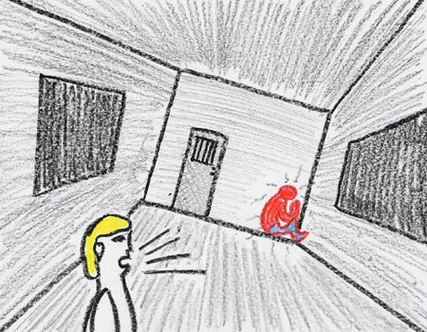
Art Therapy
Art therapy integrates
psychotherapeutic
techniques with the
creative process to
improve mental health
and well-being.
The American Art
Therapy Association
describes art therapy as
"a mental health profession that uses the creative process of art making to improve and enhance the physical, mental and emotional well-being of individuals of all ages.

Slide 34
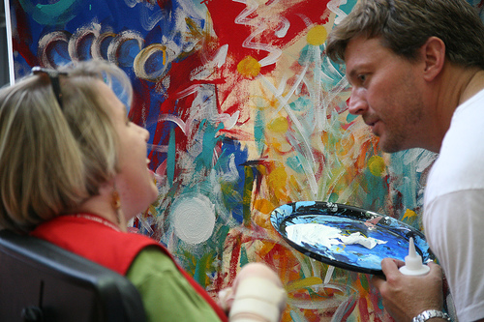
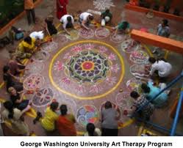
Art Therapy
It is based on the belief that the creative process involved in artistic self-expression helps people to resolve conflicts and problems, develop interpersonal skills, manage behavior, reduce stress, increase self-esteem and self-awareness, and achieve insight."

Slide 35

What is Art Therapy?
Video 4

Slide 36
Psychology and Pharmacology
Tricyclic antidepressants have been shown to enhance the effect of exposure therapy upon agoraphobic patients, and it can be argued that the therapeutic success of cognitive therapy in the treatment of anxiety disorders depends upon guided exposure to threatening situations.
A consideration of the effects of agents already in use for the treatment of anxiety, and experimental and neuroanatomical findings, suggests that pathological anxiety might well include relatively independent abnormalities of autonomic regulation and psychological reactivity.

Slide 37
Psychology and Pharmacology
Proper evaluation of these new compounds is therefore going to require careful evaluation of their cognitive and behavioral effects, as well as their physiology. This work should, therefore, draw the contributions of clinical pharmacology and clinical psychology closer together rather than drive them further apart.

Slide 38
Psychology and Medicine
The importance of psychology for medicine is being increasingly recognized and psychological topics are now included in most medical curricula.
Doctors emphasized the need for a greater incorporation of psychological and social sciences in medical training.
This rests on a wealth of research evidence that psychological factors are important in many aspects of physical and mental health.

Slide 39
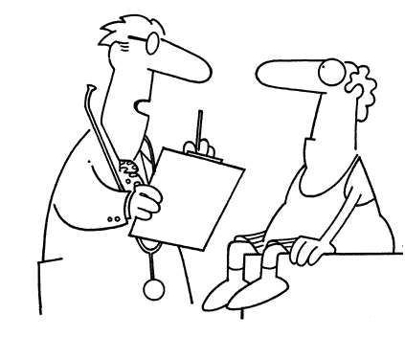
Medical Psychology
Medical psychology is the application of psychological principles to the practice of medicine for both physical and mental disorders.
The American Psychological
Association (APA) defines
medical psychology as
"that branch of psychology
that integrates body &mental.

Slide 40
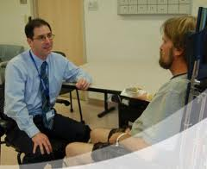
Medical Psychology
psychotherapeutic modalities into the management of mental illness and emotional, cognitive, behavioral and substance use disorders".
A medical psychologist
does not automatically
equate with a psychologist
who has the authority to
prescribe medication.

Slide 41

Medical Psychology
Medical psychologists apply psychological theories, scientific psychological findings, and
techniques of psychotherapy, behavior
modification, cognitive, interpersonal,
family, and life-style therapy to improve
the psychological and physical health
of the patient.
Clinical psychologists with post doctoral specialty training as medical psychologists are the practitioners with refined skills in clinical observation in of the field of psychology, learning, central nervous system adaptation and change, and adaptation and lifestyle change applying a number of different methods in several different mediums of treatment.

