Slide 1
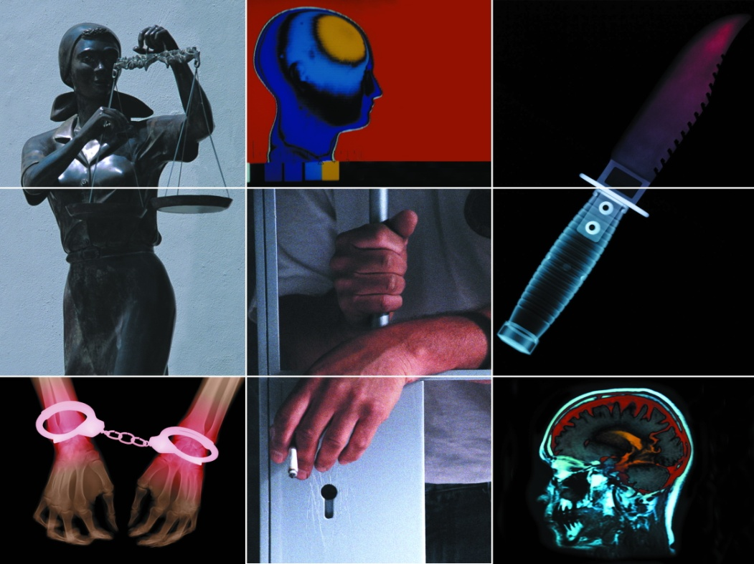
Criminal Psychology
Presented By: Sadaf sajjad

Slide 2

CRIME
Societies define crime as the violation of one or more rules or laws for which some governing authority or force may ultimately prescribe a punishment.
What constitutes a crime tends to alter according to historical, cultural and power dimensions

Slide 3
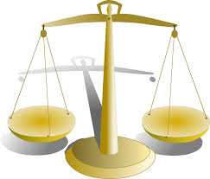
Types of Crime
Types of Crime
Offences against the person
Economic Offences
Offences against the State
Drug Offences
Public Order Offences
Traffic Offences
Victimless crimes
Preliminary Crimes

Slide 4
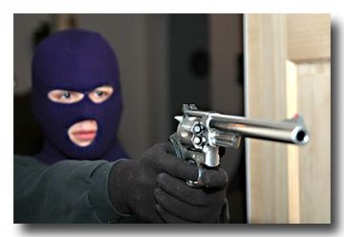
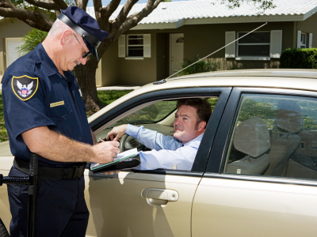


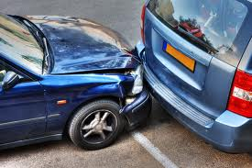
Examples of Criminal Acts
Robbery.
Traffic Offenses.
White Collar Crime: be committed by professional people in the context of business e.g. non payment of tax.
Larceny: the removal of another person’s property without consent.
Hacking.
Threatening a person.
Assault: causing physical harm to the person.
Death by irresponsible driving.
Murder.

Slide 5
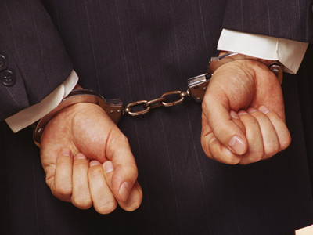

Criminal Behavior
Crime is time and culture bound.
Examples:
    Attempted suicide was regarded as a criminal offence until 1961.
    Incest was NOT regarded as a crime until 1908.
    More recently – smoking in
    public places.

Slide 6
Criminal Behavior
Criminal behaviour is designated according to age and intention – thus the same behaviour can be seen as criminal in one case and not in another. The age of criminal responsibility varies from country to country: in Scotland it is 8, in England and Wales it is 10, in France it is 13 and in Sweden it is 15.
Individuals are deemed to have committed a criminal act only if they can be shown to have had the intention of doing so. Those suffering from some forms of psychiatric illness are considered incapable of this aspect of criminal behaviour.

Slide 7
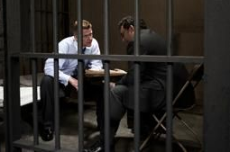
Criminal Psychology
Criminal or forensic psychology is a field of psychology which focuses on criminals.
To study the psychological factor of the criminal e.g: motivation; to examine the character, environment of the criminal and the process of the criminal behavior.
Use of psychology in order to hold back crimes.
    Using psychological method to explain crime itself and then bring evidence of a crime
    to light in order to help
    investigation, justice, and
    correction.

Slide 8

Motivation of Crime
Desire
Ability
Opportunity

Slide 9
Criminal/Forensic Psychologist VZ Forensic Scientist
Forensic Scientist | Criminal psychologist
Analyze, compare, identify & interpret physical evidence | Apply Psychiatry to the Law
Identify evidence & link it to the suspect, victim & crime scene | Expert witnesses in court
 | Application of medical treatment in forensic settings

Slide 10

Lets study history of crime and psychology with the video

Slide 11

Theories of Criminal Psychology

Slide 12
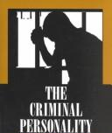
Personality And Crime
Is there a criminal personality?
Personality:
    characteristics of an individual that predisposes one to act in certain ways in certain situations
    Way one perceives, thinks about and relates to oneself and one’s environment

Slide 13
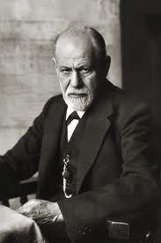
Freud And Crime
Freud the first to write about personality
Believed that behavior is influenced by unresolved conflicts in childhood
    Superego
    Ego
    Id
Crime would occur if:
    Underdeveloped superego
    Overdeveloped superego
    Malfunctioning of the id
    Weak ego

Slide 14
Psychoanalytic Theory
Freud claimed that all human beings are born with certain instincts, i.e. with a natural tendency to satisfy their biologically determined needs for food, shelter and warmth
All humans have natural drives and urges repressed in the unconscious
All humans have criminal tendencies
Freud hypothesized that the most common element that contributed to criminal behavior was faulty identification by a child with her or his parents

Slide 15
Intelligence and Crime
The brighter might get arrested less
Intelligence: capacity to act purposefully, think rationally and deal effectively with the environment
Lombroso hypothesized that his criminals were “unintelligent”, but there were no measure of intelligence
Goddard used intelligence tests on institutionalized populations such as prisoners in the early 20th century. He concluded that most prisoners were “unintelligent”

Slide 16
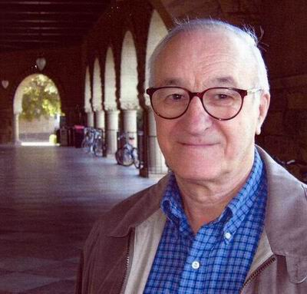
Learning Theories
Albert Bandura presented social learning theory.
According to the theory Criminal behavior is learned through direct and indirect reinforcement.
Example:
    by interacting with anti-social peers
    watching violence on television
Criminal behavior can be
attributed to faulty learning.

Slide 17
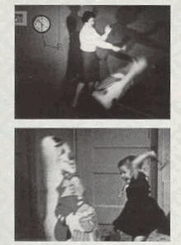
Albert Bandura Bobo Doll Experiment
He had children witness a model aggressively attacking a plastic clown called the Bobo doll.
Children would watch a video where a model would aggressively hit a doll, punch the clown and shouting.
She kicked it, sat on it, hit with a little hammer, shouting various aggressive phrases.
Bandura showed his film to groups of children and let them out to play.
Kids imitated the young lady in the film.

Slide 18
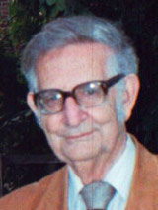
Personalities Theory
Hans Eysenck presented this theory, in which he presented a model.
PEN Model
    People high on Neuroticism and Extraversion are more likely to become involved in crime

Slide 19
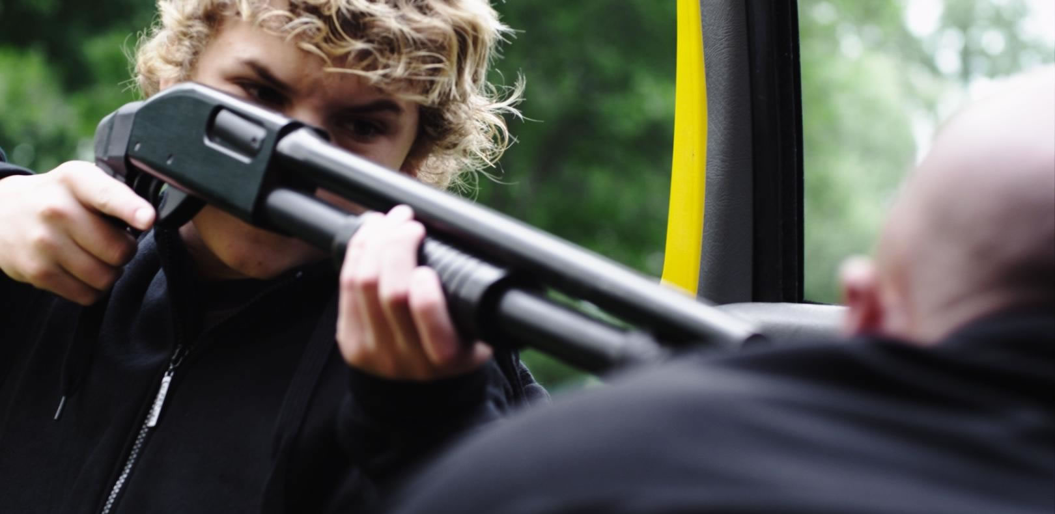
Social Learning Theory
Aggression
Is learned, not innate.
Requires personal observation of aggression or rewards for aggression.
Involves behavior modeling of family members, community members and mass media

Slide 20
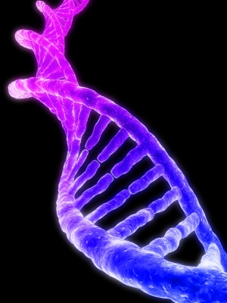
Biological theories
Biological theories tended towards seeing crime as a form of illness, caused by pathological factors specific to certain classes of individuals
“bad” behaviour vs. “sick” behaviour
We can not blame someone for being sick.

Slide 21
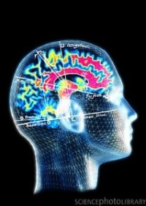
Biological theories
Hormones and criminality
    Testosterone is a male sex hormone linked to aggression.
    Research has shown a relationship between high blood testosterone levels and increase male aggression
    Low brain levels of serotonin also causes criminality.

Slide 22
Biological theories
Genetics and Crime: XYY Supermale
    Humans have 23 pairs of chromosomes, the last pair determines gender
    Males: XY pair ; Females: XX pair
    A study of Scottish prisoners found that a small number had an XYY chromosome. These were identified as potentially violent and labeled “supermale”
Criminal Families
    criminal families appeared to show criminal tendencies through several generations

Slide 23
Physical Appearance of Criminal
We frequently make inferences about another person’s character based on his/her appearance
Ancient Greeks and Romans believed in “physiognomy” :
    physical features can reveal a person’s natural disposition
There are different theories regarding physical appearance of criminal.
Example:
    Lombroso’s Theory : Bodily constitution indicates whether a person is a “born criminal”

Slide 24
Lombroso’s Theory
Lombross Observed the physical characteristics of Italian prisoners and compared them to Italian soldiers and found that criminals were physically different.
Lombroso presented a long list of physical characteristics used to identify criminals :
    Asymmetry of the face or head,
    large monkey-like ears
    twisted nose
    excessive cheek bones
    long arms
    excessive skin wrinkles
    Large forehead
The male with five or more of these physical anomalies and Female with three is marked as a born criminal.

Slide 25
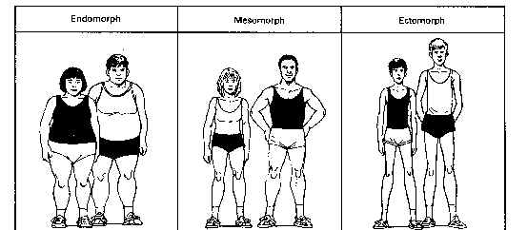
Body Type
Criminality is explained by reference to the offenders’ body types.
Body type is a genetics, or external observable physical characteristics.
W. sheldon concluded three types of human body:
    Ectomorph
    Endomorph
    Mesomorph

Slide 26
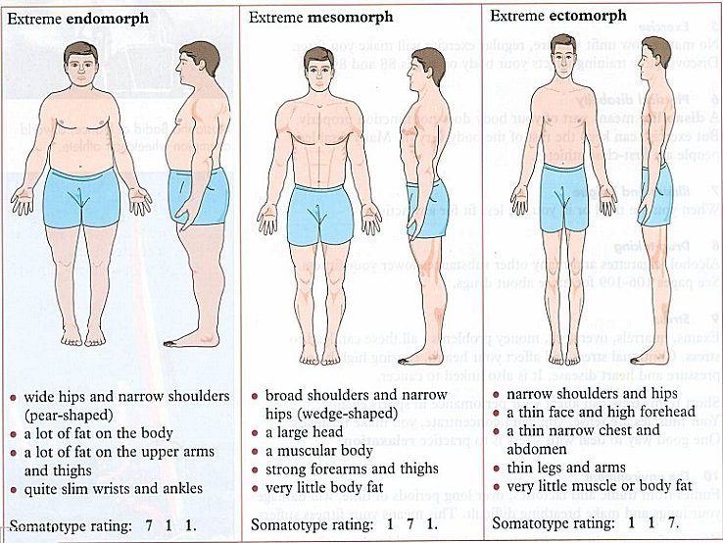
The ECTOMORPH
ECTOMORPHIC are tall, thin, Small Shouldered, less social and more intellectual than the other types.

Slide 27
The MESOMORPH
MESOMORPHIC have well-developed muscles and an athletic appearance. They are active, aggressive, sometimes violent, and the most likely to become criminals.

Slide 28
The ENDOMORPH
ENDOMORPHIC have heavy builds and are slow moving.
They are known for lethargic behavior rendering them unlikely to commit violent crime and more willing to engage in less strenuous criminal activities such as fencing stolen property.

Slide 29
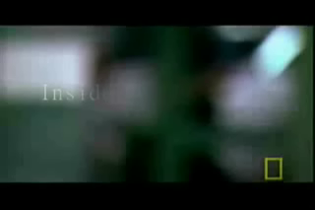
Video

Slide 30
Thank You

