Slide 1

DREAMS
Presented by
Clinical Psychologist Sadaf Sajjad

Slide 2
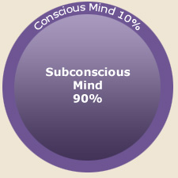
Dreams
Are they a product of your subconscious?

Slide 3
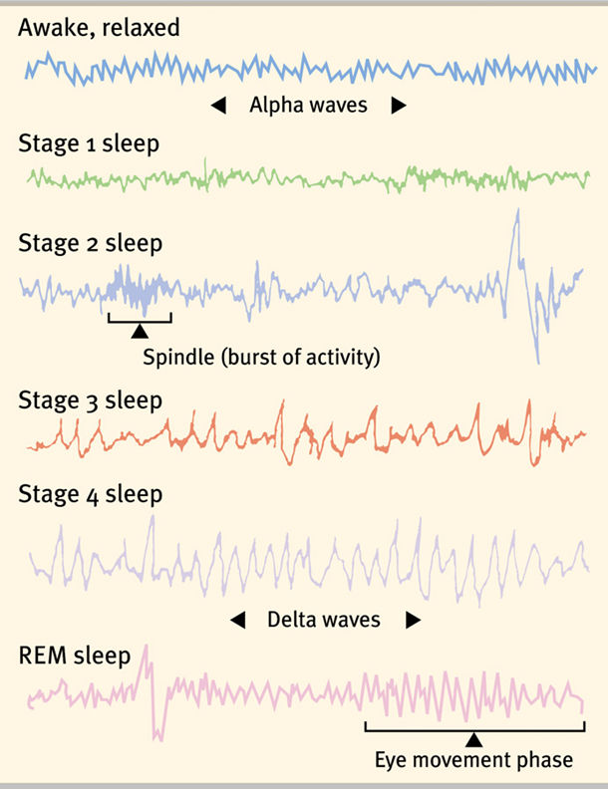
Dreams
The link between REM
Sleep and dreaming has
opened up a new era of
dream research.

Slide 4

Dreams
“Dream is a word used to describe the subconscious experience of a sequence of images, sounds, ideas, emotions, or other sensations usually during sleep, especially REM sleep”.
There is no neurologically agreed
upon, biological definition for
dreaming

Slide 5

Dreams
It is known that dreams are strongly associated with REM sleep.
But there is a lot that is unknown about dreams and the purpose of dreams is interpreted in many different ways
What is the purpose of dreams? Do we need to dream? Are dreams an interaction between your subconscious and conscious?

Slide 6
A Dream
A dream is an internal ego experience of meaning occurring internally during sleep
A dream is an experience in image, action and feeling occurring internally in sleep
A dream is a coherent whole using the universal language of imagery to convey our internal and external life issues and how to deal with them, including our limitations in facing their reality
A dream is an internal experience of meaning coming to our awareness in the aware sleep state from a wisdom source other than ego

Slide 7
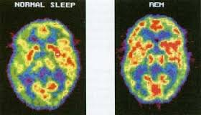
REM Sleep
REM stands for “rapid eye movement”.
REM sleep is a state of sleep in which brain activity is most like wakefulness.
Eugene Aserinsky discovered REM sleep in 1953 while working in the lab of his PhD advisor. Aserinsky noticed that the sleepers' eyes fluttered beneath their closed eyelids. He later used a polygraph machine to record the sleeper’s brain waves during these periods.

Slide 8
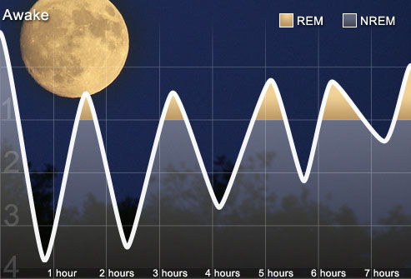
REM Sleep
Adult humans spend about a quarter of their sleep time in REM (approximately 90-120 minutes), much of it dreaming.
During a typical night,
humans experience 4 or 5
periods of REM sleep
(short periods at the
beginning of the night and
longer periods as the night
progresses).
Amount of REM sleep varies
with age- a newborn baby
typically spends more than 80% of total sleep time in REM.

Slide 9
Science of REM Sleep
Physiologically, certain neurons in the brain stem, known as REM sleep-on cells, (located in the pontine tegmentum), are particularly active during REM sleep, and are probably responsible for its occurrence. The release of certain neurotransmitters, the monoamines are completely shut down during REM. This causes REM atonia, a state in which the motor neurons are not stimulated and thus the body's muscles don't move. Lack of such REM atonia causes REM Behavior Disorder where sufferers act out the movements occurring in their dreams.
Heart rate and breathing rate are irregular during REM sleep
Body temperature is not well regulated during REM sleep

Slide 10
Sleep Cycle
When one falls asleep, the body and mind experience different levels of sleep throughout the night. Your sleep cycles consist of REM sleep (Rapid Eye Movement) and NREM (Non Rapid Eye Movement) which cycle consistently in five stages throughout the night.
The beginning stages of sleep prepare your body to shut down. This includes the feeling of dozing off and the ability to be easily awakened by noise or thoughts.

Slide 11
Sleep Cycle
The middle stages are a process of light sleep usually lasting anywhere from 10-25 minutes.
Deep sleep occurs in the later stages – when activity in the body is low and activity in the brain is very high.
REM sleep is the last stage of the sleep cycle where for about 70-90 minutes we are in our deepest sleep.
This is also the stage of sleep where we dream – the stage of sleep where one is hard to wake and sometimes can feel disoriented upon awakening.

Slide 12
Lucid Dreams
Lucid dreaming occurs when dreamers realize that they are dreaming (lucid dreaming can occur with varying levels of awareness and dream control)
The dreamers are sometimes capable of changing their dream environment and controlling various aspects of their dream.
The dream environment is often much more realistic in a lucid dream, and the senses heightened
The realization is usually triggered by the dreamer noticing some impossible or unlikely occurrence in the dream

Slide 13
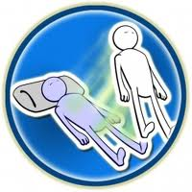
Lucid Dreams
Two types of lucid dreaming: dream-initiated lucid dreaming and wake-initiated lucid dreaming.
Dream-initiated lucid dreaming: Starts off as a normal dream until the dreamer realizes that they’re dreaming.
Wake-initiated lucid dreaming: The dreamer goes from a normal waking state directly into a dream state with no apparent lapse in consciousness.
Time passage appears to be the same
during lucid dreaming as when awake.

Slide 14
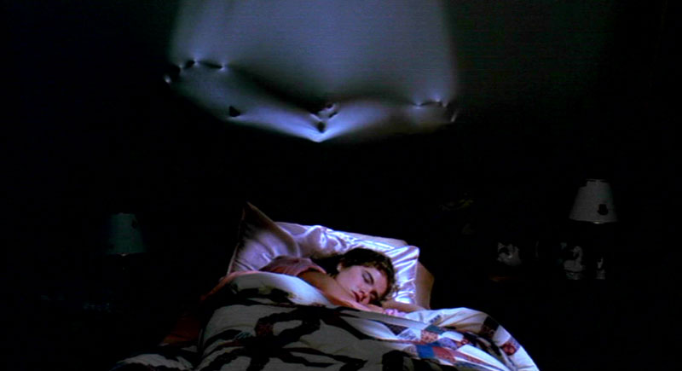
Nightmares
A nightmare is a disturbing dream that causes the dreamer to wake up feeling anxious and frightened.
Nightmares may be a
response to real life
trauma and situations.
They may also occur
because we have ignored
or refused to accept a
particular life situation.
Research shows that most people who have regular nightmares have had a family history of psychiatric problems, bad drug experiences, people who have contemplated suicide, and/or rocky relationships.

Slide 15

Recurring Dreams
Recurring dreams repeat themselves with little variation in story or theme.
These dreams may be
positive, but most
often they are
nightmarish in
content.
Dreams may recur
because a conflict
depicted in the dream
remains unresolved or ignored. Once you have found a resolution to the problem, your recurring dreams will cease.

Slide 16
Recurring Dreams
Recurrent dreams, which can continue for years, may be treated as any other dream. That is, one may look for parallels between the dream and the thoughts, feelings, behavior, and motives of the dreamer.
Understanding the meaning of the recurrent dream sometimes can help the dreamer resolve an issue that he or she has been struggling with for years.

Slide 17
Dream Functions
A dream functions to present life issues and how we are and are not dealing with them.
A dream functions to train us in better dealing with life and personality issues.
A dream uses intense imagery to affect us at the emotional level regarding issues to deal with.
A dream represents us in our attitudes and patterns in a more objective way than we usually see ourselves.
A dream functions to illustrate the need for internal and external integration and wholeness.

Slide 18
What is the purpose of dreams?
The Ontogenetic Hypothesis of REM sleep states that this sleep phase is particularly important to the developing brain, possibly because it provides the neural stimulation that newborns need to form mature neural connections and for proper nervous system development.
Studies investigating the effects of Active Sleep deprivation have shown that deprivation early in life can result in behavioral problems, permanent sleep disruption, decreased brain mass (Mirmiran et al. 1983), and result in an abnormal amount of neuronal cell death (Morrissey, Duntley & Anch, 2004).
REM sleep is necessary for proper central nervous system development (Marks et al. 1995). Further supporting this theory is the fact that the amount of REM sleep decreases with age, as well as the data from other species

Slide 19
What is the purpose of dreams?
Zhang hypothesizes that the function of sleep is to process, encode and transfer the data from the temporary memory to the long-term memory: NREM sleep processes the conscious-related memory (declarative memory), and REM sleep processes the unconscious related memory (procedural memory)
Numerous studies have suggested that REM sleep is important for consolidation of procedural and spatial memories.
A recent study (Marshall, Helgadóttir, Mölle & Born, 2006) shows that artificial enhancement of the REM sleep improves the next-day recall of memorized pairs of words

Slide 20
What is the purpose of dreams?
Freud proposed that dreams protect sleep, which might be disturbed by the arousal of unacceptable wishes
Ferenczi proposed that dreams may communicate something that is not being said outright (subconscious thoughts)
There have also been analogies made with the cleaning-up operations of computers when they are off-line. Dreams may remove parasitic nodes and other "junk" from the mind during sleep.
Dreams may also create new ideas through the generation of random thought mutations

Slide 21
What is the purpose of dreams?
Dreams may also regulate mood. A researcher says dreams may function like psychotherapy, by "making connections in a safe place" and allowing the dreamer to integrate thoughts that may be dissociated during waking life.
It’s been identified dreams as an interaction between the unconscious and the conscious.
Dreams are seen as projections of parts of the self that have been ignored, rejected, or suppressed.
It is believed that people resolve issues in their sleep and use dreams to reorganize thoughts – are dreams used to deal with traumatic events?

Slide 22
What is the purpose of dreams?
Another idea is that dreams helps the mind run tests of its Emergency Broadcast System, a way to prepare for potential disaster. For example, when new mothers dream about losing their babies, they may actually be rehearsing what they would do or how they would react if their worst fears were realized.
There's also evidence that dreaming helps certain kinds of learning. Some researchers have found that dreaming about physical tasks, like a gymnast's floor routine, enhances performance. Dreaming can also help people find solutions to elusive problems. "Anything that is very visual may get extra help from dreams," says Deirdre Barrett, assistant professor at Harvard Medical School and editor of the journal Dreaming.
It has been found that even ordinary people can solve simple problems in their lives (like how to fit old furniture into a new apartment) if they focus on the dilemma before they fall asleep.

Slide 23

Dream Interpretation
video 1

Slide 24
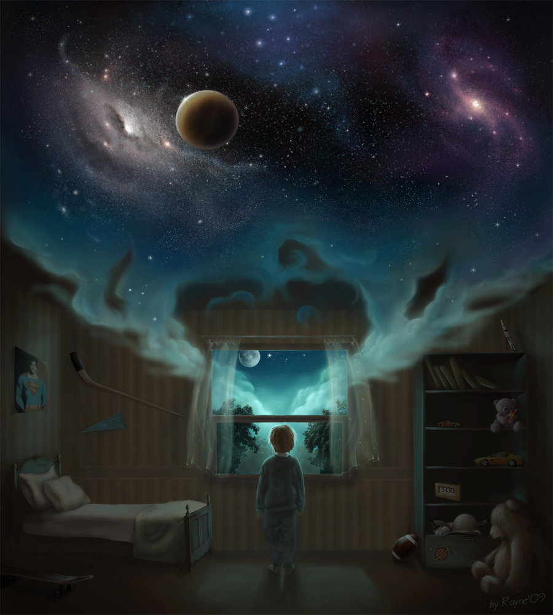
What do we Dream?
Negative Emotional
Content: 8 out of 10
dreams have negative
emotional content.
Failure Dreams: People
commonly dream about
failure, being attacked,
pursued, rejected, or
struck with misfortune.
Dreams of Gender: Women
dream of men and women
equally; men dream more about men than women.

Slide 25
Why do we dream?
Some researchers suggest that dreams serve no real purpose, while others believe that dreaming is essential to mental, emotional and physical well-being.
Wish Fulfillment: Sigmund Freud suggested that dreams provide a psychic safety valve to discharge unacceptable feelings. The dream’s manifest (apparent) content may also have symbolic meanings (latent content) that signify our unacceptable feelings.
Information Processing: Dreams may help sift, sort, and fix a day’s experiences in our memories.

Slide 26
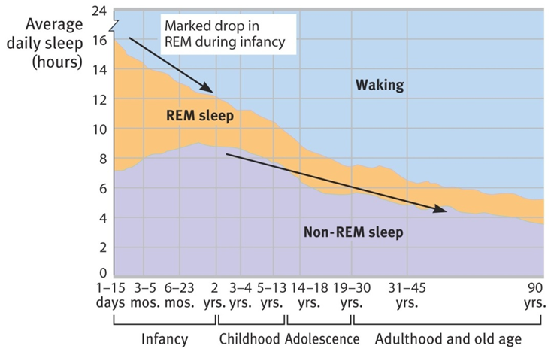
Why do we dream?
Physiological Function: Dreams provide the sleeping brain
with periodic
stimulation to
develop and
preserve neural
pathways. Neural
networks of
newborns are
quickly developing; therefore, they need more
sleep.

Slide 27
Why do we dream?
Activation-Synthesis Theory: Suggests that the brain engages in a lot of random neural activity. Dreams make sense of this activity.
Cognitive Development: Some researchers argue that we dream as a part of brain maturation and cognitive development.
All dream researchers believe we need REM sleep. When deprived of REM sleep and then allowed to sleep, we show increased REM sleep called REM Rebound.

Slide 28

Why do we dream?
video 2

Slide 29
Children and Dreams
Almost the entire state of being before we're born is REM sleep.
Researchers believe children have to reach a certain level of intellectual maturity, around the age of 8 or 9, before their dreams resemble adults.
Research has shown that children dream about animals more often than adults and are more likely to report being victims than aggressors.
Children are also more likely to have "fantastic" dreams, while adults' dreams tend to contain more elements of reality.
A typical fantastic dream from a 10-year-old studied included a cat asking for directions to the "cat bathroom." Similarly, an 11-year-old boy dreamed that a snake wanted to go up a ski lift.

Slide 30
Common dreams
They often relate to current concerns.
They often involve things that could go wrong.
Frequent themes:
falling
being chased
being in an exam
solving issues
being with the people who have passed by
loving others secretly
Snakes
Killing others or being killed

Slide 31
Freud’s Wish- Fulfillment Theory
Dreams are an attempt to satisfy sexual and aggressive impulses that we cannot satisfy when we are awake.
Manifest Content: the surface level of a dream (images, action).
Latent Content: the unconscious meaning of a dream.

Slide 32
Freud’s View
Freud described the mental processes, or “dream-work”, by which the dream was modified and rendered less disturbing.

Slide 33


Condensation
“The fusing together of different ideas and images into a single image”.

Slide 34



Displacement
“in which a
potentially disturbing
image or idea is replaced by something connected
but less disturbing”.

Slide 35

Representation
“the process by which thoughts are converted into visual
Images,”

Slide 36
Activation- Synthesis Theory
Dreams result from random activation of brain cells responsible for eye movement, muscle movement, balance, and vision.
The brain then synthesizes (combines) this activity with existing knowledge and memories as if the signals came from the environment.
How we interpret the random images and sensations is the dream’s meaning.

Slide 37
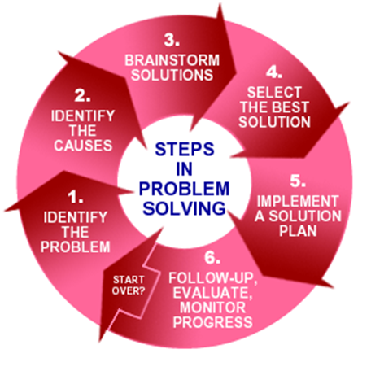
Problem Solving Theory
“Dreams give people a chance to review and address problems they face during the day”.

Slide 38
Mental Housekeeping Theory
During sleep, the brain shuts out sensory input so it can process what was stored in memory during the day.
Dreams are brief glimpses of the brain’s sorting, scanning and searching through memories. Dreams have no meaning.
Supporting the theory is research showing that REM sleep is important for remembering things that were learned during the preceding day.

Slide 39
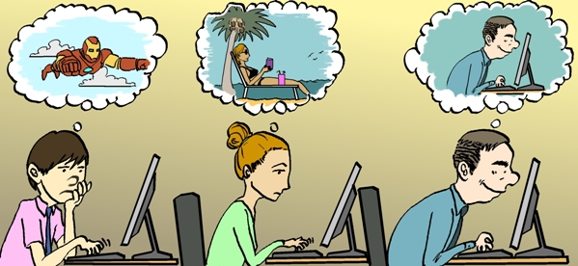
Difference between dreaming and day dreaming
“Dreaming is a subconscious state of mind while day dreaming is a conscious state of mind”.
Dreaming is something we do every night during REM sleep. It is thought to be connected to the process of forming and maintaining
memory, and
dream images
often reflect
things which are
on our mind or in
our subconscious.
Dreams can be good
or bad.

Slide 40

Difference between dreaming and day dreaming
Whereas Day dreaming is not actual dreaming. That's just when we don't concentrate on what we're doing during the
day because we're
preoccupied imagining
things (e.g. what we're going
to do on the weekend,
what you would do with a
million dollars etc.). We
don't actually dream when
awake - although some people
will experience dream-like visions while going to sleep and during the process of waking up. These are called hypnagogic and hypnopompic hallucinations and are altogether different to day dreaming.

Slide 41
FACTS
Humans spend about 6 years dreaming
Dreams are generated in the forebrain
Most common emotion experienced during dreaming is anxiety
Men generally have more aggressive feelings in their dreams than women, and children's dreams do not have very much aggression until they reach teen age
This parallel much of the current research on gender and gender role comparisons in aggressive behavior
This supports the view that there is a continuity between our conscious and unconscious styles and personalities
In men's dreams 70 percent of the characters are other men, while a female's dreams contain an equal number of men and women

Slide 42
FACTS
Approximately 70% of women have recurring dreams and 65% of men
The most common themes are: situations relating to school, being chased, sexual experiences, falling, arriving too late, a person now alive being dead, flying, failing an examination, or a car accident
Twelve percent of people dream only in black and white
In general, more introverted, psychologically oriented people naturally remember their dreams and practical, concrete thinkers don’t

