Slide 1
Psychotherapy
Presented By:
Clinical Psychologist
Sadaf Sajjad

Slide 2
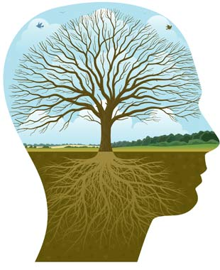
Definition
Psychotherapy is a general term referring to therapeutic interaction or treatment contracted between a trained professional and a client, patient, family, couple, or group.
The problems addressed are psychological in nature and can vary in terms of their causes, influences, triggers, and potential resolutions.
Accurate assessment of these and other variables is dependent on the practitioner's capability and can change or evolve as the practitioner acquires greater experience, knowledge, and insight.

Slide 3
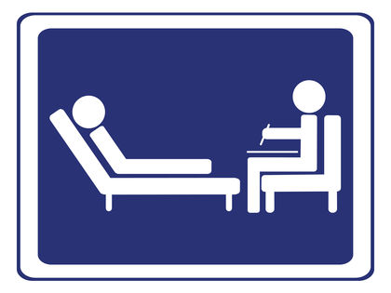
What is Psychotherapy?
Psychotherapy aims to increase the individual's sense of his/her own well-being.
Psychotherapists employ a range of techniques based on experiential relationship building, dialogue, communication and behavior change that are designed to improve the mental health of a client or patient, or to improve group relationships (such as in a family).
Psychotherapy may also be performed by practitioners with a number of different qualifications, including psychiatry, clinical psychology, counseling psychology, clinical or psychiatric social work, counseling, play therapy, music therapy, occupational therapy, psychoanalysis and those from other psychotherapies.

Slide 4

Treatment through Psychotherapy
Most psychotherapy tends to focus on problem solving and is goal-oriented. That means at the onset of treatment, you and your therapist decide upon which specific changes you would like to make in your life.
Most psychotherapists today work on and focus on helping you to achieve those goals. This is done simply through talking and discussing techniques that the therapist can suggest that may help you better navigate those difficult areas within your life.
Often psychotherapy will help teach people about their disorder, too, and suggest additional coping mechanisms that the person may find more effective.

Slide 5

Treatment through Psychotherapy Conti…
Psychotherapy is most successful when the individual enters therapy on their own and has a strong desire to change. If you don’t want to change, change will be slow in coming.
Change means altering those aspects of your life that aren’t working for you any longer, or are contributing to your problems or ongoing issues. It is also best to keep an open mind while in psychotherapy, and be willing to try out new things that ordinarily you may not do.
Psychotherapy is often about challenging one’s existing set of beliefs and often, one’s very self. It is most successful when a person is able and willing to try to do this in a safe and supportive environment.

Slide 6

Mental Health and Psychotherapy
Psychotherapy is often used either alone or in combination with medications to treat mental illnesses.
Called "therapy" for short, the word psychotherapy actually involves a variety of treatment techniques.
During psychotherapy, a person with a mental illness talks to a licensed and trained mental health care professional who helps him or her identify and work through the factors that may be triggering the illness.

Slide 7

Why do people consider using psychotherapy?
Psychotherapy is a partnership between an individual and a professional such as a psychologist who is licensed and trained to help people understand their feelings and assist them with changing their behavior.
They feel an overwhelming and prolonged sense of sadness and helplessness, and they lack hope in their lives.
Their emotional difficulties make it hard for them to function from day to day. For example, they are unable to concentrate on assignments and their job performance suffers as a result.
Their actions are harmful to themselves or to others. For instance, they drink too much alcohol and become overly aggressive.
They are troubled by emotional difficulties facing family members or close friends.

Slide 8
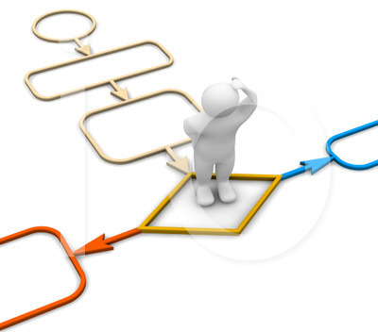
Characteristics common for all psychotherapies
Based on rationale or conceptual structure that is used to understand the patient problem
Use of the specific procedure in the relationship that is linked to rationale
Structure relationship
Expectation of improvement

Slide 9


Who seeks therapy?
Children: behavioral, school, family issues
Adolescents: as above and issues of separation and peer relationships
Young adults: all of above plus career issues
Mature adults: all of above plus issues of changing relationships, family alignments, health, work and social status
Older adults: all of above plus end of life issues

Slide 10
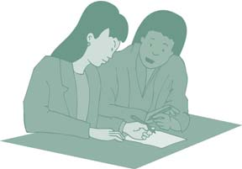
Nature of the Psychotherapy Relationship
The relationship between a therapist and a client is strictly professional. That is, the relationship exists only and solely for the purpose of helping the patient.
The therapeutic relationship differs from all other relationships. You can tell therapists things without having to worry about your information being told to others or in any way affecting your job, family or relationships.
Therapists reveal little about themselves to patients. This ensures that therapists do not do anything to change how individuals present themselves.

Slide 11
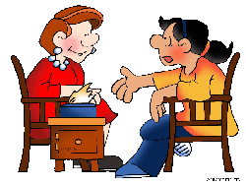
Nature of Psychotherapy Communication
Therapists are trained to understand what you say — your words, how you say them and which ones you do not use.
They pay attention to body language and voice tone to fully understand your speech.
Having learned about and treated people with your condition before, therapists can comprehend your particular problems.
They are familiar with the symptoms of various psychiatric illnesses and the difficulties of daily living.
They know what questions to ask and might pose questions that you have never heard before.

Slide 12
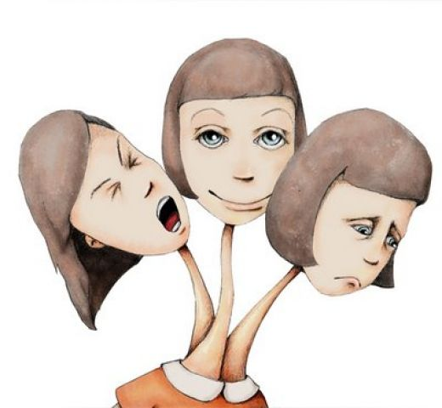
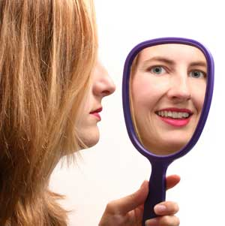

What does psychotherapy treat?
Psychotherapy is used for treating many different problems. Some alone, and some in combination with drugs. The most commons ones are listed below:
Depression
Anxiety
Post-traumatic stress disorder
Low self-esteem
Anxiety disorder, including phobias
Emotional crises
Marital problems
Family disputes
Obsessive-compulsive disorder
Personality disorders
Alcoholism
Addiction
Problems stemming from child abuse
Behavioral problems
Bipolar disorder (in combination with drugs)
Schizophrenia (in combination with drugs)

Slide 13
Approaches of Psychotherapy

Slide 14

Psychodynamic Therapy
Psychodynamic therapy is based on the assumption that a person is having emotional problems because of unresolved, generally unconscious conflicts, often stemming from childhood.
The goal of this type of therapy is for the patient to understand and cope better with these feelings by talking about the experiences.

Slide 15

Interpersonal Therapy
Interpersonal therapy focuses on the behaviors and interactions a patient has with family and friends.
The primary goal of this therapy is to improve communication skills and increase self-esteem during a short period of time.

Slide 16
Types of Psychotherapy

Slide 17

Behavioural therapy
Behavioural therapy is based on the theory that learnt behaviour in response to past experiences can be unlearnt or reformulated, without focusing on the reasoning for the original behaviour.
Individuals with compulsive and obsessive disorders, fears, phobias and addictions may benefit from this type of therapy.
The focus is on helping the client to achieve goals and modify extreme behavioural responses to stress, anxiety etc. It is based on the principles of learning, operant and respondent conditioning, and can also draw upon theories from acceptance and commitment therapy

Slide 18

Behavioural therapy Conti…
Behavioral therapies are based on the theory of classical conditioning. The premise is that all behavior is learned; faulty learning (i.e. conditioning) is the cause of abnormal behavior. Therefore the individual has to learn the correct or acceptable behavior. An important feature of behavioral therapy is its focus on current problems and behavior, and on attempts to remove behavior the patient finds troublesome.
Examples of behavior therapy include:
Systematic Desensitization
Aversion Therapy
Flooding

Slide 19

Cognitive analytical therapy
Anthony Ryle, a British GP who later became a psychotherapist, developed cognitive analytic therapy (CAT).
CAT combines cognitive theories, psychotherapy and explorations between language and thinking, and the link between historical, cultural and social factors on how we function.
It encourages clients to explore their own resources and develop the skills to change destructive patterns of behaviour, and negative ways of thinking and acting.
The therapy is short term.

Slide 20
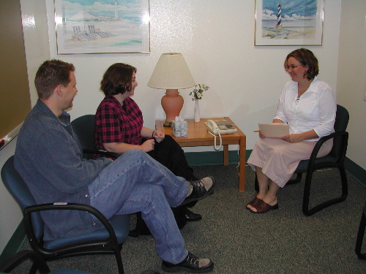
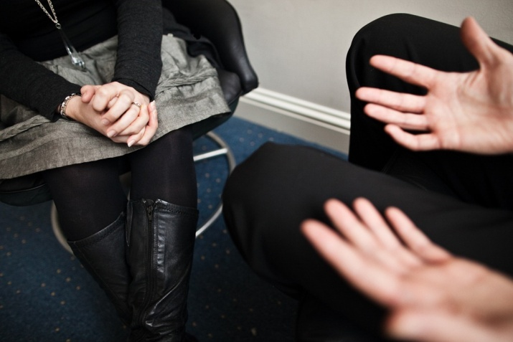
Cognitive analytical therapy Conti…
It aims to help the client solve problems by finding and changing dysfunctional thinking, behavior, and emotions.
It often develops skills for changing your beliefs, relating to others, and changing behaviors.
The psychotherapist works with the client to identify and test beliefs, leading to the understanding of dysfunctional thinking.
Cognitive therapy was initially created to fight depression, but now is used more widely.
CAT concerned itself with the treatment of neurotic disorders, and
it was in this context that the early theoretical and technical
elements were established

Slide 21

Video 1

Slide 22
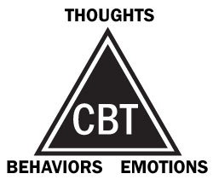
Cognitive behavioural therapy (CBT)
Cognitive behavioural therapy (CBT) developed out of behaviour modification, cognitive therapy, and rational emotive behaviour therapy, and combines cognitive and behavioural techniques.

Slide 23
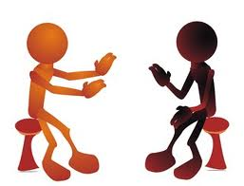
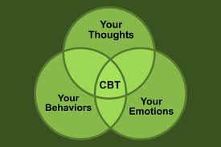
Cognitive behavioural therapy Conti…
CBT is psychotherapy based on cognitions, assumptions, beliefs and behaviours, which aims to influence negative emotions relating to inaccurate appraisal of events.
Therapeutic techniques vary to accommodate individual clients or issues but commonly include: keeping a diary of significant events and associated feelings, thoughts and behaviours; questioning and testing cognitions, assumptions, evaluations and beliefs that might be unhelpful and unrealistic; gradually facing activities which may have been avoided; trying out new ways of behaving and reacting.
Relaxation and distraction techniques are also commonly used.

Slide 24

Video2

Slide 25

Gestalt therapy
Gestalt is a German word meaning the whole and the sum of all the parts, and the symbolic configuration or pattern of elements, that make up the whole.
Gestalt therapy is a psychotherapeutic approach, devised by Fritz Perls in the 1940's.
Gestalt therapy draws on the belief that people have a natural predilection towards health, but old patterns of behaviour and fixed ideas can create blocks interrupting the natural cycle of wellness, therefore effecting communication with others.

Slide 26

Gestalt therapy Conti…
Gestalt therapy addresses what is happening in the moment, bringing into awareness an individual's representation of the self, his/her response and interaction with others.
The skilled Gestalt therapist makes effective and efficient interventions to bring the client into awareness of not only what is happening and what is being said but also body language and repressed feelings.
Gestalt techniques often include acting out scenarios and dream recall.

Slide 27
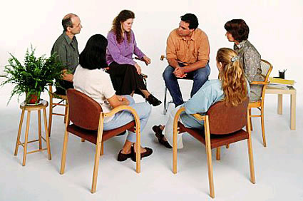
Group psychotherapy
Group psychotherapy is a branch of psychotherapy intended to help people who would like to improve their ability to cope with life's difficulties and problems but in a group situation.
In group therapy, one or more therapists, work with a small group of clients together.

Slide 28

Group psychotherapy Conti…
Practitioners recognise positive therapeutic benefits that could not be gained from one-on-one therapies.
For example - interpersonal problems are addressed well within groups. Group therapy is not based on one single psychotherapeutic theory, but many and often revolves around talking, and may also include other approaches such as psychodrama, movement work, body psychotherapy or constellations work.
Aim: The aim of group psychotherapy is to support the solving of emotional difficulties and encourage the personal development of the participants in the group. The combination of past experiences and experiences outside the therapeutic group, with the interactions between group members and the therapist's, becomes the material through which the therapy is conducted.

Slide 29
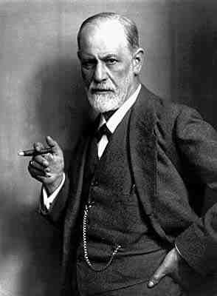
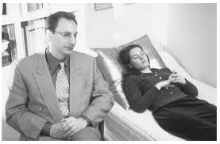
Psychoanalysis
Developed by Sigmund Freud, psychoanalysis is a form of psychotherapy in which psychotherapists work with clients to understand psychological functioning and behavior.
It can be used to investigate the mind, theorize about human behavior, and treat psychological illnesses.
It is a specific mind investigation technique that usually involves the client lying on a couch, unable to see the psychotherapist.
Psychoanalysis works primarily to explore the unconscious mind through the interpretation of mistakes, dreams, and symbols.

Slide 30
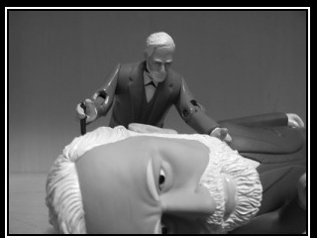
Psychoanalysis Conti…
The psychoanalytic framework stresses the importance of understanding:
That each individual is unique
That there are factors outside of a person's awareness (unconscious thoughts, feelings and experiences) which influence his or her thoughts and actions,
That the past shapes the present
That human beings are always engaged in the process of development throughout their lives.
Essentially, psychoanalysis is about the story of human beings,
what motivates, inspires and sometimes cripples them,
but it looks at these phenomena and tells a story from a
unique perspective – “what lies beneath” the surface.

Slide 31

Humanistic-Existential Psychotherapy
Humanistic psychotherapy is an approach which tries to do justice to the whole person including mind, body and spirit. It represents a broad range of therapeutic methods.
Each method recognizes the self-healing capacities of the client.
The humanistic psychotherapist works towards an authentic meeting of equals in the therapy relationship.

Slide 32
Modes of Psychotherapy

Slide 33


Individual Therapy
Just like it sounds, individual therapy is one-to-one work between client and therapist.
Individual therapy is probably the most common mode of therapy and is often used in combination with other approaches such as couples therapy or group therapy.
Individuals come to therapy for a wide range of reasons including life changes, losses, psychological injury, or for a particular disorder such as anxiety or depression.
Some people simply want the supportive environment of an unbiased third party, some people want help in pursuing meaningful life direction.

Slide 34

Couples Therapy
Couples therapy is most often used when two people have a need to address an incident or problem that has created stress in their relationship.
It can also be used to improve satisfactory relationships by deepening mutual understanding.
The focus usually addresses expectations, relationship patterns, communication dynamics, and issues related to problem-solving. Sometimes a couple's psychotherapist sees the partners individually, especially when it is important to address childhood issues that are impacting the relationship.

Slide 35

Family Therapy
Family therapy involves two or more members of a family (couples therapy is technically a subset of family therapy).
Family therapy is best used when there is a need to address problems or issues that affect family functioning when one or more family members are affected.
This approach to therapy focuses more on inter-relational issues than on an individual's internal concerns.

Slide 36

Group Therapy
Therapy groups can be organized around specific problems such as anxiety problems, sexual abuse, or eating disorders.
They also can be organized according to the type of client, such as adolescents, men, women, couples or parents.
Groups can help lessen members' sense of isolation, provide support around a particular issue, and/or enhance relationships.
Group therapy can be effective as a primary therapy or as an adjunct to other types of therapy. It can also be a more economical mode of therapy than individual therapy.

Slide 37

Confidentiality in Psychotherapy
Confidentiality of information discussed in the course of therapy is of critical importance.
It is one of the factors that creates a psychologically safe environment within which a person can explore difficult aspects of their lives and their selves.
If there were no assurance of confidentiality, most people would be reluctant to share as much about themselves and would likely derive much less benefit from therapy.

Slide 38
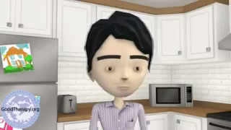
Case Study
Problem identification and solution after going through a therapy
Video 3

Slide 39

Benefits of psychotherapy
Being able to understand yourself and your personal goals and values better.
Developing skills for improving relationships.
It helps the client overcome certain problems, such as an eating disorder, depression, or anxiety.
Obtaining a solution to the problems or concerns that made the client seek therapy.

Slide 40
Thank You

