Slide 1
Abnormal Behavior
Presented by
Clinical Psychologist
SADAF SAJJAD

Slide 2
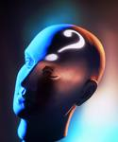
What is Abnormal Behavior?
  Actions, thoughts, and feelings harmful to a person or others; experiencing discomfort enough to not function
The abnormal behavior leads to psychological disorder
a “harmful dysfunction” in which behavior is judged to be:
    atypical--not enough in itself
    disturbing--varies with time and culture
    maladaptive--harmful
    unjustifiable--sometimes there’s a good reason

Slide 3

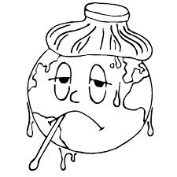
What is Psychologically Abnormal?
The Four D’s
      Deviance
      Distress
      Dysfunction
      Danger

Slide 4
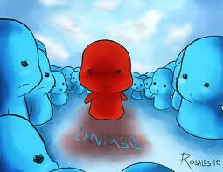
Deviance
  Deviance from or violation of a society’s ideas about proper function.
    Norms- a society’s explicit and implicit rules for proper conduct.
    Culture- a society’s shared rules that govern the behavior of its members, common history, values, beliefs, habits, skills, technology, and arts.
  Includes a valuation aspect which varies from culture to culture

Slide 5
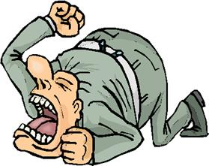
Distress
  If behaviors cause the pain or discomfort (psychological or physical), then they are abnormal

Slide 6

Dysfunctional
  Patterns of behavior which interfere with normal daily routines, such as one’s social, occupational, and emotional functioning causing significant distress
  Inability/loss of ability to perform one’s normal roles.
    Compare performance with requirements for a role
    Compare performance with potential

Slide 7
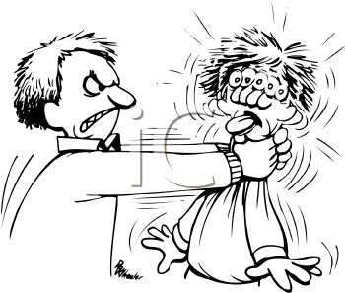
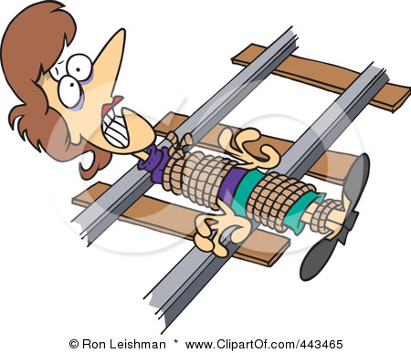
Dangerous
  Behavior that becomes dangerous to self or others.
  Result from intense emotional states or may signal the presence of a psychological disorder

Slide 8
Definition of Abnormal Behavior
Inconsistent with societal norms
Inconsistent with cultural norms
Abnormal Behavior
Emotional
Distress
Interferes with daily functioning
Inconsistent with developmental norms

Slide 9

Abnormal Behavior
Video 1

Slide 10
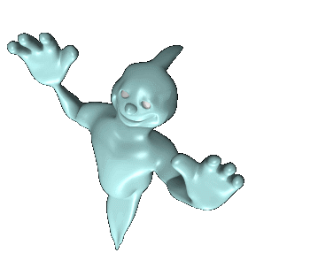
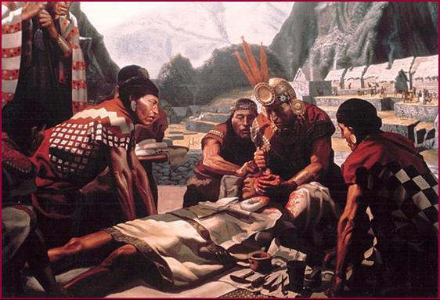
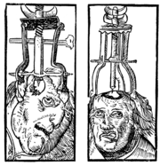
Early Theories
Abnormal behavior was evil spirits trying to get out.
Trephining was often used.

Slide 11
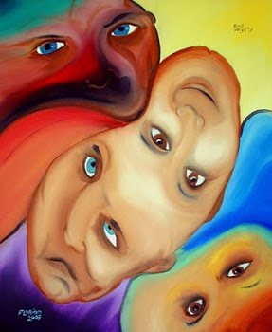
Models of Abnormality
Biological/Biomedical
  Emphasizes biological processes
Psychodynamic
  Emphasizes unconscious emotional processes
Cognitive
  Emphasizes semi-conscious thinking processes
Behavioral
  Emphasizes learning processes

Slide 12
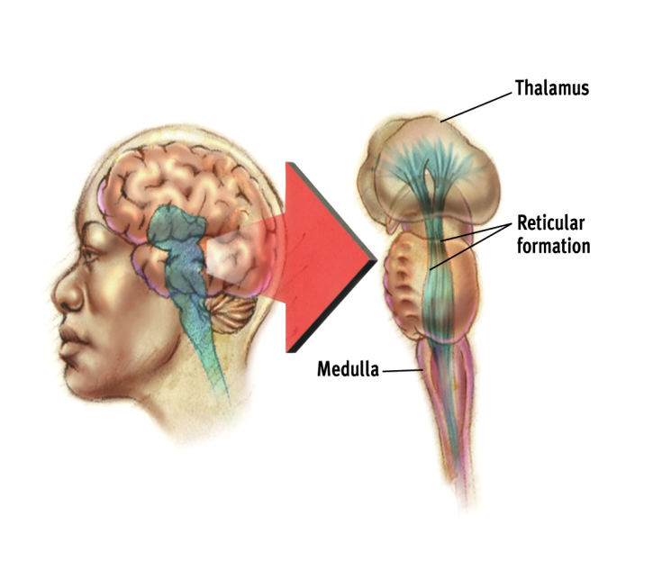
Biomedical Model
Main assumptions:
  Psychological disorders are illnesses or diseases affecting the nervous system
  Abnormal behavior, thinking and emotion are caused by biological dysfunctions
  Understanding mental illness involves understanding what went wrong with the brain

Slide 13
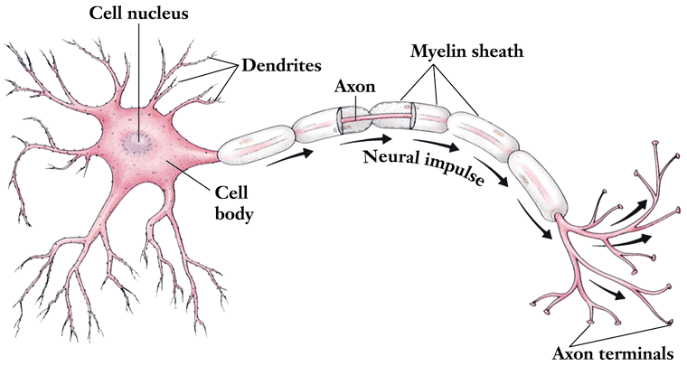
Biomedical Model
Possible causes of abnormal behavior:
  Biochemistry – an imbalance of certain neurotransmitters or hormones might cause parts of the brain to malfunction
  Structural damage or abnormality – if the structure of the brain is damaged or improperly formed then thinking, emotion and behavior may change

Slide 14
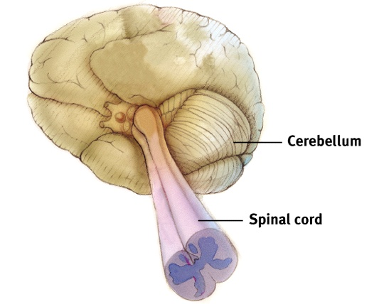
Biomedical Model
Factors that may affect NS functioning:
  Genetics – inherited developmental abnormality
  Toxicity – chemical poisoning from e.g. drugs or environmental toxins
  Infection/disease – causing chemical or structural damage to the brain
  Stress – causing abnormal hormonal effects in the long term

Slide 15
Behavioral Model
Main assumptions:
  Abnormal behavior is the consequence of abnormal learning from the environment
  There is no qualitative difference between normal and abnormal behavior – they are learned in the same ways:
    Classical conditioning
    Operant conditioning
    Social learning

Slide 16
Classical Conditioning
Learning by association:
  When two environmental changes (stimuli) occur together, we learn to associate them
  The response to one may transfer to the other
  E.g. Pavlov (1901) taught dogs to salivate when they heard a bell

Slide 17
Operant Conditioning
Learning by consequences
  Organisms operate on their environments
  The likelihood of them repeating any given behavior depends on its consequences
    Reinforcement – more likely to repeat
    Punishment – less likely to repeat

Slide 18
Social Learning Theory
Learning by observation
  People observe the behavior of other people (models)
  They may imitate the behavior they observe
  Whether or not they do so depends on the observed consequences:
    Vicarious reinforcement
    Vicarious punishment

Slide 19
The Cognitive Model
www.psychlotron.org.uk
Cognition
Real World
Thinking
Perception
Information
Emotion
Behaviour
Behaviour

Slide 20
The Cognitive Model
Main assumptions:
  Abnormal behavior is caused by abnormal thinking processes
  We interact with the world through our mental representation of it
  If our mental representations are inaccurate or our ways of reasoning are inadequate then our emotions and behavior may become disordered

Slide 21
The Cognitive Model
Factors in abnormal behavior:
  Inaccurate perception
  Poor reasoning and problem solving
Cognitive-emotion relationship assumed to be bi-directional, but cognitive processes given primacy
Underlying reasons for faulty thinking are not considered especially important

Slide 22
The Psychodynamic Model
Main assumptions:
  Psychological disorders are caused by emotional problems in the unconscious mind
  The causes of these emotional problems can usually be traced back to early childhood
  The relationship between child and parents is a crucial determinant of mental health

Slide 23
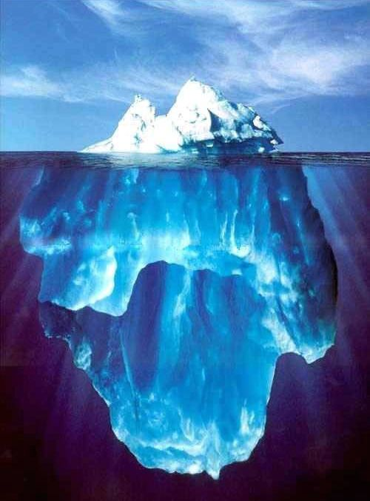
The Unconscious Mind
The conscious. The small amount of mental activity we know about.
Thoughts
Perceptions
Memories
Stored knowledge
Fears
Unacceptable sexual desires
Violent motives
Irrational wishes
Immoral urges
Selfish needs
Shameful experiences
Traumatic experiences
The preconscious. Things we could be aware of if we wanted or tried.
Bad
Worse
Really Bad
The unconscious. Things we are unaware of and can not become aware of.

Slide 24
Perspectives and Disorders
Psychological School/Perspective | Cause of the Disorder
Psychoanalytic/Psychodynamic | Internal, unconscious drives
Humanistic | Failure to strive to one’s potential or being out of touch with one’s feelings.
Behavioral | Reinforcement history, the environment.
Cognitive | Irrational, dysfunctional thoughts or ways of thinking.
Socio-cultural | Dysfunctional Society
Biomedical/Neuroscience | Organic problems, biochemical imbalances, genetic predispositions.

Slide 25
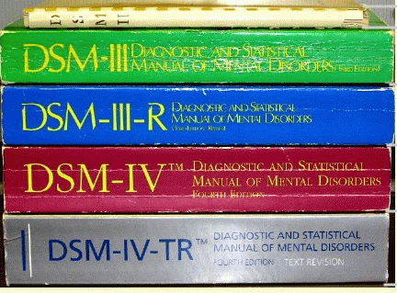
Classifying Psychological Disorders
The American Psychiatric Association (APA) rendered a Diagnostic and Statistical Manual of Mental Disorders (DSM) to describe psychological disorders.

Slide 26
Multiaxial Classification
    Axis I: Clinical disorders
    Axis II: Personality disorders and mental retardation
    Axis III: General medical conditions
    Axis IV: Psychosocial and environmental problems
    Axis V: Global assessment of functioning

Slide 27

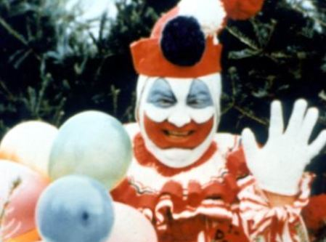
Two Major Classifications in the DSM
Neurotic Disorders
Psychotic Disorders
Distressing but one can still function in society and act rationally.
Person loses contact with reality, experiences distorted perceptions.

Slide 28
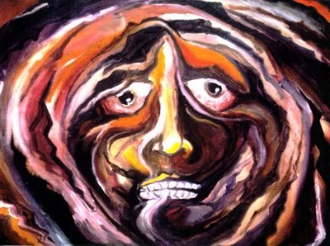
Anxiety Disorders
a group of conditions where the primary symptoms are anxiety or defenses against anxiety.
The patient fears something awful will happen to them.
They are in a state of intense apprehension, uneasiness, uncertainty, or fear.

Slide 29
Anxiety
Video 2

Slide 30

Generalized Anxiety Disorder
GAD
An anxiety disorder in which a person is continuously tense, apprehensive and in a state of autonomic nervous system arousal.
The patient is constantly tense and worried, feels inadequate, is oversensitive, can’t concentrate and suffers from insomnia.

Slide 31
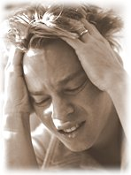
Panic Disorder
An anxiety disorder marked by a minutes-long episode of intense dread in which a person experiences terror and accompanying chest pain, choking and other frightening sensations.

Slide 32
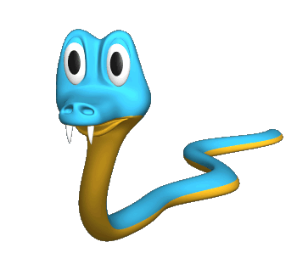

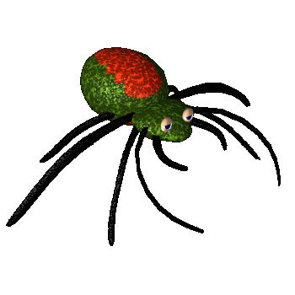

Phobias
A person experiences sudden episodes of intense dread.
Must be an irrational fear.

Slide 33
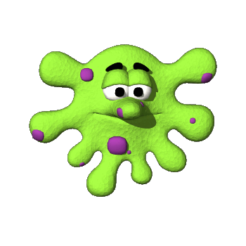

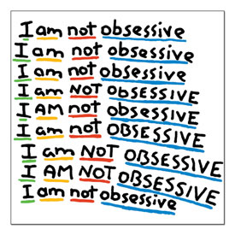
Obsessive-compulsive disorder
Persistent unwanted thoughts (obsessions) cause someone to feel the need (compulsion) to engage in a particular action.
Obsession about dirt and germs may lead to compulsive hand washing.

Slide 34
Obsessive-compulsive disorder
Video 3

Slide 35
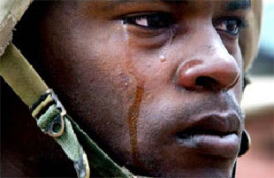
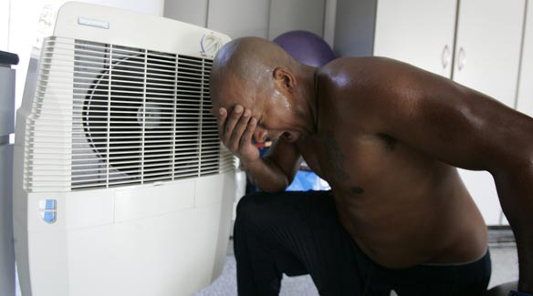
Post-traumatic Stress Disorder
PTSD
Flashbacks or nightmares following a person’s involvement in or observation of an extremely stressful event.
Memories of the event cause anxiety.

Slide 36
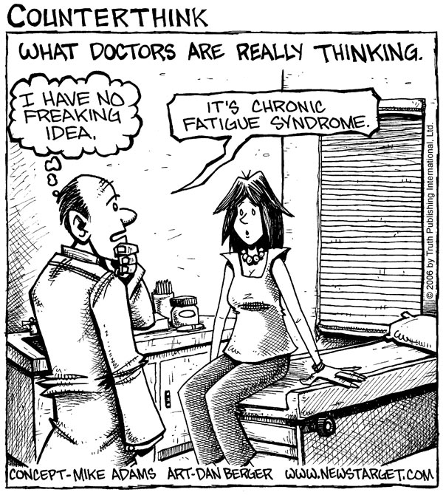
Somatoform Disorders
Occur when a person manifests a psychological problem through a physiological symptom.
Two types……

Slide 37
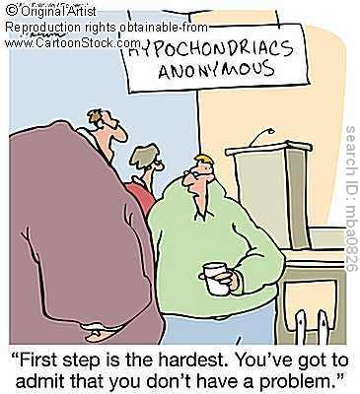
Hypochondriasis
Has frequent physical complaints for which medical doctors are unable to locate the cause.
They usually believe that the minor issues (headache, upset stomach) are indicative are more severe illnesses.

Slide 38
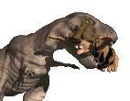
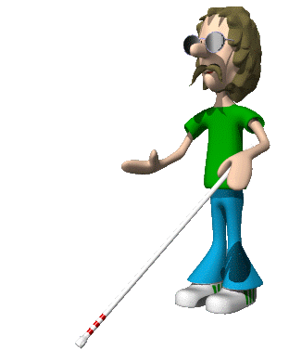
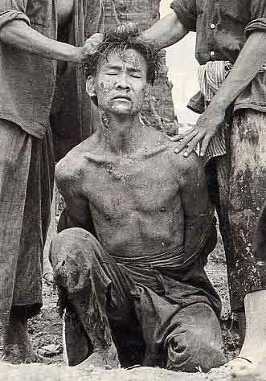
Conversion Disorder
Report the existence of severe physical problems with no biological reason.
Like blindness or paralysis.

Slide 39
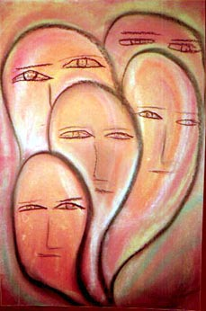
Dissociative Disorders
These disorders involve a disruption in the conscious process.
Three types….

Slide 40
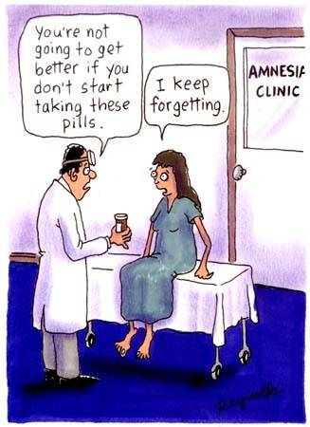
Psychogenic Amnesia
A person cannot remember things with no physiological basis for the disruption in memory.
Retrograde Amnesia
NOT organic amnesia.
Organic amnesia can be retrograde or antro-grade.

Slide 41
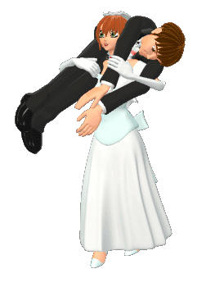
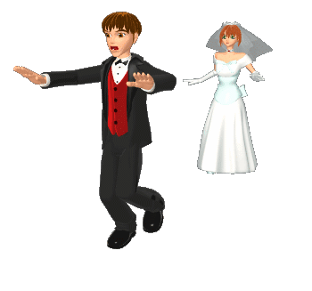
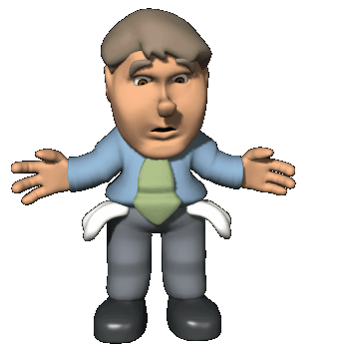
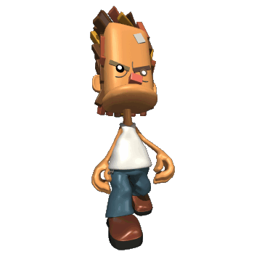
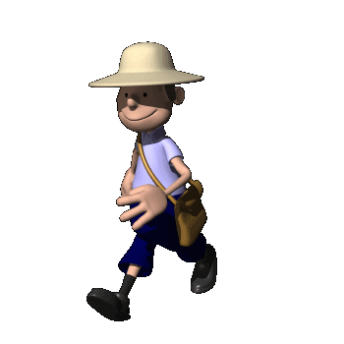
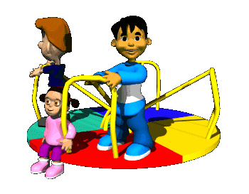
Dissociative Fugue
People with psychogenic amnesia that find themselves in an unfamiliar environment.

Slide 42
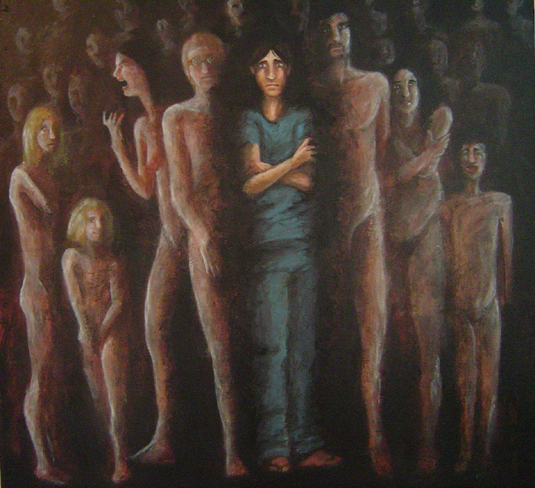
Dissociative Identity Disorder
Used to be known as Multiple Personality Disorder.
A person has several rather than one integrated personality.
People with DID commonly have a history of childhood abuse or trauma.

Slide 43


Mood Disorders
Experience extreme or inappropriate emotion.

Slide 44
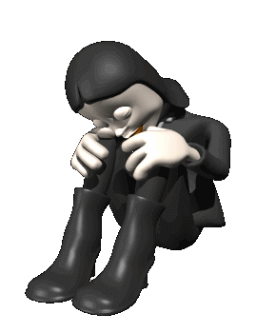
Major Depression
Also called unipolar depression
Unhappy for at least two weeks with no apparent cause.
Depression is the common cold of psychological disorders.

Slide 45
Major Depression
Video 4

Slide 46
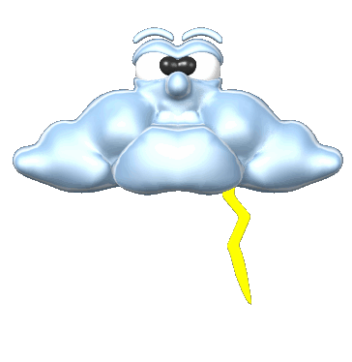
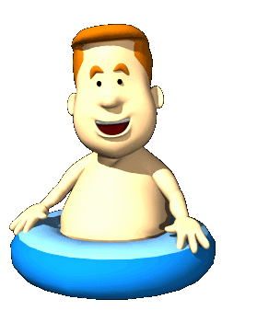

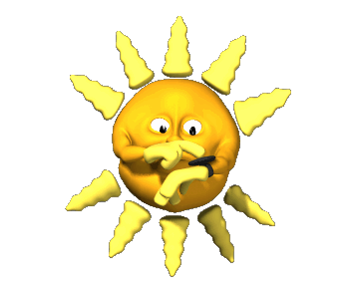
Seasonal Affective Disorder
Experience depression during the winter months.
Based not on temperature, but on amount of sunlight.
Treated with light therapy.

Slide 47
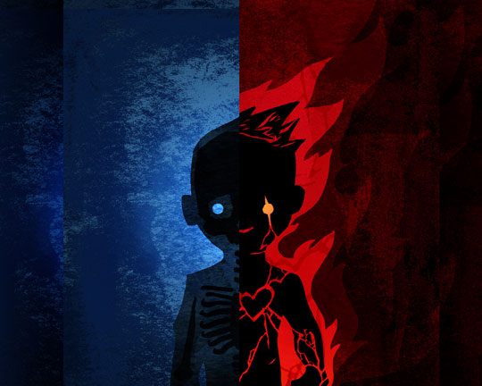
Bipolar Disorder
Formally manic depression.
Involves periods of depression and manic episodes.
Manic episodes involve feelings of high energy (but they tend to differ a lot…some get confident and some get irritable).
Engage in risky behavior during the manic episode.

Slide 48
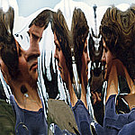
Schizophrenic Disorders
About 1 in every 100 people are diagnosed with schizophrenia.
Symptoms of Schizophrenia
    Disorganized thinking.
    Disturbed Perceptions
    Inappropriate Emotions and Actions

Slide 49
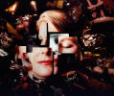
Disorganized Thinking
The thinking of a person with Schizophrenia is fragmented and bizarre and distorted with false beliefs.
Disorganized thinking comes from a breakdown in selective attention.- they cannot filter out information.

Slide 50
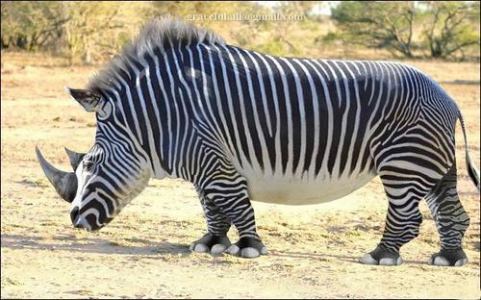
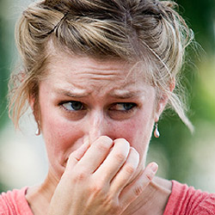
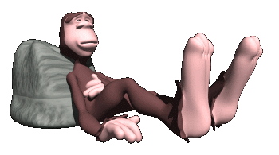
Disturbed Perceptions
hallucinations- sensory experiences without sensory stimulation.

Slide 51
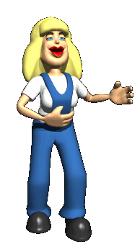
Inappropriate Emotions and Actions
Laugh at inappropriate times.
Flat Effect
Senseless, compulsive acts.
Catatonia- motionless Waxy Flexibility

Slide 52
Schizophrenic Disorder
Video 5

Slide 53
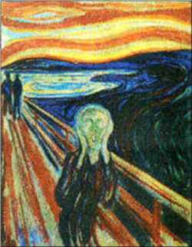
Types of Schizophrenia

Slide 54

Disorganized Schizophrenia
disorganized speech or behavior, or flat or inappropriate emotion.
Clang associations
"Imagine the worst
Systematic, sympathetic
Quite pathetic, apologetic, paramedic
Your heart is prosthetic"

Slide 55


Paranoid Schizophrenia
preoccupation with delusions or hallucinations.
Somebody is out to get me!!!!

Slide 56

Catatonic Schizophrenia
Flat effect
Waxy Flexibility
parrot like repeating of another’s speech and movements

Slide 57

Undifferentiated Schizophrenia
Many and varied Symptoms.

Slide 58

Other Disorders
Paraphilias (pedophilia, zoophilia, hybristophilia)
Fetishism
sadist, masochist
Eating Disorders
Substance use disorders
ADHD

