Slide 1
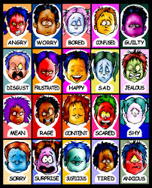
Emotional Intelligence
Presented by
Clinical Psychologist
SADAF SAJJAD

Slide 2
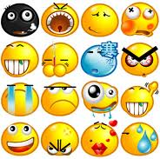
Emotional Intelligence
Emotional intelligence (EI) refers to the ability to perceive, control and evaluate emotions. Some researchers suggest that emotional intelligence can be learned and strengthened, while others claim it is an inborn characteristic.
Emotional intelligence is “something” in each of us that is a bit intangible. It affects how we manage behavior, navigate social complexities, and make personal decisions that achieve positive results.

Slide 3
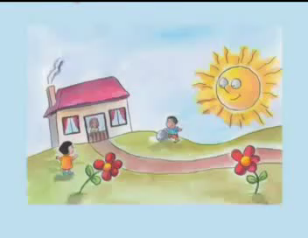
Watch video
Thoughts:
Emotional intelligence (EI) involves thoughts. It is actually the use of love thoughts instead of gouge thoughts when something unexpected and unusual happens.
Video 1

Slide 4


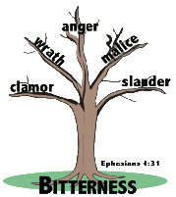
Why Emotional Intelligence?
EQ is the distinguishing factor that determines if we make lemonade when life hands us lemons or spend our life stuck in bitterness

Slide 5

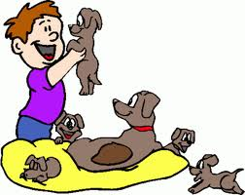
Mental ability model of Emotional Intelligence
Since 1990, Peter Salovey and John D. Mayer have been the leading researchers on emotional intelligence. They proposed a model that identified four different factors of emotional intelligence:
Perceiving Emotions: The first step in understanding emotions is to accurately perceive them. In many cases, this might involve understanding nonverbal signals such as body language and facial expressions.
Reasoning With Emotions: The next step involves using emotions to promote thinking and cognitive activity. Emotions help prioritize what we pay attention and react to; we respond emotionally to things that garner our attention.

Slide 6
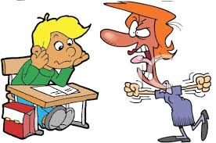

Mental ability model (continued…)
Understanding Emotions: The emotions that we perceive can carry a wide variety of meanings. If someone is expressing angry emotions, the observer must interpret the cause of their anger and what it might mean. For example, if your boss is acting angry, it might mean that he is dissatisfied with your work; or it could be because he got a speeding ticket on his way to work that morning or that he's been fighting with his wife.
Managing Emotions: The ability to manage emotions effectively is a key part of emotional intelligence. Regulating emotions, responding appropriately and responding to the emotions of others are all important aspect of emotional management.

Slide 7
Mental ability model (continued…)
According to Salovey and Mayer, the four branches of their model are, "arranged from more basic psychological processes to higher, more psychologically integrated processes. For example, the lowest level branch concerns the (relatively) simple abilities of perceiving and expressing emotion. In contrast, the highest level branch concerns the conscious, reflective regulation of emotion" (1997).
Managing
Emotions
Understanding emotions

Slide 8
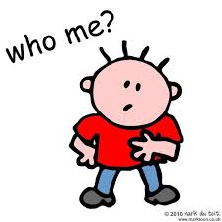
Bar-On model of Emotional Intelligence
According to the Bar-On model, emotional-social intelligence is a cross-section of interrelated emotional and social competencies, skills and facilitators that determine how well we understand and express ourselves, understand others and relate with them, and cope with daily demands, challenges and pressures. Bar-On model looks at five core factors:
Intrapersonal relates to self-awareness and self-expression, governing our ability to be aware of our emotions and ourselves in general, to understand our strengths and weaknesses, and to express our feelings and ourselves non-destructively. It consists of sub factors including self-regard, emotional self-awareness, assertiveness, independence and self-actualisation.
Interpersonal relates to our ability to be aware of others’ feelings, concerns and needs, and to be able to establish and maintain cooperative, constructive and mutually satisfying relationships. It consists of sub factors including empathy, social responsibility and interpersonal relationships.

Slide 9
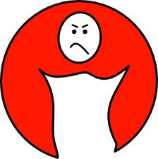

Bar-On model of Emotional Intelligence (continued…)
Stress Management relates to emotional management and controlling our ability to deal with emotions so that they work for us and not against us. It consists of sub factors including stress, tolerance, and impulse control.
Adaptability relates primarily to change management i.e., how we cope with and adapt to personal and interpersonal change as well as change in our immediate environment. It consists of sub factors including reality testing, flexibility, and problem solving.
General Mood relates to our level of self-motivation. It consists of sub factors including optimism and happiness.

Slide 10
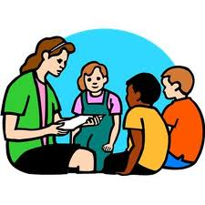
Goleman model of Emotional Intelligence
Goleman’s later writings in the field of Social and Emotional Intelligence have seen him rename the five original competencies, and collapse them into four:
Self-Awareness - emotional self-awareness, accurate self-assessment, self-confidence.
Social Awareness - empathy, organizational awareness, service orientation.
Self-Management - self-control, trustworthiness, conscientiousness, adaptability, achievement orientation, initiative.
Social Skills - developing others, leadership, influence, communication, change catalyst, conflict management, building bonds, teamwork.

Slide 11

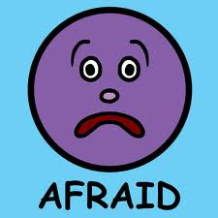
Four Skills of Emotional Intelligence
Emotional intelligence is made up of four core skills that pair up under two primary competencies: personal competence and social competence
Personal competence is made up of your self-awareness and self-management skills, which focus more on you individually than on your interactions with other people. Personal competence is your ability to stay aware of your emotions and manage your behavior and tendencies.
  Self-Awareness is your ability to accurately perceive your emotions and stay aware of them as they happen.
  Self-Management is your ability to use awareness of your emotions to stay flexible and positively direct your behavior.

Slide 12

Four Skills of Emotional Intelligence (continued…)
Social competence is made up of your social awareness and relationship management skills; social competence is your ability to understand other people’s moods, behavior, and motives in order to improve the quality of your relationships.
  Social Awareness is your ability to accurately pick up on emotions in other people and understand what is really going on.
  Relationship Management is your ability to use awareness of your emotions and the others’ emotions to manage interactions successfully.

Slide 13
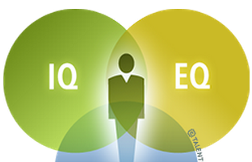
Emotional Intelligence, IQ Are Different
Emotional intelligence taps into a fundamental element of human behavior that is distinct from your intellect. There is no known connection between IQ and emotional intelligence; you simply can’t predict emotional intelligence based on how smart someone is. Intelligence is your ability to learn, and it’s the same at age 15 as it is at age 50.
Emotional intelligence, on the other hand, is a flexible set of skills that can be acquired and improved with practice. Although some people are naturally more emotionally intelligent than others, you can develop high emotional intelligence even if you aren’t born with it.

Slide 14
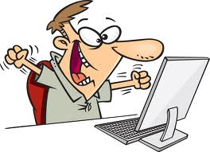
Emotional Intelligence Is Linked to Performance
How much of an impact does emotional intelligence have on your professional success? The short answer is: a lot! It’s a powerful way to focus your energy in one direction with a tremendous result.
Emotional intelligence is the foundation for a host of critical skills—it impacts most everything you say and do each day. Emotional intelligence is the single biggest predictor of performance in the workplace and the strongest driver of leadership and personal excellence.

Slide 15
Emotions
(encountering feelings)
Interpretation
Thought
belief
What really
happens….
Event
Reaction
Behavior
Communication

Slide 16
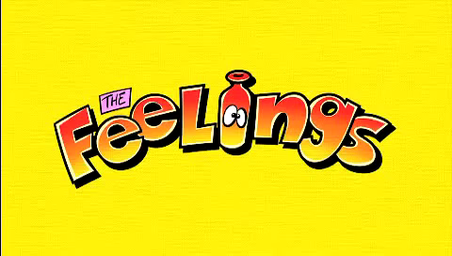
Feelings that affect our working environment
Video 2

Slide 17
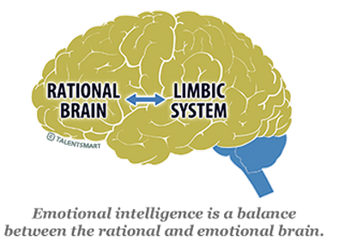
Emotional Intelligence Can Be Developed
The communication between your emotional and rational “brain” is the physical source of emotional intelligence. The pathway for emotional intelligence starts in the brain, at the spinal cord. Your primary senses enter here and must travel to the front of your brain before you can think rationally about your experience.
However, first they travel through the limbic system, the place where emotions are generated. So, we have an emotional reaction to events before our rational mind is able to engage. Emotional intelligence requires effective communication between the rational and emotional centers of the brain.

Slide 18
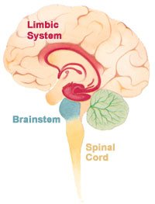
Emotional Intelligence Can Be Developed (continued…)
Plasticity” is the term neurologists use to describe the brain’s ability to change. Your brain grows new connections as you learn new skills. The change is gradual, as your brain cells develop new connections to speed the efficiency of new skills acquired.
Using strategies to increase your emotional intelligence allows the billions of microscopic neurons lining the road between the rational and emotional centers of your brain to branch off small “arms” (much like a tree) to reach out to the other cells.
A single cell can grow 15,000 connections with its neighbors. This chain reaction of growth ensures it’s easier to kick this new behavior into action in the future. Once you train your brain by repeatedly using new emotional intelligence strategies, emotionally intelligent behaviors become habits.

Slide 19
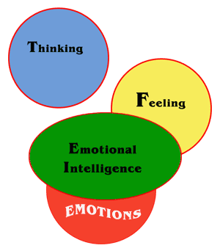
Emotional Intelligence Can Be Developed (continued…)
Developing emotional intelligence through five key skills:
Emotional intelligence (EQ) skill 1: The ability to quickly reduce stress.
Emotional intelligence (EQ) skill 2: The ability to recognize and manage your emotions.
Emotional intelligence (EQ) skill 3: The ability to connect with others using nonverbal communication.
Emotional intelligence (EQ) skill 4: The ability to use humor and play to deal with challenges.
Emotional intelligence (EQ) skill 5: The ability to resolve conflicts positively and with confidence.

Slide 20

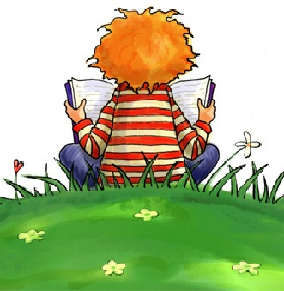
Emotional intelligence (EQ) skill 1: The ability to quickly reduce stress
Develop your stress busting skills by working through the following three steps:
Realize when you’re stressed: The first step to reducing stress is recognizing what stress feels like. How does your body feel when you’re stressed? Are your muscles or stomach tight or sore? Are your hands clenched? Is your breath shallow? Being aware of your physical response to stress will help regulate tension when it occurs.
Identify your stress response: Everyone reacts differently to stress. If you tend to become angry or agitated under stress, you will respond best to stress relief activities that quiet you down. If you tend to become depressed or withdrawn, you will respond best to stress relief activities that are stimulating. If you tend to freeze—speeding up in some ways while slowing down in others—you need stress relief activities that provide both comfort and stimulation.

Slide 21
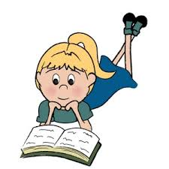
Emotional intelligence (EQ) skill 1: The ability to quickly reduce stress (continued…)
Discover the stress-busting techniques that work for you: The best way to reduce stress quickly is by engaging one or more of your senses: sight, sound, smell, taste, and touch. Each person responds differently to sensory input, so you need to find things that are soothing and/or energizing to you.
For example, if you’re a visual person you can relieve stress by surrounding yourself with uplifting images. If you respond more to sound, you may find a wind chime, a favorite piece of music, or the sound of a water fountain helps to quickly reduce your stress levels.

Slide 22
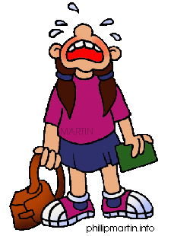
Emotional intelligence (EQ) skill 2: The ability to recognize and manage your emotions
Many people are disconnected from their emotions–especially strong core emotions such as anger, sadness, fear, and joy. This may be the result of negative childhood experiences that taught you to try to shut off your feelings. Unfortunately, without emotional awareness, we are unable to fully understand our own motivations and needs, or to communicate effectively with others.
What kind of a relationship do you have with your emotions?
  Do you experience feelings that flow, encountering one emotion after another as your experiences change from moment to moment?
  Are your emotions accompanied by physical sensations that you experience in places like your stomach or chest?
  Do you experience discrete feelings and emotions, such as anger, sadness, fear, joy, each of which is evident in subtle facial expressions?
  Can you experience intense feelings that are strong enough to capture both your attention and that of others?
  Do you pay attention to your emotions? Do they factor into your decision making?

Slide 23
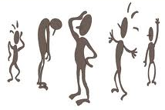
Emotional intelligence (EQ) skill 3: The ability to connect with others using nonverbal communication
Being a good communicator requires more than just verbal skills. Successful nonverbal communication depends on your ability to manage stress, recognize your own emotions, and understand the signals you’re sending and receiving. When communicating:
  Focus on the other person: If you are planning what you’re going to say next, daydreaming, or thinking about something else, you are almost certain to miss nonverbal cues and other subtleties in the conversation.
  Make eye contact: Eye contact can communicate interest, maintain the flow of a conversation, and help gauge the other person’s response.
  Pay attention to nonverbal cues you’re sending and receiving, such as facial expression, tone of voice, posture and gestures, touch, and the timing and pace of the conversation.

Slide 24

Emotional intelligence (EQ) skill 4: The ability to use humor and play to deal with challenges
Humor, laughter, and play are natural antidotes to life’s difficulties. They lighten your burdens and help you keep things in perspective. Playful communication broadens your emotional intelligence and helps you:
  Take hardships in stride: By allowing you to view your frustrations and disappointments from new perspectives, laughter and play enable you to survive annoyances, hard times, and setbacks.
  Smooth over differences: Using gentle humor often helps you say things that might be otherwise difficult to express without creating a flap.
  Simultaneously relax and energize yourself: Playful communication relieves fatigue and relaxes your body, which allows you to recharge and accomplish more.
  Become more creative: When you loosen up, you free yourself of rigid ways of thinking and being, allowing you to get creative and see things in new ways.

Slide 25
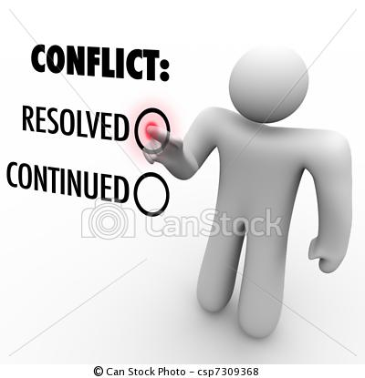
Emotional intelligence (EQ) skill 5: The ability to resolve conflicts positively and with confidence
Resolving conflict in healthy, constructive ways can strengthen trust between people. When conflict isn’t perceived as threatening or punishing, it fosters freedom, creativity, and safety in relationships.
  Stay focused in the present: When you are not holding on to old hurts and resentments, you can recognize the reality of a current situation and view it as a new opportunity for resolving old feelings about conflicts.
  Choose your arguments: Arguments take time and energy, especially if you want to resolve them in a positive way. Consider what is worth arguing about and what is not.
  Forgive: Other people’s hurtful behavior is in the past. To resolve conflict, you need to give up the urge to punish or seek revenge.
  End conflicts that can't be resolved: It takes two people to keep an argument going. You can choose to disengage from a conflict, even if you still disagree.

Slide 26

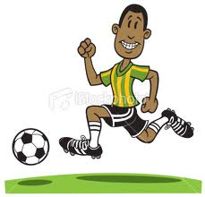
Effects of Emotional intelligence
Emotional intelligence affects:
Your performance at work: Emotional intelligence can help you navigate the social complexities of the workplace, lead and motivate others, and excel in your career. In fact, when it comes to gauging job candidates, many companies now view emotional intelligence as being as important as technical ability and require EQ testing before hiring.
Your physical health: If you’re unable to manage your stress levels, it can lead to serious health problems. Uncontrolled stress can raise blood pressure, suppress the immune system, increase the risk of heart attack and stroke, contribute to infertility, and speed up the aging process. The first step to improving emotional intelligence is to learn how to relieve stress.

Slide 27
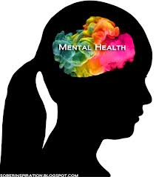
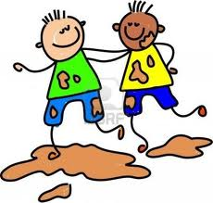
Effects of Emotional intelligence (continued…)
Emotional intelligence affects:
Your mental health: Uncontrolled stress can also impact your mental health, making you vulnerable to anxiety and depression. If you are unable to understand and manage your emotions, you’ll also be open to mood swings, while an inability to form strong relationships can leave you feeling lonely and isolated.
Your relationships: By understanding your emotions and how to control them, you’re better able to express how you feel and understand how others are feeling. This allows you to communicate more effectively and forge stronger relationships, both at work and in your personal life.

Slide 28

How can one improve emotional intelligence?elligence?
Pay attention to self and other’s body language
Listen more; speak less- develops empathy
Get curious, not furious- Watch what you say especially when frustrated or annoyed. Reframe negative emotions into curiosity - " ... this makes absolutely no sense to me" can be replaced with, "Do you see something in this that I must be missing”
Elicit pride in others – Reason for working together
Remember that emotions are contagious - A dominant person's emotions (negative or positive) always influences others. Leaders should be careful to show only those emotions, which they want to see in others

Slide 29


Characteristics of a High EQ Person
A time to wait and a time to watch
A time to be aggressive and a time to be passive
A time to be together and a time to be alone
A time to fight and a time to love
A time to work and a time to play
A time to cry and a time to laugh
A time to confront and a time to withdraw
A time to speak and a time to be silent
A time to be patient and a time to decide

Slide 30
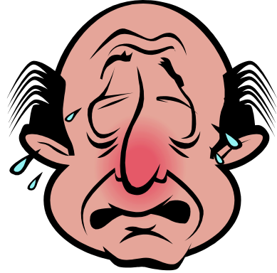
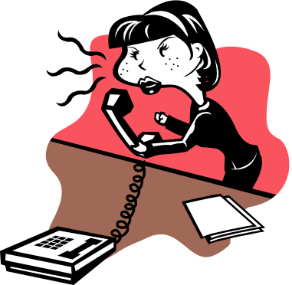
Characteristics of a low EQ personerson
“If only I had a different job … …”
“If only I had finished graduation … …”
“If only I had been handsome/beautiful …”
“If only my spouse had stopped drinking …”
“If only I had been born rich and famous…”
“If only I had good contacts…”
“If only I had better friends …”
“If only I had married someone else …”

Slide 31

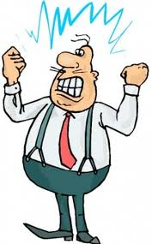
Measuring emotional intelligence
There are two types of generally valid tests for the measure of emotional intelligence:
Specific ability tests measure a key specific ability related to emotional intelligence such as the capacity to accurately identify emotion in faces.
General integrative tests measure across a number of specific emotional intelligence skills to provide an overall picture of an individual's emotional intelligence.
Emotional Intelligence, or EI, describes an ability or capacity to perceive, assess, and manage the emotions of one's self, and of others. EQ, or Emotional Quotient, is how one measures Emotional Intelligence.

Slide 32
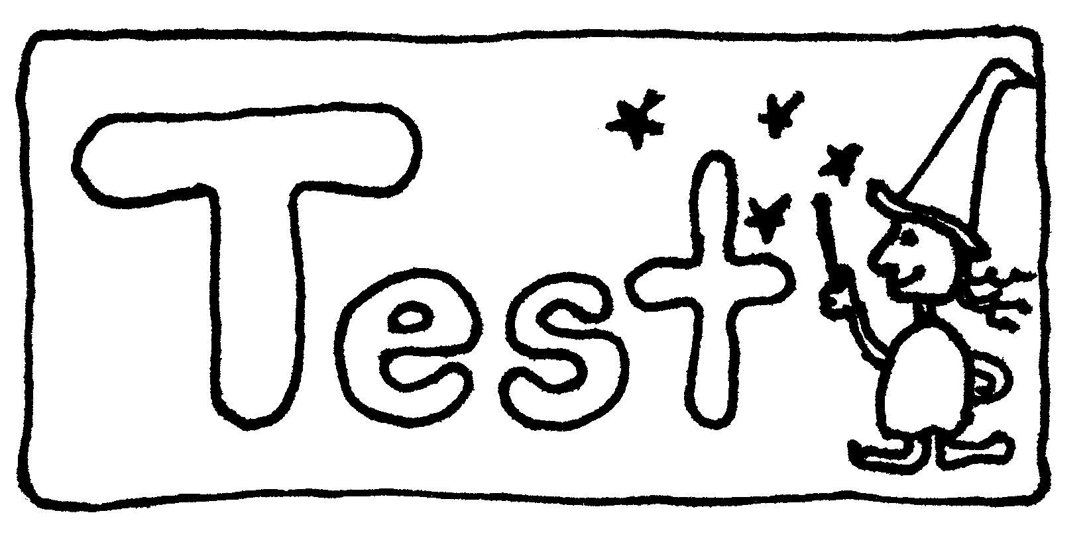
Emotional intelligence Scales
Bar-On's EQ scale: A self-report test designed to measure competencies including awareness, stress tolerance, problem solving, and happiness. According to Bar-On, “Emotional intelligence is an array of non-cognitive capabilities, competencies, and skills that influence one’s ability to succeed in coping with environmental demands and pressures.”
Multifactor Emotional Intelligence Scale (MEIS): An ability-based test in which test-takers perform tasks designed to assess their ability to perceive, identify, understand, and utilize emotions.

Slide 33
Emotional intelligence Scales (continued…)
Emotional Competence Inventory (ECI): ECI involves having people who know the individual offer ratings of that person’s abilities on a number of different emotional competencies.

Slide 34
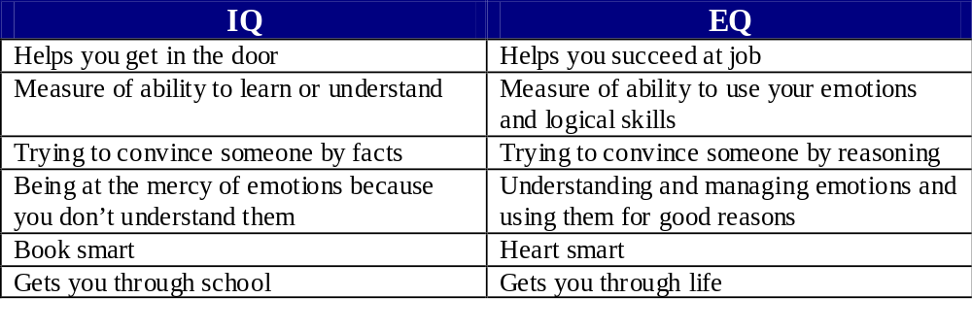
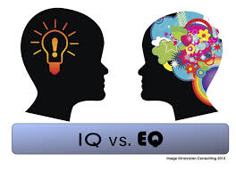
Difference between EQ and IQ

Slide 35
GETS YOU
GETS YOU
HIRED
FIRED/PROMOTED
THE PROFESSIONAL SUCCESS

Slide 36
The HEAD
The HEART
IQ
EQ
THE PERSONALITY

Slide 37
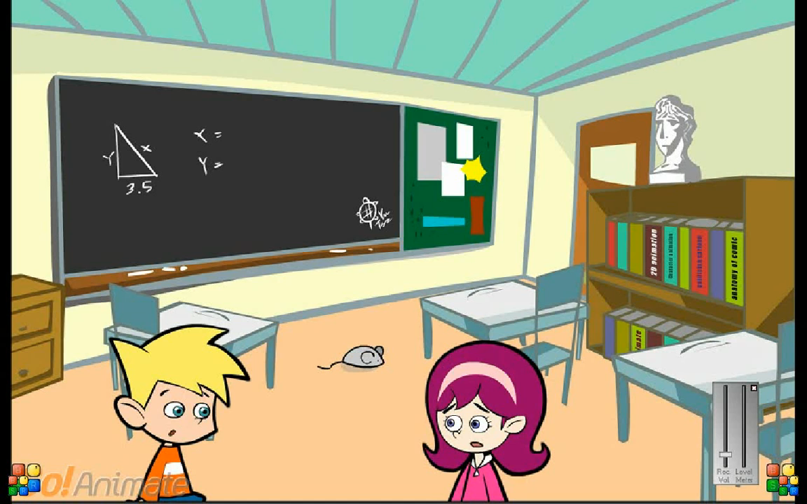
Watch video on difference between EQ and IQ
Video 3

