Slide 1

Research methods in psychology
Presented by
Clinical psychologist
sadaf sajjad

Slide 2

What is research?
Research means
“Collecting information about a particular subject or to investigate “
It’s not just a trip to the library to pick up a stack of books, or picking the first five hits from a computer search. It is the hunt for truth.

Slide 3
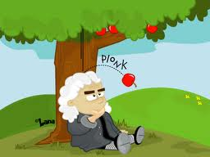

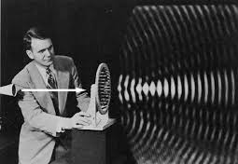
Research is about answering questions
Our mind asks questions and to answer this we do research to satisfy ourselves.
Where these questions come from?
  Personal experiences
  e-g Newton’s experience
  Curiosity to know something
    e.g Galileo’s observational astronomy
  Studying previous research
    e.g Sound generation

Slide 4

Psychological research
Psychological research refers to research conducted by psychologists. Psychologists employ a wide range of methods in order to research and analyze the experiences' and behaviour of individuals or groups.

Slide 5
Research methods in psychology
Descriptive research
Simply gathers information and gives detailed description
Experimental research
Investigates specific variables (attributes)
Correlational research

Slide 6
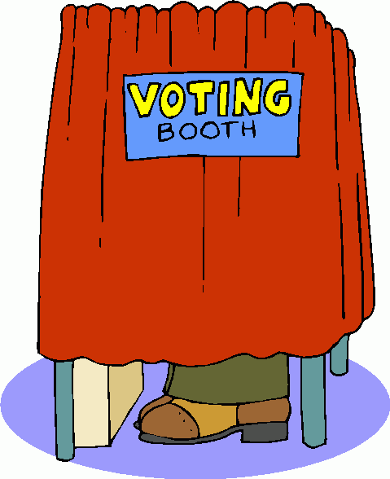
DESCRIPTIVE RESEARCH
  Descriptive research methods describe situations. This type describes data and characteristics of a particular phenomenon being studied.
  The data description is factual, accurate and systematic but the research cannot describe what caused a situation.
  The description is used for frequencies, averages and other statistical calculations.
  The goal is to portray what already exists in a group.
  For-example:
  An opinion poll to find which political candidate
  people plan to vote for in an upcoming election.

Slide 7
TYPES OF DESCRIPTIVE RESEARCH
4
  There are four types of descriptive research methods in psychology:
    Naturalistic observation
    Laboratory observation
    Case studies
    Surveys and interview

Slide 8
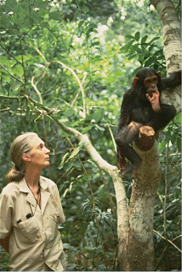
NATURALISTIC OBSERVATION
1
  A Research tool in which the subject is observed in its natural habitat without any manipulation by the observer.
  During naturalistic observation researchers take great care to avoid interfering with the behavior they are observing.
  This is a great way to study behavior in "real settings" and to see behavior occur in its most natural state.

Slide 9
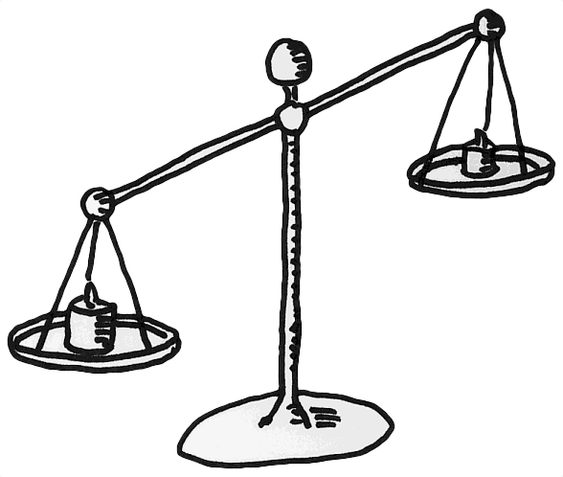
NATURALISTIC OBSERVATION (continued…)
1
  Advantages:
    Realistic view of how behavior occurs
    Observer effect
  Disadvantages:
    Observer bias
    Each naturalistic setting is unique

Slide 10

laboratory OBSERVATION
2
  A Research tool that includes observing the individual (s) in a laboratory setting, paying close attention to his/her reaction or behavior. Which is not as good as observing them in their natural environment.
  This method allows more “control” than that of a naturalistic observation but limits reality.

Slide 11

laboratory OBSERVATION (continued…)
2
  Advantages:
    The researcher has some degree of control i-e manageable
  Disadvantages:
    Artificial setting may result in artificial behavior
    Biased and not conclusive as to cause and effect
    Observer has the option of being non-participant and the study itself may be structured

Slide 12
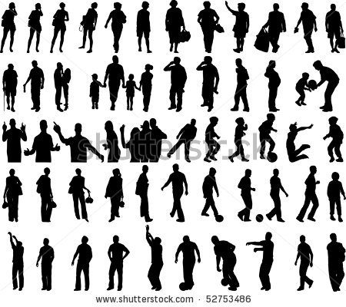
CASE STUDIES
3
    Case studies are in-depth investigation of a single person, group, event or community.
    The information is gathered by interacting with the information source involving observation, conversation or psychological testing to provide a description of behavior.
    It involves simply observing what happens to, or reconstructing “the case history” of a single participant or group of individuals.

Slide 13

CASE STUDIES (continued…)
3
  Advantages:
    Amount of detail it provides
    The only way to get certain kind of information
    Study things that are rare
  Disadvantages:
    Observer bias
    Don't know if the cases studied generalize to larger population
    May not be representative of condition, event; subject to misinterpretation by experimenter

Slide 14

Survey and interview
4
  Interview:
  Interview is a conversation with a purpose. The interviewer in one-to-one conversation collects detailed personal information from individuals using oral questions.
  Usually face to face
  Can use different types of questions, from highly structured (surveys) to unstructured, participant-led (e.g. therapy sessions)
  Most are semi-structured, i.e. some questions are prepared in advance, but these are flexible and can be adapted to follow areas of interest

Slide 15
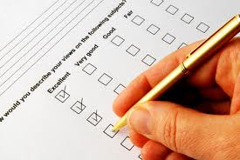
Survey and interview
4
  Survey:
  A Research tool that uses interviews and/or questionnaires to gather information about aptitudes, beliefs, experiences or behaviors of a large group.
  A survey may focus on factual information about individuals, or it might aim to collect the “opinions” of the survey takers.

Slide 16
Survey and interview (continued…)
4
In this method the research extracts a sample (representative/small group) out of a population to conduct a survey because too large population can not be studied.
Population of the study
The entire group of interest to researcher and to which they wish to generalize findings; a group from which a sample is chosen
The portion of the population selected for study and from which generalizations are made about the population
Sample of the study

Slide 17
Survey and ineterview (continued…)
4
  Advantages:
    Private information
    Amount of data from large group of people
  Disadvantages:
    Representative sample out of a population
    Courtesy bias
    Misremember things
    Distort truth
Population
Sample

Slide 18
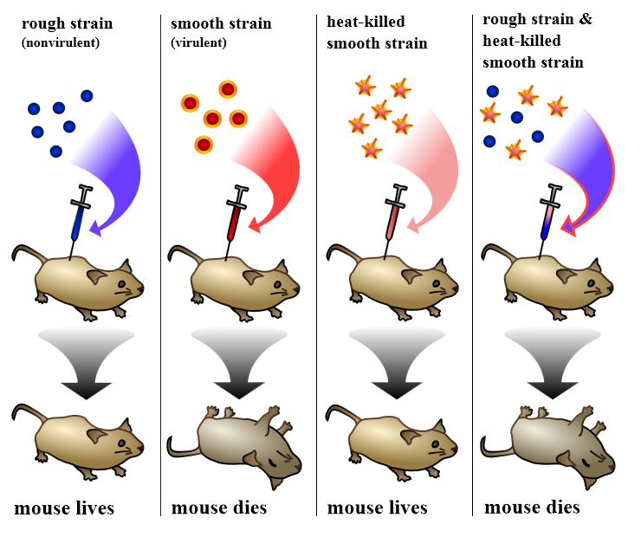
EXPERIMENTAL RESEARCH
An experiment is a study of cause and effect. It differs from non-experimental methods in that it involves the deliberate manipulation of one variable, while trying to keep all other variables constant.
What is a variable actually?
A variable is something that can be changed, such as a characteristic or value. Variables are generally used in psychology experiments to determine if changes to one thing result in changes to another.

Slide 19
EXPERIMENTAL METHOD (continued…)
Types of variables in experimental method:
Causes change
Independent variable
Dependent variable
It is the input variable that is controlled and manipulated by the experimenter to cause change in dependent variable.
It is the output variable that is measured by the experimenter. It tells about the effect produced by independent variable on it.
Cause and Effect Relationship

Slide 20

EXPERIMENTAL METHOD (continued…)
Experimental group:
In an experiment, there is a group of participants that is exposed to the independent variable or treatment to find the output variable.
For-example
We want to investigate which method is more successful at teaching children to read. The teaching method is the independent variable. The children's reading ability depends on the teaching method used that is the dependent variable.

Slide 21
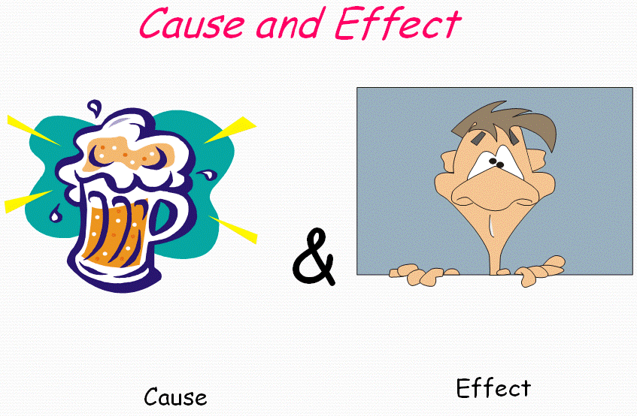
EXPERIMENTAL METHOD (continued…)
  Advantages:
    Experiments are the only means by which cause and effect can be established.
    It allows for precise control of variables.
    Experiments can be replicated
  Disadvantages:
    Experimenter effect
    Artificiality
    Known response from the participant

Slide 22

CORRELATIONAL RESEARCH
  A Research tool that finds a relationship between two variables that are to be studied. It gives an indication of how one variable may predict another.
  It finds the ”strength of relationship” between two variables.
  For-example:
  Self esteem Vs Loneliness
  Are you lonely because you have a low self-esteem?
  OR
  You have low self-esteem because you are alone?

Slide 23
Types of CORRELATION
3
  There are three types of descriptive research methods in psychology:
    Positive correlation
    Negative correlation
    No correlation

Slide 24
Positive correlation
1
  In this correlation both variables increase or decrease at the same time.
  For-example:
OR
More studying
hours
More Grade Point
Average (GPA)
Less studying
hours
Less Grade Point
Average (GPA)

Slide 25
NEGATIVE correlation
2
  In this correlation the amount of one variable increases and the other decreases.
  For-example:
OR
More playing
hours
Less Grade Point
Average (GPA)
Less playing
hours
More Grade Point
Average (GPA)

Slide 26
No correlation
3
  In this correlation Indicates no relationship between the two variables.
  For-example:
NO Change
Size of video
game player
Grade Point
Average (GPA)

Slide 27

Correlation (CONTINUED…)
  Advantages:
    Calculating the strength of a relationship.
    Useful as a pointer for further, more detailed research i-e “Predictor”
  Disadvantages:
    Cannot assume cause and effect, strong correlation between variables may be misleading.
    Lack of correlation may not mean there is no relationship, it could be non-linear.

Slide 28
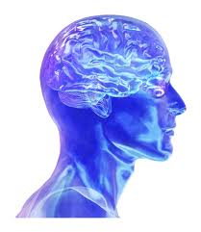
HISTORY OF PSYCHOLOGY

Slide 29

Life before psychology
Philosophy asks questions about the mind:
Does perception accurately reflect reality?
How is sensation turned into perception?
René Descartes (1596-1650)
Problem - No “scientific” way of studying problems

Slide 30
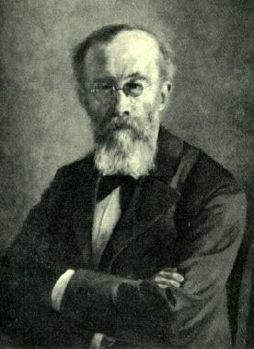
Psychology is born
First Experimental Psych Lab (1879)
Focuses on the scientific study of the mind. It was focused that Psych methods were as rigorous as the methods of chemistry & physics.
Wilhelm Wundt (1832-1920)
The beginning - Physiologist & Perceptual Psychologist
Founder of Psychology as a Science

Slide 31
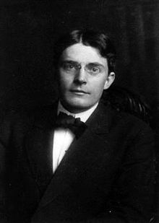
Behaviorism
Scientific Psychology should focus on observable behavior.
He argued that Mental Processes cannot be studied directly.
John Watson (1878-1958)
Observation- Founder of Behaviorism

Slide 32
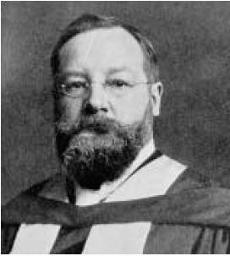
Understanding mental processes
Student of Wilhelm Wundt
Focused on mental processes and analyzed the intensity, clarity and quality of parts of consciousness.
He did “Introspection” i-e the examination of his own conscious thoughts and feelings to observe mental state.
Edward Titchner (1867-1927)
Introspection- Founder of structuralism

Slide 33
structuralism
Structuralism defines the question of what each element of the mind is. He concluded from his research that there were three types of mental elements constituting conscious experience:
  Sensations (elements of perceptions)
  Images (elements of ideas)
  Affections (elements of emotions)
These elements could be broken down into their respective properties, which he determined were quality, intensity, duration, clearness, and extensity.
Hence,
  He studied the basic elements of thoughts and sensations
  Focused on basic sensory and perceptual processes
  Measured reaction times
Sensation
Images
Emotions

Slide 34
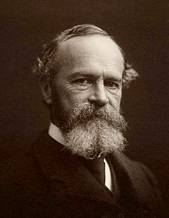
Understanding FUNCTIONALITY
Investigated the function, or purpose of consciousness rather than its structure called “Functionalism”.
Leaned applied work (natural surroundings)
Psychology is the study of mental activity (e.g. perception, memory, imagination, feeling, judgment). Mental activity is to be evaluated in terms of how it serves the organism in adapting to its environment.
William James (1842-1910)
Purpose of consciousness- Founder of Functionalism

Slide 35
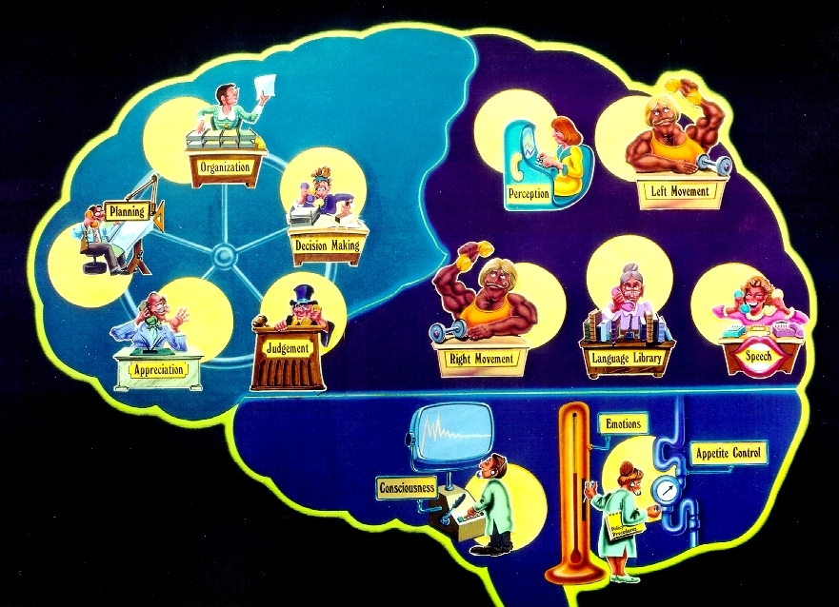

Difference between structuralism and functionalism
Structuralism:
Basic parts of a person’s thoughts and feelings. Focus on basic senses & perception.
Functionalism:
How our consciousness helps us to function or adapt to our environment.

Slide 36

Gestalt Psychology
“The whole is different than the sum of its parts.”
It states:
Gestalt means "organized whole". It means that the eye merely takes in all the visual stimuli and the brain arranges the sensations into a coherent image. It states that whatever we see is in the form of groups as we do not look at each individual part of the image.
For-example:
Describing a tree - it's parts are trunk, branches, leaves, perhaps blossoms or fruit.
But when you look at an entire tree, you are not conscious of the parts, you are aware of the overall object - the tree.

Slide 37
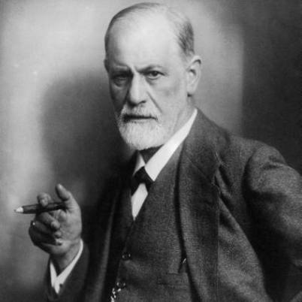
Psychoanalytical perspective
Believed that abnormal behavior originated from unconscious drives and conflicts.
Thoughts, memories & desires exist below conscious awareness and exert an influence on our behavior.
Sigmund Freud (1856-1939)
Unconsciousness- Founder of Psychoanalytical perspective
Psychoanalytic Theory attempts to explain personality, mental disorders & motivation in terms of unconscious determinants of behavior.

Slide 38

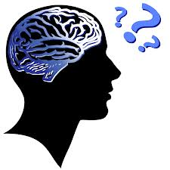

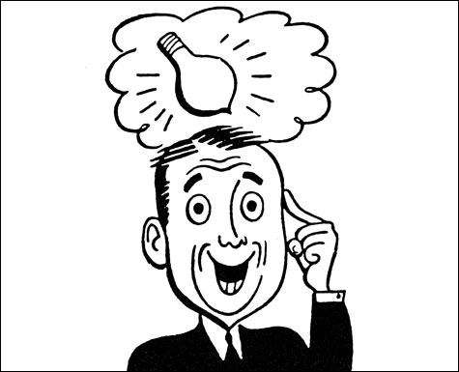
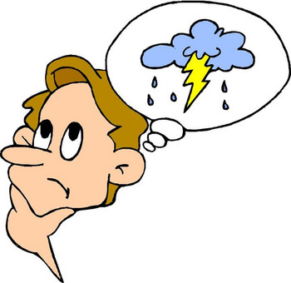
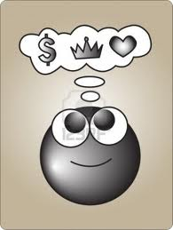

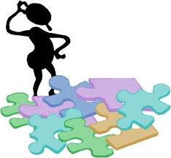
cognitive Psychology
It states:
The mental processes involved in acquiring, processing,
storing & using information
It is the study of how people perceive, remember, think, speak, and solve problems.
It explicitly acknowledges the existence of internal mental states (such as belief, desire, idea, knowledge and motivation).
Cognitive psychology

Slide 39

Sociocultural Psychology
Examines how cultural and political (religious) experience effect our everyday life.
  It studies how norms and social influences affect behavior.
  Ambition/Goals/Values: Environments influence on one’s long-term ambitions.

Slide 40
Watch video on History of Psychology
History

Slide 41
THANK YOU

