Slide 1

Intelligence and assessment of intelligence
Presented by
Clinical Psychologist
SADAF SAJJAD

Slide 2
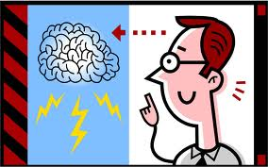
Intelligence
A very general mental capability that involves the ability to reason, plan, solve problems, think abstractly, comprehend complex ideas, learn quickly and learn from experience.
It is not merely book learning, a narrow academic skill, or test-taking smarts. Rather, it reflects a broader and deeper capability for comprehending our surroundings—"catching on," "making sense" of things, or "figuring out" what to do

Slide 3

Example of intelligence
Video 3

Slide 4
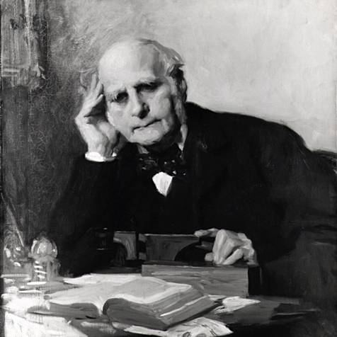
Origin of intelligence
Sir Francis Galton is the father of "intellectual measurement“
He made the first attempt to develop measures that would reflect a person's intelligence. Believing that intelligence was mainly a matter of having the right genes, Galton reasoned that superior intelligence would be a reflection of superior physical development of brain and body; if so, then simple physical measures might provide a reliable index of intellectual prowess.
To investigate this possibility, he set about measuring a variety of physical variables, such as reaction time and grip strength, and looked for a correlation between these measures and measures of success in endeavors thought to reflect intellectual ability, such as one's class rank in school or one's occupational level.

Slide 5

Intelligence in many ways:
Intelligence has been defined in many different ways including, but not limited to:
Abstract thought: Abstraction is a process by which concepts are derived from the usage and classification of literal ("real" or "concrete") concepts, first principles, or other methods. Abstractions may be formed by reducing the information content of a concept or an observable phenomenon, typically to retain only information which is relevant for a particular purpose.
For example, abstracting a leather soccer ball to the more general idea of a ball retains only the information on general ball attributes and behavior, eliminating the other characteristics of that particular ball.

Slide 6
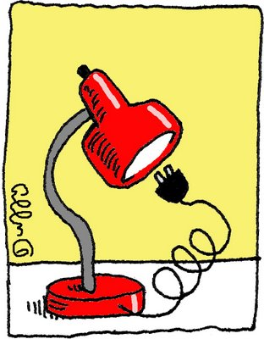
Intelligence in many ways (continued…)
Understanding: Understanding (also called intellection) is a psychological process related to an abstract or physical object, such as a person, situation, or message whereby one is able to think about it and use concepts to deal adequately with that object.
  Understanding is a relation between the knower and an object of understanding.
  Understanding implies abilities and dispositions with respect to an object of knowledge sufficient to support intelligent behavior.
Self-awareness: Self-awareness is the capacity for introspection and the ability to reconcile oneself as an individual separate from the environment and other individuals.

Slide 7
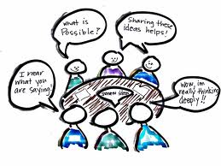
Intelligence in many ways (continued…)
Reasoning: Reason is the capacity for consciously making sense of things, for establishing and verifying facts, and changing or justifying practices, institutions, and beliefs based on new or existing information.
Learning: Learning is acquiring new, or modifying existing, knowledge, behaviors, skills, values, or preferences and may involve synthesizing different types of information. The ability to learn is possessed by humans, animals and some machines.
Emotional intelligence: Emotional intelligence (EI) is the ability to identify, assess, and control the emotions of oneself, of others, and of groups.

Slide 8
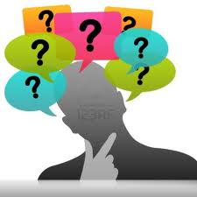
Intelligence in many ways (continued…)
Retaining: Retaining is the process by which information is encoded, stored, and retrieved.
Plan: A plan is typically any diagram or list of steps with timing and resources, used to achieve an objective.
Problem-solving: It is a mental process in psychology and a computerized process in computer science. Problems can also be classified into two different types (ill-defined and well-defined) from which appropriate solutions are to be made.
  Ill-defined problems are those that do not have clear goals or solution paths
  Well-defined problems have specific goals and clearly defined solution paths.
Communication: Communication is the activity of conveying information through the exchange of thoughts, messages, or information, as by speech, visuals, signals, writing, or behavior.

Slide 9
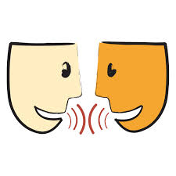
Communication and intelligence (continued…)
Effective communication occurs only if the receiver understands the exact information or idea that the sender intended to transmit. Many of the problems that occur in an organization are the either the direct result of people failing to communicate and/or processes, which leads to confusion and can cause good plans to fail.
The communication process:
Thought: First, information exists in the mind of the sender. This can be a concept, idea, information, or feelings.
Encoding: Next, a message is sent to a receiver in words or other symbols.
Decoding: Lastly, the receiver translates the words or symbols into a concept or information that he or she can understand.

Slide 10
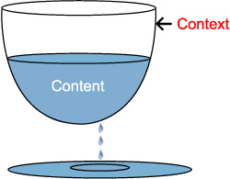
Communication and intelligence (continued…)
During the transmitting of the message, two elements will be received: content and context.
Content is the actual words or symbols of the message that is known as language — the spoken and written words combined into phrases that make grammatical and semantic sense. We all use and interpret the meanings of words differently, so even simple messages can be misunderstood. And many words have different meanings to confuse the issue even more.
Context is the way the message is delivered and is known as paralanguage — it is the nonverbal elements in speech such as the tone of voice, the look in the sender's eyes, body language, hand gestures, and state of emotions (anger, fear, uncertainty, confidence, etc.) that can be detected. Although paralanguage or context often cause messages to be misunderstood as we believe what we see more than what we hear; they are powerful communicators that help us to understand each other.

Slide 11

Example of intelligent communication
Video 4

Slide 12
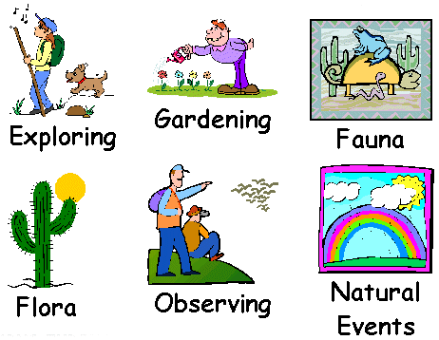
Types of intelligence
Naturalist Intelligence (“Nature Smart”): Designates the human ability to discriminate among living things (plants, animals) as well as sensitivity to other features of the natural world (clouds, rock configurations).
  This ability was clearly of value in our evolutionary past as hunters, gatherers, and farmers; it continues to be central in such roles as botanist or chef.
  It is also speculated that much of our consumer society exploits the naturalist intelligences, which can be mobilized in the discrimination among cars, sneakers, kinds of makeup, and the like.

Slide 13
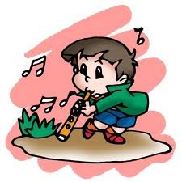
Types of intelligence
Musical Intelligence (“Musical Smart”): Musical intelligence is the capacity to discern pitch, rhythm, timbre, and tone. This intelligence enables us to recognize, create, reproduce, and reflect on music, as demonstrated by composers, conductors, musicians, vocalist, and sensitive listeners.
  Interestingly, there is often an affective connection between music and the emotions; and mathematical and musical intelligences may share common thinking processes.
  Young adults with this kind of intelligence are usually singing or drumming to themselves. They are usually quite aware of sounds others may miss.

Slide 14
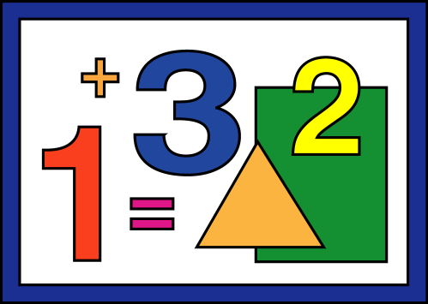
Types of intelligence
Logical-Mathematical Intelligence (Number/Reasoning Smart): Logical-mathematical intelligence is the ability to calculate, quantify, consider propositions and hypotheses, and carry out complete mathematical operations. It enables us to perceive relationships and connections and to use abstract, symbolic thought; sequential reasoning skills; and inductive and deductive thinking patterns.
  Logical intelligence is usually well developed in mathematicians, scientists, and detectives.
  Young adults with lots of logical intelligence are interested in patterns, categories, and relationships. They are drawn to arithmetic problems, strategy games and experiments.

Slide 15
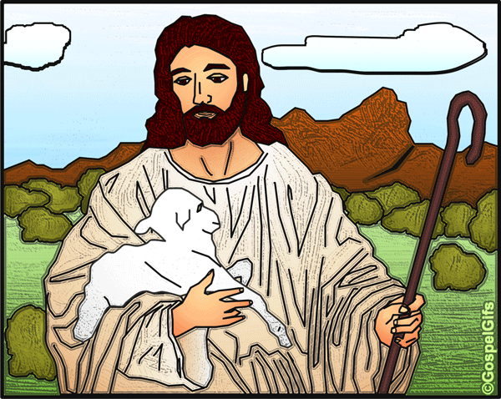

Types of intelligence
Existential Intelligence: Sensitivity and capacity to tackle deep questions about human existence, such as the meaning of life, why do we die, and how did we get here.
Interpersonal Intelligence (People Smart”): Interpersonal intelligence is the ability to understand and interact effectively with others. It involves effective verbal and nonverbal communication, the ability to note distinctions among others, sensitivity to the moods and temperaments of others, and the ability to entertain multiple perspectives.
  Teachers, social workers, actors, and politicians all exhibit interpersonal intelligence.
  Young adults with this kind of intelligence are leaders among their peers, are good at communicating, and seem to understand others’ feelings and motives.

Slide 16

Types of intelligence
Bodily-Kinesthetic Intelligence (“Body Smart”): Bodily kinesthetic intelligence is the capacity to manipulate objects and use a variety of physical skills.
  This intelligence also involves a sense of timing and the perfection of skills through mind–body union.
  Athletes, dancers, surgeons, and craftspeople exhibit well-developed bodily kinesthetic intelligence.

Slide 17
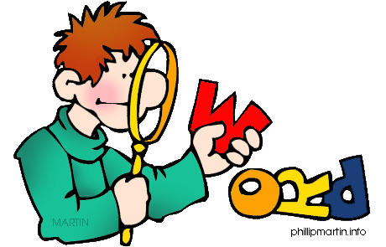
Types of intelligence
Linguistic Intelligence (Word Smart): Linguistic intelligence is the ability to think in words and to use language to express and appreciate complex meanings. Linguistic intelligence allows us to understand the order and meaning of words and to apply meta-linguistic skills to reflect on our use of language.
  Linguistic intelligence is the most widely shared human competence and is evident in poets, novelists, journalists, and effective public speakers.
  Young adults with this kind of intelligence enjoy writing, reading, telling stories or doing crossword puzzles.

Slide 18

Types of intelligence
Intra-personal Intelligence (Self Smart”): Intra-personal intelligence is the capacity to understand oneself and one’s thoughts and feelings, and to use such knowledge in planning and directioning one’s life.
  Intra-personal intelligence involves not only an appreciation of the self, but also of the human condition.
  It is evident in psychologist, spiritual leaders, and philosophers.
  These young adults may be shy. They are very aware of their own feelings and are self-motivated.

Slide 19
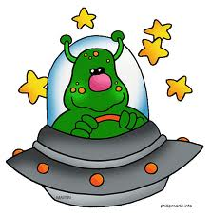
Types of intelligence
Spatial Intelligence (“Picture Smart”): Spatial intelligence is the ability to think in three dimensions. Core capacities include mental imagery, spatial reasoning, image manipulation, graphic and artistic skills, and an active imagination.
  Sailors, pilots, sculptors, painters, and architects all exhibit spatial intelligence.
  Young adults with this kind of intelligence may be fascinated with mazes or jigsaw puzzles, or spend free time drawing or daydreaming.

Slide 20

Watch types of intelligence
Video 2

Slide 21
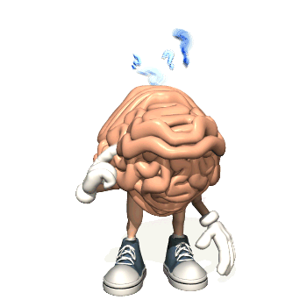
Theories of intelligence
Two-factor theory: Spearman proposed Two factor theory of intelligence in 1904. As the name implies, the theory involves two factors namely General(G) and Specific(S) factors.
  The first factor was a general capacity which was basically a reasoning factor. According to this theory every different mental ability involves a general factor(G), which it shares with all other mental activities and a specific factor(S), which is shared with none.
  The general factor is largely innate and accounts for success in all activities. It is constant in the sense that for any individual it remains the same of all the correlated activities. It differs from individual to individual. But success in any specialized field very much depends on the concern specific factor which is essentially learned.

Slide 22

Two-factor theory (continued…)
Thus no person is absolutely uniform in his mental performance. So persons who are good in certain field or discipline may be poor in the other. Some who excel in Mathematics might be poor in language or literature.
Thus, performance in any situation is predicted by the amount of share of General and Specific factors in different intellectual activities.

Slide 23
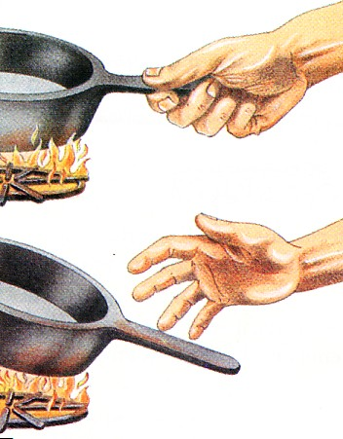
Theories of intelligence
Multi-factor theory of Thorndike: Thorndike opposed the theory of General intelligence. He proposed that they are Specific stimuli and Specific response. According to him, Intelligence is nothing more than a convenient name for almost infinite number of actual or potential specific connections between these stimuli and responses.
According to the theory intelligence is said to be constituted of multitude of separate factors or elements each being a minute element or ability. A mental act involves a number of these minute elements operating together. If any two tasks are correlated, the degree of correlation is due to the common elements involved in the two tasks.

Slide 24


Multi-factor theory of Thorndike (continued…)
Thorndike distinguished 4 attributes of intelligence. They are:
Level: This refers to the difficulty of a task that can be solved. If we think of all test items arranged in a sequential order of increasing difficulty, then the height that we can ascend on this ladder of difficulty determines our level of intelligence.
Range: This refers to the number of tasks at any given degree of difficulty that we can solve. Theoretically an individual possessing a given level of intelligence should be able to solve the whole range of task at that level. Range is determined not only by Level but also by the Breadth of experience and by opportunity to learn. In intelligence tests range is represented by items of equal difficulty.

Slide 25


Multi-factor theory of Thorndike (continued…)
Area: It refers to the total number of situations at each level to which the individual is able to respond. Area is the summation of all the ranges at each level of intelligence processed by an individual.
Speed: This is the rapidity with which an individual can respond to items. Speed and altitude are positively related. Speed is much closely bound up with altitude than are the other attributes. We should not therefore emphasis speed too much in our intelligence test.

Slide 26

Theories of intelligence
Group-factor theory of Thurstone: Thurstone and his associates proposed the Group factor theory. According to this theory, Intelligent activity is not an expression of innumerable highly specific factor as thorndike claimed. Nor it is the expression primarily of a general factor as Spearman held.
Instead the analysis and interpretation of Thurstone and others, lead them to the conclusion that certain mental operations have in common a PRIMARY factor that gives them psychological and functional unity and which differentiates them from other mental operations. These mental operations then constitute a group. A second group of mental operations has its own unifying Primary factor; a third group has a third Primary factor and so on.

Slide 27
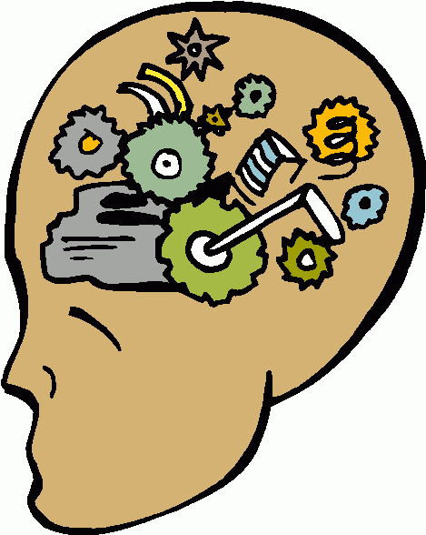
Group-factor theory of Thurstone (continued…)
Each of these primary factor is said to be relatively independent of others. Thurstone concluded that seven Primary mental abilities emerged clearly enough for identification and used in test designing. They are:
  Space visualization: The ability to visualize geometric pattern.
  Perceptual speed: Speed and accuracy of noting details.
  Numerical ability: Speed and accuracy in simple arithmetic operations.
  Verbal comprehension: Knowledge of meaning and relationship of words.
  Word fluency: Ability to think and use many isolated words at a rapid rate.
  Rote memory: Immediate recall or retrieval of material learned.
  Reasoning: Ability to see relationship in situations described in symbols.

Slide 28
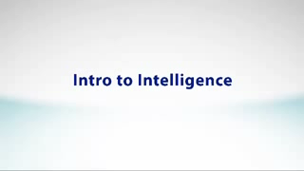
Watch video on basics of intelligence
Video 1

Slide 29

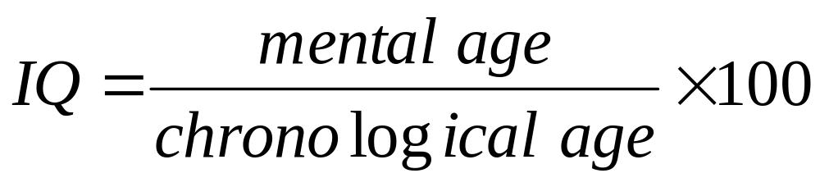
Intelligence Quotient (IQ)
An intelligence quotient, or IQ, is a score derived from one of several standardized tests designed to assess intelligence.
It is a score derived from a set of standardized tests developed to measure a person's cognitive abilities ("intelligence") in relation to their age group.
Mental age is determined by test whereas
chronological age is the age of test taker in years

Slide 30

Assessing Intelligence
Aptitude Test: A test designed to predict a person’s future performance. Aptitude and ability tests are designed to assess logical reasoning or thinking performance. It can be classified as speed tests or power tests. In speed tests the questions are relatively straightforward and the test is concerned with how many questions you can answer correctly in the allotted time.
It finds the following:
    Can this person think on their feet?
    Could I fast track this person?
    Could we use this person to drive change?
    Can they cope with the mental demands of the job?
    Is this person a problem solver?
    To what extent can we develop this person using training?
    Is this person sufficiently challenged?
    Do they have the capacity to handle greater mental demands in their role?

Slide 31
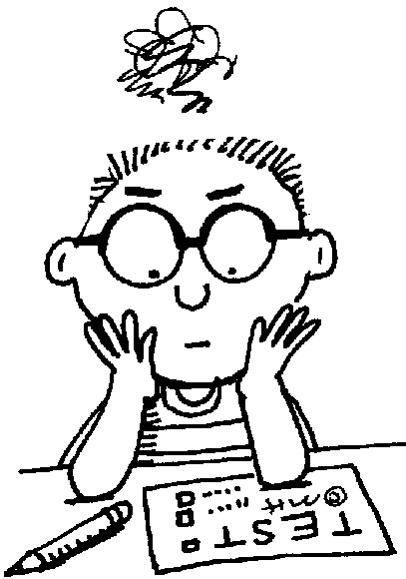
Assessing Intelligence (continued…)
Achievement Test: A test designed to assess what a person has learned. It is a test of developed skill or knowledge. The most common type of achievement test is a standardized test developed to measure skills and knowledge learned in a given grade level, usually through planned instruction, such as training or classroom instruction. E.g Exams, ACT (or SAT)
Achievement testing serves many purposes :
    Assess level of competence
    Diagnose strength and weaknesses
    Assign Grades
    Achieve Certification or Promotion
    Advanced Placement/College Credit Exams
    Curriculum Evaluation
    Informational Purposes

Slide 32
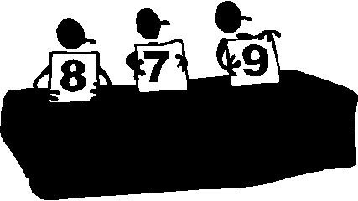

Test construction
To be useful, intelligence tests, must be constructed using the established criteria of standardization, reliability, and validity.
Standardization: It is the process of making uniform and objective both testing procedures and scoring procedures in order to obtain meaningful scores. Scores on standardized tests are interpreted in reference to scores obtained from a standardization sample, that is, scores from a comparable group of subjects tested under appropriate conditions.
Reliability: The term reliability refers to the consistency of results.

Slide 33
Test construction (continued…)
Reliability of a test is determined by one of the following methods.
  Test and retest reliability: comparison of original test scores with retest scores
  Alternate form reliability: comparison of scores obtained on alternate forms of a test
  Split-half reliability: comparison of scores obtained on two halves of tests (such as scores on odd- versus even-numbered questions)

Slide 34
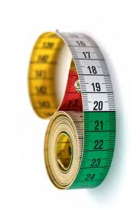
Test construction (continued…)
Validity: The term validity refers to the extent that a test measures what it is supposed to measure. Types of validity include:
  Content validity: the extent to which a test reflects a sample of the behavior to be measured
  Predictive validity: the extent to which a test can predict a person's behavior in another situation
  Face validity: how appropriate a test “appears” to be, just from the way the items read
  Construct validity: how well a test assesses the construct (for example, intelligence) for which it was designed
  Concurrent validity: how well the results of a test agree with those of a new test or a different form of the test measuring for the same construct (for example, intelligence)

