Slide 1

Personality
Presented by
Clinical Psychologist Sadaf Sajjad

Slide 2
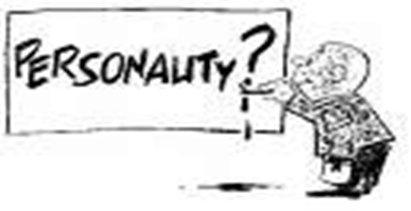
Personality
“An individual’s unique and relatively consistent patterns of thinking, feeling, and behaving.”
Personality – an attempt to describe and explain how people are similar, how they are different, and why every individual is unique.
tries to explain the whole person.

Slide 3
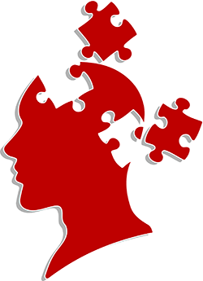
Personality
Some people also say that Personality is:
“Psychological organization of the individual as a whole and especially
to those features that distinguish the individual from others”.
It is distinctive patterns of
behavior,
thought, emotion that
characterize each person's
adaptation to the situations of life.

Slide 4
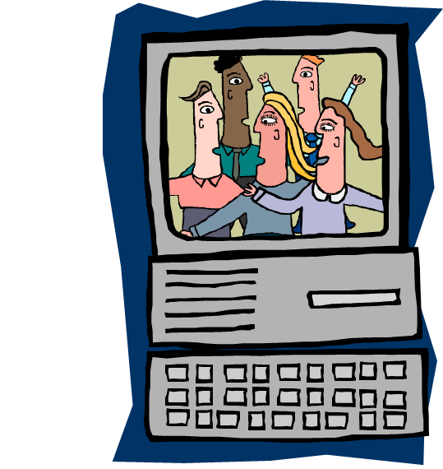
Personality
Personality - A relatively stable set of characteristics that influences an individual’s behavior.

Slide 5

Personality
Personality is an interaction between biology and environment.
Genetic studies suggest heritability of personality.
Other studies suggest learned components of personality

Slide 6

Does Personality Change Over Time?
Depends on how you study personality…
Cross sectional studies vs. Longitudinal studies.
Depends on how, what aspect of personality you are measuring…Theories of Personality

Slide 7
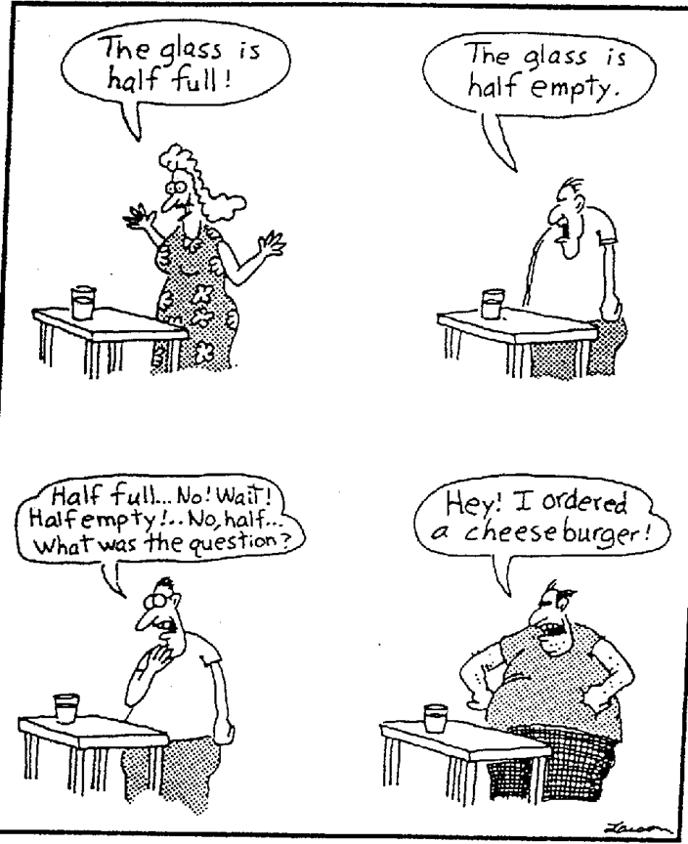
Personality Types

Slide 8
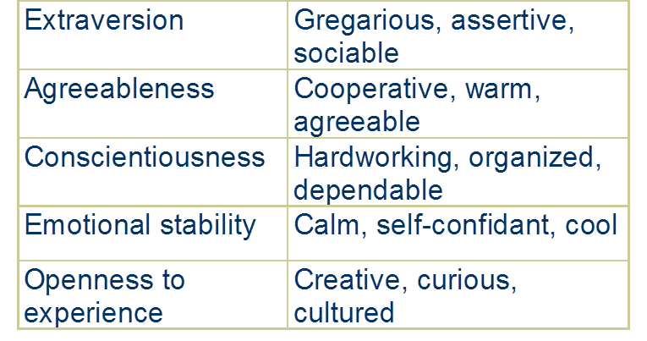
Big Five Personality Traits

Slide 9

Personality Characteristics
Positive Affect - an individual’s tendency to accentuate the positive aspects of oneself, other people, and the world in general
Negative Affect - an individual’s tendency to accentuate the negative aspects of oneself, other people, and the world in general

Slide 10
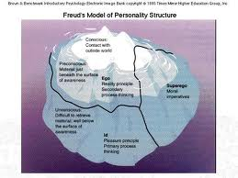
Personality structure
Id: the collection of unconscious urges and desires that continually seek expression.
Pleasure principle : the way in which the id seeks immediate gratification of an instinct.
Ego : the part of the personality that mediates between environmental demands, conscious, and instinctual need; now often used as a synonym for self

Slide 11
Personality structure
Reality principle : the way in which the ego seeks to satisfy instinctual demands safely and effectively in the real world.
Super ego : According to Freud, the social and parental standards the individual has internalized; the conscious and the ego ideal.
Ego ideal: The part of the superego that consists of standards of what one would like to be.

Slide 12
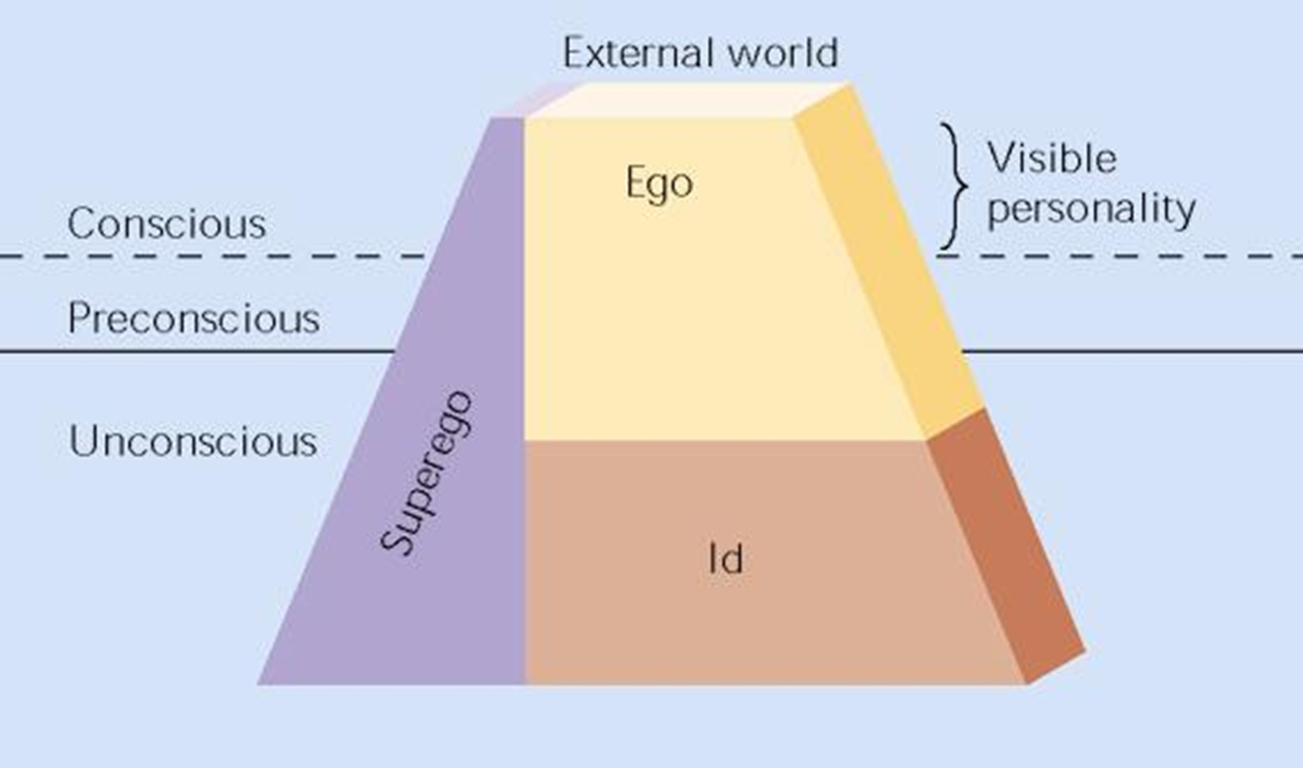
The approximate relationship between id, ego, and superego, and the levels of awareness

Slide 13
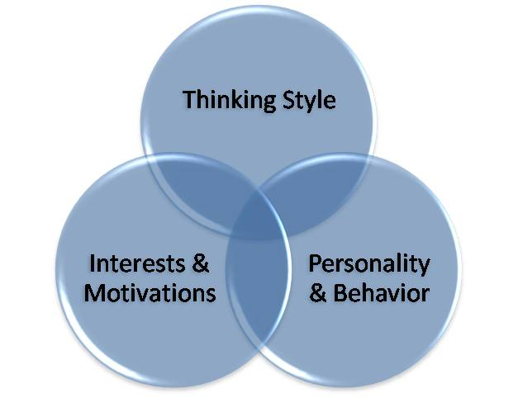
Personality Assessment
The personal interview
Direct observation
Objective tests
Projective tests

Slide 14
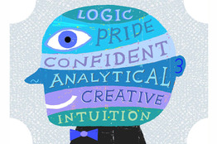
Personality Assessment
2 Basic kinds:
- Objective vs. Projective
Intelligence vs. Personality testing
-Some argue intelligence is part
of personality
-Gold standard
-What is intelligence?
Work best when correlated with predictive outcomes
Ex. Suicidality scale

Slide 15
Personality Assessment
Interview: Face-to-face meeting designed to gain information about someone’s personality, current psychological state, or personal history
  Unstructured Interview: Conversation is informal, and topics are discussed as they arise
  Structured Interview: Follows a prearranged plan, using a series of planned questions
Halo Effect: Tendency to generalize a favorable or unfavorable first impression to unrelated details of personality (make a good first impression)
Direct Observation: Assessing behavior through direct surveillance

Slide 16
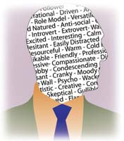

Objective assessments
Personality assessment is subjective - for the most part it is, though subjective doesn't necessarily mean inaccurate or even less accurate. How can personality assessment be more objective assess any biases and correct for them (lie, defensiveness) find a method to avoid such biases look for convergence with reports from others assess with low face valid instruments and look for consistent patterns (though this only really addresses intentional faking).

Slide 17
Objective assessments
Personality assessment is used to further describe the client, just as a diagnosis does (note that you would not say that depression is causing the patient's behaviors, you merely use the term to summarize a cluster of behaviors. The diagnosis itself also does not necessarily imply a causal mechanism nor an explanation - those from different perspectives would define it differently)
For example, if someone is depressed it could be explained biologically, cognitively, behaviorally, or even in psychodynamic terms.

Slide 18
Personality Theories
Trait Theory - understand individuals by breaking down behavior patterns into observable traits
Psychodynamic Theory - emphasizes the unconscious determinants of behavior
Humanistic Theory - emphasizes individual growth and improvement
Behavioral Theory – emphasizes Focus on external environment and on effects of conditioning and learning

Slide 19
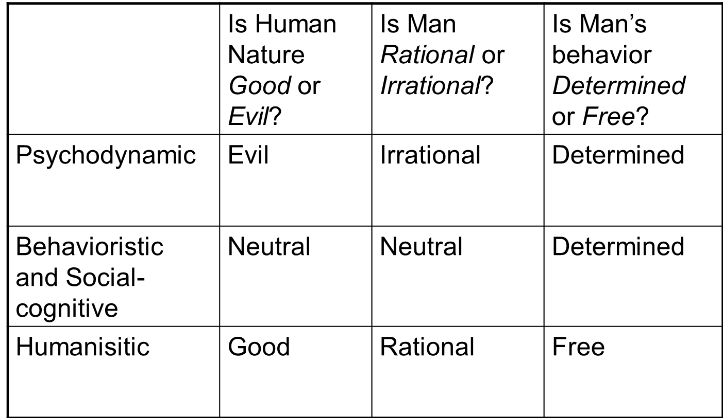
Personality Theories

Slide 20
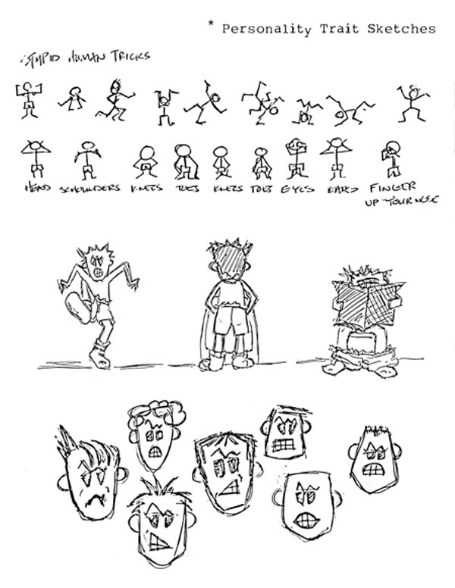
Trait Theory
“Traits are relatively stable and consistent personal characteristics”.
Trait theory comprises of:
Personality Types and Traits
Identification of Personality
Traits

Slide 21
Personality Types and Traits
A personality type is a discrete category into which a person can be sorted
A personality trait is an enduring personal characteristic that underlies a person’s reactions to a variety of situations

Slide 22
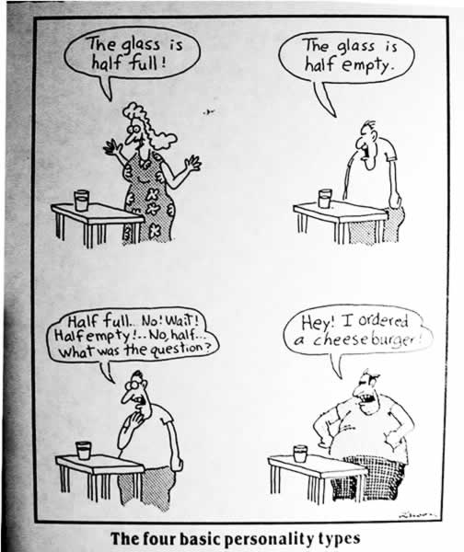
Identification of Personality Traits
Allport looked at the English language
Cattell listed sixteen personality variables
Eysenck suggests that there are only three bipolar dimensions to
personality
- Introversion-extroversion
- Neuroticism-emotional
stability
- Psychoticism–self-control

Slide 23
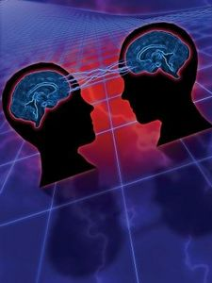
Trait Theory
Assumption of trait stability has led researchers to examine personality traits longitudinally
McCrae and Costa (1984, 1990) proposed 5-factor model of personality traits:
Neuroticism
Extraversion
Openness to experience
Agreeableness
Conscientiousness

Slide 24
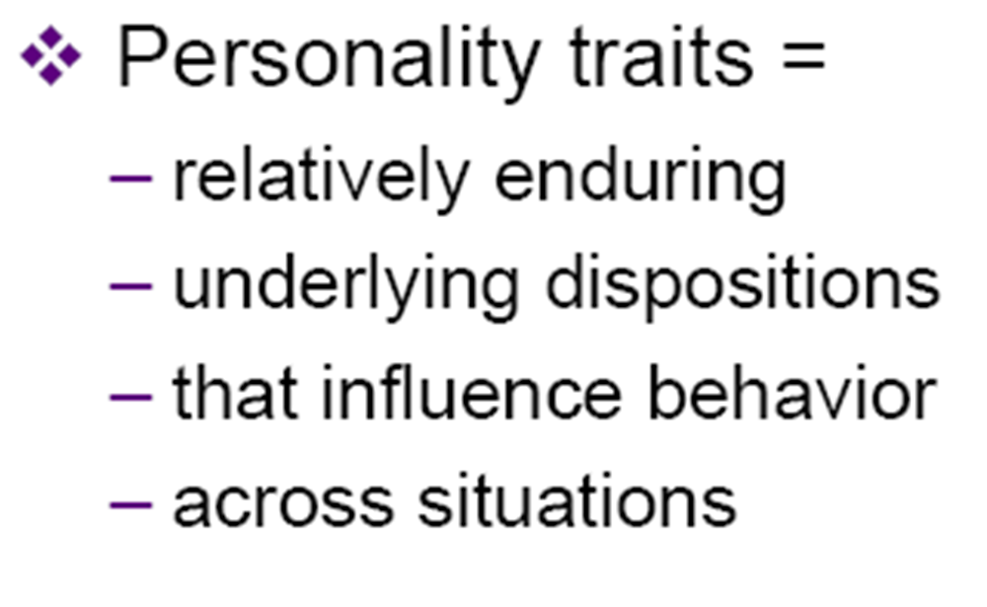
Trait Theory

Slide 25
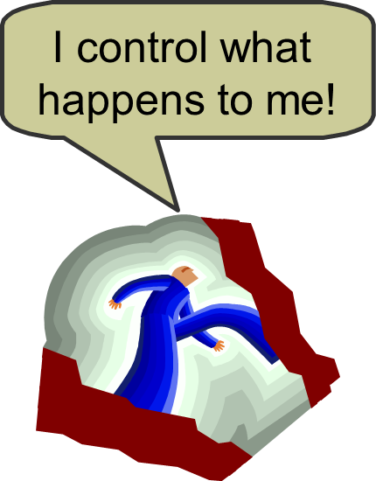
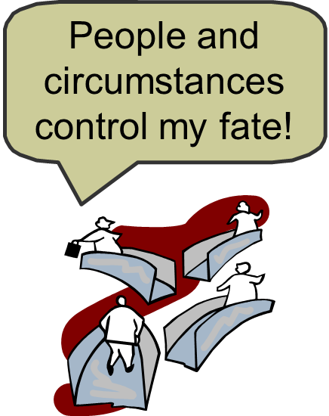
Trait (beliefs about control)
Locus of Control
Internal External

Slide 26
The “Big 5”
Modern personality research argues for 5 basic personality traits (OCEAN)
Openness: whether a person is open to new experiences
Conscientiousness: whether a person is disciplined and responsible
Extroversion: whether a person is sociable, outgoing and affectionate
Agreeableness: whether a person is cooperative, trusting, and helpful
Neuroticism: whether a person is unstable and prone to insecurity

Slide 27
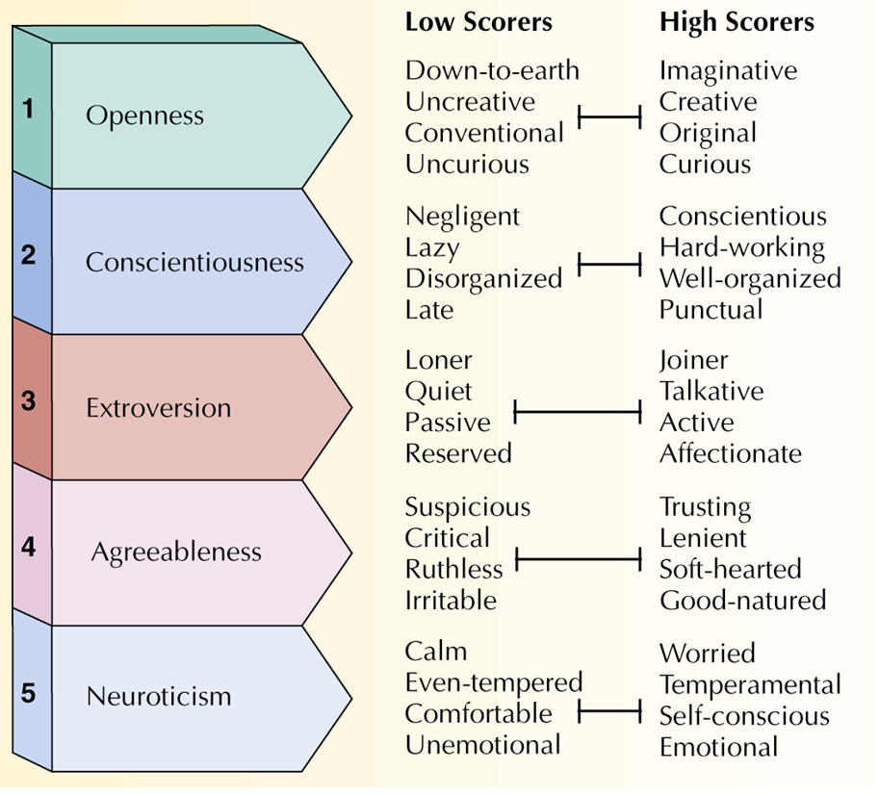
Overview of the Big “5

Slide 28

Trait Theory
video 1

Slide 29
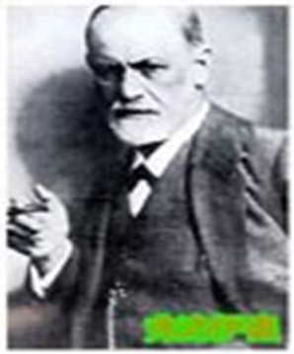
Psychodynamic theory
Personality theory contending that
“behavior results from psychological forces that interact within the individual, often outside conscious awareness”.

Slide 30
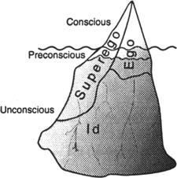
Psychodynamic theory
Theory of Personality
Method of Therapy
Technique of Investigation
Freud developed his theories based on intensive clinical studies of individual cases – women with hysterical symptoms

Slide 31
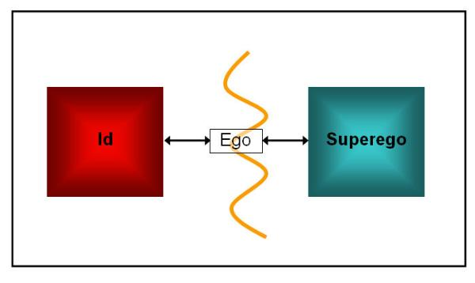
Psychodynamic theory
Violence, the exertion of physical force to injure or destroy.
Always accompanied by emotion of anger or hostility
Which may or may not be consciously perceived.
Can be expressed,
suppressed or repressed

Slide 32
Psychodynamic theory
The three aspects of personality inevitably come into conflict with each other
Conflict = anxiety
However, much of this conflict is unconscious due to defense mechanisms.
In Psychodynamic Theory,
goals are not so ambiguous.
Focused
Not so intensive
Less intensive therapist training
Flexible

Slide 33

Psychodynamic theory
video 2

Slide 34
Humanistic Theory
Humanistic psychologists contended that the most important factor in personality is the individual’s conscious, subjective perception of his or her self.
“A theory that asserts the fundamental goodness of people and their striving toward higher levels of functioning”.

Slide 35
Humanistic Theory
Humanistic personality theories reject psychoanalytic notions
- Humanistic theories view each person as basically good and that people are striving for self-fulfillment
- Humanistic theory argues that people carry a perception of themselves and of the world
- The goal for a humanist is to develop/promote a positive self-concept

Slide 36
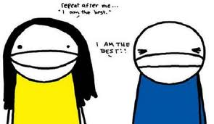
Humanism
Approach that focuses on human experience, problems, potentials, and ideals
Human Nature: Traits, qualities, potentials, and behavior patterns most characteristic of humans
Free Choice: Ability to choose that is NOT controlled by genetics, learning, or unconscious forces

Slide 37
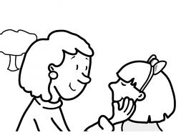
Humanism
Subjective Experience: Private perceptions of reality
Self-Actualization (Maslow): Process of fully developing personal potentials
Peak Experiences: Temporary moments of self-actualization

Slide 38
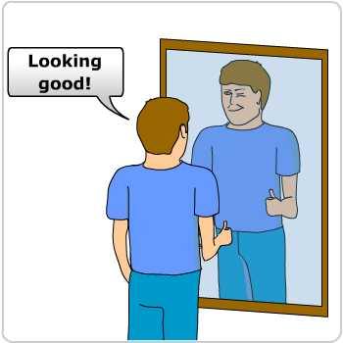
Humanistic Theory
Self-actualizing tendency: According to Rogers, the drive of human beings to fulfill their self-concepts, or the images they have of themselves.

Slide 39
Humanistic Theory
Unconditional positive regard: In Roger’s theory, the full acceptance and love of another person regardless of his or her behavior.
Conditional positive regard: In Roger’s theory, acceptance and love that are dependent on another’s behaving in certain ways and on fulfilling certain conditions.

Slide 40
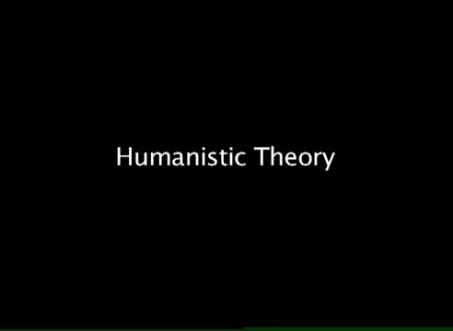
Humanistic Theory
video 3

Slide 41
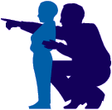
Behavioral Theory
According to the behaviorists, learning can be defined as
“the relatively permanent change in behavior brought about as a result of experience or practice.”

Slide 42
Behavioral Theory
The focus of the behavioral approach is on how the environment impacts overt behavior.
Remember that biological maturation or genetics is an alternative explanation for relatively permanent change.
Behaviorists are not interested in the conscious decision of the individual to disrupt, modify, or go against the conditioning process, they are only interested in that aspect of feedback that connects directly to overt behavior.

Slide 43
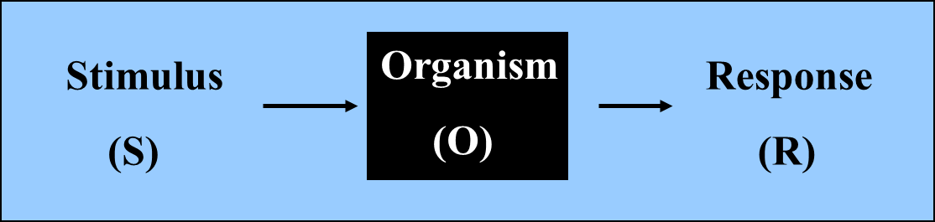
Behavioral Theory
The behavioral learning theory is represented as an S-R paradigm. The organism is treated as a “black box.” We only know what is going on inside the box by the organism’s overt behavior.

Slide 44
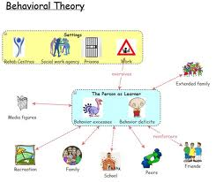
Behavioral Theory
The feedback loop that connects overt behavior to stimuli that activate the senses has been studied extensively from this perspective.

