Slide 1

Industrial Psychology
Presented By
Clinical Psychologist Sadaf Sajjad

Slide 2

Definition
The branch of applied psychology that is concerned with efficient management of an industrial labor force and especially with problems encountered by workers in a mechanized environment.
Industrial psychology looks at behavior that occurs within the workplace. Also called industrial-organizational (I/O) psychology, people who work in this field might study worker personalities and performances, or the interactions between the individuals within a business or organization.

Slide 3

The Basics
The Society for Industrial and Organizational Psychology (SIOP) as "the scientific study of the workplace.“
When employed to advise a company, the psychologist will draw on his or her knowledge about psychological areas and theories particularly important in the workplace.
study of employees, workplaces, and organizations. Industrial and organizational psychologists contribute to an organization's success by improving the workplace and the performance, satisfaction and well-being of its people.

Slide 4

Importance of Industrial Psychology
It looks about the biological side of behavior (which means it really discovers what chemicals aren't at proper levels in a person with a chemical imbalance).
Psychology plays major role in improving human relations and also in solving industrial dispute.
Psychology also helps in explaining difference in individuals relating to interests, aptitudes, specialties, intelligence etc.
Psychological also helps an individual in dealing with particular conditions or environment while working and so helps in better adjustment and so relief of tension. Psychology also helps in personal adjustment for prevailing environment

Slide 5

History of Industrial Psychology
Industrial Psychology is almost as old as Psychology itself. Psychology came about in 1879 in the laboratory of Wilhelm Wundt in Germany and William James at Harvard.
Both of them were philosophers and physicians fascinated with the mind-body debate.
The older discipline of philosophy could not alone deal with this debate, more room and new tools were needed, giving way to Psychology. Texts applying psychology to business first appeared in 1903; the first Industrial-Organizational (I/O) psychology text appeared in 1910 (Landy, 1997).

Slide 6

Scope of Industrial Psychology
Personnel Selection: Selection of employees, executives. Developing instruments of personnel selection.
Personnel Development: Developing means of appraisal of performance for all, measurement of attitudes, employee counseling for better adjustment with the environment.
Human Engineering: Suggesting changes, innovations in machines/ technology / operations/equipment for greater ease in operation in least possible human energy.
Productivity Study: Activities of lessening worker fatigue, improving work environmental conditions, Light, ventilation, work arrangements etc to maximize efficiency.
Management:Activities involving development of managerial skills.
Accident Prevention and Safety Measures
Labour Relations

Slide 7

Work Behavior
The psychology of work behavior is one form of industrial psychology. Attitudes of employees as related to their performance is a main theme.
Variables in employee personalities and abilities are listed and situational and background differences are studied.
The industrial psychologist also studies human mental and physical abilities, administering tests and assessing values and establishing job-related criteria.
Human-error factors also are monitored, as are costs and causes of accidents.

Slide 8

Management
Many management skills fall under the umbrella of industrial psychology. Managers must be educated concerning the area of employee supervision.
Motivational tactics are imperative to the success of industry, thus the industrial psychologist also may devise financial or other incentives.
Determination of training needs and abilities to resolve conflict are skills that managers would learn in their study of industrial psychology.

Slide 9

Workplace Interactions
Industrial psychology often focuses on worker interaction and satisfaction.
Employees who work together well and are happy in their jobs can significantly strengthen a business or organization.
Common workplace issues might include disruptive employee behavior, lack of teamwork, or personality clashes between employees.

Slide 10

Motivation
Motivation is an area of psychology that has gotten a great deal of attention, especially in the recent years.
Motivated employees are happy, productive and loyal, and that's what companies want. Motivation at work can be used as a basis for creating practices, procedures and processes to affect employee motivation.

Slide 11
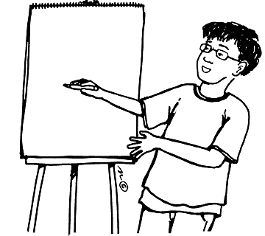
Theories

Slide 12
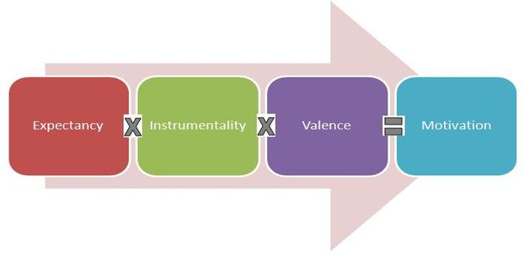
Expectancy Theory
The Expectancy theory states that employee’s motivation is an outcome of how much an individual wants a reward (Valence), the assessment that the likelihood that the effort will lead to expected performance (Expectancy) and the belief that the performance will lead to reward (Instrumentality).
In short, Valence is the significance associated by an individual about the expected outcome. It is an expected and not the actual satisfaction that an employee expects to receive after achieving the goals.

Slide 13


Expectancy Theory
Instrumentality
Instrumentality is a personality trait associated with the ability to be focused in a competitive way, objective and to make decisions easily.
The instrumentality is the belief that if one does meet performance expectations, he or she will receive a greater reward. This reward may come in the form of a pay increase, promotion, recognition or sense of accomplishment. It is important to note that when it is perceived that valued rewards follow all levels of performance, then instrumentality is low. For example, if a professor is known to give everyone in the class an "A" regardless of performance level, then instrumentality is low.

Slide 14

Expectancy Theory
Valance
The valance refers the value the individual personally places on the rewards. This is a function of his or her needs, goals, values and Sources of Motivation.

Slide 15

Expectancy Theory
Video 2

Slide 16
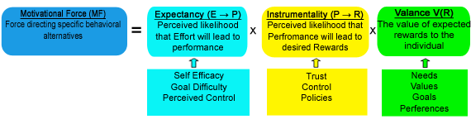
Expectancy Flow

Slide 17
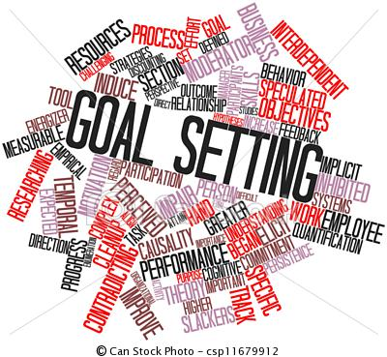

Goal Settings Theory
Goal-setting theory refers to the effects of setting goals on subsequent performance.
Researcher Edwin Locke found that individuals who set specific, difficult goals performed better than those who set general, easy goals.
Locke proposed five basic principles of goal-setting: clarity, challenge, commitment, feedback, and task complexity.
One of the most effective ways to stay motivated is to set goals for yourself. However, the type and quality of goals you set affects how well they will work.

Slide 18

Goal Settings Theory
Video 3

Slide 19



Effective goal-setting principles
Clarity: A clear, measurable goal is more achievable than one that is poorly defined. In other words, be specific! The most effective goals have a specific timeline for completion.
Challenge: The goal must have a decent level of difficulty in order to motivate you to strive toward the goal.
Commitment: Put deliberate effort into meeting this goal. Share your goal with someone else in order to increase your accountability to meet that goal.

Slide 20

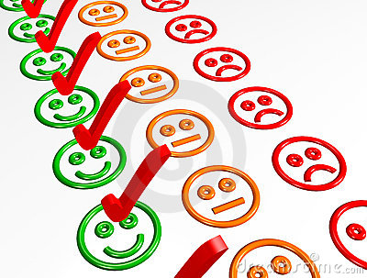
Effective goal-setting principles Conti…
Feedback: Set up a method to receive information on your progress toward a goal. If losing 30 pounds in four months turns out to be too hard, it is better to adjust the difficulty of your goal mid-way through the timeline than to give up entirely.
Task complexity: If a goal is especially complex, make sure you give yourself enough time to overcome the learning curve involved in completing the task. In other words, if a goal is really tough, make sure you give yourself some padding to give you the best chance at succeeding.

Slide 21
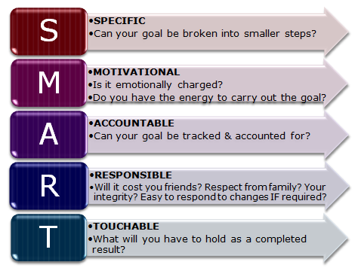
S.M.A.R.T. Method
The S.M.A.R.T. method assumes that if you set a goal that is:
Specific
Measurable
Attainable
Relevant
Time bound

Slide 22
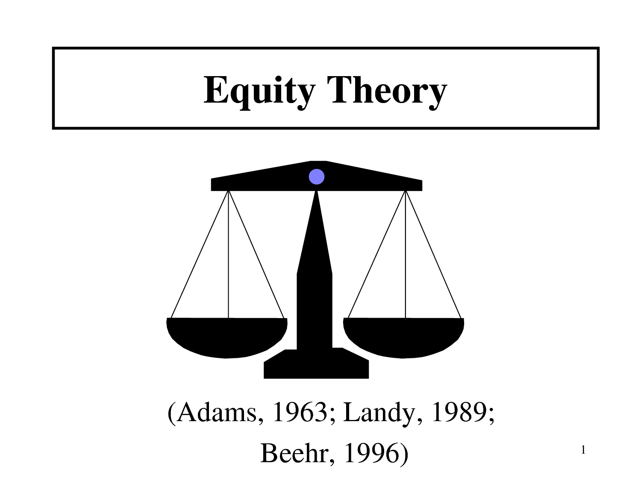
Equity theory
Equity theory is a theory that attempts to explain relational satisfaction in terms of perceptions of fair/unfair distributions of resources within interpersonal relationships.
The core of the equity theory is the principle of balance or equity. As per this motivation theory, an individual’s motivation level is correlated to his perception of equity, fairness and justice practiced by the management. Higher is individual’s perception of fairness, greater is the motivation level and vice versa.

Slide 23
Equity theory Conti…
People are happiest in relationships where the give and take are about equal. If one person is getting too little from the relationship, then not only are they going to be unhappy with this—the person getting the lion’s share will also be feeling rather guilty about this imbalance. This is reinforced by strong social norms about fairness.
In short-term relationships we tend to trade in things, such as loaning small sums or buying beers. In longer-term relationships the trade is more emotional.
Overall, though, it is still better to be getting more than less—although you could feel better about the relationship, the benefits you get from it can buy you compensatory happiness elsewhere.
Equity Theory is also called Inequity Theory as it is the unequal difference that is often the area of interest.

Slide 24
Industries and Organizations

Slide 25


Psychology of Workplace
Positive psychology in the workplace is about shifting attention away from negative aspects such as work violence, stress, burnout, and job insecurity.
Positive psychology can help create a working environment goal of promoting positive affect in its employees.
Employers who understand the link between employee well-being and organizational performance strived to maintain a work environment characterized by openness, fairness, trust, and respect, even when difficult actions were required.
These employers are positioned for success in the economic recovery and will have a distinct competitive advantage in their ability to attract and retain the very best employees.

Slide 26

Psychology of Workplace Conti…
Employee Involvement
Efforts to increase employee involvement empower workers, involve them in decision-making and give them increased job autonomy. Employee involvement programs can increase job satisfaction, employee morale, and commitment to the organization as well as increase productivity, reduce turnover and absenteeism and enhance the quality of products and services.

Slide 27

Psychology of Workplace Conti…
Work-Life Balance
Programs and policies that facilitate work-life balance generally fall into two categories: flexible work arrangements and resources to help employees manage their non-work demands. Conflict between work and other life responsibilities can diminish the quality of both work and home life for employees, which in turn can affect organizational outcomes such as productivity, absenteeism and turnover. Efforts to help employees improve work-life balance can improve morale, increase job satisfaction and strengthen employees’ commitment to the organization.

Slide 28

Psychology of Workplace Conti…
Employee Recognition
Employee recognition efforts reward employees both individually and collectively for their contributions to the organization. Recognition can take various forms: formal and informal, monetary and non-monetary. By acknowledging employee efforts and making them feel valued and appreciated, organizations can increase employee satisfaction, morale and self-esteem. Additionally, the organization itself may benefit from greater employee engagement and productivity, lower turnover and the ability to attract and retain top-quality employees.

Slide 29

Psychology of Workplace Conti…
Human resources
Human resources is the set of individuals who make up the workforce of an organization, business sector or an economy. "Human capital" is sometimes used synonymously with human resources, although human capital typically refers to a more narrow view; i.e., the knowledge the individuals embody and can contribute to an organization.

Slide 30

Prison Psychology
Prison psychology relates to the application of psychology within a correctional setting.
Writing in his article "Ethical Concerns Within the Practice of Correctional Psychology", Michael Decaire notes that
"The correctional psychologist’s primary mission is to assist in offender rehabilitation and reintegration. The psychologist enhances staff and inmate safety by promoting a healthy institutional environment."

Slide 31

Psychology in Schools
Treatment of children's and adolescents' behavioral and learning problems, to teachers, politicians and other responsible persons in the institutionalized education systems with pedagogic, didactic or systemic-organizational problems, sometimes also integrating parents of school children to find common solutions.

Slide 32


Job Satisfaction
Job satisfaction is how content an individual is with his or her job.
Scholars and human resource professionals generally make a distinction between affective job satisfaction and cognitive job satisfaction.
Affective job satisfaction is the extent of pleasurable emotional feelings individuals have about their jobs overall, and is different to cognitive job satisfaction which is the extent of individuals’ satisfaction with particular facets of their jobs, such as pay, pension arrangements, working hours, and numerous other aspects of their jobs.

Slide 33
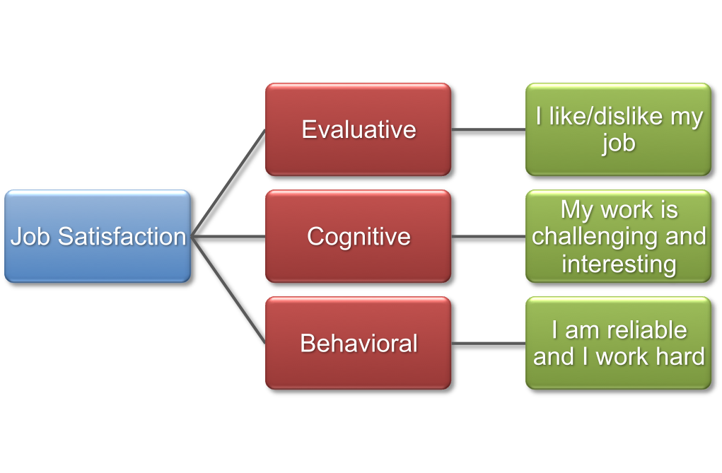
Job Satisfaction

Slide 34


Influence on Employees
Psychology of industry also play role in promotions by considers various parameters of an individual that affects his behaviour and so capability.
Helps an individual in dealing with particular conditions or environment while working and so helps in better adjustment and so relief of tension.
Helping to give businesses and organizations a more efficient structure.
Primitive and sometimes deadly attacks on the strikers would usually just increase the workers' resolve to struggle.
Industrial Psychology makes workers interchangeable and therefore expendable, as a problematic worker may easily be replaced with a more docile one.

Slide 35
Employee Psychology
Video 1

Slide 36

Muchinsky’s key areas of I/O Psychology
According to Muchinsky (2000), most industrial organizational psychologists work in one of six major subject areas:
Training and development: Professional in this area often determine what type of skills are necessary to perform specific jobs as well as develop and evaluate employee training programs.
Employee Selection: This area involves developing employee selection assessments, such as screening tests to determine if job applicants are qualified for a particular position.
Ergonomics: The field of ergonomics involves designing procedures and equipment designed to maximize performance and minimize injury.

Slide 37

Muchinsky’s key areas of I/O Psychology Conti…
Performance Management: I/O psychologists who work in this area develop assessments and techniques to determine if employees are doing their jobs well.
Work Life: This area focuses on improving employee satisfaction and maximizing the productivity of the workforce. I/O psychologists in this area might work to find ways to make jobs more rewarding or design programs that improve the quality of life in the workplace.
Organizational Development: I/O psychologists who work in this area help improve organizations, often through increasing profits, redesigning products, and improving the organizational structure.

Slide 38
Thank You

