Slide 1
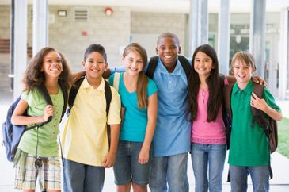
Prejudice
Presented by
Clinical Psychologist Sadaf Sajjad

Slide 2
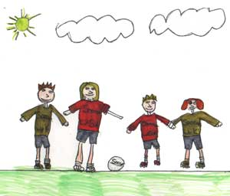
Prejudice
Definition:
“A preconceived negative judgment of a group and its individual members”.
  Prejudice is an attitude and therefore has an affective component, a behavior tendency, and a cognitive component.

Slide 3
Prejudice
The root word of prejudice is "pre-judge."
It is
“a set of attitudes which causes, supports, or justifies discrimination. Prejudice refers to a tendency to "over categorize."
Prejudiced people respond to others in a more or less fixed way (Farley, 2000:18).

Slide 4
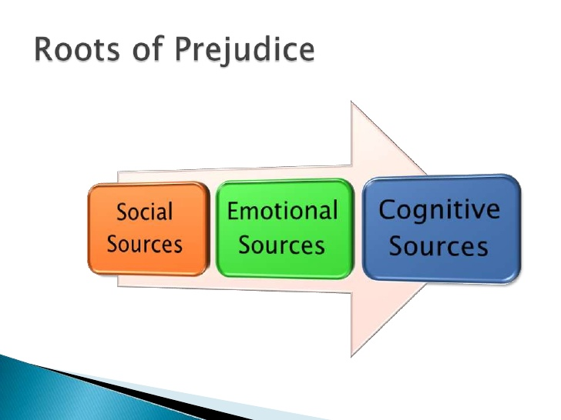

Slide 5
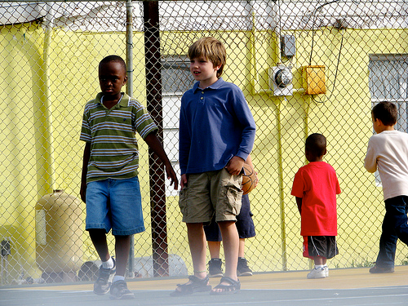
Prejudice
Prejudice is an unjustified or incorrect attitude (usually negative) towards an individual based solely on the individual’s membership of a social group.
For example,
A person may hold prejudiced views towards a certain race or gender etc. (e.g. sexist).
A family may preach its children some prejudiced belief about some other family in order to make up the minds of their children against them due to some classicism or racism factors.

Slide 6
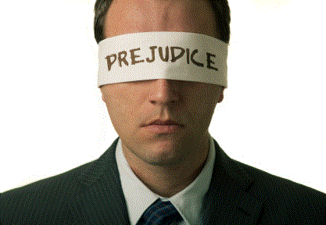
Prejudice
  A prejudiced person might dislike those different from themselves, behave in a discriminatory manner, and believe they are ignorant and dangerous.
  While specific definitions of prejudice given by social scientists often differ, most agree that it involves prejudgments (usually negative) about members of a group.

Slide 7
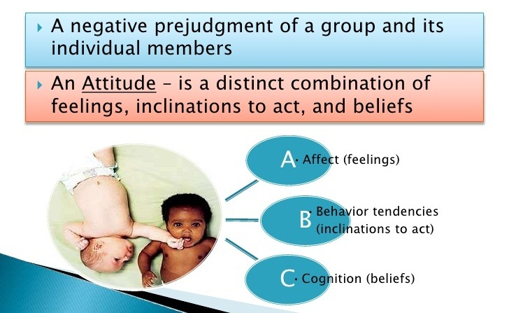
Prejudice

Slide 8
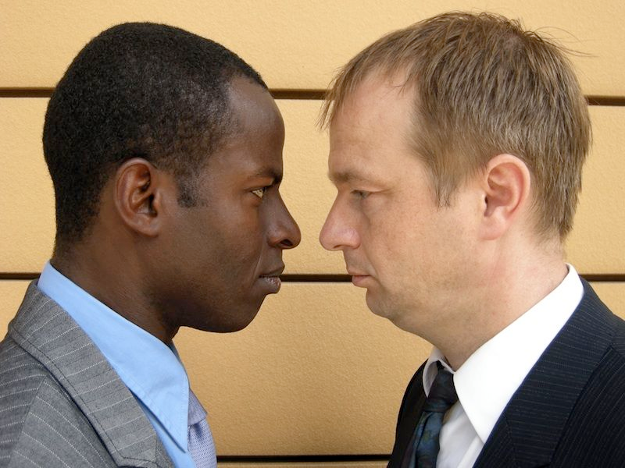
Cont.….
Prejudice is a baseless and usually negative attitude toward members of a group.
Common features of prejudice include:
Negative feelings,
Stereotyped beliefs, and
A tendency to discriminate against members
of the group.

Slide 9
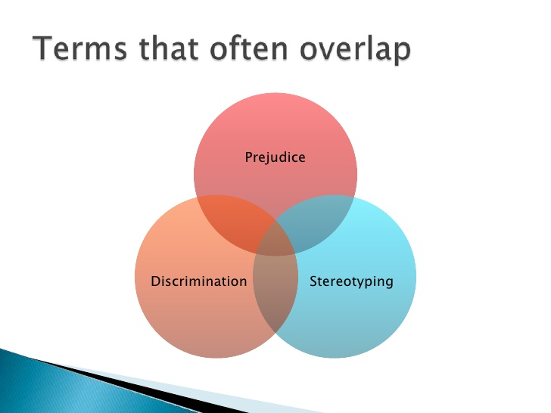

Slide 10
Discrimination
Definition:
“is the behavior or actions, usually negative, towards an individual or group of people, especially on the basis of sex/race/social class, etc.”
Example of Discrimination
World War II - In Germany and German-controlled lands, Jewish people had to wear yellow stars to identify themselves as Jews. Later, the Jews were placed in concentration camps by the Nazis.

Slide 11
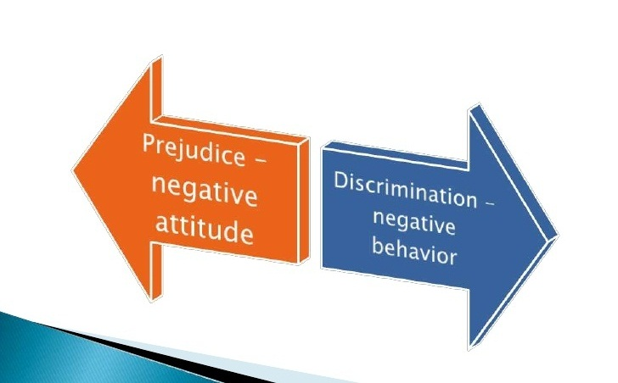
Prejudice and Discrimination

Slide 12
Types of Prejudice
Prejudice can be based upon a number of factors including sex, race, age, sexual orientations, nationality, socioeconomic status and religion. Some of the most well-known types of prejudice include:
Racism
Sexism
Classicism
Homophobia
Nationalism
Religious prejudice
Agism

Slide 13
Origin of Prejudice
Throughout the past century, research on prejudice has closely reflected ideological trends, telling as much about the personal biases of the scientific community as about prejudice itself.
Psychological research on prejudice first emerged in the 1920’s and was based upon American and European race theories that attempted to prove White superiority.
Several influential theorists came to regard prejudice as pathological, and they searched for personality syndromes associated with racism, anti-Semitism, and other forms of prejudice.
Theodor Adorno (1950), who had fled Nazi Germany and concluded that the key to prejudice lay in what he called an "authoritarian personality."

Slide 14
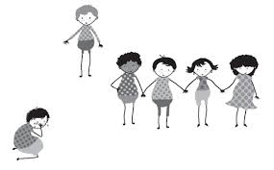
Origin of Prejudice
Adorno believed people with authoritarian personalities were the most likely to be prejudiced against groups of lower status.
In the 1970s, research began to show that much of prejudice is based not on negative feelings towards other groups but favoritism towards one’s own groups.
In 1979, Thomas Pettigrew described the ultimate attribution error and its role in prejudice. The ultimate attribution error occurs when in-group members.

Slide 15
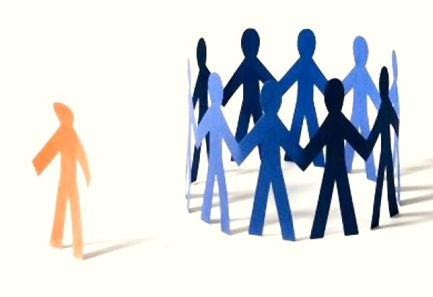
Origin of Prejudice
(1) attribute negative out-group behavior to dispositional causes (more than they would for identical in-group behavior), and
(2) attribute positive out-group behavior to one or more of the following causes:
(a) a fluke or exceptional case,
(b) luck or special advantage,
(c) high motivation and effort, and
(d) situational factors.

Slide 16
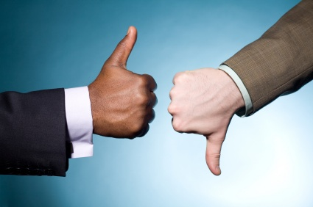
Direct Intergroup Conflict
Definition:
“Intergroup prejudice includes the negative emotions and irrational beliefs one group has concerning other groups (again, by repeating “group” a special effect is achieved), and as thus is linked to ignorance and hatred.”

Slide 17
Direct Intergroup Conflict
Intergroup conflict can take many forms, ranging from a disagreement with the neighbors to a full-out war between countries.
Though consequences vary, the cause of intergroup conflict usually stems from a few basic principles.
Example
The class fellow’s family having a latest Toyota, big home, the newest technology gadgets,
may bring up a prejudice in the other fellows who are deprived of them.

Slide 18
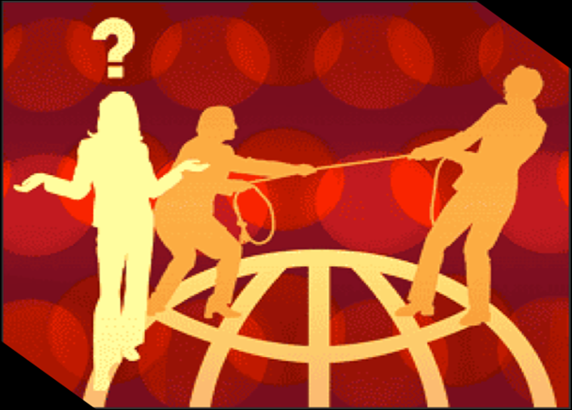
Cont.….
Direct Inter-Group conflict, or hostilities between different groups, is a pervasive feature common to all levels of social organization (e.g., sports teams, colleagues, ethnic groups, nations, religions, gangs).

Slide 19
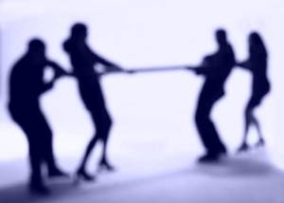
Cont.….
Many psychologists are of the view that Direct Inter-group Conflict is:
“A circumstance in which groups take antagonistic actions toward one another to control some outcome important to each.”
“An overt expression of tensions between the goals or concerns of one party and those of another.”

Slide 20

Sources of Direct Intergroup Conflict
Competing Goals
Competition for Resources
Cultural Differences
Power Discrepancies
Assimilation Versus Preservation of Micro-
Cultural Identity

Slide 21
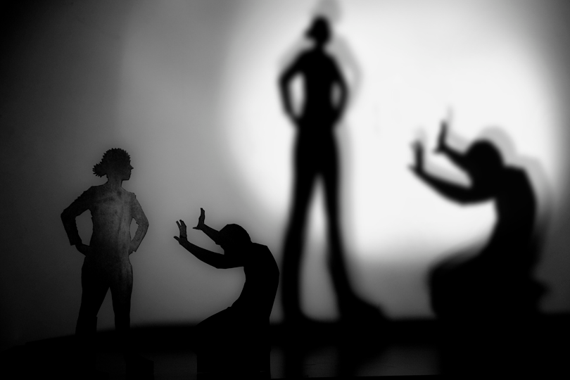
Domains that contribute to Direct Intergroup Conflict
Roy J Eidelson and Judy I Eidelson, identified parallels between individuals and the collective world views of groups on the basis of five key belief domains, such as:
Superiority
At an individual level, this belief revolves around a person's enduring conviction that he or she is better than other people in important ways. At the group level, superiority includes shared convictions of moral superiority,
entitlement, being the chosen and
having a special destiny. Being
chosen, the belief that one's own
group has a superior cultural

Slide 22
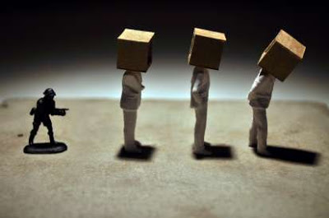
Domains that contribute to Direct Intergroup Conflict
heritage (e.g., history, values, language, tradition) is common among groups who base their identity on their ethnicity.
Injustice
At the individual level, this belief revolves around perceived mistreatment by others, and/or the world at large. At the group level, this translates to a worldview that the in-group has significant and legitimate grievances against an out-group. This belief is seen as contributing greatly to the force for war over the past two centuries, as the majority of wars in that time period have centered on issues of justice rather than security or power (Welch, 1993).

Slide 23
Cont.….
Vulnerability
At the individual level, vulnerability refers to a person's belief that he or she is perpetually in harm's way. At the group level, this belief is manifested in the form of fears about the future. This vulnerability can manifest itself in a group as catastrophic thinking – when the envisioned worst case scenario is seen as being inevitable.
Distrust
At the individual level, this belief focuses on the presumed intent of others to cause harm and/or exhibit hostility. The notion of trust is often seen by psychologists as the first challenge of psychosocial development. At the group level, this worldview focuses specifically on the perspective that outgroups are dishonest, untrustworthy and have negative

Slide 24
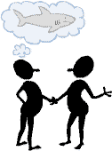

Cont.….
Intentions toward the in group. In more extreme manifestations, this belief is similar to collective
paranoia, which is defined as the collectively held
beliefs.
Helplessness
At the individual level, helplessness focuses on the
belief that even carefully planned and executed actions will fail to produce the desired outcome. When taken at the group level, it translates into a collective mindset of powerlessness and dependency. The group shares a
pessimistic approach which focuses on
their own weaknesses, and attributes
setbacks to their own limitations.

Slide 25
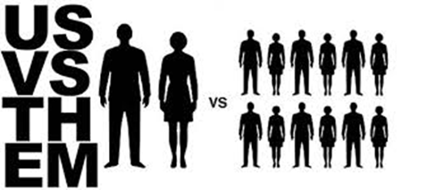
Us vs. Them
“us” (in-group) vs. “them” (out-group).
“People belonging to a particular race, religion, culture, region, country, town etc. divide themselves among groups Us (their own group of people) and Them (the other group of people).”
Ingroup
“Us”—a group of people who share a sense of belonging, a feeling of common identity.
Ingroup Bias
The tendency to favor one’s own group.
Out-group
“Them”—a group that people perceive
as distinctly different from or apart from
their in-group.

Slide 26

Us vs. Them
People mistakenly believe that if they share ideas, wealth and resources, there will be less left for them.
People having Us vs. Them attitude have great difficulty expressing pleasure or feeling happy for the good fortunes or achievements of other people, even members of their own family or close friends.
They are not prepared to take the second best spot. There can only be one position, the top position which they must occupy. Their constant comparing with others is to ensure they remain continuously at the top position.

Slide 27
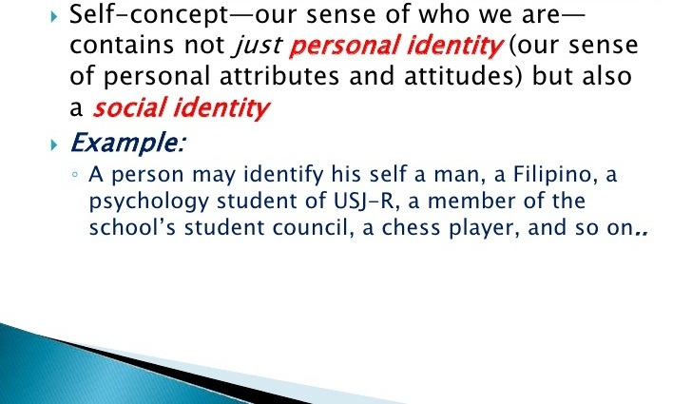
Social Identity

Slide 28
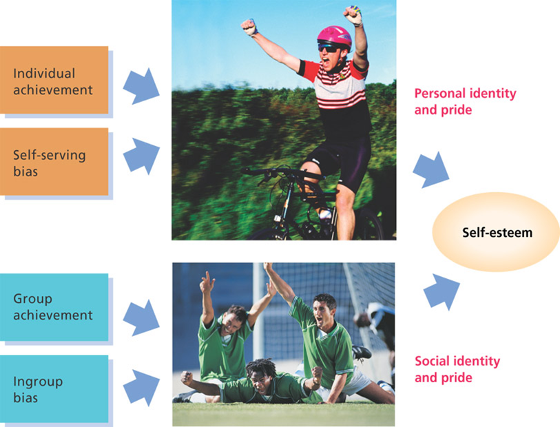
Us vs. Them
Those whose self-image is low tend to be more prejudiced.
Personal identity and social identity together feed self-esteem.

Slide 29
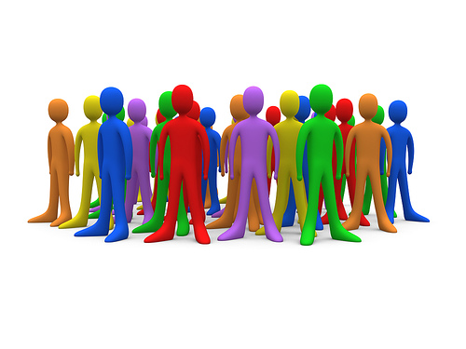
Social Learning
Social learning is:
“is a perspective that states that people learn within a social context and is facilitated through concepts such as modeling and observational learning.”
Social learning is a perspective that states that social behavior (any type of behavior that we display socially) is learned primarily by observing and imitating the actions of others.

Slide 30

Social Learning
People, especially children, learn from the environment and seek acceptance from society by learning through influential models.
The social behavior is also influenced by
being rewarded and/or punished
for the actions they perform.

Slide 31
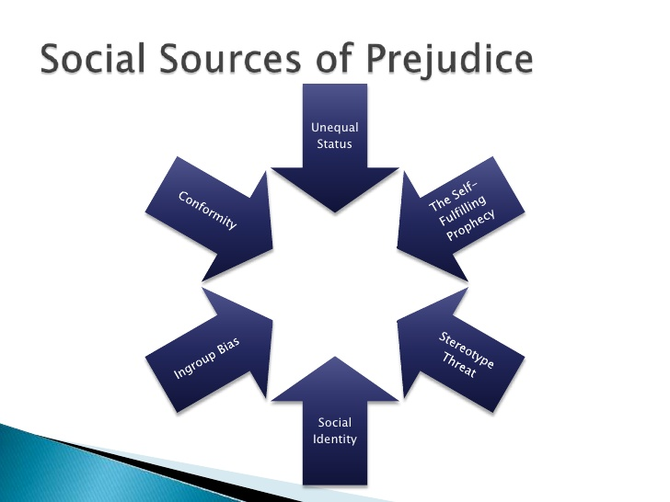

Slide 32
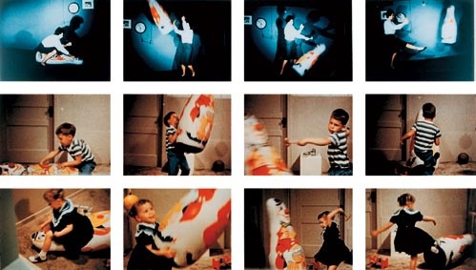
Example of Social Learning
One of the most famous experiments performed by Bandura is the famous bobo doll experiment. Children observed as adults modeled either violent or passive behavior towards the doll, and this observation was found to influence the manner in which the children subsequently interacted with the dolls. Children who observed violent behavior behaved violently
toward the doll and
vice versa.

Slide 33
Role of Social Learning
Role of Social learning comprises extensively of
understanding of aggression (Bandura, 1973) and
psychological disorders, particularly in the context of behavior modification (Bandura, 1969).
It is also the theoretical foundation for the technique of behavior modeling which is widely used in training programs.
In recent years, Bandura has focused his work on the concept of self-efficacy in a variety of contexts.

Slide 34
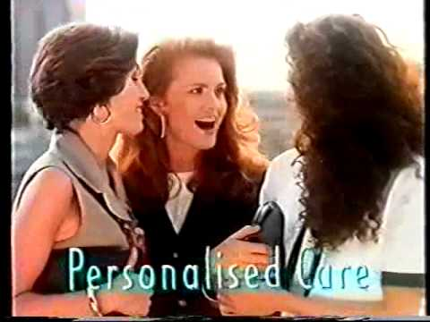
Example
The most common (and pervasive) examples of social learning situations are television commercials. Commercials suggest that drinking a certain beverage or using a particular hair shampoo will make us popular and win the admiration of attractive people. Depending upon
the component processes
involved (such as
attention or motivation),
we may model the
behavior shown in the
commercial and buy the
product being advertised.

Slide 35
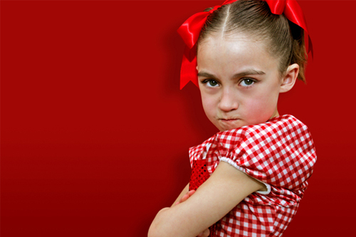
Role of Social Learning
Social learning is more prevalent among children, as Children model what they see and hear their parents and caregivers and other close adults say and do.
Children soak in the assumptions and prejudices around them and take them in by way of vicarious learning (in which they model the behaviors and attitudes they see) without thinking about what they are learning with any critical awareness.

Slide 36
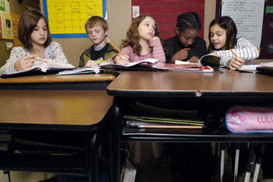
Cont.….
Children who observe their parents (or aunts, uncles, cousins, grandparents, clergy, friends, etc.) making racist, prejudiced remarks or acting in prejudiced and discriminatory ways learn to be
racist,
prejudiced and
discriminatory in those
same ways. Such children
may find themselves
discriminating against
others
"just because".

Slide 37
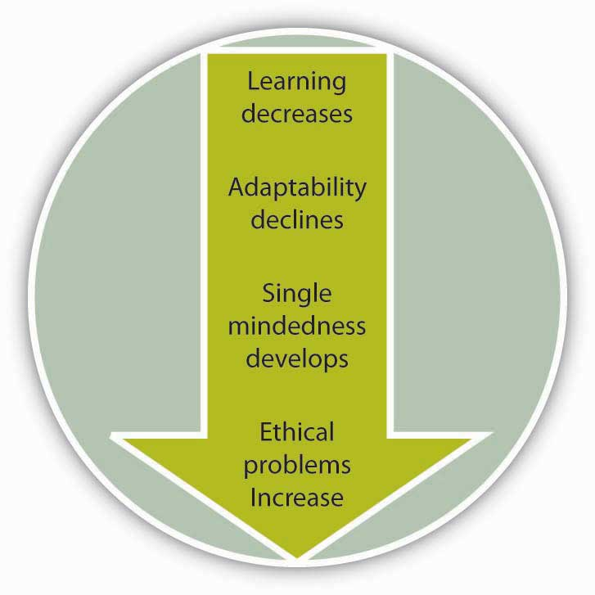

Cognitive Sources
Comprises of:
“the possibility that prejudice stems at least impart from basic aspects of social thoughts, from basic ways in which we think about others and process social information”.

Slide 38
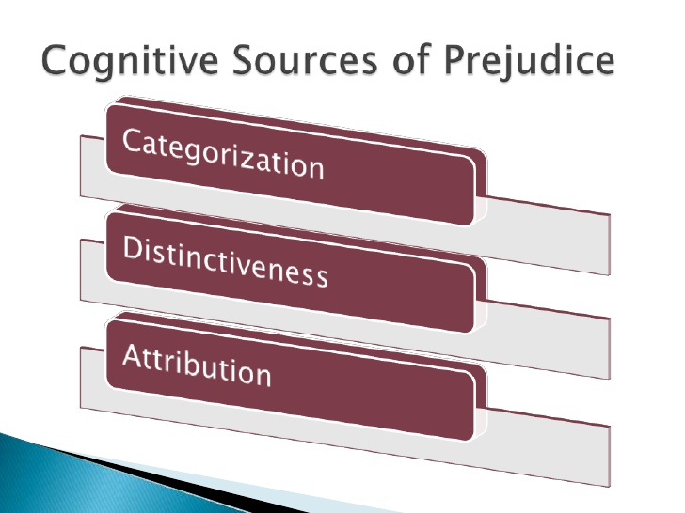

Slide 39
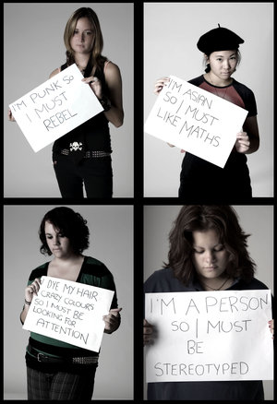
Stereotype
“A belief about the personal attributes of a group of people. Stereotypes are sometimes overgeneralized, inaccurate, and resistant to new information”.
Common stereotypes are:
British people are stuffy.
American people are outgoing.
Professors are absent-minded.
Stereotypes can be accurate
or inaccurate.

Slide 40
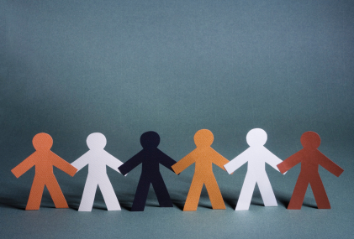
Stereotype
A "stereotype" is basically a generalization about a person or group of persons.
Stereotypes are developed when we are unable or unwilling to obtain all of the information we would need to make “fair judgments” about people or situations.
In the absence of the
"total picture," stereotypes
in many cases allow us to
"fill
in the blanks.”

Slide 41
Stereotype
Our society often innocently creates and perpetuates stereotypes, but these stereotypes often lead to unfair discrimination and persecution when the stereotype is unfavorable.
By stereotyping, we assume that a person or group has certain characteristics. Quite often, we have stereotypes about persons who are members of groups with which we have not had firsthand contact.

Slide 42
Stereotype
For example,
If we are walking through a park late at night and encounter three senior citizens wearing fur coats and walking with canes, we may not feel as threatened as if we were met by three high school-aged boys wearing leather jackets.
Why is this so?

Slide 43
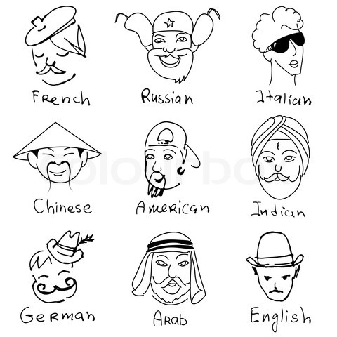
Cont.….
We have made a generalization in each case.
These generalizations have their roots in experiences we have had ourselves, read about in books and magazines,
seen in movies or television,
or have had related to us by
friends and family.
In many cases, these
stereotypical
generalizations
are reasonably accurate.

Slide 44
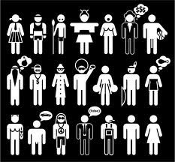
Cont.….
Stereotypes also evolve out of fear of persons from minority groups.
For example,
Many people have the view of a person with mental illness as someone who is violence-prone. This conflicts with
statistical data, which indicate
that persons with mental
illness tend to be no more
prone to violence than the
general population.

Slide 45
Cont.….
Television, books, comic strips, and movies are all abundant sources of stereotyped characters.
For much of its history, the movie industry portrayed African-Americans as being unintelligent, lazy, or violence-prone.
As a result of viewing these stereotyped pictures of African-Americans,
for example, prejudice against African-Americans has been encouraged.
In the same way, physically attractive women have been and continue to be portrayed as unintelligent or unintellectual and sexually promiscuous.

