Slide 1
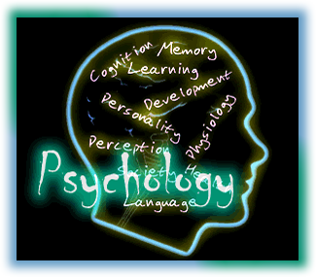
Introduction to psychology
Presented By
Clinical Psychologist Sadaf Sajjad

Slide 2

Myths of Psychology
Psychologists read faces, they mix their own preconceived ideas with their training.
They are like magicians.
Like Psychiatric patients, Psychologists are crazy people too.
Going to visit Psychologists means you have something abnormal, or you are considered mad.

Slide 3

Myths of Psychology

Slide 4

Facts about Psychology
Psychology is an organized body of knowledge.
It collects and analyze knowledge.
Psychologist are trained in living a balanced life
Anyone can visit a psychologist starting from a counseling session to a major disorder

Slide 5
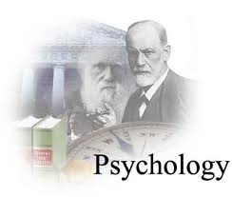
What is Psychology
Derived from two Greek words
  Psyche means soul
  logos means to talk.
  literal meaning of Psychology is: to talk about soul.
  Definition
Psychology is a science which deals with the behaviour and minds of animals and human beings, both.

Slide 6


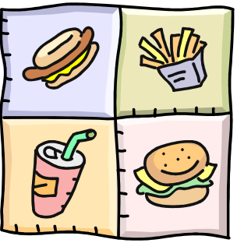

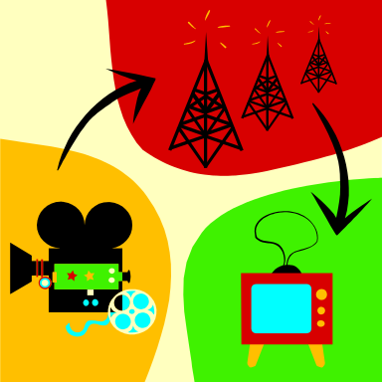


What Causes Behavior?
Behavior

Slide 7
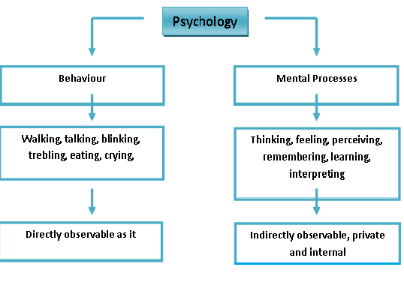
Psychology and Behavior

Slide 8
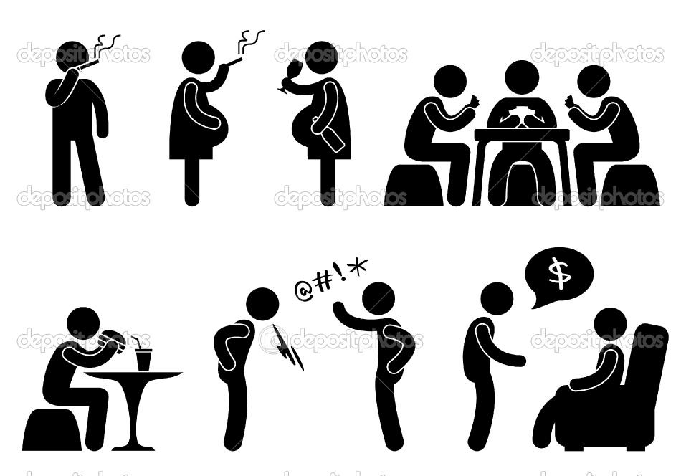
Psychology and Behavior Conti…
Behavior is learned and can be unlearned
Social learning perspectives are used in practice (social-skills, modeling, etc)
Behavior Modification is done according to condition

Slide 9


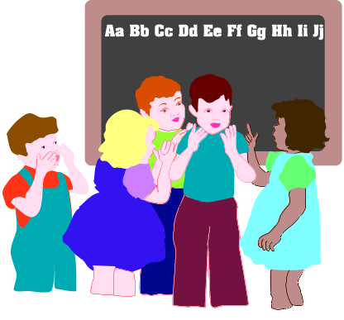
Behavior is Shaped by Culture
Literacy Rate
Social Interaction
Personal Space

Slide 10
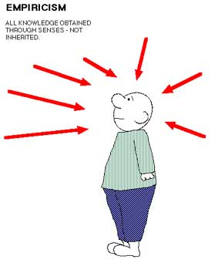
Psychology and Science
Psychology is Empirical
Knowledge acquired through observation
It is a systematic approach to the understanding of people, their thoughts, emotions and behavior. The application of this understanding helps to solve
human problems

Slide 11
Branches of Psychology
It has two main branches:
Pure Psychology:
It deals with the psychological research and data which helps to formulate the principles of activity
Applied Psychology
It applies the information given by Pure Psychology, to the problems of actual life.

Slide 12

Pure Psychology
Psychology is the scientific study of human and animal behavior with the object of understanding why living beings behave as they do. It deals with the psychological research and data which helps to formulate the principles of acvtivity
Experimental Psychology
Social Psychology
Abnormal Psychology
Developmental Psychology
Comparative Psychology
Physiological Psychology:

Slide 13



Applied Psychology
The basic premise of applied psychology is the use of psychological principles and theories to overcome problems in other areas, such as mental health, business management, education, health, product design, ergonomics, and law.
Clinical Psychology
Industrial Psychology
Educational Psychology
Application of Psychology in Medicine
Application of Psychology in Law

Slide 14
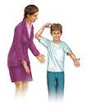
The Four Primary Goals Of Psychology
Describing and Explaining Behavior
  Differentiating between normal, healthy and unhealthy behaviors is the cornerstone of psychology, so it is important that psychologists have a keen sense of observation.
  the second goal of psychology, explaining. The attempt to explain behavior based on observation is actually rather difficult due to many factors. For instance, behavior varies among culture and can change over time

Slide 15

Predicting and Influencing Behavior
  Psychologists try to determine if a person is likely to make healthy or unhealthy decisions when confronted with certain situations. Most of the time, they will use experiments to make their predictions.
  The last of the goals of psychology is to influence behavior. This can be to change unhealthy behavior as well as encourage already existing healthy behavior. There are many methods used to influence behavior such as positive reinforcement or rewarding good behavior.

Slide 16
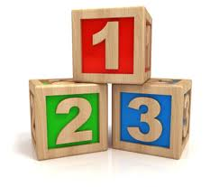
Different Perspectives in Psychology
Biological Psychology
Behavioral/Clinical Psychology
Cognitive Psychology
Social-Cultural Psychology
Personality Psychology
Experimental Psychology
Educational Psychology
Industrial Psychology
Criminal Psychology
Computational Psychology

Slide 17
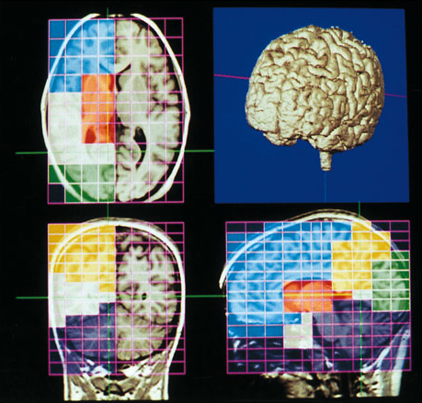
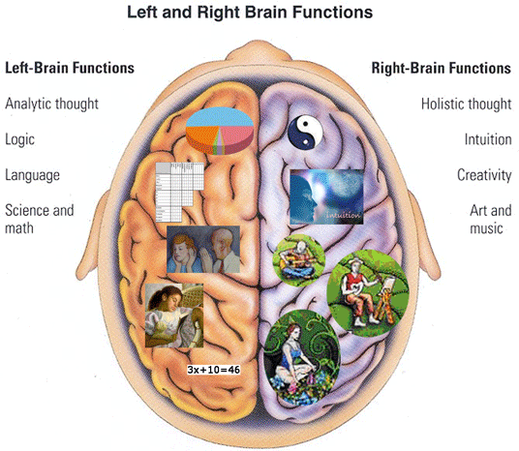
Biological psychology
How the body and brain create emotions, memories,
and sensory experiences.
Biological psychology Includes the study
of psychology, biology, physiology, biochemistry, the neural sciences and related fields.

Slide 18
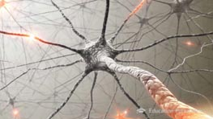
Biological psychology Conti…
Biological psychology looks at the link between biology and psychological events such as how information travels though out our bodies (neural impulses, axons, dendrites, etc.), how different neurotransmitters effect sleep, dreams, and other behaviors, just to name a few.
Alternative names of biopsychology, such as behavioral neuroscience and physiological biology.
The study of how all body processes function, including the electrical and chemical processes necessary for nervous system communication.

Slide 19

How Information travels

Slide 20

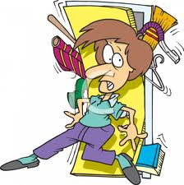
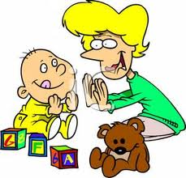
Behavioral Psychology
Behavior is Action in response to a cause
Behavioral psychology is a branch of psychology
that focuses on observable behaviors.
Conditioning, reinforcement and punishment are key concepts used by behaviorists.

Slide 21

Behavioral Psychology

Slide 22
Behavioral Psychology Conti…
Conditioning
Classical conditioning is a behavioral-intervention technique by which two stimuli that are paired together repetitively elicit the same behavioral response separately.
Operant conditioning, is a technique that focuses on the association between voluntary behavior and consequence.

Slide 23


Behavioral Psychology Conti…
Reinforcement
Reinforcement is a psychology term that refers to the way behaviors increase or decrease according to whether people associate it with a positive experience (a "reward") or a negative experience (a "punishment").

Slide 24
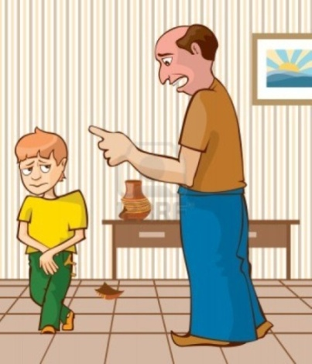
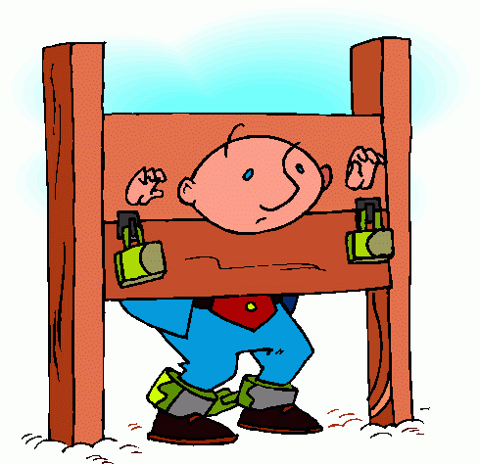
Behavioral Psychology Conti…
Punishment
Negative punishment is an important concept.
In behavioral psychology, the goal of punishment is to decrease the behavior that precedes it.
In the case of negative punishment,
it involves taking something good
or desirable away in order to reduce
the occurrence of a particular behavior.

Slide 25

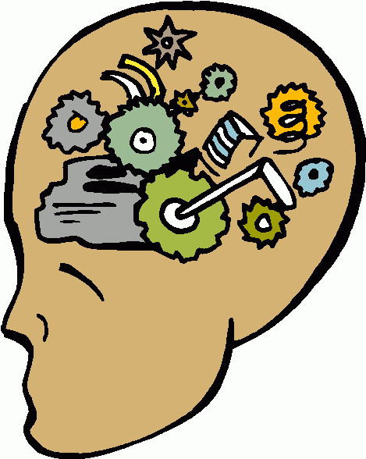
Cognitive Psychology
Cognition means the mental processes involved in acquiring,
processing, storing & using information
Cognitive Psychology is the study of human
thought processes and cognitions. Cognitive psychologists study topics such as attention, memory, perception, decision-making, problem solving and language acquisition.

Slide 26
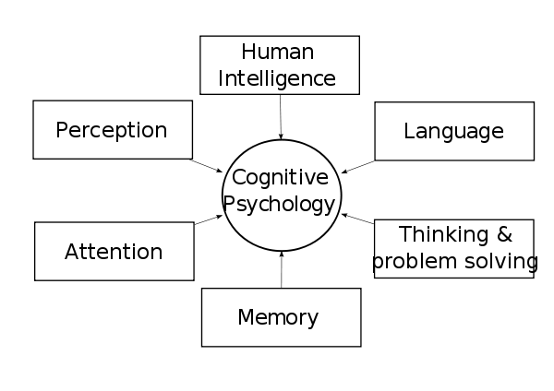
Cognitive Psychology Conti…
Cognitive psychology focuses on the way humans process information, looking at how we treat information that comes in to the person (what behaviorists would call stimuli), and how this treatment leads to responses.
This includes:
  Memory
  Problem-Solving
  Perception
  Language
  Information Processing

Slide 27


Social-Cultural Psychology
Stresses the interaction between developing people and the culture in which they live.
Baron, Byrne & Suls (1989) define social psychology as .......“the scientific field that seeks to understand the nature and causes of individual behavior in social situations”
Social psychology is about understanding individual behavior in a social context

Slide 28


Socio cultural psychology focuses on the fact that our interactions with others in society affect not only our thought process, but also our perception, and the manner in which we make decisions.
Our socio cultural thought process begins in childhood and steadily gains momentum as we grow older.
This branch of psychology explains how we create our identity or self-image, and shape our perception.

Slide 29
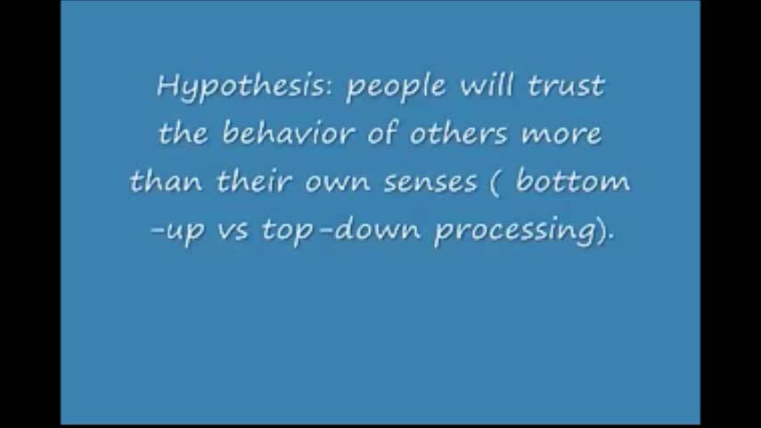

Slide 30
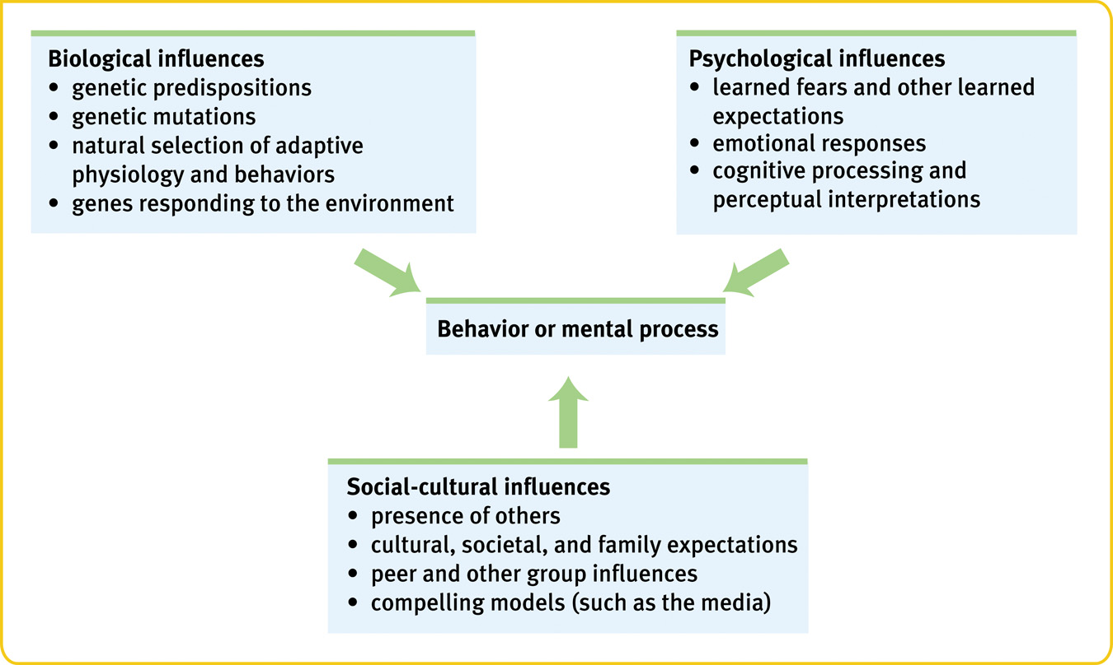

Slide 31


Personality Psychology
About personality, how it develops, and how it influences our behavior
Personality psychology is a branch of psychology which studies personality and individual different processes - that which makes us into a person.

Slide 32

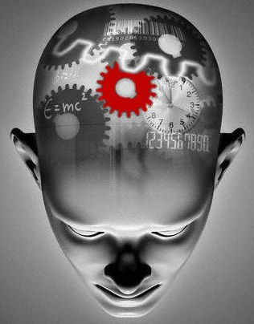
Experimental Psychology
A method of studying psychological phenomena and processes.
Experimental psychology is an area of psychology that utilizes scientific methods to research the mind and behavior.
Experimental psychologists work in a wide
variety of settings including colleges,
universities, research centers, government
and private businesses.

Slide 33
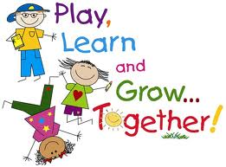

Educational Psychology
General sense is a form of learning in which knowledge, skills
Educational psychology is the study of how humans learn in educational settings, the effectiveness of educational interventions, the psychology of teaching, and the social psychology of schools as organizations.
It involves learning process of early childhood and adolescence, includes the social, emotional and cognitive processes.

Slide 34


Industrial Psychology
Attitudes of employees and employers, organizational behavior, workplace environment and its effects
Industrial organizational psychology is an applied area of psychology that involves using psychological theories and principles to solve problems related to the workplace and organizations.
Concerned with efficient management of an industrial labor force and especially with problems encountered by workers in a mechanized environment.

Slide 35
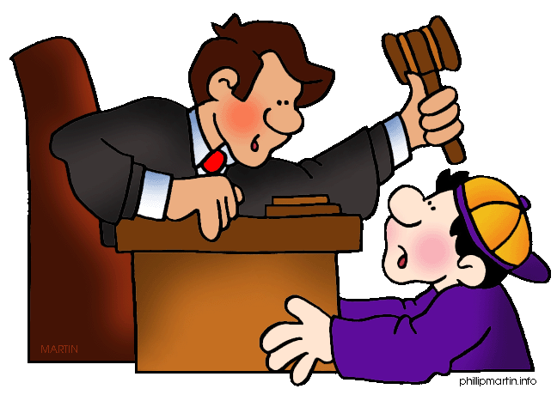
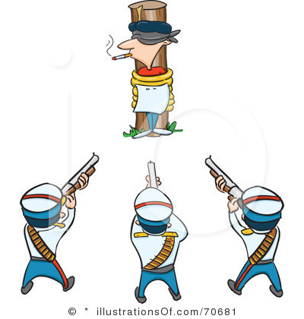
Criminal Psychology
Criminal or forensic psychology focuses on criminals.
Criminal psychology is the study of the wills, thoughts, intentions and reactions of criminals, all that partakes in the criminal behavior.
This psychology is particularly uneasy with tests of social structure that are based on assessments of age, race, ethnicity, and gender at the personal level.

Slide 36

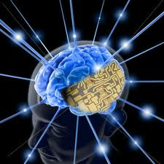
Computational Psychology
A discipline lying on the border between artificial intelligence and psychology.
It is concerned with building computer models of human cognitive processes and is based on an analogy between the human mind and computer programs. T
The brain and computer are viewed as general-purpose symbol-manipulation systems, capable of supporting software processes.

Slide 37
The importance of psychology
Self-Knowledge
Learning can be viewed as one purpose of life, and self-knowledge can be viewed as an important element of learning.
Learning About Others
learning about oneself, the field of psychology allows us to learn about others.
Solving Important Problems
Theories and findings in psychology may help us to solve important problems.

Slide 38

Development of psychology
Development describes the growth of humans throughout the lifespan, from conception to death.
The scientific study of human development seeks to understand and explain how and why people change throughout life.
This includes all aspects of human growth, including physical, emotional, intellectual, social, perceptual, and personality development.

Slide 39
Thank You

