Slide 1
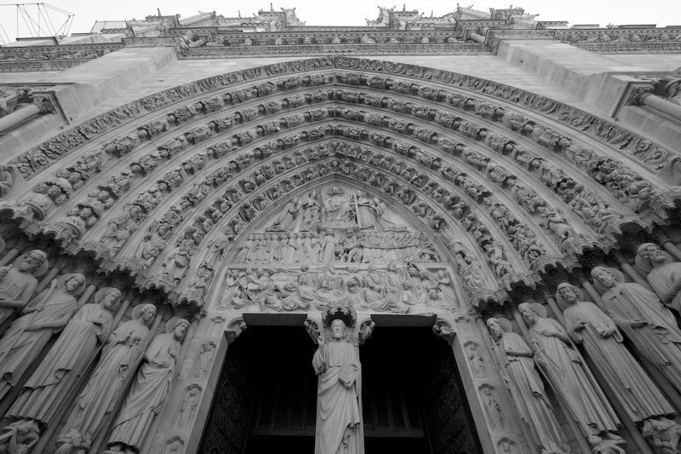
Deontological & Consequential Ethics

Slide 2
Consider these quotes:
“The remarkable thing is that we really love our neighbor as ourselves: we do unto others as we do unto ourselves. We hate others when we hate ourselves. We are tolerant toward others when we tolerate ourselves. We forgive others when we forgive ourselves. We are prone to sacrifice others when we are ready to sacrifice ourselves.” ~ Eric Hoffer

Slide 3
Consider these quotes:
“We can discover this meaning in life in three different ways: (1) by doing a deed; (2) by experiencing a value; and (3) by suffering.” ~ Victor Frankl.

Slide 4
Consider these quotes:
“ Never let your sense of morals get in the way of doing what's right.” ~ Isaac Asimov.
“When morality comes up against profit, it is seldom that profit loses.” ~ Shirley Chisholm

Slide 5
Consider these quotes:
“Actions are right in proportion as they tend to promote happiness; wrong as they tend to produce the reverse of happiness. By happiness is intended pleasure and the absence of pain.” ~ John Stuart Mill

Slide 6
Major Ideas:
Virtue Ethics: An action is right if it is what the virtuous agent would do.
1. An action is right if it is what a virtuous agent would do in the circumstances;
  1a. A virtuous agent is one who acts virtuously, i.e., one who has & exercises the virtues.
  2 A virtue is a character trait a human being needs to flourish or live well. What is essential is to note the conceptual link between virtue & flourishing (living well or eudemonia).

Slide 7
Major Ideas:
Deontological Ethics: An action is right iff it is in accordance with a moral rule or principle. A moral rule is one that is
(a) laid on us by God,
(b) required by natural law,
(c) laid on us by reason,
(d) required by rationality,
(e) would command universal rational acceptance, or
(f) would be the object of choice of all rational beings. What is essential is the link between right action, moral rule, & rationality.

Slide 8
Major Ideas:
Consequential Ethics: An action is right if it promotes the best consequences. The best consequences are those in which happiness is maximized. What is essential to note is that it forges a link between consequences & happiness.

Slide 9
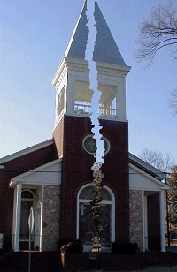
Major Ideas:
Before we consider consequential and deontological ethics, let’s explore some other basic terms that are important to know:
Good ideas have good consequences, bad ideas have bad consequences.

Slide 10
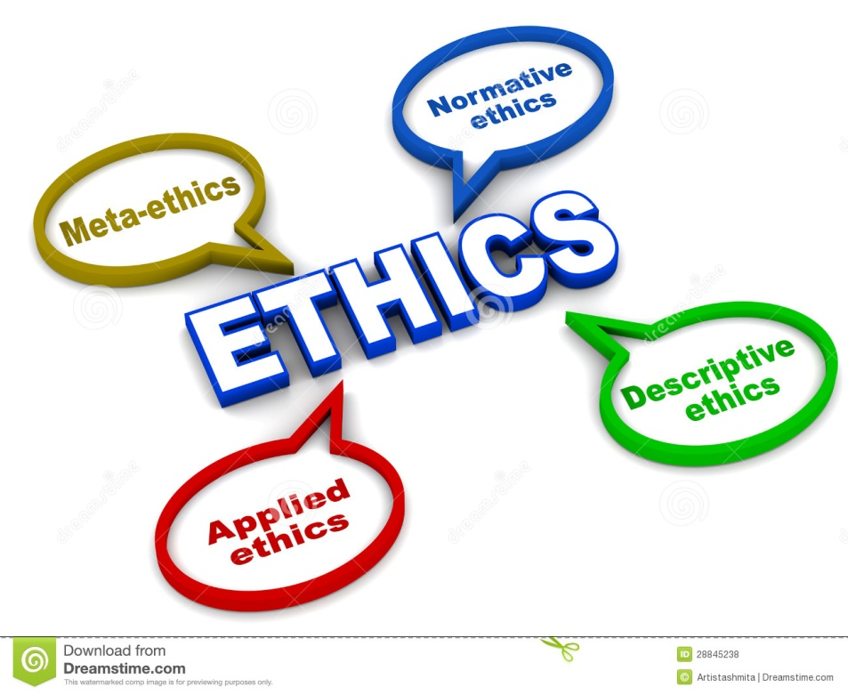

Slide 11
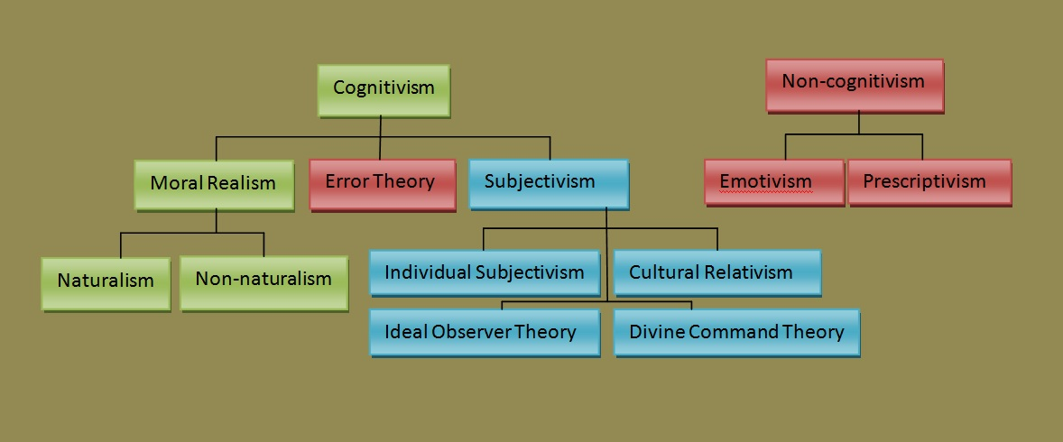

Slide 12
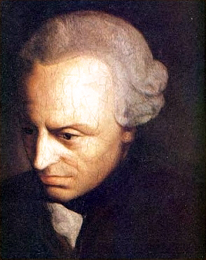
Let’s now explore Deontological Ethics:

Slide 13
Deontological Ethics
We should choose actions based on their inherent, intrinsic worth; evangelical approaches to ethics are deontological because it presupposes Scripture as revelation.
“Deontological” comes from the Greek word “deon”, meaning that which is binding, in particular a binding duty. So, you are bound to your duty.

Slide 14
Deontological Framework:
An action is right if and only if (if) it is in accordance with a moral rule or principle.
  This is a purely formal specification, forging a link between the concepts of right and action and moral rule, and gives one no guidance until one knows what a moral rule is.

Slide 15
Deontological Framework:
Therefore, the links between right action, moral rule, and rationality based upon moral rule + given by God or required by natural or laid on us by reason or required by rationality or would command universal rational acceptance or would by the object of choice of all rational being—are all essential aspects to any deontological framework.

Slide 16
Deontological Framework:
  So, the next thing the theory needs is a premise about that: A moral rule is one that would have been historically:
  A. Theistic:
  1. Given to us by God;
  2. Is required by Natural Law (theistic connection);
  B. Secular (though can still be connected to God):
    1. Is laid on us by reason.
    2. Is required by rationality;
    3. Would command universal acceptance;
    4. Would be the object of choice of all rational beings.

Slide 17
Deontological Ethics
It holds that acts are right or wrong in and of themselves because of the kinds of acts they are and not simply because of their ends or consequences.
- The ends do not justify the means.
- A good end or purpose does not justify a bad actions.
- You are duty-bound; binding is not dependent on consequences, no matter if it is painful or pleasurable.

Slide 18
Deontological Ethics
For example:
1. You are duty-bound to keep your promise to be faithful to your spouse, even if a more attractive person comes along.
2. You are duty-bound to always telling the truth, even if it cost you a job.
Duty is not based on what is pleasant or beneficial, but rather upon the obligation itself.

Slide 19
Deontological Ethics
For example, a deontologist might argue that a promise ought to be kept simply because it is right to keep a promise, regardless whether the doing so will have good or bad consequences.
In contrast, a utilitarian will argue that we should keep our promises only when keeping them results in better consequences than the alternatives.

Slide 20
Overview of Ethical Systems: Immanuel Kant (1724-1804):
. To act morally you must be motivated exclusively
by rational commitment to the universal moral law or the categorical
Imperative: “Act in conformity with that maxim, and that maxim only,
that you can will at the same time be a universal law.”
Right actions flow out of right principles
Do the act that is motivated by the sincere belief that what you are doing is the right thing not merely for you, but for anybody seeking to act properly in any situation.
To act morally requires the rational power to recognize absolute moral laws that transcend our natural world.
To act morally requires the power of the will to rise above all natural feelings and inclinations. This raises us above our natural world.
Second form of categorical imperative:
“Act in such a way that you always treat humans not merely as a means to an end but also as an end.”

Slide 21
Basic Terms to Know:
1. Deontological Ethics: "rule or duty-based morality; ...emphasizes right action over good consequences“
2. a priori: "not in any way derived from experience or dependent upon it"; concepts derived a priori are universal rules that determine, in advance, the conditions for knowledge in a particular domain
3. maxim: rule of conduct;
4. Hypothetical imperative: an action that is good only as a means to something else;
5. Categorical imperative: an action that is good in itself and conforms to reason; categorical imperatives act as universal rules governing a situation regardless of circumstance

Slide 22
Summary:
Thus, Kantian ethics states an action is right iff it is in accord with the Categorical Imperative (the supreme principle of morality). Right actions flow from right principles.
From using our capacity to reason Kant believes the Categorical Imperative can be formulated in at least three ways; they are all equivalent with the first formulation being the basis. Though they bring out various aspects of the moral law, they cannot tell us more than what the first formula does.

