Slide 1
Personal Values Influence Ethical Choices

Slide 2
Chapter Preview: Personal Values
Influence Ethical Choices
Developing a strong sense of character
How values are formed
Value conflicts and how to resolve them
Making ethical decisions based on personal values
Corporate crime and steps to eliminate it

Slide 3
Character, Integrity and Moral Development
Character is composed of your personal standards of behavior including:
  Honesty
  Integrity
  Moral strength

Slide 4
Integrity: A Dimension of Character
Integrity is congruence between what you
  know
  say
  do
Practicing what you believe demonstrates integrity
Critical to successful relationships

Slide 5
A Valued Character Trait
People with integrity do what they say they will do
Are clear about what they stand for
Think hard about what is right and wrong

Slide 6
The Corrosion of Character
Richard Sennett believes decline of character can be traced to:
  economic conditions
    fast-paced, high stress
    information-driven
  limited connections
    past
    neighbors
    selves

Slide 7
Character Development
Integrity can be developed
Make and keep promises to self and others
Many organizations and educational institutions believe in character training

Slide 8
Six Pillars of Character
According to the Josephson Institute of Ethics:
  Trustworthiness
  Respect
  Responsibility
  Fairness
  Caring
  Citizenship

Slide 9
Total Person Insight
People working together with integrity and authenticity and collective intelligence are profoundly more effective as a business than people living together based on politics, game playing, and narrow self-interest.
Peter Senge
Author, The Fifth Discipline

Slide 10
Personal Values
Values are personal beliefs and preferences that influence one’s behavior
Deep-seated in personality
Exist at different levels of awareness
Awareness of values enhances integrity

Slide 11
Five-Part Valuing Process to Clarify and Develop Values
Thinking
  critical thinking
  distinguishing fact from opinion
Feeling
  listening to “gut level”
Communicating
  listening closely
  interacting with others

Slide 12
Five-Part Valuing Process to Clarify and Develop Values
Choosing
  being well informed
Acting
  repeatedly and consistently

Slide 13
Identifying Your Core Values
Core values are those that consistently rank higher than others
General principles and beliefs that guide intermediate and long-term goals
Influence the behavior of individuals and organizations

Slide 14
Values and Job Selection
We often must choose among core values
  High salary
  Security
  Meaningful work
  Lots of time off
Most choices require compromising at least one

Slide 15
Values Shaping Influences
Major influences that shape our values are:
  People
  Events
  Family
  Religious groups
  Schools
  The media

Slide 16
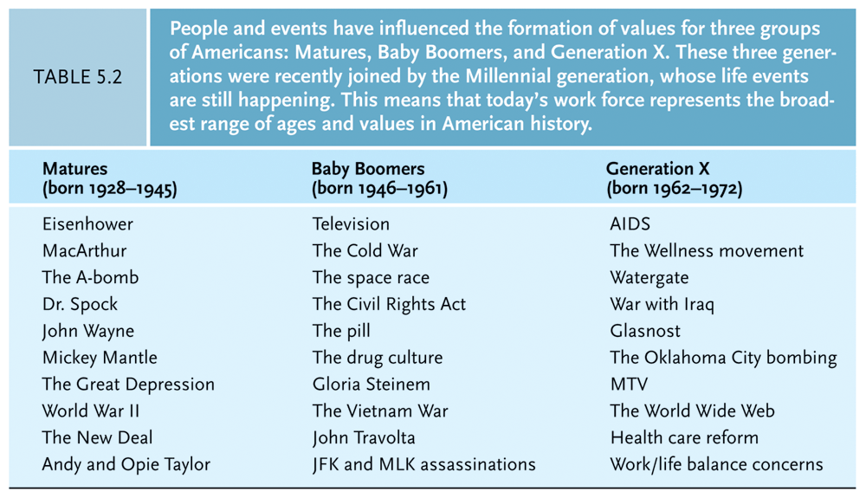

Slide 17
Family
Parents assume many roles
Most important role is moral teacher
Challenges to families:
  single-parent households
  two parents working outside the home
  care for elderly parents
  financial pressures

Slide 18
Religious Groups
Value priorities often developed through religious training
  Religious doctrine
  Role models
Many now seeking spiritual and moral anchors in both personal lives and work

Slide 19
Schools
Some see character education as fundamental aspect of education
Values clarification common part of curriculum in 70s
Objections and fears about imposing values, so much was eliminated
Resurgence in the movement today

Slide 20
Media
Viewers often see
  people abusing and degrading each other without consequences
  violence and antisocial behavior
Research connecting television viewing and
  depression
  desensitization of children

Slide 21
People We Admire
Modeling is shaping behavior to be like people you admire
Important for children and adults
Leaders in the workplace are important models for adults

Slide 22
Avoiding Values Drift
Values drift is the slow erosion of core values over time
  exposure to conflicting situations
  pressure to compromise
Reflect on core values when making decisions at work
Choose appropriate ethical behavior to maintain integrity

Slide 23
Avoiding Values Drift
Organizations must constantly ask the following questions:
  What do we stand for?
  Why do we exist?
Successful companies, through constant monitoring, adapt to a changing environment without losing sight of core values

Slide 24
Values Conflicts
Differences between individual’s personal values is major cause of values conflict
Problems may be due to conflicts between worker’s and the manager’s value systems

Slide 25
Values Conflicts
Organizations should look for value conflicts when addressing organizational problems
  Declining quality
  Absenteeism
  Poor customer service

Slide 26
Total Person Insight
If you want young people to take notions like right and wrong seriously, there is an indispensable condition: they must be in the presence of adults who take right and wrong seriously.
William J. Bennett
Author, The Book of Virtues

