Slide 1
Ethics
Concept Summary

Slide 2
Ethics and Social Responsibility
Ethical values
Social responsibility
Fundamental approaches to ethical issues

Slide 3
Ethics
The code of moral principles and values that govern the behaviors of a person or group with respect to what is right or wrong.

Slide 4
Three Domains of Human Action
Domain of Certified Law
(Legal Standard)
Domain of Ethics
(Social Standard)
Domain of Free Choice
(Personal Standard)
Amount of
Explicit Control
High
Low

Slide 5
Ethical Dilemma
A situation that arises when all alternative choices or behaviors have been deemed undesirable because...
potentially of negative ethical consequences, making it difficult to distinguish right from wrong

Slide 6
Criteria For
Ethical Decision Making
Most ethical dilemmas involve
Conflict between needs of the part & whole
  Individual versus the organization
  Organization versus society as a whole
Managers use normative strategies to guide their decision making - norms and values

Slide 7
Ethical Decision Making Approaches
Utilitarian Approach
Individualism Approach
Moral-Rights Approach
Justice Approach

Slide 8
Utilitarian Approach
Moral behavior produces the greatest good for the greatest number
Critics fear a “Big Brother” approach and ask if the common good is squeezing the life out of the individual
Example – Oregon’s decision to extend Medicaid to 400,000 previously ineligible recipients by refusing to pay for high-cost, high-risk procedures

Slide 9
Individualism Approach
Acts are moral when they promote the individual's best long-term interests, which ultimately leads to the greater good
Individual self-direction paramount
Individualism is believed to lead to honesty & integrity since that works best in the long run
Examples: Top executives from WorldCom, Enron, Tyco demonstrate flaws of approach

Slide 10
Moral-Rights Approach
Moral decisions are those that best maintain the rights of those people affected by them.
An ethical decision is one that avoids interfering with the fundamental rights of others

Slide 11
Six Moral Rights
1. The right of free consent
2. The right to privacy
3. The right of freedom of conscience
4. The right of free speech
5. The right to due process
6. The right to life & safety

Slide 12
Justice Approach
Moral Decisions must be based on standards of equity, fairness, impartiality
Three types of Justice Approaches:
Distributive Justice
Procedural Justice
Compensatory Justice

Slide 13
Distributive Justice
Different treatment of people should not be based on arbitrary characteristics
In case of substantive differences, people should be treated differently in proportion to the differences among them

Slide 14
Procedural Justice
Rules should be clearly stated
Rules should be consistently and impartially enforced

Slide 15
Compensatory Justice
Individuals should be compensated for the cost of their injuries by the party responsible
Individuals should not be held responsible for matters they have no control over

Slide 16
Factors Affecting Ethical Choices
The Manager
Levels or stages of moral development
  Pre-conventional
  Conventional
  Post-conventional
The Organization

Slide 17
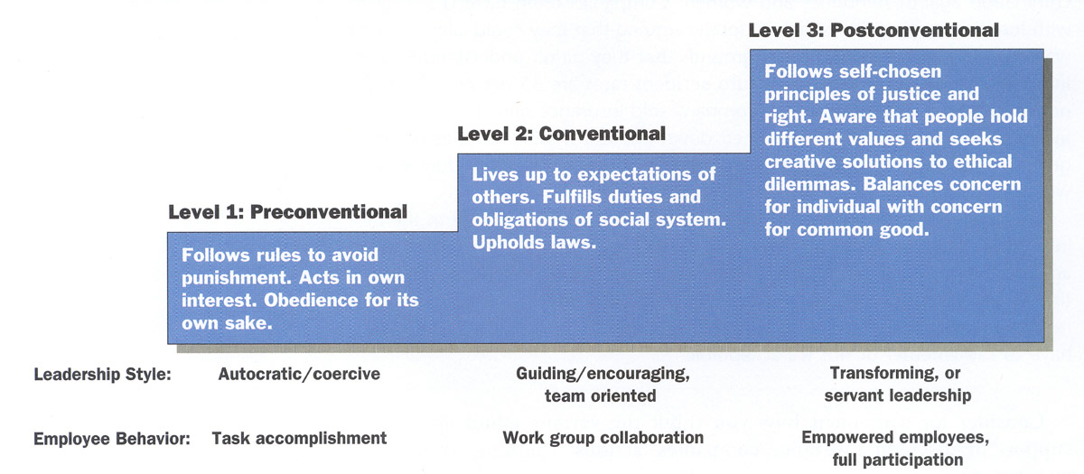
Levels of Personal Moral Development

Slide 18
The Organization
Rarely can ethical or unethical corporate actions be attributed solely to the personal values of a single manager
Values adopted within the organization are highly important
Most people believe their duty is to fulfill obligations and expectations of others

Slide 19

Social Responsibility
Organization’s obligation to make choices and take actions that will contribute to the welfare and interests of society and organization
Being a good corporate citizen
Difficulty in understanding – issues can be ambiguous with respect to right and wrong

Slide 20
Organizational Stakeholders
Any group within or outside the organization that has a stake in the organization’s performance
Each stakeholder
  Has a different criterion of responsiveness
  Has a different interest in the company
Monsanto

Slide 21
Environmental Responsibility Commitment
The Shades of Corporate Green
Activist Approach
StakeholderApproach
Market Approach
Legal Approach

Slide 22

Total Corporate Responsibility
Economic Responsibility
Legal Responsibility
Ethical
Responsibility
Discretionary
Responsibility

Slide 23
The Ethical Organization
Ethical individuals = honest, have integrity, strive for a high level of moral development
Ethical leadership = provides the necessary actions, committed to ethical values and helps others to embody those values
Organizational structure = embodies a code of ethics, and methods to implement ethical behavior

Slide 24
Ethics and the New Workplace
Telecommuting, virtual work, and flexible hours - Success of new programs depends on mutual trust
IT provides opportunities for monitoring
Companies that make an unwavering commitment to maintaining high standards of ethics and social responsibility will lead the way toward a brighter future for both business and society

