Slide 1
Ethics and Communication (Persuasion)

Slide 2

Ethical issues are bound up in the use of communication
Every interaction involves a “content” and a “relationship” dimension, either of which may entail ethical implications.
Persuasion is goal-directed, and therefore involves choices between means and ends.
Richard Weaver’s notion that all language is “sermonic,” e.g., normative, value-laden.

Slide 3
Many persuasion texts ignore the subject of ethics entirely!
Persuasion texts with no dedicated chapter on ethics
Brock & Green (2005). Persuasion: Psychological insights and perspectives
Cooper & Williams (2002). Power persuasion: Moving an ancient art into the media age
O’Keefe (2002). Persuasion: Theory and Research
Perloff (2003). The dynamics of persuasion
Reardon (1991). Persuasion in practice
Stiff & Mongeau (2003). Persuasive Communication
Why do texts give short-shrift to ethical concerns?
They presume they are simply imparting knowledge and information
They presume that ethical judgments are matters of personal opinion
They think it is presumptuous, or even unethical, to teach ethics

Slide 4
Is persuasion in general unethical?
negative stereotypes: persuasion as “sophistry,” including deceit, beguilement, trickery
idealistic view: persuasion as “manipulation,” getting others to do our bidding
feminist view: persuasion as a “masculine” approach to problem solving

Slide 5
Another view of ethics and persuasion
idealistic views of human communication are unrealistic, impractical
  communication does break down
  people do have incompatible goals
persuasion is not a dirty word
“tool” analogy of persuasion (amoral view)
the motives color the means

Slide 6
The motives color the means

Slide 7
Ethics of central versus peripheral processing
Central processing is based on:
  thought, reflection, deliberation
  scrutiny of message content
  high level of receiver involvement
Peripheral processing is based on:
  mental shortcuts such as credibility, images, appearance-based cues
  emotional processing
  low level of receiver involvement

Slide 8
Ethical questions that can’t be answered
“Truth” versus “truths”
Issues related to the ends of persuasion
  pro-life versus pro-choice
  gay marriage
  assisted suicide
  capital punishment

Slide 9
Persuaders as Lovers
characteristics of ethical influence
  respect
  equality
  tolerance

Slide 10
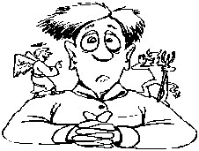
Characteristics of Ethical Influence
Intentionality
Conscious awareness
Free choice, free will on the receiver’s part
In the “world of words” e.g., language and symbolic action
Is the presumptive ethical superiority of words over images justified?

Slide 11

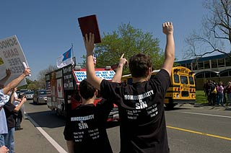
When is banning persuasion ethical?
is there a right to avoid influence attempts? (aggressive panhandling, school rules banning slogans on clothing)
  A16 year was suspended from Poway High School for wearing a t-shirt with an anti-gay message on the “National Day of Silence.”
  He filed a lawsuit, but the 9th U.S. Circuit Court of Appeals upheld a lower-court ruling that his constitutional rights were not violated because the message on his shirt was offensive to homosexual students.

Slide 12
Free choice, free will
Can voters make good decisions about U.S.’ involvement in Iraq if the Pentagon withholds information?
The Pentagon says that photographs of American war dead arriving at Dover Air Force Base should not be released.

Slide 13
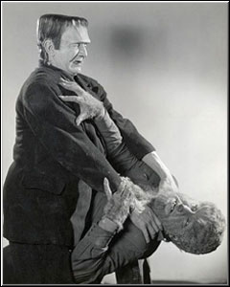
Is the use of coercion ever be ethically justified?
A child is forced to get a vaccination by his or her parents
a psychotic or delusional person is forcibly restrained so he/she won’t harm him/her self or someone else
the “ticking bomb” scenario: using torture to save lives?

Slide 14

Ethical questions regarding source credibility
Is it unethical for a celebrity endorser to promote a product or service he or she does not actually use, or about which he or she lacks expertise?
Does the use of authority become an abuse of authority if receivers place too much faith or reliance in a particular source?
Is Michael Jordan responsible if Nike shoes are made in sweatshops using child labor?

Slide 15
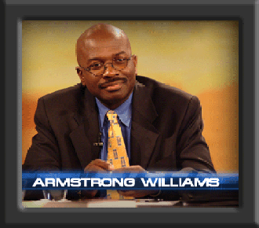
Paid punditry: Government credibility and “planted” news
Armstrong Williams, a syndicated columnst, was paid $240,000 by the Education Department to promote the "No Child Left Behind" law.
In an appearance on CNN's "Crossfire“ Williams said, "I used bad judgment," and apologized to his audience.
the Dept. of Defense is paying the Lincoln Group to plant stories in Iraqi newspapers that put a positive spin on the U.S.’ role in Iraq.
The articles, written by U.S. military "information operations" officers, are translated into Arabic and placed in Baghdad newspapers.

Slide 16
More on paid punditry
In 2000, President Clinton's drug czar, Barry McCaffrey, secretly paid television networks to promote its anti-drug message.
Scripts on “ER,” “Chicago Hope,” “The Practice,” “Beverly Hills 90210" and other programs were altered to include anti-drug messages.
In return, the networks were allowed to sell advertising time that had been promised to the government.

Slide 17


Ethical questions relating to receivers
What ethical guidelines should be followed when attempting to persuade highly vulnerable audiences?
  Children
  Elderly
  Poor, inner-city residents
  Immigrants, non-English speakers

Slide 18
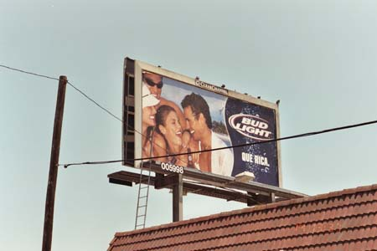
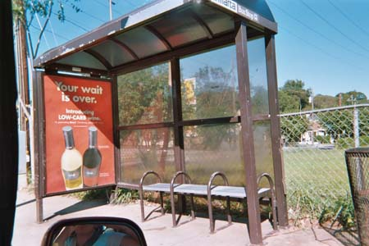
Alcohol and tobacco advertising in the inner city
African-American communities are targeted by the alcohol and tobacco industry
Billboards: 55%-58% of inner city billboards carried cigarette and/or alcohol ads compared to only 34% in more affluent areas.
Magazine ads: Black youths were exposed to 66% more beer and ale ads and 81% more distilled spirits magazine advertisements in 2002.
Radio ads: Blacks youths heard 12% more beer advertising and 56% more ads for distilled spirits than non-African-American youth.

Slide 19
Marketing alcohol to underage drinkers
On average, young people view 2,000 beer and wine commercials per year
America’s youth saw more beer commercials than ads for sneakers, gum, jeans, crackers, cookies, or fruit juice.
Alcohol ads outnumber anti-drinking ads by 50 to 1.
The Center on Alcohol Marketing and Youth (CAMY) found that alcohol ads aired on 13 of the 15 most popular teen shows
Ten magazines with at least one-fourth of their total readership below the legal drinking age, featured nearly one-third of all alcohol advertising expenditures in magazines

Slide 20
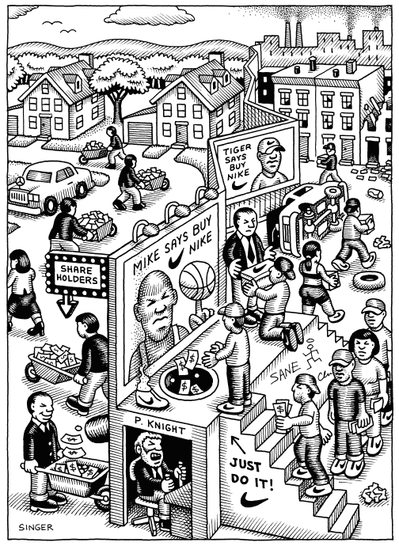
Common criticisms of advertisers/marketers
Advertising sells us dreams and entices us with romanticized images.
Advertising makes us believe there is a quick fix for all of life’s problems
Advertising panders to our desires for things that are bad for us.
Advertisers manipulate us into wanting things we don’t really need.

Slide 21
Responses to criticisms
Caveat emptor—let the buyer beware
Consumer stupidity is not the fault of advertising
  In 2004, more people voted in the American Idol competition than voted in the presidential election
Media literacy movement: can facilitate informed understandings of mediated texts and their social, cultural, and moral force.
Economic Darwinism: bad products won’t survive no matter how good the advertising
The FCC and other watchdog groups regulate advertising
Advertisers and other groups have their own professional codes of ethics.

Slide 22
Ethical questions regarding the use of deception
Is deception ever justified? Is honesty always the best policy?
Is deception a form of communication competence? Should people practice being better deceivers?

Slide 23
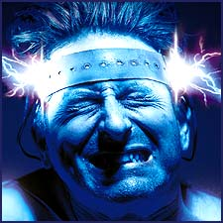
Ethical questions related to the use of threats and fear appeals
Is the use of threats ever ethically justifiable?
Is the use of fear appeals ever ethically justifiable and, if so, under what conditions or circumstances?
Cartoon boy (Saatchi & Saatchi):

Slide 24
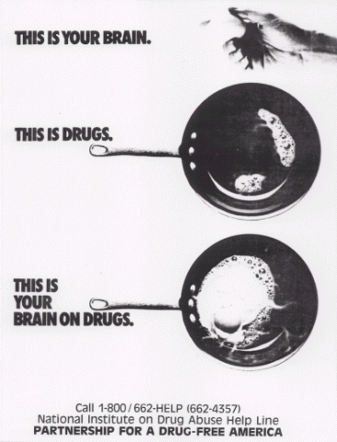
A culture of fear?
Barry Glassner, a sociology professor at USC, claims people are bombarded with fear appeals
  Fear of terrorism
  Fear of immigrants taking jobs, jobs being outsourced overseas
  Fear of exotic diseases
  Fear of ailments that require prescription drugs
  Fear of crime, violence
  Fear of lack of health care coverage
  Fear of Social Security cuts

Slide 25

Ethical questions related to using emotional appeals
Is playing on another’s emotions ethically defensible?
Are some types of emotional appeals better, or more ethically defensible than others?

Slide 26
Ethical questions related to the use of ingratiation?
Is ingratiation an unethical strategy, or an honest acknowledgement of the way things work?
Research by Ronald Deluga shows ingratiating employees enjoy a 5% advantage when it comes to employee performance reviews

Slide 27



Ethics and visual persuasion
Philip Morris spends twice as much promoting its philanthropy as it does on philanthropy itself.
Kraft/Philip Morris ad on food relief in Kosovo
Voice-Over: “In 1998 thousands of families were forced to flee the tragedy in Kosovo. We, at the Philip Morris Companies, felt we needed to do something to help so we sent 5 tons of food.”
“For more than 40 years the Philip Morris Companies have been one of the largest corporate contributors to disaster relief efforts in the United States and abroad.”

Slide 28
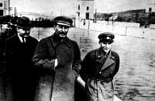
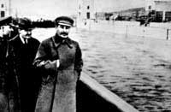
The camera does lie
The documentary quality of photographs and video footage makes people think these are “objective,” “impartial” representations of reality.
Can you spot the fake photos?
http://www.autodesk.com/eng/etc/fake_or_foto/quiz.html
The Vanishing Commissar: Josef Stalin with and without Nikolai Yezhov. Yezhov, the commissar of water, was cropped out of this photo after he was executed in 1940.

Slide 29



Ethical of subliminal persuasion
Should subliminal messages be allowed and, if so, should they be regulated by the government or some other institution?

