Slide 1
Lecture 3

Slide 2
WHAT IS THE MATERIAL AND FORMAL OBJECT OF ETHICS?

Slide 3
OBJECT! WHAT IS THAT?
Material Object in any science:
  It is the WHAT you study
  The matter / thing / direct object you actually study
  Material Object of Medicine / Finance?
Formal Object of any science:
  It is the ANGLE / PERSPECTIVE from which you study the material object
  Formal Object of Medicine / Finance?

Slide 4
What is the object of study in ethics?
The material object is the free human acts which influence and form the way of being a person.
The formal object of ethics is the moral value of the acts (their level of goodness or badness).

Slide 5
Objectives of ethics.
To help the individual to understand basic principles of ethics.
To help the individual gain some practical knowledge about self and about different ethical issues.

Slide 6
To obtain true and systematic knowledge of upright and authentic human behavior based on universal principles.
To establish a series of norms and criteria for judging human acts.
The aims of ethics

Slide 7
Continued..
To study the basic truths about the human nature in order to discover the deepest and most common truths about the human person
Establishes guiding principles that facilitate life in a community

Slide 8
Continued.. comes up with practices and customs that fosters good habits in a personal conduct (virtues)
Builds personal character by learning how to acquire good habits that can perfect us as persons and how to avoid bad habits that perverts us.
Notes:
THIS IS ONE OF THE AREAS THAT NEEDS TO BE EXAMINED IN AN EXAM SETTING.

Slide 9
WHAT IS MORALITY?
Write your own definition of morality in your notes
Share it with a few people around you and discuss the concept briefly
Rewrite your definition of morality with any new insights you may have gained from your sharing with others

Slide 10
To understand “morality”...
We need to know that there are different types of goodness in our real world
Natural goodness: the goodness that an act or that any real thing possesses by the very fact that it exists!
Technical goodness: the effectiveness or goodness of the technique and skill used in carrying out the act
Moral goodness: goodness of the act based on the fact that it leads the person closer to their true, objective, real, final goal

Slide 11
Morality…
Morality is goodness or badness of human acts.

Slide 12
The nature of ethics.
Ethics is considered to be a theoretical (speculative), normative and practical science…
Ethics can also be divided into three areas; Meta ethics, Normative ethics or Applied ethics.

Slide 13
A theoretical science.
Because it tries to understand the nature of value judgments and norms of behavior in order to determine the truth about what is really good or really evil for the human person.

Slide 14
Nature of ethics.
Descriptive ethics: What do people think is right? (this is relativistic)
Normative (prescriptive) ethics: How should people act?
Applied ethics: How do we take moral knowledge and put it into practice?
Meta-ethics: What does 'right' even mean?

Slide 15
A normative science
Because it establishes norms or rules of conduct to help people choose what is really good for them.
Formulation of value judgments and norms of behavior wit an aim of guiding the freedom of each human being.

Slide 16
Theories in normative ethics.
Virtue theories, Plato, Aristotle…
Duty theories (Deontological theories) Deon is a Greek word for duty.(Kant, W. D Ross)
The rights theories (John Locke)
Consequationalist normative theories
Utilitarianism e.tc.

Slide 17
EXAMPLE OF NORMATIVE PRINCIPLES IN APPLIED ETHICS
PERSONAL BENEFIT
SOCIAL BENEFIT
PRICIPLE OF BENEVOLENCE
PRICIPLE OF PETERNALISM
PRINCIPLE OF HARM
PRINCIPLE OF HONEST
PRICIPLE OF LAWFULLNESS
PRINCIPLE OF OUTONOMY
PRICIPLE OF JUSTICE
PRICIPLE OF RIGHT.

Slide 18
A practical science
Because it provides a reference point
for making /taking decisions that one
can put into practice. It helps one to
know how to act well.

Slide 19
APPLIED ETHICS
Medical ethics
Business ethics
Environmental ethics
Political ethics
Legal ethics.
Accounting ethics
and so on.

Slide 20
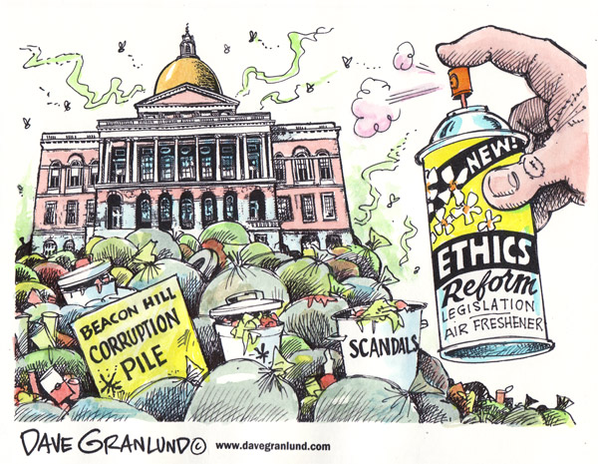
Political Ethics.

Slide 21

Environmental ethics.
GO GREEN!

Slide 22
Meta ethics.
Ethics finds its foundations in meta ethics
Meta ethics deals with very important topics such as the basic truths about God, Creation, the spiritual nature of man and his freedom among other topics.

Slide 23
Other ways of looking at ethics
Ethics can be divided into two;
General ethics- basic principles regarding the morality of human acts. Example, the last end of man, the moral law, conscience, sin, and virtues
Social ethics- it applies the previous mentioned principles of the life of man as a member of society.

Slide 24
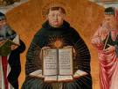

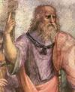
Scholars we are going to refer to:
Thomas Aquinas
Aristotle
Plato

