Slide 1
Ethical Power and Politics

Slide 2
Introduction (1 of 2)
Power is needed to reach objectives in all organizations
  Power affects performance
  The way managers use power affects human relations and performance
Successful global companies are sharing power with employees through empowerment
  Employee empowerment forms the basis of new decentralized decision-making of contemporary organizational structures

Slide 3
Introduction (2 of 2)
Politics is important to organizational performance
  Political human relations affect performance
  People who use ethical politics are more productive in the long run than people who use unethical politics

Slide 4
Organizational Power
Power is a person’s ability to influence others to do something they would not otherwise do
Sources of Power
Position Power –
  derived from top-level management
  delegated down the chain of command
Personal Power –
  derived from the follower

Slide 5
Bases of Power
Coercive Power | Involves threats and / or punishment to influence compliance
Connection Power | Based on the user’s relationship with influential people
Reward Power | Based on the user’s ability to influence others with something of value to them
Legitimate Power | Based on the user’s position power
Referent Power | Based on the user’s personal power
Information Power | Based on the user’s information being desired by others
Expert Power | Based on the user’s skill and knowledge

Slide 6
Sources and Bases of Power with Situational Supervision and Communication Styles
Personal power
Personal power
Expert
Referent
Reward
Coercive
Information
Legitimate
Connection
Laissez-faire
Participative
Consultative
Autocratic
Exhibit 10.1

Slide 7
Influencing Tactics
Create and Present a Win-Win Situation
Reading People

Slide 8
Reading People (1 of 2)
Put yourself in the place of the person you want to persuade
  Anticipate how the person sees the world
  Anticipate what his or her expectations are during your persuasion presentation
Get the other person’s expectations right
  If you don’t, you most likely will not influence the person

Slide 9
Reading People (2 of 2)
Incorporate the information about the other person’s expectations into your persuasive presentation
  Use the influencing tactic that will work best with the person
Keep the focus on the other person’s expectations when trying to persuade
  This helps create a win-win situation
  Other person wants to hear how they will benefit

Slide 10
Influencing Tactics
Ingratiation
(Praise)
Rational
Persuasion
Legitimization
Inspirational
Appeal
Personal
Appeal
Notes:
9
The following suggestions specify the types of changes in jobs that are most likely to lead to improvements in each of the five core dimensions.
(1) Combine tasks - managers should put existing fractionalized tasks back together to form a new, larger module of work. This increases skill variety and task identify.
(2) Create natural work units - managers should design tasks that form an identifiable and meaningful whole. This increases employee “ownership” of the work and encourages employees to view their work as meaningful and important rather than as irrelevant and boring.
(3) Establish client relationships - the client is the user of the product or service that the employee works on. Whenever possible, managers should establish direct relationships between workers and their clients. This increases skill variety, autonomy, and feedback for the employee.
(4) Expand jobs vertically - vertical expansion means giving employees responsibilities and controls that were formerly reserved for management. It partially closes the gap between the “doing” and “controlling” aspects of the job, and it increases employee autonomy.
(5) Open feedback channels - by increasing feedback, employees not only learn how well they are performing their jobs but also whether their performances are improving, deteriorating, or remaining at a constant level. Ideally, employees should receive performance feedback directly as they do their jobs rather than from management on an occasional basis.

Slide 11
Guidelines for Using Ingratiation
Being friendly and giving praise to get the person in a good mood before making a request
  Be sensitive to the person’s moods
  Complement the person’s past related achievements
  State why the person was selected for the task
  Acknowledge inconvenience by your request

Slide 12
Guidelines for Using Rational Persuasion
Includes logical arguments with factual evidence
  Explain the reason why your objective needs to be met
  Explain how the other person will benefit by meeting your objective
  Provide evidence that your objective can be met
  Explain how potential problems and concerns will be met
  Explain why your proposal is better than competing ones

Slide 13
Guidelines for Using Inspirational Appeal
Attempts to arouse follower enthusiasm through internalization
  Develop emotions and enthusiasm based on the other person’s values
  Link the appeal to the person’s self-concept
  Link the request to a clear appealing vision
  Be positive and optimistic
  Use nonverbal communication to bring emotions to the verbal message

Slide 14
Guidelines for Using Personal Appeal
Request the person to meet an objective based on loyalty and friendship
  Begin by stating that you need a favor and why it is important
    Then ask for the favor
  Appeal to your friendship
  Tell the person that you are counting on him or her

Slide 15
Guidelines for Using Legitimization
Relying on organizational authority
  Refer to organizational policies, procedures, rules, and other documentation
  Refer to written documents
  Refer to precedent

Slide 16
Organizational Politics
Politics – the process of gaining and using power
  The network of interactions by which power is acquired, transferred, and exercised upon others
Like power, politics often has a negative connotation due to people who abuse political power
  The amount and importance of politics varies from organization to organization

Slide 17
Political Behavior
Three primary political behaviors:
  Networking - process of developing relationship alliances with key people for the purpose of politicking
  Reciprocity – involves:
    creating obligations and debts,
    developing alliances, and
    using them to accomplish objectives
  Coalition Building – a coalition is a network of alliances that help you achieve a specific objective

Slide 18
Business Ethics
Type I Ethics
Behavior that is:
  considered wrong by authorities
  yet not accepted by others as unethical
Type II Ethics
Behavior that is:
  considered wrong by authorities and the individual,
  yet conducted anyway

Slide 19
Ethical and Unethical Politics
Ethical Politics
Behavior that benefits both the individual and the organization
Creates a win-win situation
  Meeting the goal of human relations
Stakeholders approach to ethics
  When dealing with people outside the firm
Unethical Politics
Behavior that benefits the individual and hurts the organization
Creates a win-lose situation
Includes management behavior that helps the organization, but hurts the individual

Slide 20
Codes of Ethics
Establish guidelines that clearly describe ethical and unethical behavior
Most organizations consider ethics codes to be important
To be ethically successful, organizations must:
  audit the ethical behavior of employees
  confront and discipline employees who are unethical

Slide 21
Etiquette
Etiquette – the socially accepted standard of right and wrong behavior
Includes manners beyond simply saying please and thank you
Most organizations do not usually have codes or any formal training in etiquette

Slide 22
Etiquette Skills
Job Interview
Etiquette
Table Manners
Telephone
Etiquette
Meeting
Etiquette
Hoteling
Etiquette
E-mail
Etiquette
Notes:
5
Break-even Analysis
identifies profit or loss at various sales volumes
Return on Investment
measures productivity of assets
Marginal Analysis
compares the additional cost in a particular decision rather than average cost
Game Theory
mathematical models that analyze multi-party decision contexts
Linear Programming
for optimally solving resource allocation problems
Queuing Theory
for calculating waiting lines

Slide 23
Vertical Politics
Relations with Your Boss
Loyalty
Cooperation
Initiative
Information
Openness to criticism
Regaining boss’s trust
Relations with Subordinates
Developing manager-employee relations
Friendship
The open-door policy

Slide 24
Horizontal Politics (1 of 2)
Relations with Members of Other Departments
Relations with Peers

Slide 25
Horizontal Politics (2 of 2)
Relations with Peers
Cooperating with peers
Competing with peers
Criticizing peers
Relations with members of other departments
Develop good human
relations through being cooperative and following guidelines set by the organization.
Develop good relations with people in other organizations

Slide 26
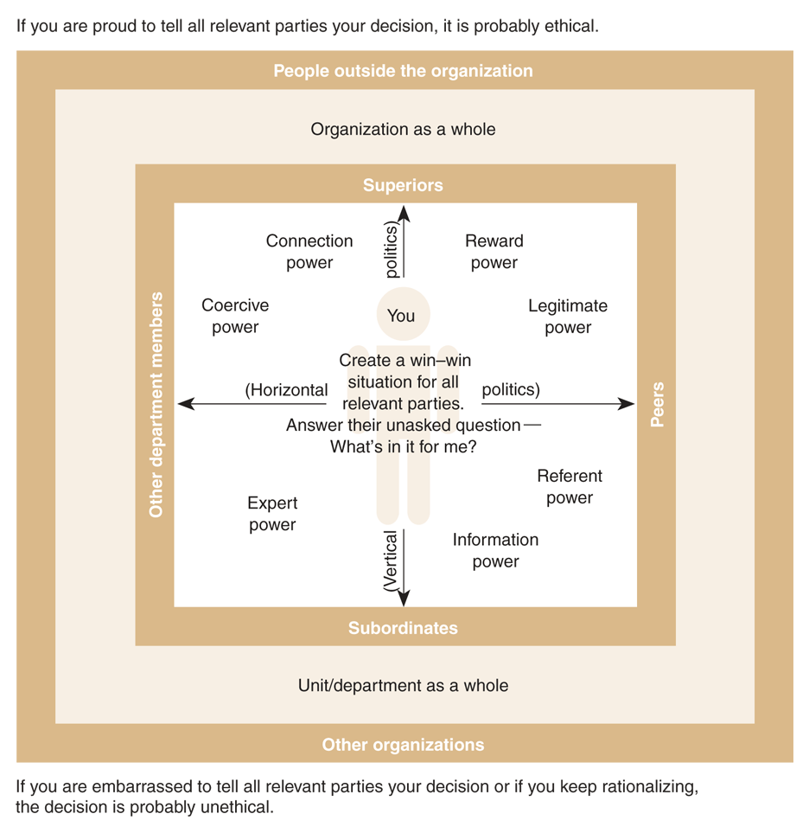
Human Relations Guide to Ethical Decision Making
Exhibit 10.4

Slide 27
Do Power, Politics, and Etiquette Apply Globally? (1 of 3)
Power is perceived and exercised differently around the globe
Power distance – the extent to which employees feel comfortable interacting across hierarchical levels
  It reflects expectations of centralized or decentralized decision-making

Slide 28
Do Power, Politics, and Etiquette Apply Globally? (2 of 3)
In high power distance cultures:
  Using strong power and politics is acceptable
  Leaders are expected to behave differently from people in low ranks
  Differences in rank are more apparent
  i.e., Latin American cultures, Mexico, Venezuela, Philippines, Yugoslavia, France

Slide 29
Do Power, Politics, and Etiquette Apply Globally? (3 of 3)
In low power distance cultures:
  Using strong power and politics is not acceptable
  Power is expected to be shared with employees through empowerment
  People are less comfortable with differences in power
  Less emphasis on social class distinction and hierarchical rank
  i.e., U.S., Ireland, Australia, New Zealand, Denmark, Israel, the Netherlands

