Slide 1
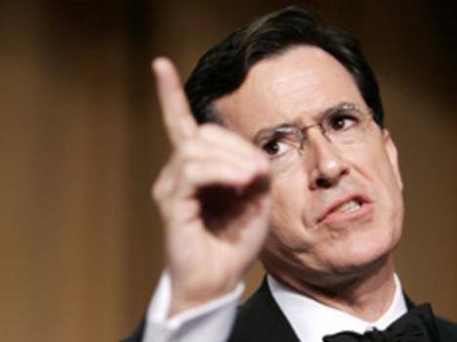
Media Ethics:
Understanding Media Morality
Chapter Outline
History
Ethical Principles
Controversies

Slide 2
A Brief History of Media Ethics
Ethics –
  The study of guidelines that help people determine right from wrong in their voluntary conduct
The Print Era - Early American ethical views
    Often depended on political orientation.
    Advancement of one’s political point of view was often more important than a search for the truth.
    Objectivity
      Describing something based on factual elements rather than the feelings of the one describing it (subjectivity) as a journalistic standard.

Slide 3
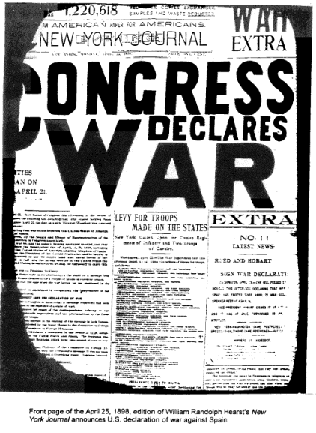
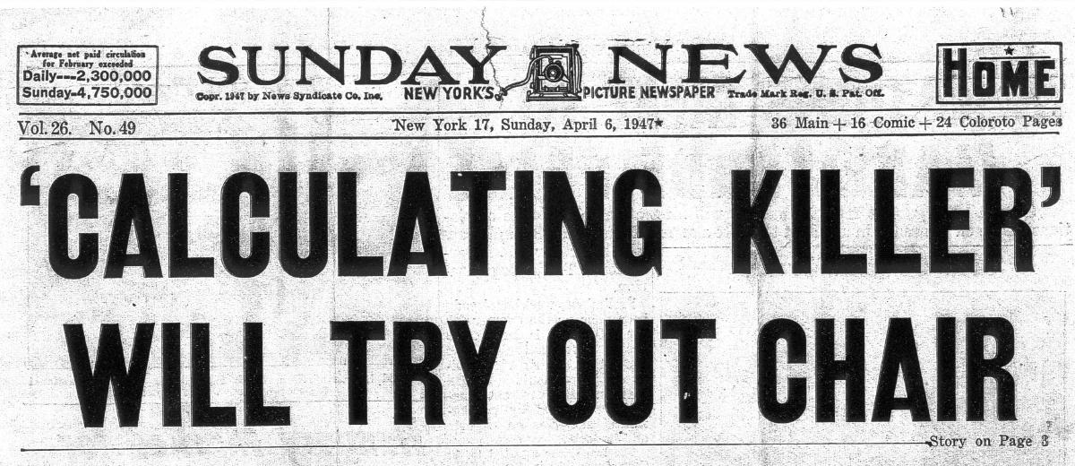
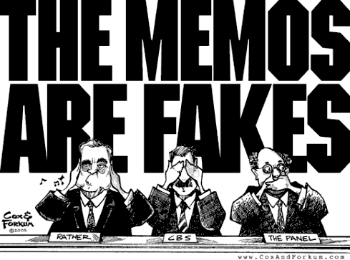
A Brief History of Media Ethics
  In the 1830s some critics were upset that hoaxes (purposeful deceptions) were often used to sell newspapers.
  Many of the techniques of nineteenth century yellow journalism were ethically questionable.
      Sensational slanting of the news.
      Publishing lurid headlines.
      William Randolph Hearst’s 1895 incitement for the United States’ entry into the Spanish American War.

Slide 4


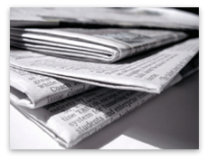
A Brief History of Media Ethics
  Theodore Roosevelt believed investigative reporters
    Were unethical when uncovering corruption
    Ignored good things that government accomplished
  Worries about media power led to development of ethical codes.
    The Canons of Journalism,
      Outlined the need for fair and impartial reporting,
      Published in 1923 by the American Society of Newspaper Editors (ASNE).
    The American Association of Advertising Agencies
      Created a code that established false and misleading advertising as unethical.

Slide 5
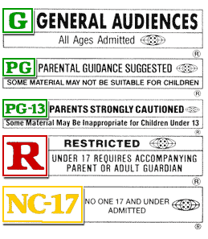
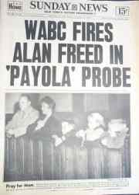
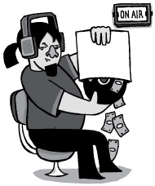
A Brief History of Media Ethics
Motion Picture Code of 1930
  Limited the sex and violence that could be portrayed in movies.
  This was a precursor to today’s movie rating system.
National Association of Broadcasters (NAB)
  In 1929 Established code of ethics that limited sex and violence in programs and banned commercials directed at children.
  The NAB code was abandoned in 1983.
Payola,
  Practice of record promoters paying DJs to play their songs,
  Was both an ethical and legal scandal in the radio and recording industries.
  Do you think this occurs today? how? why?

Slide 6
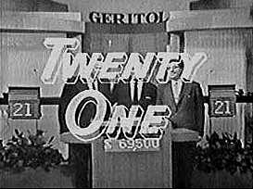
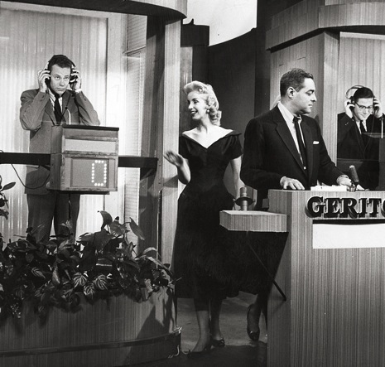
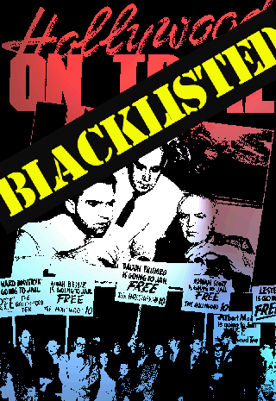

A Brief History of Media Ethics
1950’s quiz shows created one of the most famous media ethics scandals
  When producers of “Twenty-One” gave a contestant answers and coached him to appear as if he were straining to think.
  Federal laws were passed against fixing game shows.
Blacklisting – Another 1950s scandal
  Media executives fired anyone listed as suspected communist sympathizers

Slide 7
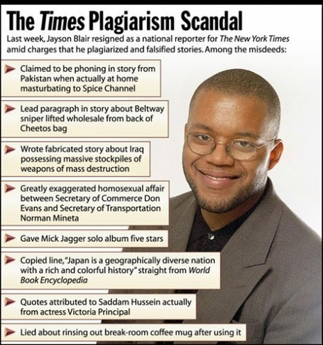
A Brief History of Media Ethics
In 2003 Jayson Blair, a former New York Times reporter, resigned from the newspaper
  Found to have plagiarized 36 of 73 articles
    Fabricated other stories over several years.
  Washington post
    Reporter Janet Cooke
    Won Pulitzer for fake story about 8yr old heroine addict
    Pg 438

Slide 8
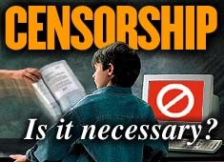
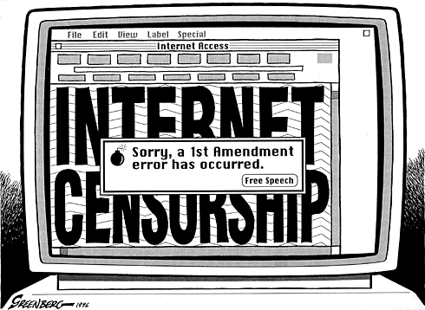
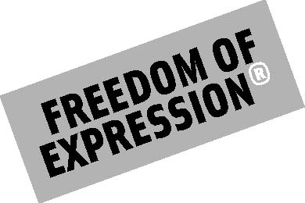
A Brief History of Media Ethics
The digital era has ushered in a rethinking of media responsibility that might be called
  “The ethics of unlimited information.”
  Pornography and hate sites flourish on the Web,
    Several 24 hour news services have shown that no information, no matter how lurid, can be hidden from children.
  Do you think internet content can be held to any standards?
  Is it possible to regulate web content effectively?
    How/Why

Slide 9
Understanding Today’s Media Ethics
Basic Ethical Orientations
  Absolutist Ethics
    Right or wrong response for every ethical decision.
    Often based on religious ideals, and are often rigidly adhered to.
    Are prescriptive
      Stipulate specific behaviors to be followed.
    Are proscriptive
      Stress the things that should not be done.
    Many news organizations have a two-source rule
      Nothing will be published as fact without a second independent confirmation.

Slide 10
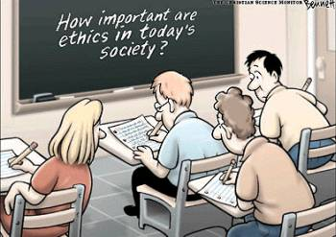
Understanding Today’s Media Ethics
American philosopher John Rawls,
  Ethical behavior is only possible when practitioners wear a veil of ignorance
  Treating everyone equally
  Allows them to be very objective in presenting their media
Situation ethics are where ethical choices can be made rationally without a rigid adherence to a predetermined set of rules.
  Situation ethics are sometimes called relativistic ethics.
How important are ethics in the today’s society
Can you think of any media examples where ethics is/was an issue?
  What do you think about this commercial?
  Video Clip

Slide 11
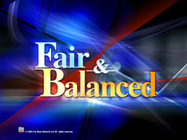
Understanding Today’s Media Ethics
Aristotle’s golden mean,
  Ethical behavior is a midpoint between extremes
  Practitioners navigate between professional needs and those of society.
  Commonly used as ethical theory modeling journalistic values as balance, fairness, and proportion
Utilitarian principle According to John Stuart Mill’s,
  Ethical behavior is that which is useful in generating the greatest good for the greatest number of people.

Slide 12
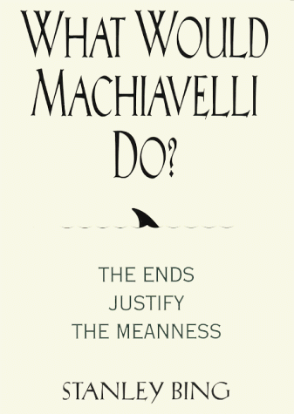
Understanding Today’s Media Ethics
Machiavellian ethics
  Encapsulated in the expression “the ends justify the means.”
  Holds that the consequences of a particular action form the basis for any valid moral judgment about that action.
    A morally right action is one that produces a good outcome, or consequence
Enlightened self-interest
  If you do what is right for yourself it will also probably be right for the rest of the world in the long run.
  Right or Wrong 4 Media
  Publishing/Reporting the name of a person who is HIV positive?
  What if the person is ???

Slide 13
Understanding Today’s Media Ethics
Conflicting Loyalties
  There is a wide range of conflicting loyalties that influence the ethical decisions of media practitioners.
    Duty to personal conscience.
    Duty to one’s organization or firm.
    Duty to one’s profession or art.
    Duty to society.
  Which of these do you think is most important for a Journalist?
  Would it be the same for everyone else
    Why/Why Not

Slide 14
Understanding Today’s Media Ethics
Conflicting Loyalties
  In entertainment:
    Filmmakers may seek to tell an artistic truth rather than a historical truth in movies.
  In advertising:
    Advertisers want a truth that depicts the satisfaction the product will bring to the consumer.
      Video Clip Video Clip
  In the news media:
    Journalists are expected to present an objective truth
    Sometimes personal bias can make this challenging

Slide 15
Controversies
Stereotypes
  Show the media present prejudice & can encourage prejudice in others.
“Pump and dump”
  Occurs when broadcast analysts buy a stock, talk about it on the air, and then sell it as soon as the price goes up.
    Is this wrong for them to do
Paying for news,
  The essential element of checkbook journalism,
    Is viewed as an ethical problem because it creates a conflict of interest.
Practitioners are accountable to
  Corporate owners, editors,
  Internal censors, news councils,
  Competitors, and citizen’s groups.

Slide 16
Controversies
  Anonymity and who deserves it
    The use of anonymous sources is always controversial
    At least one editor must know the name of the source before information from that source is used in an article
    Readers are to be told why a source is granted anonymity
  Do you think that controversial stories should be published if the source demands anonymity?
    Example - Accusations towards a company or public figure
  Why/Why Not

Slide 17
Controversies
In 1960s and 1970s, TV networks maintained large and powerful departments known as
  Standards and Practices
    To oversee the ethics of their programming.
    The "network censors."
    Standards and Practices Departments are maintained at each broadcast and many cable networks.
  Some newspapers have an ombudsman
    Oversee employee’s ethical behavior and answer reader complaints.

Slide 18
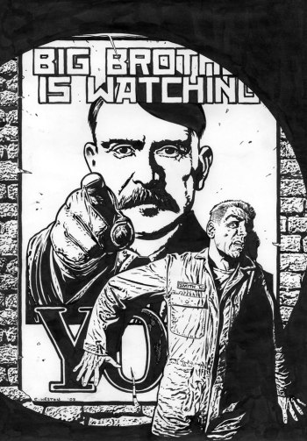

Controversies
News councils
    Independent agencies whose mission is to objectively monitor media performance
Media people also accountable to citizens’ groups,
    Members of the general population who form associations to exert influence on the media.
    Also called “pressure groups.”
  Parents Resource Music Center
      Lobbied for “Explicit Lyric” labels on music albums

