Slide 1
Lecture 02

Slide 2
INTRODUCTION TO ETHICS

Slide 3

WHY SHOULD I STUDY INTRODUCTION TO ETHICS?
Notes:
From an anthropological perspective. Biological man needs assistance of the mature people to survive unlike many animals. Social perspective, we need to conduct ourselves in a manner that respects other human beings for harmony in society- to avoid treating human beings as objects. Spiritual or transcendental perspective, man has intelligence and will that help one to have freedom, know tre truth, desire the good and hence get towards an ultimate end which is eternal happiness…

Slide 4
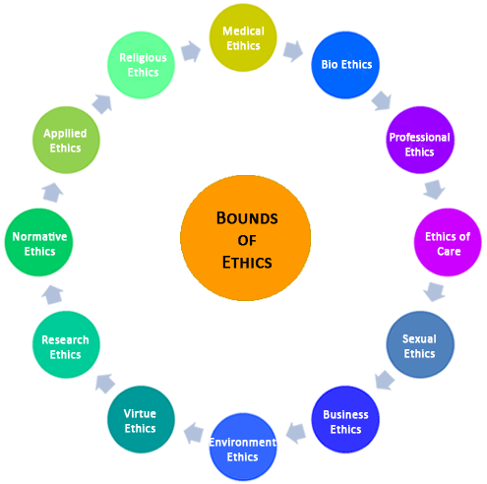

Slide 5
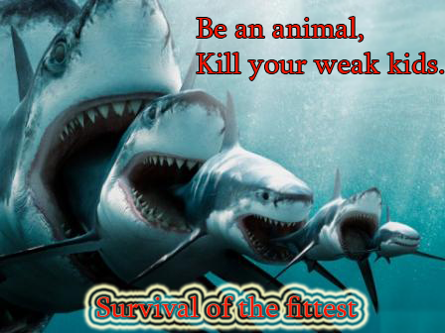

Slide 6

WHY SHOULD I STUDY INTRODUCTION TO ETHICS?
Notes:
From an anthropological perspective. Biological man needs assistance of the mature people to survive unlike many animals. Social perspective, we need to conduct ourselves in a manner that respects other human beings for harmony in society- to avoid treating human beings as objects. Spiritual or transcendental perspective, man has intelligence and will that help one to have freedom, know tre truth, desire the good and hence get towards an ultimate end which is eternal happiness…

Slide 7
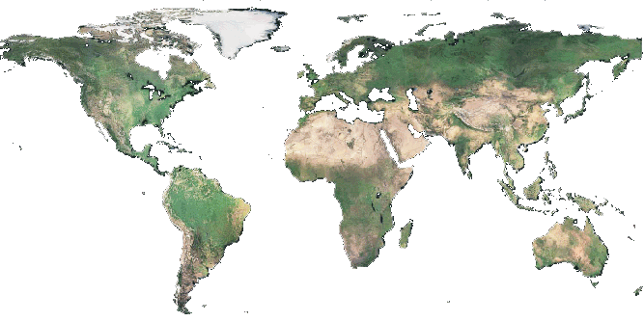
IT’S A GLOBAL PHENOMENON.
Notes:
glo

Slide 8
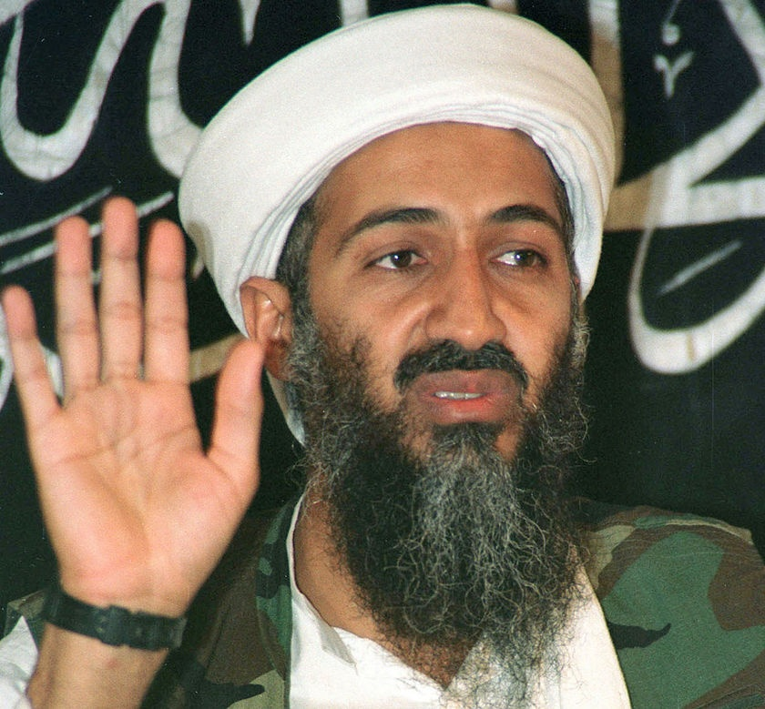
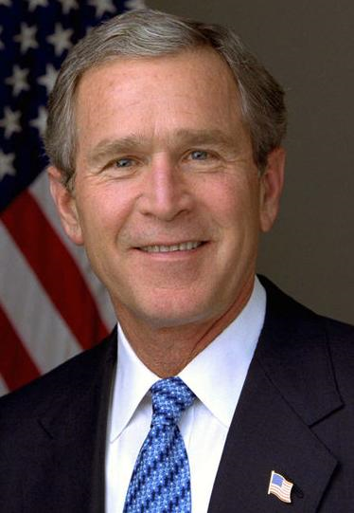

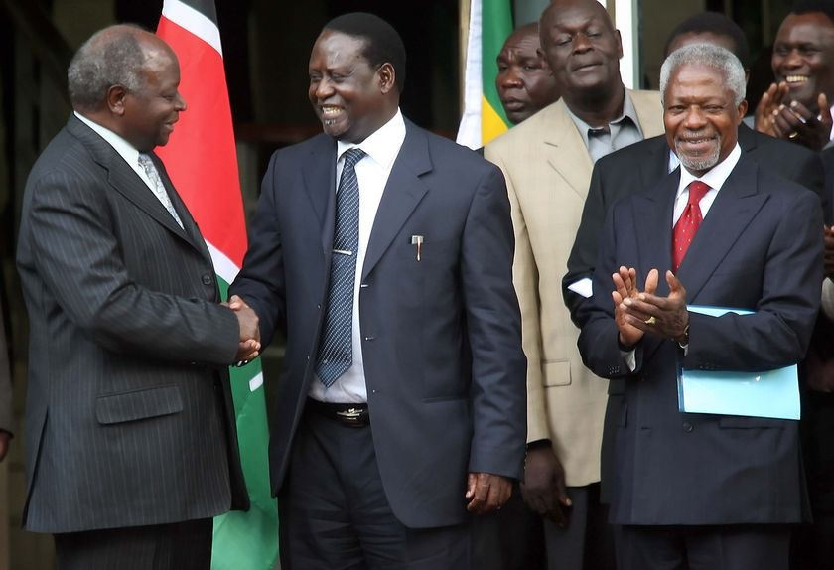
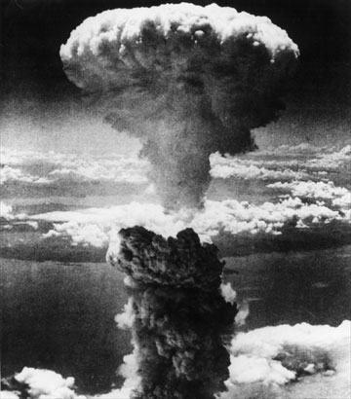

Slide 9
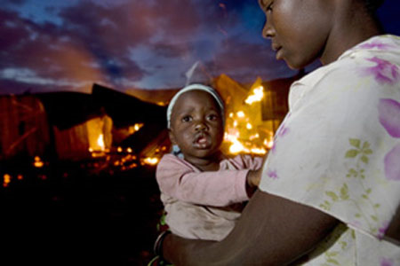
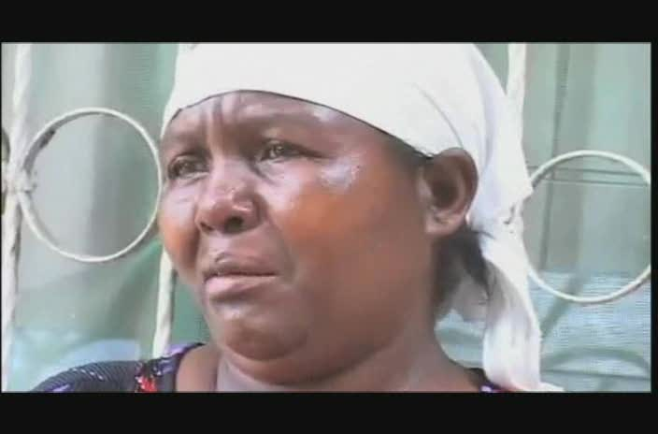

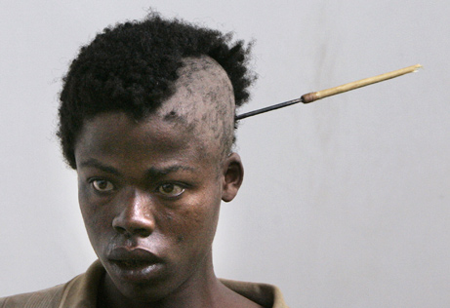
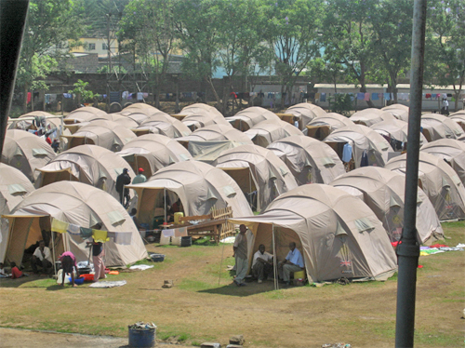
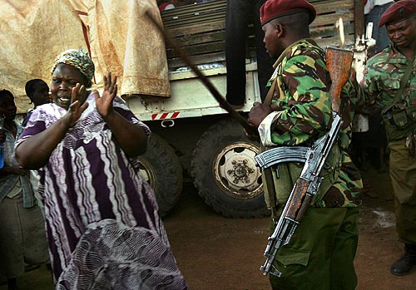
KENYA FEW YEARS AGO.

Slide 10
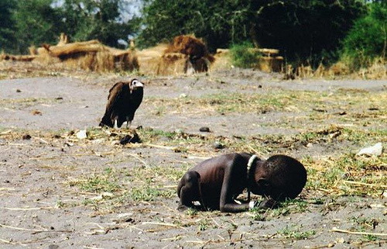
You will meet ethics in your professional life.

Slide 11
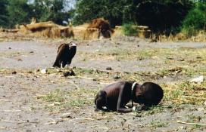
The prize-winning image: A vulture watches a starving child in southern Sudan, March 1, 1993.
Carter’s winning photo shows a heart-breaking scene of a starving child collapsed on the ground, struggling to get to a food center during a famine in the Sudan in 1993. In the background, a vulture stalks the emaciated child.
Carter was part of a group of four fearless photojournalists known as the “Bang Bang Club” who traveled throughout South Africa capturing the atrocities committed during apartheid.
Haunted by the horrific images from Sudan, Carter committed suicide in 1994 soon after receiving the award.

Slide 12

Atmosphere of freedom and responsibility.

Slide 13
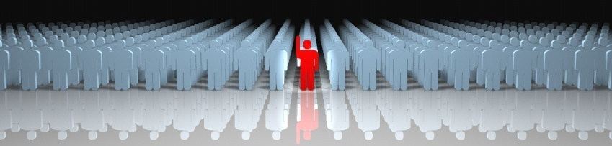
Example
“Ethical MISSION”
To provide market-driven professionals by offering high quality examinations in accountancy, management, information technology and related disciplines.

Slide 14
We commit ourselves to the following core values.
(I) Excellence and meritocracy.
(ii) Accountability and transparency.
(iii) Honesty and integrity.
(iv) Competence and professionalism.
(v) Team-work.
(vi) Social responsibility.
(vii) Equal opportunities and fair play.

Slide 15
Humanity in order to enable a holistic development.
Ethics classes are an integral component of that all-round development.

Slide 16
Our aim.
To forge personalities that are of the same caliber as the technical knowledge and skills of the person.
Thus providing society with good individuals and professionals who are technically and morally prepared to place their knowledge at the service of the human person and the common good of society.

Slide 17
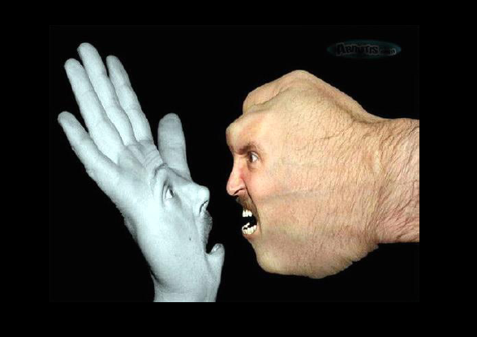
STUDENT CENTERED LEANING. FREEDOM

Slide 18
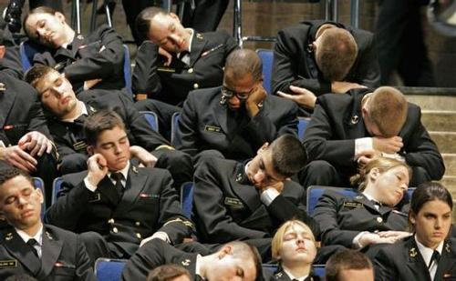
Class participation.

Slide 19
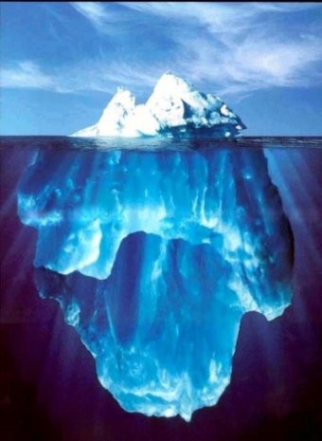

Slide 20

First class work…
What is ethics?
How do we define ethics?

Slide 21
Defining Ethics
Think and write your own definition of Ethics in your notes
Share / compare your definition with the people seated close to you
Rewrite your definition of Ethics in your notes with any new ideas you may have gained by sharing your knowledge

Slide 22
What is ethics?
Ethics is the branch of philosophy that studies free human acts from the point of view of their moral value (their goodness or badness) in relations to mans ultimate end.
Ethics is also termed as moral philosophy it involves systematizing, defending and recommending concepts of right and wrong behavior.

Slide 23
Ethics
It is the systematic study of human actions from the point of view of their rightness or wrongness as a means for the achievement of man’s ultimate happiness.
Ethics is the study of human acts from a moral perspective.

Slide 24
General definitions of Ethics
“Ethics is the area of Philosophy which studies the moral life of man; that is, his human life as a person, considered from the point of view of its goodness or badness” (Debeljuh, p. 25)
“Ethics may be defined as the science of the moral rectitude of human acts in accordance with the first principles of natural reason
“ (Mimbi, p. 25)

Slide 25
Final definition for today.
The study of the moral goodness or badness of specific, free human actions, from the perspective of the First Moral Principles!

