Slide 1
Applied and professional ethics an introduction

Slide 2
Three cases
The whale
The neonate
TRIPS

Slide 3
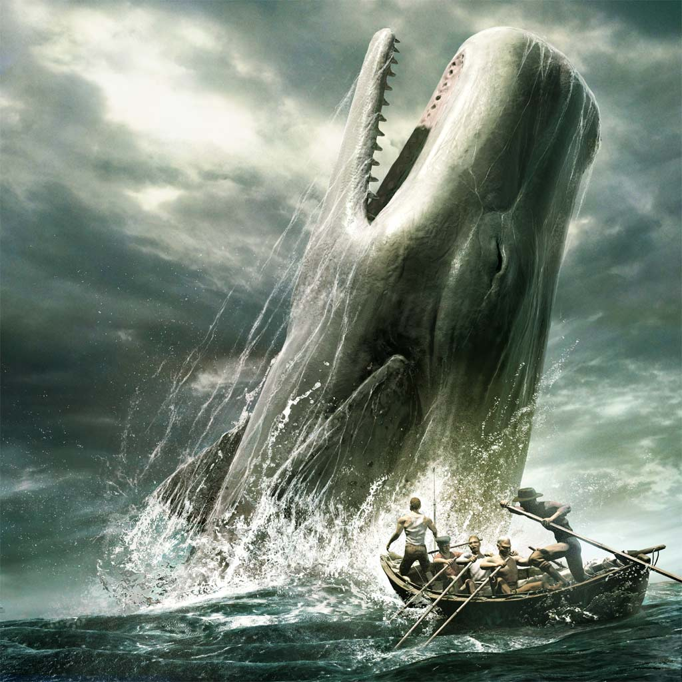

Slide 4
The whale
Whale hunting
Why? Meat, profit
Why not? Suffering, extinction
Moral questions:
Does animal suffering matter?
Do whales have a right to life?

Slide 5
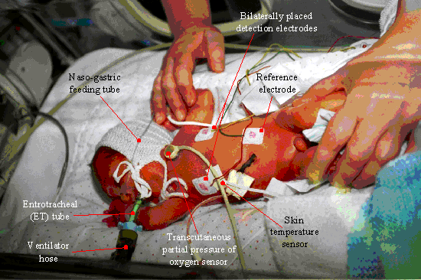

Slide 6
The neonate
New medical technology: newborns can be saved week 22-24
Undeveloped, risk of early death, life-long handicaps
What to do if the neonate catches pneumonia?
A moral conflict: The right to life vs quality of life

Slide 7
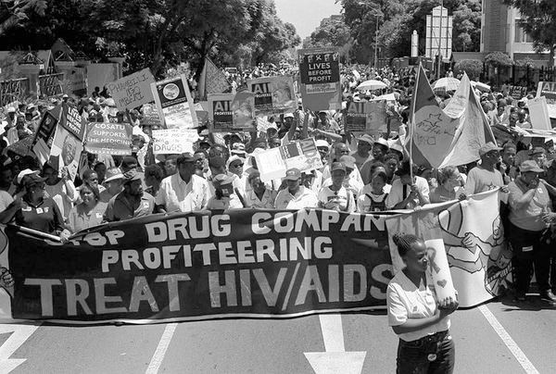

Slide 8
Arguments for Trade Related Aspects of Intellectual Property Rights(TRIPS)TRIPS
In the interest of the inventor, company and home country – partial
Moral:
(1) A person who has invented or created something also has the right to control and own his or her invention or creation.
(2) IPR encourage and reward creative work and as a consequence companies have incentives to develop new technology which benefits economic development and welfare

Slide 9
Trade Related Aspects of Intellectual Property Rights(TRIPS)
Prices on AIDS/HIV drugs 100-200$/month
Millions of patients die…
Right to medicine?

Slide 10
Common to these cases
No simple answers
No given answers
Conflicts of values and rights
A need for assessment of consequences,
listening to stakeholders, balancing of values…
reflection = applied ethics

Slide 11
Definition
“The terms “applied ethics” and “practical ethics” are used interchangeable to indicate the application of ethics to special arenas of human activity, such as business, politics and medicine, and to particular problems, such as abortions.” (Childress, 1986)

Slide 12
How to do applied ethics? – What is the question?
Should IPR be limited so that poor countries can produce generic medicines?
Does the inventor have a right to control his/her invention?
Does the poor have a right to medicines?
Does WTO have an obligation to limit IPR?

Slide 13
1. Identification
What are the relevant moral considerations?
Suffering
Inequality
Property rights
Rights to medicine
...
What are the morally relevant facts?
Facts of intellectual property
Extreme poverty
Spread of HIV/AIDS, TBC...
What are the consequences of enforcement of IPR?
…….

Slide 14
2.Analysis/discussion/argument
Moral intuitions?
Ethical theory?
How do we balance relevant ethical principles and rights? In this case?
Are there any facts that are of particular importance?
What are the implications of different alternatives?
---------
How do we achieve a reflective equilibrium- justified view?

Slide 15
3.Decision/action/evaluation
What is the answer?
What should we do?
Did it turn out well?

Slide 16
Doing applied ethics
Everything is open for discussion!
Don’t jump to conclusions!
No dogmatic answers!
Open minds!

Slide 17


Slide 18
What is the role of the ethicist?
Peter Singer vs Ronald Dworkin:
“Animal liberation” vs
“philosophy from the inside – out”
Should the applied ethicist be an activist or a moderator?

Slide 19
Professional ethics
– mirroring applied ethics
Medical ethics doctors,nurses
Business ethics businessmen…
Technology and ethics engineers..

Slide 20
Professional relations generates moral norms
1) Relations to people dependent on professional work and service – honesty, trustworthiness, care, safety…
2) Relations to workmates – loyalty, solidarity…
3) Relations to employers – loyalty, confidentiality….

Slide 21
Professional ethics as rule ethics
Rules for professional behaviour:
“The patient/client is entitled to be treated with respect, which means that:
The therapist shall respect the right of the patient/client to a private life.
The therapist shall obtain such information only as is necessary for the treatment.”
(Swedish Code of Ethics for Occupational Therapists)

Slide 22
Professional ethics as virtue ethics
“A virtue is an acquired human quality the possession and exercise of which tends to enable us to achieve those goods which are internal to practices and the lack of which effectively prevents us from achieving any such goods.” (MacIntyre)
…professional virtues

Slide 23
Questions for discussions
Why should we engage in applied ethics? What is the aim?
Peter Singer vs Ronald Dworkin:
Should the applied ethicist be a judge or a moderator?
3. Are there any absolute moral norms or principles?

Slide 24
Case 2
You are doctor at a clinic for early born babies. There is a baby born in week 24. Many organs are underdeveloped and if you use intensive care you estimate that the probability for survival with grave handicaps is 50%.
You can choose either to put in all intensive care or give the baby an injection resulting in death. What do you do? Why?

