Slide 1
Ethics in Different Religions

Slide 2
Overview
1. The Christian Worldview
2. The Navajo Worldview
3. Islam
4. Buddhism

Slide 3
Part 1
The Christian Worldview

Slide 4
Socrates’
Question
It’s helpful to begin by contrasting the Christian and the atheistic world views.
In order to answer the question of how reason and religion are related, let’s begin with Socrates’ question to Euthyphro.
Then we will consider some positions on the relationship between religion and ethics.

Slide 5
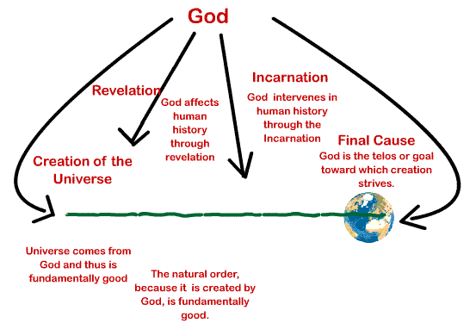
God’s Relationship to the World
Consider the ways in which God is in touch with the world.

Slide 6
God’s Interaction with the World
In this view, God interacts with the world in several ways:
  God creates the world
  God is in contact interaction with the world
  God’s creative act (esse) continually sustains the world in its existence
  God gives the world a final purpose or goal or telos toward which it strives

Slide 7
Unity, Purpose, and Value
As a result of these interactions, the world has:
  Unity
    This is a single world with structure
  Purpose
    Beings on earth have a goal or purpose ordained by God
  Value
    The world is good because:
      It comes from God, who is all good
      It is aiming toward God, who can only establish good purposes

Slide 8
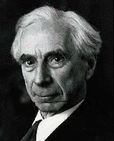
The Atheistic Worldview
For Bertrand Russell, existence has no unity, no value, and no purpose in the Christian sense of these terms.

Slide 9
“A Free Man’s Worship”
“That Man is the product of causes which had no prevision of the end they were achieving;
“That his origin, his growth, his hopes and fears, his loves and his beliefs, are but the outcome of accidental collocations of atoms;
“That no fire, no heroism, no intensity of thought and feeling, can preserve an individual life beyond the grave,
“That all the labors of the ages, all the devotion, all the inspiration, all the noonday brightness of human genius, are all destined to extinction in the vast death of the solar system,
“And that the whole temple of Man’s achievement must inevitably be buried beneath the debris of a universe in ruins
“--all these things, if not quite beyond dispute, are yet so nearly certain, that no philosophy which rejects them can hope to stand.
“Only within the scaffolding of these truths, only on the firm foundation of unyielding despair, can the soul’s habitation henceforth be safely built.”

Slide 10

The Contrast
The contrast between these two worldview could not be sharper.
  No place for preordained purposes in Russell’s view
  No goodness inherent in the world for him
  No privileged place for humanity within his view

Slide 11
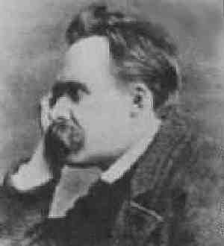
Implications for Ethics
The implications of these differences for ethics are profound
  No ultimate purpose for humanity
  No ultimate reward or punishment
    Nietzsche's question: if God is dead, is everything permitted?
  No guarantee that nature is good or bad
    “Unnatural” becomes a purely descriptive term
Now let’s expand the discussion beyond Christianity.

Slide 12
The Diversity of Religious Traditions: Central Themes
Navajo
  An Ethic of Harmony
Islam
  An Ethic of Law
Buddhism
  An Ethic of Compassion

Slide 13
The Diversity of Religious Traditions: God and World
Navajo
  A plurality of gods, not necessarily in agreement with one another
Islam
  One God
Buddhism
  No personal God

Slide 14
Overview
 | Theme | God
Navajo | Harmony | Many gods
Islam | Law | One God
Buddhism | Compassion | No personal God
Christianity | Love | One God

Slide 15

Part 2
The Navajo Religion

Slide 16
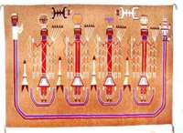
The Navajo Holy Wind
Tradition and Society
  Oriented toward how Navajo treat one another
  Small society
  Practical, not theoretical
Dualisms and Antagonisms
  No Western mind-body split
  Don’t choose one side of the dualism
The Mountain Chant: Great Plumed Arrows Sequence

Slide 17
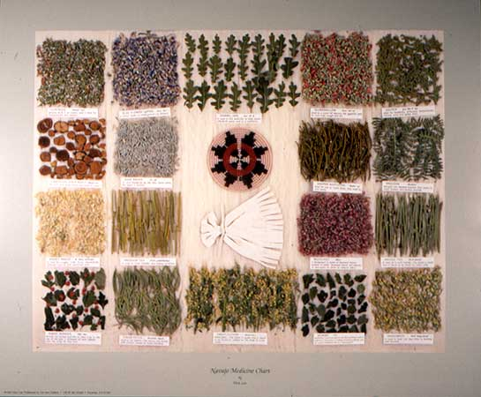
Navajo Medicine
Western view
  mind/body split (Descartes)
  heal the body
  Stamp out
  disease
Navajo view
  Mind and body together
  Heal the whole person
  Seek harmony

Slide 18
Evil
Western attitude:
  stomp it out
Navajo
  Evil is a part of life; it just “is”
  Avoid it instead of eliminate it

Slide 19
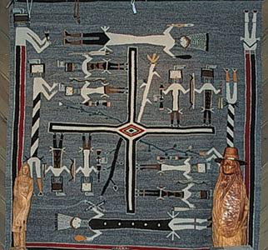
Hozho
Hozho
  harmony, beauty, peace of mind, goodness, health, well-being or success
Morality guides an individual back into a state of harmony with all that surrounds the individual
Nightway Chant:
Whirling Logs

Slide 20
Hozho
Three levels to harmonize:
  natural
  human
  supernatural
Create harmony rather than domination
  Example: moving to higher ground rather than building a dam
  Respecting the rattlesnake

Slide 21
The Holy Wind
The wind is both:
  physical (we feel it on our faces);
  ephemeral (we cannot see it).
The wind is both:
  one
  many
The wind comes from the four principal directions, the four mountains
Is local

Slide 22
The Messenger Wind
Acts like Christian conscience
  Swirls around an individual through a hidden point in the ear
  Warns individuals of impending disruptions of hozho
  Does not punish

Slide 23
Practical Ethics
Basic premise: life is very, very dangerous
Maxims:
  “Maintain orderliness [i.e., harmony] in those sectors of life which are little subject to human control;”
  “Be wary of non-relatives;”
  “Avoid excesses;”
  “When in a new situation, do nothing;”
  “Escape.”

Slide 24
The Role of Rituals
Rituals are intended to reestablish or insure hozho, harmony
The Blessingway is one of the ceremonies performed to reestablish harmony when there has been a disruption

Slide 25
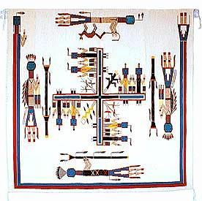
An Ethic of Harmony
Ultimately, the Navajo way suggests an ethics of harmony among the natural, human, and supernatural world.

Slide 26
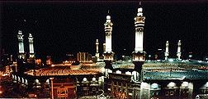
Part 3
Islam
Mecca

Slide 27
The Islamic Shari’ah
Rejects traditional Western distinctions between
  Church and state
  Religion and ethics
Islam: “surrender to the will of God”
Concerned with all behavior

Slide 28
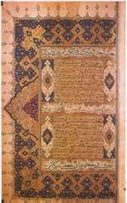
The Three Canonical Elements
belief or faith
  imam
practice or action
  islam
virtue
  ihsan

Slide 29
Divine Command
“What should I do?” = “What is Allah’s will?”
“What is right” = “What Allah wills”
The will of Allah is embodies in Shari’ah, divine Islamic law
Note primacy of the will

Slide 30
Shari’ah
Covers all areas of human behavior
Tells what is:
  required
  recommended
  permitted
  discouraged
  forbidden

Slide 31
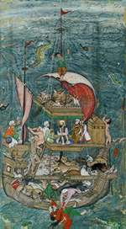
Shari’ah
Two areas of law:
  How Muslims act toward God
    Described in the Five Pillars
  How Muslims act toward other human beings
    Describes in civil law

Slide 32
The Five Pillars
Shahadah: the profession of faith that “there is no god but God (Allah) and that Mohammed is the Messenger of God;”
Salah: ritual prayer and ablutions, undertaken five times a day while facing the holy city of Mecca;
Zakah: the obligatory giving of alms (at an annual rate of approximately 2.5% of one’s net worth) to the poor to alleviate suffering and promote the spread of Islam;
Saum: ritual fasting and abstinence from sexual intercourse and smoking, especially the obligatory month-long fast from sun-up to sun-down during the month of Ramadan to commemorate the first revelations to Mohammed;
Hajj: a ritual pilgrimage, especially the journey to Mecca which traditionally occurs in the month after Ramadan and which Muslims should undertake at least once in a lifetime.

Slide 33
Virtue
Ihsan, or virtue
  worshipping God
    Strictly religious
  pursuing an aim
    Similar to Aristotle

Slide 34
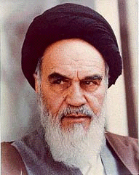
Ulama
The Ulama, or clergy, give the definitive interpretation of Allah’s will
No separation between church and state
The Ulama also have an executive role in implementing Allah’s will

Slide 35
Jihad
Literally means “striving”
Focus on resisting, overcoming evil
Greater Jihad:
  focus on internal striving
Lesser Jihad
  focus on external striving

Slide 36
Moderate & fundamentalist Factors
Islam, like many religions, has various factions.
  Fundamentalist factions see little room for compromise with other religions
    Leads to attacks against others, including attacks against the United States and against Hindus
  Moderate factions see Islam as coexisting with other major religions.

Slide 37
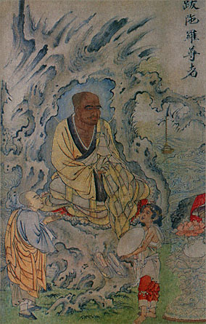
Part 4
Buddhism

Slide 38

Buddhism
An Ethic of Compassion for all
An Ethic of renunciation for monks
An Ethic of reincarnation for lay persons

Slide 39
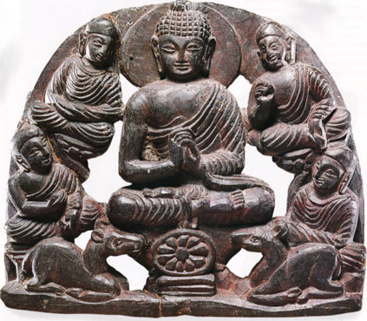
The Four Noble Truths
The Four Noble Truths deal with
  The inevitability of suffering
  The sources of suffering
  The elimination of suffering
  The paths to the elimination of suffering

Slide 40
Two Ways of Reducing Suffering
Suffering arises from a discrepancy between desire and actuality
  change the actual world--Western technology
  change the desire, extinguish the individual self--Buddhism

Slide 41
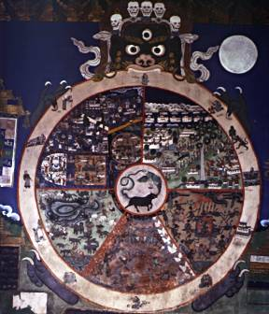
Reincarnation
Personal self moves through the wheel of existence like a flame being passed from one candle to another
Karma: each individual action helps to set free or bind us to the personal self
Moral commandments are generated by demands of karma

Slide 42
The Eight-fold Path
right views; Wisdom Prajna
right intention; Wisdom Prajna
right speech; Wisdom Prajna
right action; Morality Sila
right livelihood; Morality Sila
right effort; Morality Sila
right mindfulness Concentration Samadhi
right concentration Concentration Samadhi

Slide 43
Compassion
Theravada Buddhism stresses an ethic of self-renunciation, self-purification, detachment
Mahayana Buddhism stresses an ethics of compassion for all living things

Slide 44
Overview
 | Christianity | Navajo | Islam | Buddhism
Ideal | Love | Harmony | Law | Compassion
View of God | One God, Three Persons | Many Gods | One God | No personal/ individual God

Slide 45
Religion and Reason in Ethics
 | Supremacy of Religion | Compatibilist Theories | Supremacy of Reason
Strong Version | All morality is based on divine commands (Islamic shari’ah) | Reason and religion are iddenitcal in content (Hegel) | Ethics is based only on reason (agnostic or atheistic)
Weak Version | Divine commands sometimes override ethics (Kierkegaard’s teleological suspension of the ethical) | Reason and religion may be different but do not contradict one another. (Aquinas) | Even God must follow dictates of reason. (Kant)

Slide 46
Weakness of Divine Command Theories
How can we know God’s will? Sacred texts? Which ones? Which tradition? What exactly is God’s will? Inner voice? Clergy? Community consensus? Natural events?
God and the Criteria for the Divine: is something good because God wills it, or does God will it because it’s good?
Human Autonomy: human moral life depends solely on God’s will. Omnipotence of God, no independent human reason or choice.

Slide 47
Autonomy of Ethics Theories:
Reason should override divine command
Heritage of the Enlightenment – reason is autonomous and effective.
Autonomy of Reason: nothing outside of itself taken for granted. (Descartes)
Efficacy of Reason: force for changing the world.
Theistic versions: Kant – reason is the same for God and human
Agnostic and Atheistic versions: disregard God.
Compatibilist Theories: faith and reason don’t conflict – Hegel and Aquinas.

Slide 48
Saints and Moral Exemplars
Models of moral goodness more compatible among religions than dogmas
Stories: allow cross-cultural identification more easily than dogmas.

Slide 49
Is Religion Harmful to Morality?
Marx and the “opiate of the people”
Nietzsche, morality and the Death of God
New atheism: Dawkins, Dennett, Harris and Hitchens: religion is false, delusional and harmful
Are the bad effects necessary or accidental to history?

Slide 50
Does Morality Need Religion?
Ultimate reckoning: God will balance the scales
Motivation of reward and punishment
Practices and community that support values
Religion as liberating: Civil Rights, peaceful change, cause of the poor
Moral significance of suffering

Slide 51
Religious Belief: Diversity and Dialogue
Jihad vs.MacWorld
Fundamentalism: beliefs as literal and spelled out; beliefs are absolute; beliefs are true for everyone for all times. Intolerant of disagreement
Ecumenism: Pluralism Project – statements of belief are metaphorical, not absolute, language distorts. Disagreement tolerated.

