Slide 1
Being Ethical and
Socially Responsible

Slide 2
Learning Objectives
Understand what is meant by business ethics.
Identify the types of ethical concerns that arise in the
business world.
Discuss the factors that affect the level of ethical behavior
in organizations.
Explain how ethical decision making can be encouraged.
Describe how our current views on the social responsibility
of business have evolved.
(cont.)

Slide 3
Learning Objectives (cont.)
Explain the two views on the social responsibility of business and understand the arguments for and against increased social responsibility.
Discuss the factors that led to the consumer movement
and list some of its results.
Analyze how present employment practices are being used
to counteract past abuses.
Describe the major types of pollution, their causes,
and their cures.
Identify the steps a business must take to implement a program of social responsibility.

Slide 4
Ethics
…the study of right and wrong
and of the majority of the choices individuals make.

Slide 5
Business Ethics
…the application of moral
standards to business situations.

Slide 6

Companies
Today Monitor Employees’...
Phone calls
E-mail
Internet usage
Computer activities
Movements in the building

Slide 7
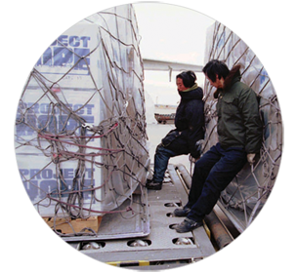
A Business Has Ethical Issues and
Business Relationships with...
Customers
Investors
Employees
Creditors
Competitors

Slide 8
Ethical Issues
Fairness and honesty
  Businesspeople are expected to refrain from knowingly deceiving, misrepresenting, or intimidating others.
Organizational relationships
  A businessperson should put the welfare of others
  and that of the organization above his or her
  personal welfare.
Conflict of interest
  Issues arise when a businessperson takes advantage of a situation for personal gain rather than for the employer’s interest.
Communications
  Business communications that are false, misleading, or deceptive are both illegal and unethical.

Slide 9
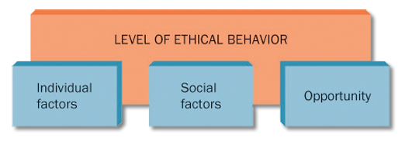
Figure 2.1: Factors That Affect the Level of Ethical Behavior in an Organization
Source: Based on O. C. Ferrell and Larry Gresham, “A Contingency Framework for Understanding Ethical Decision Making in Marketing,” Journal of Marketing, Summer 1985, p. 89.

Slide 10
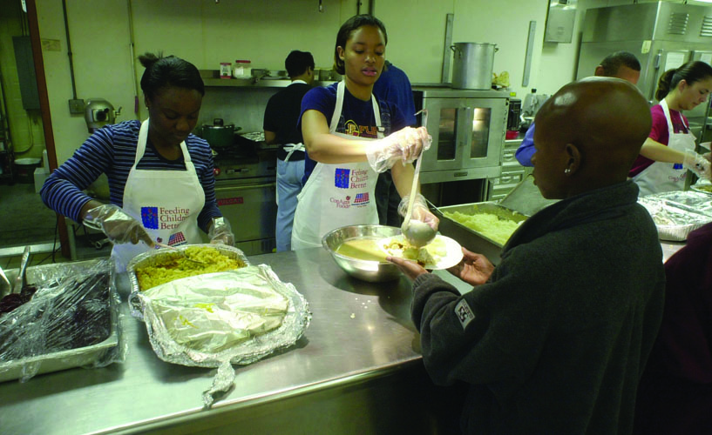
Factors Affecting Ethical Behavior
  Individual factors
    Individual knowledge of an issue
    Personal values
    Personal goals
  Social factors
    Cultural norms
    Coworkers
    Significant others
    Use of the Internet
  Opportunity
    Presence of opportunity
    Ethical codes
    Enforcement

Slide 11
Encouraging Ethical Behavior
External to a specific organization
  Governmental legislation and regulations
  Trade association guidelines
Within an organization
  Code of ethics
  Organizational environment
    Management direction
    Employee training
    Ethics officer

Slide 12
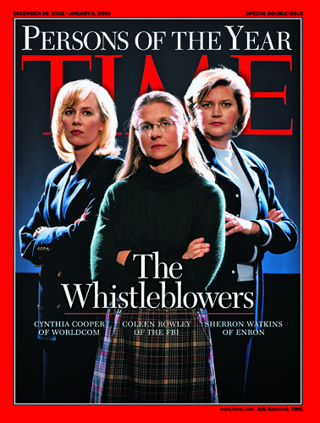
Whistle-Blowing
…informing the press
or government officials
about unethical practices
within one’s organization.

Slide 13
Sarbanes-Oxley Act of 2002
…provides sweeping new legal
protection for employees who report corporate misconduct.
Deals with
Corporate Responsibility
Conflicts of Interest
Corporate Accountability

Slide 14
Code of Ethics
…a guide to acceptable and ethical
behavior as defined by an organization;
it outlines uniform policies, standards,
and punishments for violations.

Slide 15

How Managers Provide Direction
Fostering communication
Actively modeling ethics
Encouraging ethical
decision making
Training employees
to make ethical decisions

Slide 16
Ethics Officer
…coordinates ethical conduct (and) gives employees someone to consult if they are not sure of the right thing to do.

Slide 17
Table 2.1: Guidelines for
Making Ethical Decisions
1. Listen and learn. | Recognize the problem or opportunity; be sure you understand others.
2. Identify the ethical issues. | Examine how others are affected by the situation; understand the viewpoint of those involved in the decision or its consequences.
3. Create and analyze options. | Put aside strong feelings; come up with alternatives; assess which options offer the best results.
4. Identify the best option from your point of view. | Consider the option and test it against criteria such as respect, understanding, caring, fairness, honesty, and openness.
5. Explain your decision and resolve any differences that arise. | May involve arbitration or additional proposals.

Slide 18
Social Responsibility
…the recognition that business
activities have an impact on society
and the consideration of that impact
in business decision making.
  Social responsibility costs money but is also
  good business.
  How socially responsible a firm acts may affect the decisions of customers to do or continue to do business with the firm.

Slide 19
The Six Pillars of Character
        Trustworthiness
        Respect
        Responsibility
        Fairness
        Caring
        Citizenship
Source: Josephson Institute of Ethics, “Resources: Making Ethical Decisions─The Six Pillars of Character,” http://josephsoninstitute.org/MED/MED-2sixpillars.html.

Slide 20
Sample Forms of Social Responsibility
Ongoing organization support
(Young Eagles)
Specific situation support
(Tsunami relief, Fallen Heroes Fund)
Employee support of local community projects
(GE, 3M)
Product/service contribution
(Patient Assistance Program)
Education programs
(Bayer, Merck)

Slide 21
Evolution of Social
Responsibility in Business
Caveat emptor ─ “let the buyer beware”
Government involvement
Franklin D. Roosevelt
  Monopoly laws
  Social service
Employees’ demand for better working conditions
Consumers’ desire for safe, reliable products
Advocacy groups

Slide 22
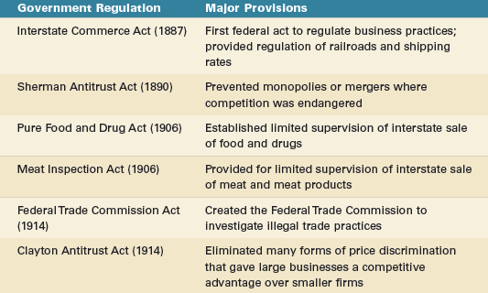
Table 2.2: Early Government Regulations
That Affected American Business

Slide 23
Two Views of Social Responsibility
Economic Model
Society will benefit most when business is left alone to produce/market profitable products that society needs.
Socioeconomic Model
Business should emphasize not only profits
but also the impact of decisions on society.

Slide 24
Arguments for
Increased Social Responsibility
Business is part of society and cannot ignore social issues.
By helping resolve social issues, business
can create a more stable environment for
long-term profitability.
Socially responsible decision making by firms can prevent increased government intervention, which could force businesses to do what they
fail to do voluntarily.

Slide 25
Arguments Against
Increased Social Responsibility
Managers are responsible to stockholders,
so want return on owners’ investment.
Corporate time, money, and talent used to maximize profits, not solve society’s problems.
Social problems affect society, so business should not be expect to solve these problems.
Social issues are responsibility of elected officials who are accountable to voters.

Slide 26
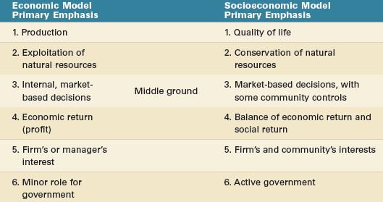
Table 2.3: A Comparison of Models of Social Responsibility
Source: Adapted from Keith Davis, William C. Frederick, and Robert L. Blomstron, Business and Society: Concepts
and Policy Issues (New York: McGraw-Hill,1980), p. 9. Used by permission of McGraw-Hill Book Company.

Slide 27
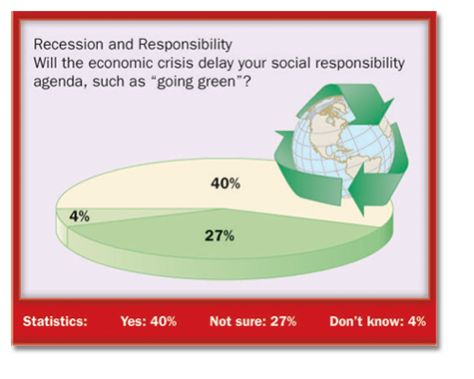
Recession and Responsibility
Source: Booz & Co. survey of 828 chief executive officers and managers.
Margin of error: 3+/- percentage points.

Slide 28
Consumerism
…all activities undertaken to protect
the rights of consumers.

Slide 29

Six Basic Rights of Consumers
Consumer Bill of Rights
  Right to Safety
  Right to Be Informed
  Right to Choose
  Right to Be Heard
Additional Rights
  Right to Consumer Education
  Right to Service

Slide 30

Major Consumerism Forces
Individual Consumer Advocates
Consumer Organizations
Consumer Education Programs
Consumer Laws

Slide 31
Table 2.4: Major Federal Legislation
Protecting Consumers Since 1960
Federal Hazardous Substances Labeling Act (1960) | Warning labels on toxic household chemicals
Kefauver-Harris Drug Amendments (1962) | Drug testing and labeling for both generic and trade names
Cigarette Labeling Act (1965) | Warning labels on packages and ads
Fair Packaging and Labeling Act (1966) | Labels on products sold across states must include net weight, ingredients, and manufacturer’s name/address
Motor Vehicle Safety Act (1966) | Standards for safer cars
Wholesome Meat Act (1967) | Meat inspection within states

Slide 32
Table 2.4: Major Federal Legislation
Protecting Consumers Since 1960 (cont.)
Flammable Fabrics Act (1967) | Flammability standards for children’s sleepwear
Truth in Lending Act (1968) | Finance charge disclosure in both dollars and annual percentage rates
Child Protection and Toy Act (1969) | Toys with mechanical or electrical defects banned from interstate commerce
Credit Card Liability Act (1970) | Card holder liability limited to $50 per card; unsolicited cards stopped
Fair Credit Reporting Act (1971) | Consumers can get credit reports and correct errors
Consumer Product Safety Commission Act (1972) | Established Consumer Product Safety Commission

Slide 33
Table 2.4: Major Federal Legislation
Protecting Consumers Since 1960 (cont.)
Trade Regulation Rule (1972) | Cooling off period for door-to-door sales
Fair Credit Billing Act (1974) | Consumer can challenge billing errors
Equal Credit Opportunity Act (1974) | Equal credit opportunities for males/females and single/married people
Magnuson-Moss Warranty-Federal Trade Commission Act | Minimum standards for written consumer warranties for products over $15
Amendments to Equal Credit Opportunity Act (1976, 1994) | Discrimination prohibited when granting credit
Fair Debt Collection Practices Act (1977) | Abusive collection practices by third parties outlawed

Slide 34
Table 2.4: Major Federal Legislation
Protecting Consumers Since 1960 (cont.)
Drug Price Competition and Patent Restoration Act (1984) | Abbreviated procedure for registering generic drugs
Orphan Drug Act (1985) | Tax incentives encourage drugs for rare diseases
Nutrition Labeling and Education Act (1990) | FDA review of food labeling and packaging
Telephone Consumer Protection Act (1991) | Automated dialing and prerecorded-voice calling prohibited
Consumer Credit Reporting Reform Act (1997) | Credit issuers are responsible for accurate credit data
Children’s Online Privacy Protection Act (2000) | Parents control what info is collected from kids; commercial web sites must protect child info
Do Not Call Implementation Act (2003) | Directed the FCC and FTC to apply consistent rules on telemarketing

Slide 35
Minority
…a racial, religious, political, national, or other group regarded as different from the larger group of which it is a part and that is often singled out for unfavorable treatment.

Slide 36
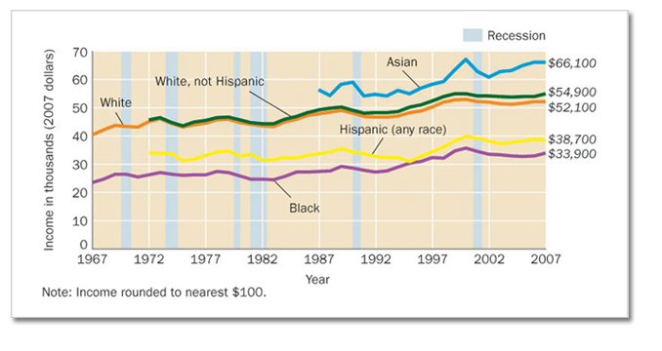
Figure 2.3: Comparative Income Levels
This chart shows the median household incomes of white, black, Hispanic, and Asian workers in 2007.
Source: U.S. Census Bureau, Current Population Survey, 1968 to 2008 Annual Social and Economic Supplements, Income, Poverty, and Health Insurance Coverage in the United States: 2007, issued August 2008, U.S. Census Bureau, U.S. Department of Commerce, p. 6,
www.census.gov/prod/2008pubs/p60-235.pdf, accessed May 1, 2009.

Slide 37
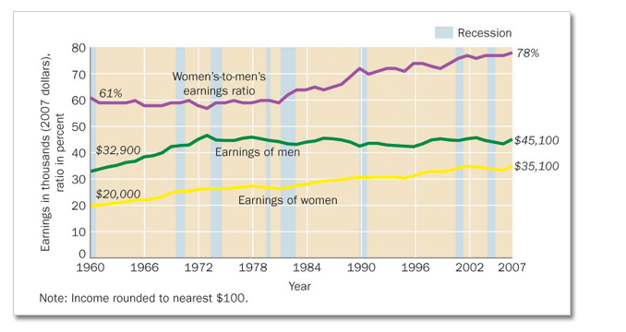
Figure 2.4: Relative Earnings of Male and Female Workers
The ratio of women’s to men’s annual full-time earnings was 78 percent in 2007, and new all-time high, up from 74 percent first reached in 1996.
Source: U.S. Census Bureau, Current Population Survey, 1968 to 2008 Annual Social and Economic Supplements, Income, Poverty, and Health Insurance Coverage in the United States: 2007, issued August 2008, U.S. Census Bureau, U.S. Department of Commerce, p. 11, www.census.gov/prod/2008pubs/p60-235.pdf, accessed May 1, 2009.

Slide 38
Affirmative Action Program
…a plan designed to increase
the number of minority employees
at all levels within an organization.

Slide 39
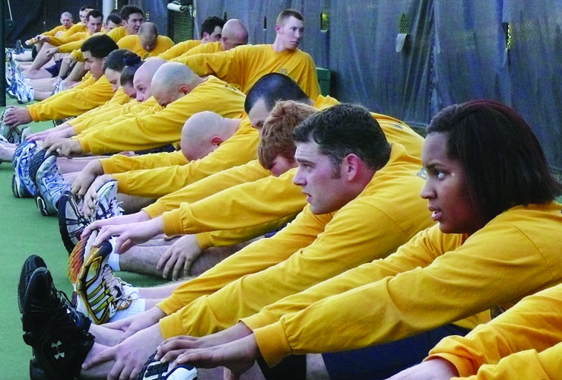
Problems with
Affirmative Action Programs
Quotas ─ reverse discrimination
Not many businesspeople in favor

Slide 40
Equal Employment Opportunity Commission
…a government agency with power
to investigate complaints of employment discrimination and power to sue firms
that practice it.

Slide 41
Hard-Core Unemployed
…workers with little education or
vocational training and a long history
of unemployment.
National Alliance of Business
“…a joint business-government program
to train the hard-core unemployed.”

Slide 42
Pollution
…the contamination of water, air, or land through the actions of people in an industrialized society.

Slide 43
Table 2.5: Summary of
Major Environment Laws
National Environmental Policy Act (1970) | Established EPA to enforce federal environmental laws
Clean Air Amendment (1970) | Automotive, aircraft, and factory emission standards
Water Quality Improvement Act (1970) | Strengthened water regulations; provided for large fines
Resource Recovery Act (1970) | Enlarged solid-waste disposal program; EPA enforcement
Water Pollution Control Act Amendment (1972) | Standards for cleaning navigable streams/lakes; elimination of harmful waste disposal by 1985
Noise Control Act (1972) | Standards for major sources of noise; EPA advises FAA on standards for planes
Clean Air Act Amendment (1977) | New deadlines for cleaning up polluted areas; review of air quality standards

Slide 44
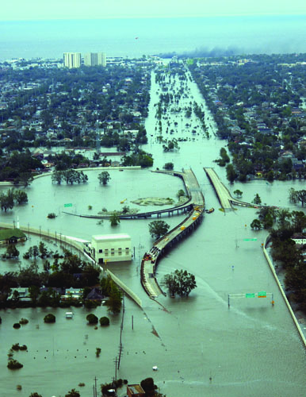
Forms of Pollution
Water Pollution
Air Pollution
  Suspended Particles
  Sulfur Dioxide
  Nitrogen Dioxide
  Land Pollution
Noise Pollution

Slide 45
Air Pollution City
Comparisons
“Air Pollution: City Comparisons,” Air Pollution Problems Facing Cities, http://www.portfolio.mvm.ed.ac.uk/studentwebs/session4/27/citydiff.htm

Slide 46
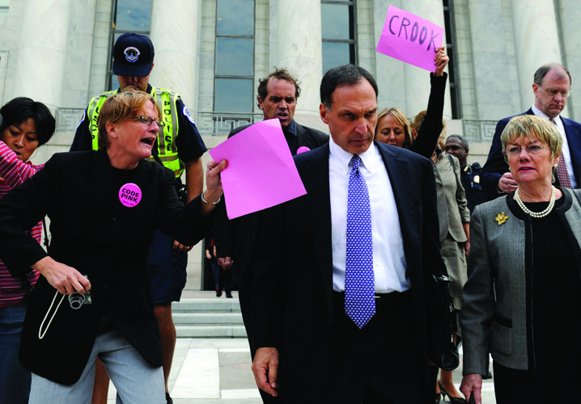
Who Should Pay for a Clean Environment?
Government
Business
Consumer

Slide 47
Who Should Pay?
Factors to Consider
Governments and businesses spend billions annually
to reduce pollution.
Much of the money required is supposed to come
from already-depressed industries.
A few firms have discovered it is cheaper to pay a fine than to install equipment for pollution control.
Many business leaders say tax money should be used because business is not the only source of pollution.
Environmentalists say the cost is an expense of
doing business.
Consumers will probably pay a large part of the costs —either as taxes or in the form of higher prices.

Slide 48
Developing a Program of Social Responsibility
  Secure the commitment of top executives
  Plan the program
  Appoint a top-level executive as director
  to implement the plan
  Prepare a social audit ─ a comprehensive report of what the organization has done and is doing with regard to social issues that affect it

Slide 49
Funding the Program
Pass cost on to consumer in form of
higher prices
Force company to absorb cost of program and treat it as a business expense
Have federal government pay for all or part through tax reductions or other incentives

Slide 50
Chapter Quiz
  Ethical issues often arise out of a business’s
  relationship with
    investors.
    customers.
    employees.
    creditors.
    all of these.

Slide 51
Chapter Quiz (cont.)
  The factor that refers to the amount of latitude within an organization that allows an employee to behave unethically is called
    the code of ethics.
    company policies and procedures.
    the individual.
    opportunity.
    social pressure.

Slide 52
Chapter Quiz (cont.)
  Peat Marwick, one of the largest accounting firms in the world, has extensive international operations. Operating internationally makes ethical decision making especially difficult because
    bribes and payoffs are acceptable business activities
    in the United States.
    Americans are more ethical than foreigners.
    many foreigners do not speak English.
    the U.S. government cannot prosecute American companies for unethical or illegal acts committed
    on foreign soil.
    standards of ethical behavior vary from country to country.

Slide 53
Chapter Quiz (cont.)
  Proponents of the socioeconomic model use which of the following arguments to support their position?
    Business managers are responsible primarily
    to stockholders.
    Business has the technical, financial, and
    managerial resources needed to tackle today’s complex social issues.
    Corporate time, money, and talent should be used
    to maximize profits, not to solve society’s problems.
    Social problems affect society in general, so
    business probably should not be expected to solve such problems.
    Social issues are the sole responsibility of government officials elected to represent the people.

Slide 54
Chapter Quiz (cont.)
  A friend of yours, a loan officer at a local bank, tells you that her annual salary is $15,000 less than that of her male counterparts. She says further that her education and banking experience are equivalent or superior to those of most of these men. She should file a complaint with the
    Better Business Bureau.
    Equal Employment Opportunity Commission.
    National Organization for Women.
    Oprah Winfrey Show.
    National Alliance of Business.

