Slide 1
ARISTOTLE &
VIRTUE ETHICS:
Character, Virtue, Courage & Friendship

Slide 2
The Range of Ethics
Absence of Ethics
The
Criminal
“I KILLED HIM
AND I DON’T
CARE”
The
Delinquent
“I DON’T CARE
ABOUT THAT”
“CATCH ME IF
YOU CAN.”
Relativism
Consequentialism
Duty Ethics
(Absolutism)
Virtue
Normative
Relativism
Descriptive
Relativism
Individual
Relativism
Accepted
Practices
Utilitarianism
Most Pleasure
Greater Net
Happiness
Based On :
Consequences
Outcomes
Kantian – Duty
Truth
Justice
Rights
Divine Law
Natural Law
Aristotle
Honor
Character
Habituation
Stoicism
Rule Based Moral Theories
Character
Based

Slide 3

Admirable action?
Extreme action?
Justifiable?
What if the Capt had died?

Slide 4
Virtue Ethics
Virtue ethics (Aristotle) is a broad term for theories that emphasize the role of character and virtue [of the moral agent] in moral philosophy rather than either doing one’s duty (Kant) or acting in order to bring about good consequences (Utilitarianism).

Slide 5
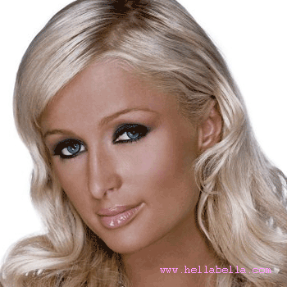
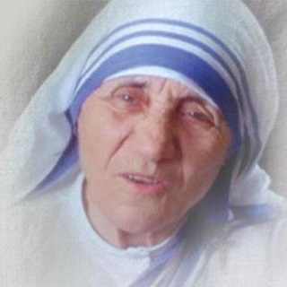

Would you rather lead an enviable or an admirable life?
Why?
What is the difference?
Which life is best for the bearer?

Slide 6
Enviable vs. Admirable
What is a good life?
Would you rather lead an enviable life or an admirable life?
  Give your example of an enviable life
  Give your example of an admirable life
How do you want to live?
  What do you value?
  How do you want to LEAD your life?
Intrinsic vs Instrumental
  Intrinsic good: something worthwhile not because it leads to something else, but for its own sake alone; i.e., Good-in-itself.
  Instrumental good: something considered as a means to some other good; i.e., an instrumental good leads to something else that is good
Notes:
http://stopthatcrow.blogspot.com/2006/03/values-oughts-and-good-life.html
Values, Ought's and the Good Life
In Aristotle’s Nicomachean Ethics he asks the reader to consider “whether happiness is among the things that are praised or rather among the things which are prized.” In this post I will ask this question not about happiness, but rather what is good in general. How do the is/ought and fact/value distinctions relate to the admirable and enviable? How do questions regarding the admirable and enviable lives inform our concept of the good, both morally as well as non-morally speaking?
Before proceeding to such questions, let’s further clarify the difference between these two types of life. The enviable life is one which tends to be characterized with accomplishment and enjoyment. It is a life surrounded by good friends, filled with good times, engaged in gratifying activities and eating good food.
The admirable life is quite different and can often be characterized in terms of immense personal sacrifice and selflessness. One here thinks of Martin Luther King, Saint Theresa and perhaps Jesus of Nazareth. While this life may involve many loyal friends, those who are not loyal have no desire to participate in such a life. The admirable life often involves doing what’s good whether one enjoys it or not, whereas the enviable life tends to be more one of doing what one enjoys whether it is good or not.
But that distinction is too extreme for our purposes, and is meant to merely illustrate the difference between the two lifestyles. I believe that most of what is enjoyable is actually good (family, friends, curiosity, self-expression, etc.) and that at least a good portion of that which is good is enjoyable (sharing, not-killing, etc.) Of course the ideal would be to fully equate what is good and what we want, as Plato attempted to do in the Republic.
I think, however, that such an attempt ultimately fails, for as we will see, there is a certain degree of tension between the two lifestyles. In this I agree with the Christian message that all people are at least tempted to abandon that which is admirable in favor of that which is enviable; though I would stop well short of calling this a sin.
Referring back to Plato again, he calls admirable lives “lives of virtue” and enviable lives “good for their bearers.” This is remarkably parallel to Peter Railton’s distinction between non-moral good, which he calls “good for a person”, and moral good, which is simply called good. Also recall that
“An individual’s good (non-moral good, good for the person) consists in what he would want himself to want, or to pursue, were he to contemplate his present situation from a standpoint fully and vividly informed about himself and his circumstances, and entirely free of cognitive error or lapses of instrumental rationality.” (Railton i, 54)
Moral good, according to Railton, is
“What would be rationally approved of were the (non-moral) interests of all potentially affected individuals counted equally under circumstances of full and vivid information… What is rational from a social point of view with regard to the realization of intrinsic non-moral goodness.” (Railton ii, 190-191)
Thus we can see the tension emerging. The fully enviable life is one which is considered in absolute isolation from other people and their lives. It is the life which is literally self-centered in that the interests of other people do not even enter the picture. In the admirable life, the interests of any other single person are counted as equal to those of the individual himself, thus the interests of all others far out-weigh the interests of the individual. Thus it is a life of near total selflessness.
Thus the enviable life, if it is to have no aspects of the admirable life, is to be one of significant solitude. The social features of life, features which are themselves quite enviable, are aspects of the admirable life. Similarly, the aspirations of the admirable life can only be met by tending to at least some of the aspirations of the enviable life such as personal health and psychological stability. Of course, the one can also see that the admirable life is only instrumental in facilitating what can only be enviable aspects in other lives. It would thus seem that a life fully and purely dedicated to either the enviable or the admirably is practically impossible as well as undesirable in principle. The good life must necessarily be a mixed life as well it should be.
In this we can better see how the is/ought divide is related to the fact/value divide. A person’s values, by Railton’s account, are the enviable aspects of a person life. It is what he as an individual values in his own personal life. This can never be fully isolated from the ought’s in that person’s life, the ought’s being what are the admirable aspects of his life. In other words a person must value morals (ought’s) just as he ought to tend to his own interests (values) if he is to lead a good life.
It would seem, then that values and morals, when defined as such, are always in a tension with each other. The social aspects of the admirable life will continually want to expand away from the self-centered-ness of the enviable life, while the enviable life will always want to contract upon the interests of the individual. Thus, the good life seems to be one of a constant internal struggle. In this we can see the importance of a somewhat, but not totally contemplative life.
Bibliography
Aristotle: Nicomachean Ethics, Book I
Plato: Republic, Book IX
Peter Railton i: “Facts and Values”
Peter Railton ii: “Moral Realism”

Slide 7
To live the “right” kind of life…
How ought I to act?
(question of action)
What kind of person ought I to be?
(question of character)

Slide 8
Merriam Webster on Virtue
Main Entry:
  vir·tue
Pronunciation:
  \ˈvər-(ˌ)chü\
Function:
  noun
Etymology:
  Middle English vertu, virtu, from Anglo-French, from Latin virtut-, virtus strength, manliness, virtue, from vir man — more at virile
Date:
  13th century
1 a: conformity to a standard of right : morality
b: a particular moral excellence
2 plural : an order of angels — see celestial hierarchy
3: a beneficial quality or power of a thing
4: manly strength or courage : valor
5: a commendable quality or trait : merit
6: a capacity to act : potency
7: chastity, especially in a woman

Slide 9
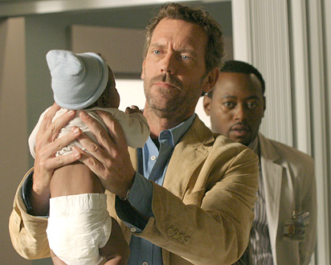


Class Exercise:
List Virtues of Professions
“Excellence” (arete, virtue) is defined with respect to a specific practice
Some traits show up on several lists
Some traits are recognizably moral traits
Q: Are there excellences pertaining to the “practice” of being a human being?
Aristotle’s problem: what are the traits of character that make for a full and flourishing human life
(happiness, eudaimonia)

Slide 10
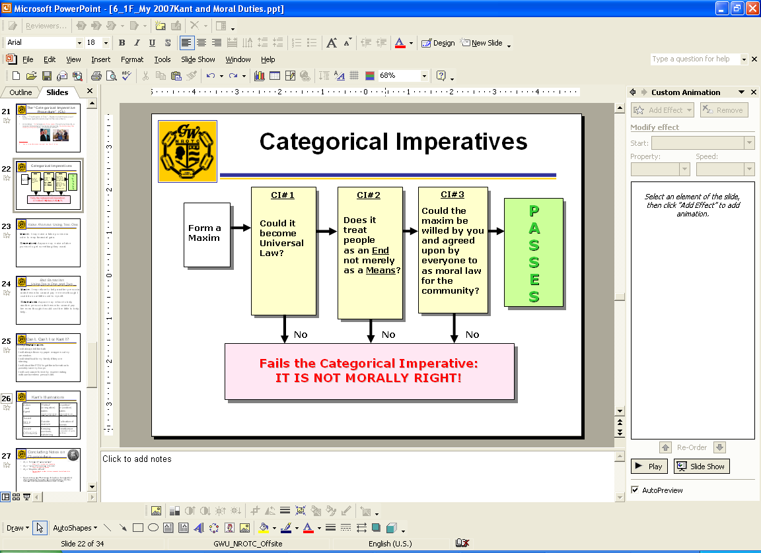
Character and Excellence (arete)
Thusfar we have discussed rational decision theory; morality seems to be procedural…
  Utilitarian “Greatest Happiness” calculus
  Categorical Imperative (CI) procedure
    (e.g., do not kill, harm, lie, cheat, steal, develop yourself, help others)
But is Morality more than just a set of decision procedures?
u (X) = B(x) - H(x)

Slide 11

What Else might be Involved?
Perhaps morality is not just about making the right choice
  doing the “right thing”
  (duty)
  getting the right result
  (greatest good for the greatest number)
Perhaps morality is also about building character
  what kind of person do I wish to become?
  “what kind of a human being ARE you?”
Utilitiesman 2nd Class Michael Deangelo attached to Construction Battalion Maintenance Unit Two Zero Two (CBMU-202) looks for the name of a Seabee killed during combat in Vietnam

Slide 12
Merriam Webster on Character
Main Entry: Function: noun Pronunciation: \ˈker-ik-tər, ˈka-rik-\
Etymology:
  Middle English caracter, from Latin character mark, distinctive quality, from Greek charaktēr, from charassein to scratch, engrave; perhaps akin to Lithuanian žerti to scratch
1 a: a conventionalized graphic device placed on an object as an indication of ownership, origin, or relationship
b: a graphic symbol (as a hieroglyph or alphabet letter) used in writing or printing
c: alphabet e (1): writing, printing (2): style of writing or printing (3): cipher
2 a: one of the attributes or features that make up and distinguish an individual
b (1): a feature used to separate distinguishable things into categories; also : a group or kind so separated <advertising of a very primitive character>
(2): the detectable expression of the action of a gene or group of genes
(3): the aggregate of distinctive qualities characteristic of a breed, strain, or type <a wine of great character>
c: the complex of mental and ethical traits marking and often individualizing a person, group, or nation <the character of the American people>
d: main or essential nature especially as strongly marked and serving to distinguish <excess sewage gradually changed the character of the lake>
3: position, capacity
4: reference 4b
5: reputation <the scandal has damaged his character and image>
6: moral excellence and firmness <a man of sound character>
7 a: a person marked by notable or conspicuous traits <quite a character>
b: one of the persons of a drama or novel
c: the personality or part which an actor recreates <an actress who can create a character convincingly>
d: characterization especially in drama or fiction
e: person, individual <a suspicious character>
8: a short literary sketch of the qualities of a social type
Proposal: Virtue = strength/excellence of character
Notes:
Just so you know I am not talking about Charlie Brown (Cartoon Character) or a greek letter (Character)…

Slide 13
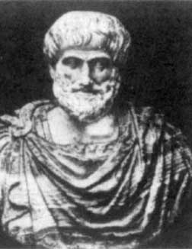
Central Questions about Character or Virtue Ethics
What are the “right habits”?
  (i.e., the ones that lead to human flourishing, happiness)?
Are you born with them or are they cultivated?
Can they be taught?
  Or must they be acquired over time?

Slide 14
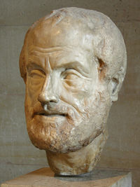
Aristotle 384-322 BC
Student of Plato at the Academy (no not Annapolis!)
Teacher of Alexander the Great
Zoologist, Biologist (chemist, mathematician, political scientist, literary, geography, geology, meteorology,, etc)
Founded the Lyceum
Author- Significant writings:
  Logic
  Physical and scientific
  Metaphysics
  Ethics
  Aesthetics
  Politics
Influenced :
Aquinas,
Bentham,
Mill,
Kant

Slide 15
The “Range” of Attitudes
 | Deficit (Vice) | Mean (Virtue) | Excess (Vice)
Facing Danger or death | Cowardice | Courage | Reckless
Giving | Cheap | Charitable | Prodigal
Towards other’s suffering | Indifference Meanness | Empathy Compassion | Pity “Bleeding Heart”
Towards Self | Self-deprecating | Self Respect | Vanity, Arrogance Conceit, Narcissism
For each of these…do we have a natural tendency in one direction?

Slide 16
The “Range” of Attitudes

Slide 17
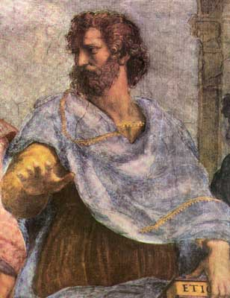
Aristotle’s Types of Virtue
Virtues or excellences of character include:
  Moral virtues
        honesty, fairness or justice
  Prudential virtues
        temperance, modesty
  Intellectual virtues
        wisdom
  Some that are hard to classify
      courage

Slide 18
Virtue As the “Golden Mean”
Strength of character (virtue), involves finding the proper balance between two extremes
  Excess: having too much of something.
  Deficiency: having too little of something.
Not mediocrity, but harmony and balance
There do not seem to be general rules or principles, and certainly no algorithms or formulae for virtue
Example of courage
  Sometimes the deficiency is more to be avoided than the excess
Excess
Deficiency
Main Entry: mean
Function:
  noun
1 a (1): something intervening or
intermediate
(2): a middle point between
extremes
b: a value that lies within a range of values and is computed according to a prescribed law
* Courtesy of Merriam-Webster Dictionary
“It is the things which we are naturally inclined that appear to us more opposed to the mean.”

Slide 19

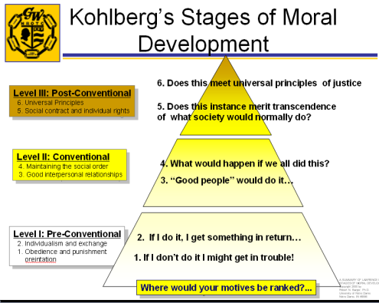
Childhood & Adult Morality
We can contrast two approaches to the moral life.
  The childhood conception of morality:
    Comes from outside (usually parents)
    Is negative (“don’t touch that stove burner!”)
    Rules and habit formation are central
  The adult conception of morality.
    Comes from within (self-directed)
    Is positive (“this is the kind of person I want to be.”)
    Virtue-centered,often modeled on ideals

Slide 20
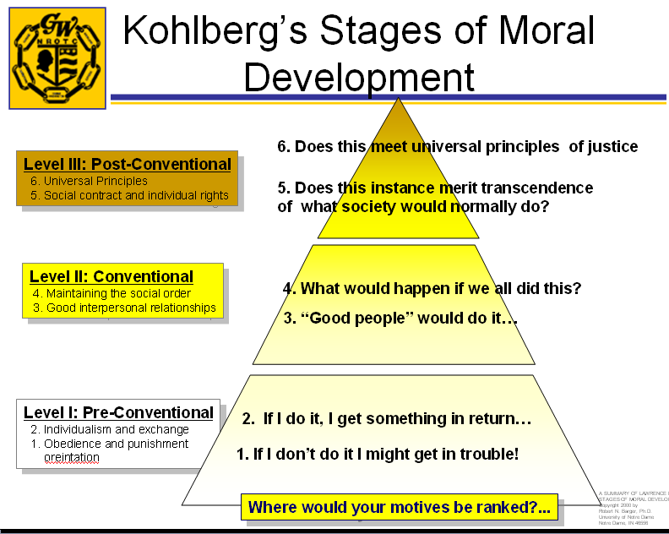
Moral Growth & Progress
Both of these conceptions of morality are appropriate at different times in life.
During adolescence and early adulthood (some) people make the transition from the childhood conception of morality to the adult conception….hopefully
Marines take longer than others…

Slide 21
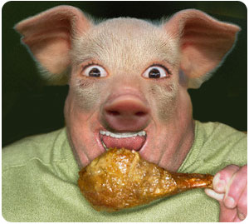


Rightly-ordered Desires
Lawrence M. Hinman
Values Institute
Univ of San Diego
Aristotle draws an interesting contrast between:
  Weakness of will (akrasia) occurs when individuals cannot keep their desires under control.
  Continent people, who have unruly desires but manage to control them.
  Temperate people, whose desires are naturally—or through habit, second-nature—directed toward that which is good for them.

Slide 22
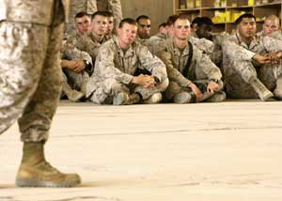
Rightly-ordered Desires & the Goals of Moral Education
Moral education may initially seek to control unruly desires through rules, the formation of habits, etc.
Ultimately, moral education aims at forming rightly-ordered desires
  that is, teaching people to desire what is genuinely good for them.
Gen Hagee conducting
USMC Core Values
Training at Al, Asad, Iraq, May 2006
From “Weak-willed” to “Continent” to “Temperate”…
…cultivating the right desires
Notes:
Marines and sailors from the Twenty-nine Palms, Calif.-based Regimental Combat Team 7 listen to Gen. Michael W. Hagee, commandant of the Marine Corps, speak May 30, 2006, at Al Asad, Iraq, during the top Marine officer’s visit to Marines and sailors throughout western Al Anbar Province. During the visit, Hagee spoke to Marines and sailors about the future of Distributed Operations – a concept designed to put more tactical-level decision making authority, equipment and education to Marine small-unit leaders. The visit was part of a tour to Marines throughout the world to reinforce the Corps’ core values of honor, courage and commitment in light of recent allegations of Marines killing Iraqi civilians. “Honor is more than just telling the truth,” he said to air hangar filled with Marines and sailors in the Marines’ signature tan, digital-patterned camouflage uniforms. “It’s also believing in and upholding the three basic values our country was founded on – respect for human life and dignity, respect for telling the truth, and respect for other people’s property.”
Photo by: Staff Sgt. Jim Goodwin
Photo ID: 20066951543
Submitting Unit: 1st Marine Division
Photo Date:05/30/2006

Slide 23

Aristotle’s Observations about Virtues
Virtues, including moral virtues, are not so much taught as learned by example, observation, practice.
  Cultivating these traits is compared
  to practicing archery or marksmanship
  Hitting the “bull’s eye” takes time,
  practice, patience
Demonstrating the appropriate behavior at the “right” time, “right” place, to the “right” degree
This has clear implications for moral education, for Aristotle obviously thinks that you can teach people to be virtuous.
Notes:
Peanuts cartoon: Charlie Brown shoots an arrow at a fence, then draws a bull's-eye around it…Lucy has a fit – that’s not how it works! Charlie Brown – but this way I get a bull's-eye every time!

Slide 24

Importance of Habituation
  “…Virtues are concerned with actions and feelings; but every feeling and every action implies pleasure or pain.” – Aristotle, Nichomachean Ethics
Natural capacities are not acquired by habituation
Virtue and vice are formed by good and bad actions
Right sort of habituation must avoid excess and deficiency
Virtue requires habituation, and therefore requires practice, not just theory
…until it becomes second nature
Notes:
We hate to run…through habits, Marines learn to LOVE to run…through healthy habits, they develop a culture of fitness. It is encouraged, it is mentored, they take pride in it…
Happiness - But what is happiness? In order to answer this question Aristotle says that we must look at what it is to be a human being, that is, what is the particular and peculiar function of a human being. In answering the question, Aristotle concludes that life (being alive) cannot be what is particular or peculiar to human beings, because other living things such as plants share this quality. And it cannot be sense perception (sight, sound, smell, taste, touch) that is particular or peculiar to human beings, because other animals have this as well.
But what is particular and peculiar about us is our ability to reason, both practically (reason about how best to achieve our given ends), and theoretically or speculatively (reason about abstract eternal truths and first principles as we do in philosophy and theology, for example).
Now when we use practical reason with excellence we achieve moral virtue. And when we use theoretical or speculative reason with excellence we achieve intellectual virtue. And when we achieve moral and intellectual virtue, we fulfill our unique function as human beings and attain happiness. That is, we attain a life worth living, or to put it another way, we flourish and attain well-being.
This is what Aristotle calls Eudaimonia (pronounced you-die-mow-knee-a). But because Aristotle is very practical, he acknowledges that to be happy one must also have such things as moderate wealth, good looks, friends, and can’t be beset by tragedies.
In conclusion, it is essential for you to understand that Aristotle’s conception of happiness differs drastically from most other conceptions. It is not subjective and based on pleasure. Rather, it is objective and based upon the idea of fulfilling with excellence our unique function as human beings. If we don’t fulfill with excellence our unique function as human beings, i.e., if we don’t live virtuous lives, both moral and intellectual, we will not, according to Aristotle, achieve happiness.

