Slide 1
Realism—Relativism—Pragmatism

Slide 2
Realism and Relativism: An Overview
They are about the „evaluation” of theories of knowledge
Suppose we have a satisfactory theory of
  What knowledge states are,
  What justification is etc.,
And suppose we know quite a lot according to this epistemology,
Then what is the status of all this knowledge?
Realism – Anti-realism are about the ontological value of this knowledge
Relativism and its contrasts are about the ontological/metaepistemological status of this knowledge (uniqueness, universality etc.)

Slide 3
Realism

Slide 4
Realism--Anti-Realism
Commonsense view: We have knowledge of the (physical) world that exists independent of us. E.g. Planets revolve around the Sun. This is a fact and it is independent of what we think about it.
Our knowledge represents the world as it really is: our beliefs are true (correspondence theory of truth) they describe the world as it really is.
Realism about a particular domain is the conjunction of the following two theses.
There exist certain entities constituting the domain.
Their existence and nature are independent of our mind (theories, beliefs about them).
Domains: realism about X, X=physical objects, natural laws, moral laws, moral values etc.

Slide 5
Realism—Anti-Realism
 | mind-independence
non-existence | Instrumentalism | Realism | existence
 |  | Idealism Verificationism Social consturctivism
 | mind- dependence |  | (Brock & Mares 2007:4)

Slide 6
Realism
Realism (in its general form): The world consists of some fixed totality of mind-independent objects. There is one true and complete description of „the way the world is”. (Putnam 1981:49)
Truth as correspondence: x is true iff x corresponds to some fact
Realism is an ontological position with significant epistemological bearings.
Realism is our natural attitude toward our knowledge. We think we know the world, to have a true description of it.
E.g. (cf. theories of perceptions) we perceive objects whose existence and nature are independent of our perception. Contrary to Berkeley for whom „To be is to be perceived.”

Slide 7
Against Realism 1.
For any belief, description (proposition) about the world, the world constitutes a criteria of correctness. E.g. The belief that the Earth revolves around the Sun is correct iff the two material objects have the right sort properties.
Criteria (the world) can make a proposition correct only if they are properly related.
We can use world (these criteria) to evaluate propositions only if we have non-propositional access to the world and to the world-proposition relation.
We do not have this kind of access.
Therefore
  The criterion, the world in itself is unintelligible
  On this account of correctness, we cannot evaluate our beliefs, we may be in massive error (skepticism)

Slide 8
The dispute
Against 4, we have causal theroy of knowledge (and reference).
Against this,
causal theory is just another theory (i.e. description). Then how could causal relation be a description independent relation?
If causal relation can explain something then it is perceptual knowledge, but if perceptual evidence can be explained by various and mutually inconsistent theories (see underdetermination and holism) then it is only by sheer luck if we choose the true one (that describes the world as it really is).
Against these…..

Slide 9
Against Realism 2.
We had false views earlier

Slide 10
Consequences of the Anti-Realist Argument
(if it is sound) Ontological consequence: Realism is false. We should opt for some version of anti-realism.
Epistemological consequence: There is no mind and description independent criteria of correctness of beliefs and descriptions. This readily leads to relativism.

Slide 11
Relativism

Slide 12
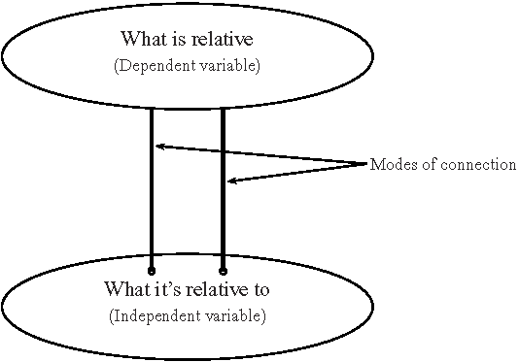
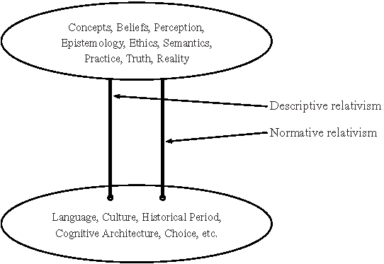
Relativism: X is relative to Y
Stanford Enc. of Phil.: „Rel.”

Slide 13
Relativism (generally!!) denys
(a) the thesis of universalism or the position that there could and should be universal criteria of truth, justification, goodness, beauty, meaningfulness, etc.;
(b) the thesis of objectivism or the position that cognitive, ethical and aesthetic values such as truth, justifiedness, goodness and beauty are mind-independent; (Cf. realism)
(c) the thesis of absolutism, that is the view that truth, justification, goodness, beauty, etc. are timeless, unchanging and immutable;
(d) monism or the view that, in any given area or on any given topic, there can be no more than one correct opinion, judgment, or norm.
Not necessarily all of them are denied!

Slide 14
Epistemological Relativism
The thesis of epistemological relativism: There are no absolute, universal, framework-independent (transcultural, beyond a system of beliefs/language, over historical periods etc.) norms of rationality (system of justification). That is: there are no absolute, universal criteria of (or facts about) what makes a belief rational (justified): what evidence justifies what claim. (Normative relativism)
Pluralism: There are many fundamentally different and genuinely alternative epistemic systems (including different methods of acceptable justifications), and there is no objective criterion by virtue of which one is more correct than the others.

Slide 15
Argument for Epistemological Relativism 1.
Circularity argument:
If there were absolute, universal criteria of/facts about what evidence justifies what claims, then it should be possible to arrive at justified beliefs about them.
It is not possible to arrive at justified beliefs about what these absolute criteria are.
There are no absolute, universal criteria of justification.
Ad 2. It is not possible because any such justification is necessarily circular relying on one particular rationality (system of justification). In the interesting cases, there are no neutral meta-criteria of justifications. (E.g. even observation is theory-laden.)
Suppose that there are two different systems of justification. How would it be possible to justify the superiority of one over the other? They should use their own justifications.

Slide 16
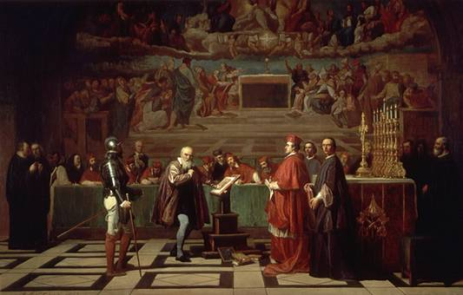
A case
Galileo contra Bellarmine

Slide 17
The Equivalience Principle
One may conclude from the circularity argument that all epistemic systems are on a par: They are (1) equally justified (or unjustified), (2) equally rational or irrational, (3) true or false, (4) equally good or bad.
(1) and (2) follow from the argument (2) and (3) do NOT.

Slide 18
Related Versions of Relativism:Truth-Value Rel.
Normative truth-value relativity:
Sentences or beliefs (or truth bearers in general) are true only relative to a framework (linguistic/system of beliefs/culture etc.) One sentence/belief can be true in one framework and false in another.
(Descriptive relativism about truth-values: members of different groups hold different sentences beliefs true.)

Slide 19
Epistemic and Truth-Value Relativism
Normative relativism about truth-values does not follow from normative relativism about epistemic standards (epistemological relativism). (See also the equivalence principle) Another principle is needed.
  Truth is what is justified under certain ideal conditions. (Truth cannot be equated simply with what is actually justified for justification is changing and truth is not so easily.)
  Epistemic norms are legitimate only if they are truth-conducive. (When applied, they generate justifications leading to truth.)
If (1) OR (2) is taken together with epistemological relativism, they entail relativism about truth-values.

Slide 20
Against Ep. Relativism: Incoherence
Epistemological relativism is self-referentially incoherent in that defending the doctrine requires one to give it up.
Epistemological relativists holds that justification and rationality are relative to a framework. Relativism precludes the possibility of evaluation of justifications of contentious claims of different frameworks .
Thus the thesis of epistemological relativism can also be rational within a relativist framework and it can be defended within that relativist framework.
Therefore relativism itself cannot be rationally defended against non-relativists provided that there is no neutral justification. Give it up altogether (Death of epistemology).
In sum: if relativism is right then it undermines (framework-independent) rightness, then, eventually it cannot be defended, cannot be claimed to be right.

Slide 21
Against Truth-value Relativism I.
Self-refutation:
p= Truth is relative to a framework.
Either p is absolute or relative.
If it is absolute then we have a truth-value that is not relative. (Contradiction) And we have to explain why no other exception is possible.
If the truth of p is relative, then it can be false in other frameworks, so why should we care about the relativist's framework. Why should the relativist care about his own?

Slide 22
Against Truth-value Relativism II.
Truth, frameworks, people etc. are lost:
It can be true in F1 (framework1) that F1 is a framework while it can be false in F2. Frameworks are not objective entities. Therefore the relativist's framework and his truth and the relativist himself can be eliminated by other frameworks.

Slide 23
Pragmatism

Slide 24
An Overview
(Philosophical pragmatism as opposed to linguistic pramgatism)
Pragmatism as a tradition in philosophy („as many pragmatisms as pragmatists”)
  Classical pragmatism: C.S. Peirce, W. James, J. Dewey ... etc. (I discuss.)
  Neo-pragmatism: W.V.O. Quine, H. Putnam, R. Rorty … etc. (You read.)
Pragmatism as a philosophical theory based on some version of pragmatist maxim. (Some pragmatists do not have a THEORY. See Rorty.)

Slide 25
Versions of the Pragmatist Maxim
Meaning: The content of a hypothesis is the sum of its practical consequences: We explain the meaning of a hypothesis by identifying its practical consequences. Eg. This is coal. Diamond is hard.
Truth: The standards (criteria) for the truth (the correctness) of our believes can be derived from their efficacy in practical applications. A belief is true if it works in the long run in practice.

Slide 26
General Common Assumptions
Instrumentalism: Beliefs, knowledge, theories (and language) are instruments we use in coping with our world.
Fallibilism
Anti-Cartesianism: epistemology is not the quest for certainty and not a weapon against skepticism.
Anti-intellectualism: What knowledge is is not solely the matter of beliefs and other states of mind.

Slide 27
What are practical consequences? I.
Practical consequences:
Revisionist sense (narrow sense): The practical consequences of a proposition are the sum of the experiential and experimental consequences in the practice of inquire – that is, what sensations we are to except if we adopt it, and what reactions we must prepare. (empiricism, verificationism)
The proposition is true if it is successful in scientific research practice in the long run. Truth is what comes out in the end of an ideal scientific inquiry. (impersonal and objective standard/criterion)

Slide 28
What are practical consequences? II.
Revolutionist sense (broad sense): The practical consequences of a proposition are the effects upon the believer when she believes it. How does it affect her senses, feelings, actions, plans etc., her life in general?
OR
How does it affect a community of believers.
A belief is true if it works for X in proving efficient and effective for the realization of X’s, a particular person’s (group’s) goals (good life) in the long run and on the whole. (subjective standard/criterion)

Slide 29
The Role of Pragmatist Maxim
The pragmatic maxim gives us the rule
  how to clarify our ideas, then
  how to test them (for if the hypothesis is not true then it will fail to produce some predicted sensible effects) -- how to conduct (scientific) inquire
  how to accept (revise, reject beliefs); a rule of rationality
  how to eliminate senseless metaphysical questions.

Slide 30
Pragmatism, Realism, Relativism
No one believes that anything goes, that we can hold anything true as we like.
There are constraints on what we can rationally believe. What are these constraints?

Slide 31
Constraint: Realist Conceptions
Realist conception, causal theory: Our beliefs are constrained by mind-independent reality. Because they are caused by reality.
Realist conception , revisionist pragmatism: It is evident from scientific experience that when different people use different methods to identify, e.g. the velocity of light and they tend to arrive at the same result, their opinion tend to converge.
„Different minds may set out with the most antagonistic views, but the progress of [scientific] investigation carries them by a force outside of themselves to one and the same conclusion. …[it] is like the operation of destiny.” (Peirce)
„The opinion which is fated to be ultimately agreed to by all who investigate, is what we mean by truth, and the object represented in this opinion is the real. That is the way I would explain reality” (Peirce)
Reality is what constrains our beliefs . This convergence is the practical consequence of the existence of reality.

Slide 32
Constraint: Anti-Realist Conception
Social cooperation and the ensuing conventions and/or common practices can also explain the convergence of beliefs. No need for (and no access to) reality.
Constraint may spring form
  social cooperation and conventions
  common practices, common goals

Slide 33
Objections
Objection to the realist conception: The mutability of truth
Objection to the anti-realist conception: Revolutionary Pragmatists are committed to plainly false beliefs for they mix practical goals with truth. E.g. the belief in Santa Clause is emotionally expedient but it is false.

