Slide 1
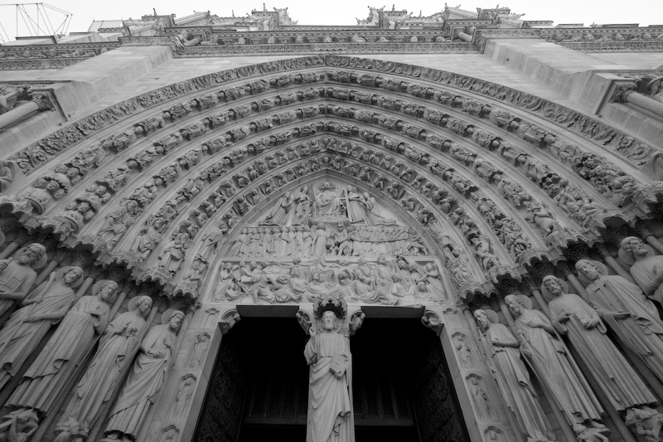
Deontological & Consequential Ethics
Contd…

Slide 2

Let’s now explore consequential ethics:

Slide 3
Consequential Ethics:
We choose the actions that bring about the best outcomes. There are many kinds of consequential forms of ethics. Let’s consider the following:
- Egoism: we should always act to maximize our own individual interests.

Slide 4
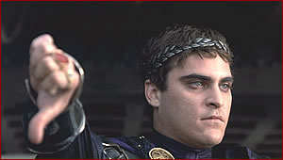
A. Consequential Ethics:
We choose the actions that
bring about the best outcomes:
- Egoism: we should always act to maximize our own individual interests.
- Utilitarianism: we should act to maximize the happiness of all affected by the action.

Slide 5
A closer look at Utilitarianism:
This theory that holds that an act is right or wrong according to the utility or value of its consequences.
An act that produces more good than harm has greater value than act that produces more harm than good.

Slide 6
A closer look at Utilitarianism:
Utilitarianism believe in the value of ethical laws in helping people determine which action will probably bring about the greatest good for the greatest number of people.
While they are not against laws or values (antinomians), they are not absolutists either.
Every act is judged by its results, not by it intrinsic and universal value.

Slide 7
A closer look at Utilitarianism:
In order to do determine the best consequence, some argue that you must add up the happiness in one person and then multiply the total happiness in the total number of people and subtract the total pain.
  If the result is positive then the action is good.
  If the result is negative then the action is bad.

Slide 8
A closer look at Utilitarianism:
Uses of Utilitarian Ethics in terms of Pleasure vs. Pain (Peter Singer):
1. When we testify the safety of a new shampoo, we drip the shampoo in concentrated form into the eye of rabbits, causing them terrible pain. But does shampoo leaving your hair lustrous and manageable, sufficient to justify the infliction of so much suffering?

Slide 9
A closer look at Utilitarianism:
2. The taste of a char-grilled steak, juicy and tender, is a genuine source of pleasure. But can this gourmet pleasure (which is not essential to sustain our lives), and in fact may shorten our lives by contributing to LDL levels, justify the infliction of suffering on cattle that are raised on crowded feedlots, and then herded into slaughter houses?

Slide 10


A closer look at Utilitarianism:
3. It must be delightful to live in an elegant home, richly equipped with a Jacuzzi and sauna in addition to having a master bedroom suite with an entire wall-covered entertainment system. But is it really right to spend that much on luxuries that add only a small increase to our pleasure when the same resources could be used to care for impoverished children living in hunger? For example, $21.00 US dollars can feed over 150 elementary students in Ghana for two weeks (rice mixed with yams).

Slide 11
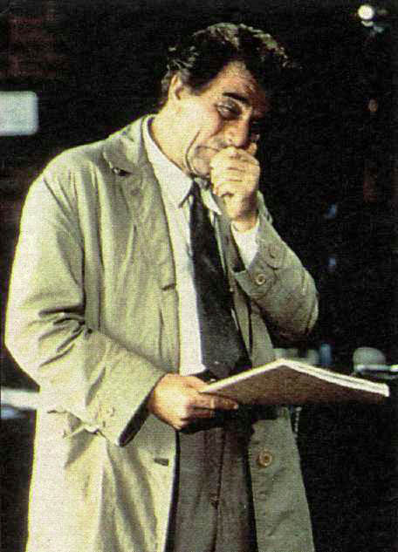
A closer look at Utilitarianism:
4. I purchase another expensive “GQ suit” to add to my already stuffed closet-for it will bring me pleasure. But is that small increment of pleasure even remotely comparable to the pleasure and relief of suffering that would result if I took that same money and purchased clothes to orphan children or a threadbare family?

Slide 12
A closer look at Utilitarianism:
5. A tummy tuck will certainly improve sagging appearances and make some of us feel better. But the cost of a tummy tuck can be used to drill a water well and provide clean and pure water to an entire village in most third world countries.

Slide 13
A closer look at Utilitarianism:
6. Utilitarian Ethics and Public Policy:
If we are trying to decide whether a new football stadium with luxury boxes for the very rich is a better investment than decent inner-city schools and health care for the poor, is utilitarian calculations a better guide for making such decisions than deontological ethics?

Slide 14
Problems with Utilitarianism:
The end does not justify the means.
  An act is not automatically good simply because it has a good goal.
  The road to destruction is paved with good intentions (Prov. 14:12).
  Ex. President Nixon’s goal of national security was noble, but the criminal activity of Watergate was not justified.

Slide 15
Problems with Utilitarianism:
Utilitarian acts have no intrinsic value.
  Ex. The attempt to save a life is not an intrinsically valuable act.
  No benevolence, no sacrifice, no love has any value unless it happens to have good results.
  Ex. If forced to choose to save either a medical doctor or a poor child from a destructive house fire, one is obligated to save the medical doctor.

Slide 16
Problems with Utilitarianism:
People are subject to the greater good of statistics:
  Ex. If forced to choose to save either a medical doctor or a poor child from a destructive house fire, one is obligated to save the medical doctor because we know he is able to help people; we don’t know the future of the child.

Slide 17
Problems with Utilitarianism:
The need for an absolute standard:
Relative norms do no stand alone. They must be relative to something which is not relative. So, unless there is a standard, how can they know what is the greater good.

Slide 18
Problems with Utilitarianism:
The “end” is an ambiguous term:
If the utilitarian contends that ethics should be based on what will bring the best results in the long run, how long is “long?” A few years? a life-time? Eternity? Anything beyond the immediate present is outside of the human range.

Slide 19
Problems with Utilitarianism:
Ambiguous as well in determining whether the “end” means “for the greatest number” or for “all individuals.”
Could good could be achieved for the most people if basic rights were denied to some people? Is this intuitively right?

Slide 20
Problems with Utilitarianism:
    Pleasure vs. Pain:
  Pain and Pleasure are not exact opposites. Is this true?
  How do you measure pain and pleasure?
  Can pain be beneficial over and against pleasure?

Slide 21
Conclusion to Consequentialism:
  Consequentialists believe that consequences are the only things that matter:
  A. We do not necessarily know the outcome.
  B. The consequences of our own action may be unpredictable.

Slide 22
Conclusion to Consequentialism:
  C. he consequences of other people’s actions which impact on our actions may also be unpredictable.
  D. We do not know what the consequences will be of our action in the long term.
  E. We can’t necessarily control the consequences.

Slide 23
Concluding thought to Consequentialism:
  Dostoyesky’s Challenge to Utilitarian Ethicists:
  “Tell me honestly, I challenge you-answer me: imagine that you are charged with building the edifice of human destiny, the ultimate aim of which is to bring people happiness, to give them peace and contentment at last, but that in order to achieve this it is essential and unavoidable to torture just one speck of creation, that…little child beating her chest with her little fists, and imagine that this edifice has to be erected on her unexpiated [suffering for having done nothing wrong] tears. Would you agree to be the architect under those conditions? Tell me honestly!”
  ~ The Karamazov Brothers, trans. Ignat Avsey (Oxford: Oxford University Press, 1994).

Slide 24
Overview of Ethical Systems: Utilitarianism:
A theory of moral reasoning within teleological ethics or consequentialism that looks to the principle of utility, i.e., the degree to which an act is helpful or harmful in order to determine the rightness or wrongness of an act.
J. Bentham:
Only 2 intrinsic values: “Good is whatever brings the greatest happiness to the greatest number.”
R.M. Hare’s 2-level utilitarianism: The logic of moral terms & facts about human nature & condition) leads to a 2 level version whereby both rule & act utilitarianism are bridged: intuitive level (simple, general rules) & critical level (act utilitarianism.
J.J. C. Smart:
Preference Utilitarianism: Maximize the achievements of people’s priorities; it is for each person to decide what counts as being happy.
Negative Utilitarianism by K. Popper in The Open Society & Its Enemies (1945): Promote the least amount evil or harm; prevent the greatest amount of harm for the greatest number:
Motive Utilitarianism (Robert Adams): Inculcate motives within ourselves that will be generally useful across the spectrum of the situations we are likely to encounter.
John S. Mill:
Cultural, intellectual, & spiritual pleasures are of greater values than mere physical pain or pleasure.
John S. Mill: Though still hedonistic utilitarianism Mill argues that cultural, intellectual, and spiritual pleasures are of greater values than just mere physical pain or pleasure.
Ideal Utilitarianism by G.E. Moore: The rightness or wrongness of acts is determined by their actual consequences; our duty: produce the best possible consequences.

Slide 25
A Closer look at Consequentialism:
Classic utilitarianism is a complex combination of many distinct claims, including the following claims about the moral rightness of acts (even though it reduces all morally relevant factors to consequences):

Slide 26
Issues of Formulation: How utility is to be defined and whether it can be measured in the way utilitarians requires:
1. Consequentialism = whether an act is morally right depends only on consequences (not circumstances, the intrinsic nature of the act, or anything that happens before the act).
2. Actual Consequentialism = whether an act is morally right depends only on the actual consequences (not foreseen, foreseeable, intended, or likely consequences).
3. Direct Consequentialism = whether an act is morally right depends only on the consequences of that act itself (not consequences of the agent's motive, of a rule or practice that covers other acts of the same kind, and so on).

Slide 27
Issues of Formulation: How utility is to be defined and whether it can be measured in the way utilitarians requires:
4. Evaluative Consequentialism = moral rightness depends only on the value of the consequences (as opposed to other features of the consequences).
5. Hedonism = the value of the consequences depends only on the pleasures and pains in the consequences (as opposed to other goods, such as freedom, knowledge, life, and so on).
6. Maximizing Consequentialism = moral rightness depends only on which consequences are best (as opposed to satisfactory or an improvement over the status quo).
7. Aggregative Consequentialism = which consequences are best is some function of the values of parts of those consequences (as opposed to rankings of whole worlds or sets of consequences).

Slide 28
Issues of Formulation: How utility is to be defined and whether it can be measured in the way utilitarians requires:
8. Total Consequentialism = moral rightness depends only on the total net good in the consequences (as opposed to the average net good per person).
8. Universal Consequentialism = moral rightness depends on the consequences for all people or sentient beings (as opposed to only the individual agent, present people, or any other limited group).
9. Equal Consideration = in determining moral rightness, benefits to one person matter just as much as similar benefits to any other person (= all who count count equally).
10. Agent-neutrality = whether some consequences are better than others does not depend on whether the consequences are evaluated from the perspective of the agent (as opposed to an observer).

Slide 29
Issues of Formulation: How utility is to be defined and whether it can be measured in the way utilitarians requires:
These claims could be clarified, supplemented, and subdivided further. What matters here is just that these claims are logically independent, so a moral theorist could consistently accept some of them without accepting others. Yet classic utilitarians accepted them all. That fact makes classic utilitarianism a more complex theory than it might appear at first sight.
It also makes classic utilitarianism subject to attack from many angles. Persistent opponents posed plenty of problems for classic utilitarianism. Each objection led some utilitarians to give up some of the original claims of classic utilitarianism. By dropping one or more of those claims, descendants of utilitarianism can construct a wide variety of moral theories. Advocates of these theories often call them consequentialism rather than utilitarianism so that their theories will not be subject to refutation by association with the classic utilitarian theory.

Slide 30
John Stuart Mill (1806-1873): Hedonistic Utilitarianism:
Greatest Happiness Principle: “Acts are right in proportion as they tend to promote happiness (intended pleasure), wrong as they tend to produce the reverse of happiness” (pain and privation of pleasure). Cultural, intellectual, & spiritual pleasures are of greater value than mere physical pleasure, because the former would be valued more highly by competent judges than the latter. A competent judge, according to Mill, is anyone who has experienced both the lower pleasures and the higher.
Mill reaffirmed though developed the hedonistic theory of Bentham from strict hedonistic path by saying that some kinds of pleasure, whatever their quantity, are intrinsically superior to others.
.
Pleasures differ from each other qualitatively as well as quantitatively, a “higher” pleasure being intrinsically better than a “lower” pleasure.”
“It is better to be a human being dissatisfied than a fool satisfied.”
Bentham treats all forms of happiness as equal: “a pushpin is as good as opera.” Some desires are primitive: others the result of experience, training, self-discipline, & special associations.
Qualitative differences easily recognizable whereas quantitative differences are difficult to determine.
He also differed with Bentham by denying that human motivation implies egoism. Even though we are by nature pleasure-seekers, we can be trained through proper development of our feelings to find pleasure in the pleasure of others.
Mill was an advocate of rule utilitarianism: you obey those rules which experience has shown will produce the greatest happiness of the greatest number. When you always know what people will do you get predictability and security.
We ought to choose the action which looks most likely to produce most happiness. In order to do so we should usually be guided by those general rules which have been formulated as a result of the long experience of men in society:
The beliefs that have come down are the rules of morality for the multitude, and or the philosopher, until he has succeeded in finding better.”
A rule is valid only because it passes the utilitarian test: and it is difficult to believe
John S. Mill:
Cultural, intellectual, & spiritual pleasures are of greater values than mere physical pain or pleasure.
The only justification society has in interfering with the liberty of action of an individual is self-protection; People should be allowed to think & do whatever they like. Mill was worried about the “tyranny of the majority” in his Essay On Liberty.

Slide 31
John Stuart Mill:
Essential Terms:
1. higher pleasures: "pleasures of the intellect, ...relating to our feelings and imagination"; also those relating to our moral values.
2. lower pleasures: bodily and physical pleasures
3. inferior type: persons who find enjoyment by indulging in the lower pleasures (88-89)
4. superior type: persons who find enjoyment by indulging in the higher pleasures
5. altruism: personal sacrifice; "putting other's interests before one's own"
6. incommensurable: (in this case) two things that are incomparable because they are essentially different. Mill uses this word to describe the comparison of pleasure and pain.

Slide 32
John Stuart Mill:
7. Although Mill was heavily influenced by Bentham, there are two specific points of the latter's utilitarian theory that are rejected in Mill's version:
  Mill did not regard all pleasures equally. He made a distinction between higher and lower pleasures.
  Mill rejects Bentham's hedonic calculus because he believes that pleasures and pains are incommensurable.
8. Higher pleasures are such because they:
  offer a sense of human dignity,
  offer greater permanency, safety, and un-costliness, and
  challenge us to develop our intellectual capabilities.
9. The only persons qualified to judge the relative merit of pleasures are those acquainted with the higher pleasures. Mill inserts this qualification so that his ethics can overcome the charge the it is an ethics for pigs and because he argues that anyone who is acquainted with both types or pleasures will certainly affirm the superiority of the higher type.

Slide 33
Egoism vs. Altruistic Utilitarianism:
Enlightened self-interest is rejected in favor of consider the greatest happiness of all concerned.
Persons responsible for making ethical decisions should do so from a disinterested, benevolent perspective.
The value of personal sacrifice or altruism takes center stage over that of psychological egoism.
If one can see that personal interests are bound up with communal interests, then the conflict between ego and community will be minimized.

Slide 34
Other Points on Mills:
10. Human Suffering: Mill argues that "we have ... a moral duty to prevent or to reduce to human suffering.“
  Selfishness and a want of mental cultivation are the greatest causes of unhappiness.
  Individuals who have not taken the time to develop their intellectual capabilities are unlikely to share the view that the improvement of the human condition is of paramount importance.
11. On Democracy:
  Although he favored democracy, Mill sees the possibility for domination of the minority by the majority under a strict system of "mob rule.“
  Accordingly, Mill argues that safeguards be put in place to protect the interests and viewpoints of minorities in the political process. Note that the term minority is not meant to denote racial minorities, but rather all types of political and social minorities that do not share majority/mainstream views.

Slide 35
Utilitarianism vs. Deontological Ethics:
Utilitarian Ethics:
Consequential Outcomes-Based.
Case-by-Case.
Hypothetical Imperative.
4. Happiness (Greatest Happiness Principle)
Deontological Ethics:
One universal law for each situation.
All times, all places, & all people.
Categorical Imperative (Maxim-rule)
4. Duty, Obligation, & Good will.

