Slide 1
Lecture 4
Topic: Land & the People of Pakistan I
Recap of the lecture # 3
What is the concept of welfare state
History of the concept of Welfare State
Resolution of the Welfare State
Quaid e Azam and the concept of welfare state
Islamic state’s welfare responsibilities
Conclusion

Slide 2
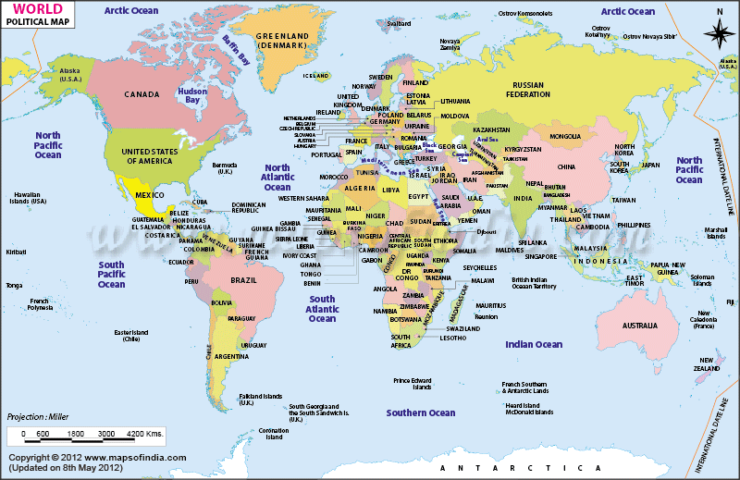
Lecture # 04

Slide 3
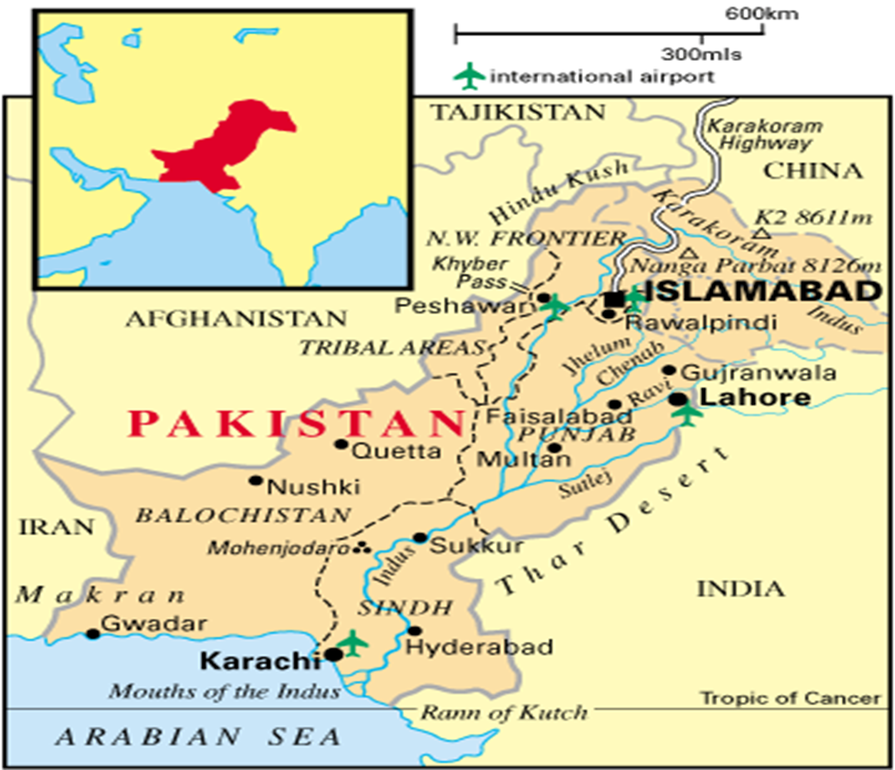
Map of Pakistan

Slide 4
What is Geography?
Geography is the study of the earth’s landscapes, peoples, places and environments. It is, quite simply, about the world in which we live.
Geography is unique in bridging the social sciences (human geography) with the natural sciences (physical geography).Human geography concerns the understanding of the dynamics of cultures, societies and economies, and physical geography concerns the understanding of the dynamics of physical landscapes and the environment.

Slide 5
Geography informs us about:
The places and communities in which we live and work
Our natural environments and the pressures they face
The interconnectedness of the world and our communities within it
How and why the world is changing, globally and locally

Slide 6
Cont.
How our individual and societal actions contribute to those changes
The choices that exist in managing our world for the future
The importance of location in business and decision-making

Slide 7
What are Important Geographical Features
Physical Environment
Natural Resources:
water Sources: Rivers, Glaciers, Ground Water
Land Forms :Mountain, Valleys, Plateaus, Plains, Deserts
Climate: Temperature, Rainfall, Pressure, Humidity
Minerals: Metallic, Non-Metallic
Natural Vegetation: Forests

Slide 8
Cont.
2. Uses of the physical environment creates “Human Environment”
Human Resources:
Industry
Agriculture
Mining
Settlement
Transport
Trade

Slide 9
Importance of Pakistan’s Location
Air Links
Sea ports
Land route/ links

Slide 10
Location of Pakistan
Pakistan is located between latitudes 24 35’ north and 37 05’ and extends from longitude 61 east to 78’ east. (approx.)
The total area of Pakistan is 706,096 sq km.
Stretching over 1600 km from north to south and about 885 km from east to west. (approx.)

Slide 11
Cont.
Boundaries of Pakistan:
China : in the extreme north-east.
Afghanistan : in the west, known as Durand line
Iran: in south-west.
India: in east
Arabian Sea: south
Tajikistan: Wakhan is the narrow strip of Afghan territory which separates Pakistan from Tajikistan.

Slide 12
Cont.
The map shows that Pakistan’s borders with Afghanistan and India are longer than those with Iran and China
It was discovered after the disintegration of USSR in 1991that:
CAS Republics possess untouched power resources such as mineral oil and natural gas

Slide 13
Cont.
Which can easily be transported through Pakistan and Iran to the South Asian and South East Asian countries by constructing pipelines.
These projects could bring huge economic benefits to Pakistan such as transit revenue, power resources for various industrial, commercial and domestic uses etc.

Slide 14
Cont.
Land links to the north and north west because of the large mountain ranges and the climate
Karakoram Highway makes communication with China
Khyber Pass provides a route to Afghanistan
North and north-west are land locked: thus Pakistan’s seaport of Karachi and Gwader can also serve these areas.

Slide 15
Cont.
Feasibility of Natural Gas Pipeline Project from the CAS countries and Iran to India and South East Asian countries after passing through Pakistan.
Easy access to CAS Republics via Afghanistan.
Inflow of Chinese industrial products to Pakistan through common border.

Slide 16
Cont.
Jinnah Terminal connects the West with Asia by Air
Karachi, a natural harbor and an important warm water port also serves as a refueling stop for ships.

Slide 17
Pakistan: The Natural Topography
The Northern Mountains and North-Western Mountains. Himalayas-Hindukush, Karakorm, Safed Koh range, waziristan hills, sulaiman range, kirthar range, The Siwaliks , salt range etc
Valleys of Himalayas: Murree and gallies, kaghan
Valleys of Hindukash range: Sawat, Chitral, Dir
Valleys of karakuram range: Gilgit, Haunza, Baltistan
Glaciers: Baltoro, Batura and Siachin in the karakuram range.

Slide 18
Cont.
Passes through the western mountains: Khyber, Kurram, Tuchi, Gomal, Bolan.
Passes through the northern mountains: Khunjerab, Shandur, Babusar.

Slide 19
Cont.
Plateau: Potwar, Salt range, Baluchistan plateau
Plains: Upper Indus Plain, Lower Indus Plain, Labella Plain
Deserts: Cholistan(Punjab), Nara (Sindh), Therparkar(Sindh), Thal(Punjab), Kharan (Balochistan)

Slide 20
Administrative Division of Pakistan
Punjab
Sindh
KPK
Baluchistan
Azad Kashmir
FANA
FATA

Slide 21
Summary
World’s Map
Map of Pakistan
What are Important Geographical Features
Importance of Pakistan’s Location
Location of Pakistan
Pakistan: The Natural Topography
Administrative Division of Pakistan

Slide 22
QUOTATION
“Geography has made us neighbors,
History has made us friends,
Economics has made us partners,
and necessity has made us allies.”
Thank you

