Slide 1
Lecture 32
Agriculture sector: Problems & Solutions
Recap of lecture # 31
Topic: Industrial Sector: Problems & Solutions
Pakistan Economic Structure : Primary Sector
Pakistan Economic Structure: Secondary Sector
Pakistan Economic Structure: Services Sector
Problems of Industrial Sector
Controversial Industrial Strategy
Shortage of Capital
Limited Markets

Slide 2
Cont.
Lack of Technical Know-How
Lack of Infrastructure
Lack of Industrial Research
Unbalanced Industrial Structure
Labor Unrest
Nationalization
Lack of Specialization Solution of Industrial Problems
Clear strategy for industrial sector
Provision of industrial finance

Slide 3
Cont.
Provision of infrastructure
Development of capital goods industry
Industrial research
Fiscal incentives
Technical education and training
Pakistan Economic Review
Today’s topic: Agriculture sector: Problems & Solutions

Slide 4
History of Agriculture in Pakistan
Agriculture and irrigation system was developed in the Indus Valley Civilization (Mohenjo-daro) by around 4500 BCE.
The size and prosperity of the Indus civilization grew as a result of this innovation, which eventually led to more planned settlements making use of drainage and sewers.
Sophisticated irrigation and water storage systems were developed by the Indus Valley Civilization, including artificial reservoirs at Girnar dated to 3000 BCE, and an early canal irrigation system from circa 2600 BCE.

Slide 5
Cont.
Archeological evidence of an animal-drawn plough dates back to 2500 BC in the Indus Valley Civilization.
All agricultural affairs and activities in Pakistan are overseen and regulated by the Ministry of Agriculture.
***

Slide 6
Introduction: Agricultural of Pakistan
Economy of every state depends on three sectors that is agriculture, industry and commerce.
These three are interrelated with each other as the progress or revert of one sector effects the other two.
Pakistan is an agricultural state thus agriculture gains are of much importance than any other sector.
Importance of this sector is manifold as it feeds people, provides raw material for industry and is a base for foreign trade.

Slide 7
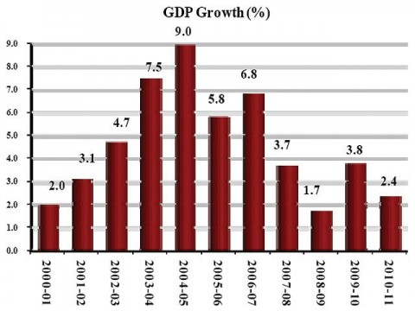
Cont.

Slide 8
Cont.
It contributes 26% of GDP and 52% of the total populace is getting its livelihood from it. 67.5% people are living in the rural areas of Pakistan and are directly involved in it.
There are two crops in Pakistan: Rabi & Kharif.
Crop | Sowing season | Harvesting season
Kharif | April – June | Oct – Dec
Rabi | Oct – Dec | April – May

Slide 9
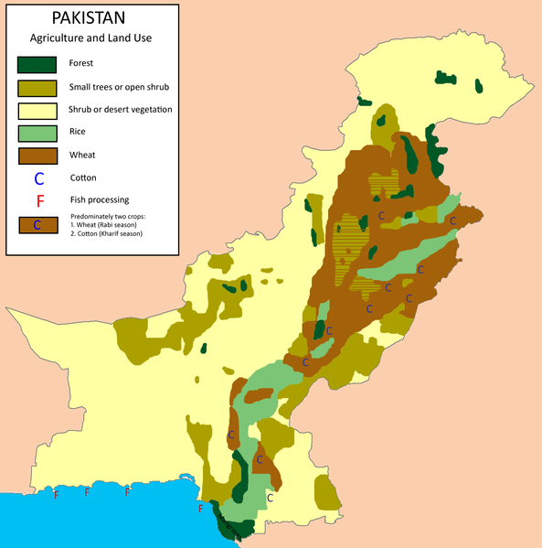
Cont. Agriculture and land use

Slide 10
Agricultural Reforms in Pakistan
First Agricultural Reforms in Pakistan were introduced by General Ayub Khan in Jan 24, 1959. According to these reforms an individual was not allowed to own 500 irrigated and 1000 of non-irrigated land in Pakistan.
The remaining lands were given freely to the landless farmers. It was also narrated that no surcharge or extra money will be taken from any landless person in return for the transfer of land.

Slide 11
Cont.
The total geographical area of Pakistan is 79.6 million hectares. About 27 percent of the area is currently under cultivation. Of this area, 80 percent is irrigated. In this regard, Pakistan has one of the highest proportions of irrigated cropped area in the world.
The cultivable waste lands offering good possibilities of crop production amount to 8.9 million hectares. Growth in cropped area is very impressive: from 11.6 million hectares in 1947 to 22.6 million hectares in 1997.

Slide 12
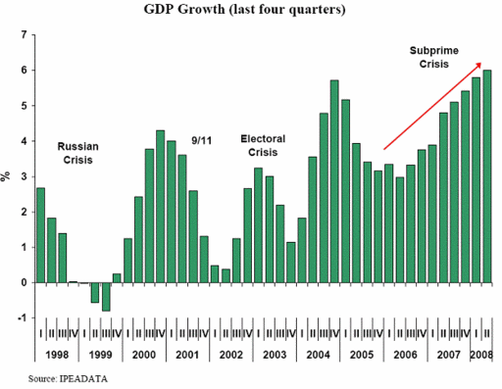
Cont.

Slide 13
Land use, farming systems and institutions
Most of Pakistan is classified as arid to semi-arid because rainfall is not sufficient to grow agricultural crops, forest and fruit plants and pastures. About 68 percent of the geographical area has annual rainfall of 250 mm, whereas about 24 percent has annual rainfall of 251 to 500 mm.
Only 8 percent of the geographical area has annual rainfall exceeding 500 mm. Thus supplemental water is required for profitable agricultural production, either from irrigation or through water harvesting.

Slide 14
Cont.
Though the agricultural sector is facing problems in Pakistan yet the major chunk of money comes from this sector. Following are the major causes of agricultural problems in Pakistan which disturb the agricultural growth or development in Pakistan.
Agriculture is the important sector of Pakistan’s economy. It importance has reduced due to following reasons:

Slide 15
Problems of Agriculture Sector in Pakistan
Under Utilization of Land
Under Utilization of Manpower
Uneconomic Holdings
Water-logging and Salinity
Lack of Water Supply
Low per Acre Yield
Insufficient Use of Inputs
Poor Rural Infrastructure
Insufficient Agricultural Research
Lack of Extension Service
Defective Land Tenure System
Insufficient Facilities

Slide 16
Under Utilization of Land
The resources in the agricultural sector are not properly utilized. There is a huge wastage of land which is evident from the fact that out of about 90 million acres of cultivable land, only 44 million acres have so for been brought under plough. This wastage comes to 60 % of the area . Further, the land is divided into many small units. The area is used to provide passage (due to small land holding) in form of strips summed up runs into hundred of acres that are wasted.

Slide 17
Under Utilization of Manpower
The total labor force in the rural sector is about 16 million out of which only 15% are paid workers while the rest are self employed. The employment picture in the agriculture is complicated. This had resulted due to abundance of self employed and unpaid family workers and the seasonal nature of work in agriculture. Disguised unemployment is difficult to estimate. However, an estimate put it at about two million workers, which is a severe wastage.

Slide 18
Uneconomic Holdings
The term uneconomic holding refer to the cultivating units which are small in size and the cultivation processes can not be properly and effectively applied to them. As a result there input-output ration is low compare to bigger farms. According to agriculture census 1980, there are 4.7 million formers and almost half of them own only three acres or less of land. The main cause of this is Islamic law of inheritance and lack of alternative occupations.

Slide 19
Water-logging and Salinity
Due to leakage of water from the canals, the water table has come closer to the surface of the soil and the plants are unable to get air and grow. This is called water logging. When this water evaporates the salts contained in the water spread on the surface. This makes the surface hot and destroys the plants. This is known as salinity. These problems are found in the irrigated areas Punjab and Sind. According to an estimate above 15 lakh acres have been made unfit for cultivation due to water logging and salinity.

Slide 20
Lack of Water Supply
The agriculture out put depends upon the water supply at different stages of cultivation. If the water supply is not sufficient, the crop is damaged and the yield is reduced. In Pakistan, the agricultural output depends on irrigation facility, which is defective in the sense that the supply of water is either delayed or is less than the requirement.

Slide 21
Low per Acre Yield
This is a problem to be solved as well as the result of various problems. Per acre yield in Pakistan is among the lowest in the world. It is about one third of what is produced in other countries. For examples, in case of rice , Japan and Egypt production is more than three times in Pakistan. Similar is the case of sugarcane, cotton and wheat.

Slide 22
Insufficient Use of Inputs
To increase agricultural output, it is essential to expand the use of agricultural inputs which includes chemical fertilizers, improve seeds, plant protection and mechanization. At present, seeds are used by formers are generally defective and of inferior quality. Similarly, lack of use of fertilizers like urea and pesticides result in less production.

Slide 23
Poor Rural Infrastructure
Poor rural infrastructure is another basic problem of agriculture in Pakistan. Due to lack of transport and communication facilities, the rural population has restricted mobility. There is less flow of credit in rural areas due to lack of credit institutions. There are no organized marketing facilities so the poor farmers are exploited by the traders.

Slide 24
Insufficient Agricultural Research
Research and education is a continuing requirement for the agricultural development not only in developing better seeds, improving cultivation methods and better use of other inputs, but also for finding out there best combination for our conditions. Unfortunately, it has not received due attention and suffers from financial and personal constraints.

Slide 25
Lack of Extension Service
Lack of extension services in Pakistan, the agricultural extension service has not been active. An agricultural extension service aims at providing the formers with systemic excess to knowledge about farming practices, multiple cropping and use of physical in puts and ensuring that the knowledge provided is appropriate to the farming being practice. In Pakistan, the coverage of extension services is extremely limited. Mainly due to poor service conditions and the insufficient provision of extension aids.

Slide 26
Defective Land Tenure System
The phrase “Land tenure system” signifies the rights and obligations associated with the arrangement of ownership and the use of land. It is obvious that a number of problems can arise in a system dominated by land owners. It results in absolute landlordism in which the landlord obtains a substantial share of the produce of the land without making any effort. The land is cultivated by tenants who suffer not only from social subordination but also from different types of exploitation. All this leads to low production.

Slide 27
Insufficient Facilities
In Pakistan rural credit supplied both through institutional and non-institutional sources. Institutional sources include ADBP, commercial banks, and cooperative institutions. Non institutional sources are the private money lenders like commission agents, village traders, and landlords and well-to-do farmers. “ Friends and relatives” is also an informal source of credit. These sources are generally regarded as exploitative and undesirable. Any attempts to drive them out by lowering the interest rates have not been successful.

Slide 28
Current Status of Agriculture Sector
Over the past 20 years some important structural changes have taken place in the sector. In particular, livestock has emerged as an important subsector, today contributing more than one-third of agricultural GDP, compared with about 28 percent 20 years ago.
Similarly, fisheries and forestry, while still minor contributors to agricultural GDP, have grown rapidly. Structural changes have also taken place within the produce sector. Cotton is now as important as wheat in terms of value added with a one-fifth share of total earnings.
Rice and sugar have, however, fallen from a 20 percent share in the early 1970s to 15 percent today.

Slide 29
Solutions to Problems
Increase in Irrigation Facilities
Farm Mechanization
Agricultural Research
Reclamation Program
Agricultural Price Policy
Land Reforms
Credit Policy
Cooperative Movement

Slide 30
Increase in Irrigation Facilities
The availability of water has to be increased by construction of small dams, installation of tube-wells, etc., for bringing in more land under cultivation and increasing the output. There will, thus, be less dependence on rain for the supply of timely water. The government of Pakistan established Water and Power Development Authority (WAPDA) in 1959 to build dams for storage and supply of irrigation water.

Slide 31
Farm Mechanization
There is unanimity of opinion that farm mechanization increases agricultural productivity and income of the farmers. Spray machines are applied to spray the standing crops. The threshers and harvesters replace the manual harvesting. Tractors, bulldozers and attached implements are being increasingly use. In Pakistan, there are at present five tractor manufacturing plants producing its various parts. Until 1990, the total numbers of tractors use were about three lakh. ADPB is providing loans to farmer for the purchase of tractors and installation of tube-wells in the different areas of the country.

Slide 32
Agricultural Research
In order to rise the potential of agricultural production, there should continuous improvement in the research for agricultural growth. The specific areas of research includes the development of high yielding, short duration , disease and drought resistant varieties of major food and cash crops of Pakistan according to the situation prevailing in different areas of the country.

Slide 33
Reclamation Program
Vigorous efforts should be made to protect and reclaim the areas effected by water logging, salinity and soil erosion in the country. The government of Pakistan started salinity control and reclamation project (SCARP) in 1959. Under this scheme, about 12,500 tube-wells were installed and other derange schemes were introduced the result is about 3 million acres have been reclaimed.

Slide 34
Agricultural Price Policy
An agricultural price policy refers to the government’s role in defining or inducing the prices of agricultural outputs and inputs. The price mechanism can, if used carefully and systematically, prove to be an effective supplement efforts towards the revival of agriculture and increase agricultural productivity. The policy regarding out put is also called price support policy.

Slide 35
Land Reforms
Land reforms refers to the concept of redistribution of land ownership in excess of certain ceiling. Pakistan inherited of feudalistic land tenure system. At the time of partition 7% of the land owners owned 53% of the total land. These big landlords had little incentive to cultivate all the land or to rise the productivity of their lands. Thus in 1959, individual ownership was restricted to 500 acres of irrigated and 1000 acres of irrigated land. In 1972, this was further reduced to 150 irrigated and 300 irrigated acres. The resume land was distributed among the landless farmers.

Slide 36
Credit Policy
Agriculture is a backward and a poor sector. The farmers need loans to purchase various types of inputs like seeds, fertilizers, pesticides, tractor, tube-wells, etc. The Agricultural Development Bank of Pakistan (ADBP) was established in 1961.The ADBP is the largest source of credit to agriculture sector of Pakistan. The bank provides short, medium and long term loans for farm and off farm activities. The bank has five following windows of investment:

Slide 37
Cont.
Development loans
Production loans
Agri-Business loans
Cottage industry loans
Off farm income generating activities loans
The ADBP advance loans based on land, mortgage, or on personal security. Till 1996, the ADBP has provided credit for about Rs. 100 billion to 4million farmers. Most of it was given for purchase of tractors and tube-wells.

Slide 38
Cooperative Movement
Cooperative farming is a voluntary organization in which the farmers poll their resources in order to carry out various agriculture operations by helping each other for the protection of their common interest. The farmers may be motivated to farms cooperative societies for production of crops, purchase of inputs and for sale of out put. Cooperative farming, if adopted, can solve the problems of disintegration of holding, mechanization, and middlemen.
****

Slide 39
Tentative List of Lectures
Lecture 1 Intro. to Pakistan Ideology of Pakistan
Lecture 2 Muslim Nationalism
Lecture 3 Aims and objectives of the establishment of Pakistan
Lecture 4 Land and the People of Pakistan I
Lecture 5 Land and the People of Pakistan II
Lecture 6 Land and the People of Pakistan III
Lecture 7 History of Pakistan I (2500BC-712AD)
Lecture 8 History of Pakistan II (712AD- 1526AD)

Slide 40
CONT.
Lecture 09 History of Pakistan III (1526- 1900AD)
Lecture 10 Evolution of Muslim Nationalism in India
Lecture 11 Emergence of Pakistan Movement
Lecture 12 Pakistan Movement – Historical events
Lecture 13 Creation of Pakistan and Role of Muslim Leadership
Lecture 14 Establishment of Pakistan I from 1947-77
Lecture 15 Establishment of Pakistan Ifrom 1978- 2008
Lecture 16 Different ruler from 1947-2008

Slide 41
Cont.
Lecture 17 Constitutionnel Développements in Pakistan I.
Lecture 18 Constitution of 1956
Lecture 19 Constitution 1962, 1973.
Lecture 20 Neighboring Countries I China & Iran
Lecture 21 Neighboring Countries II India & Afghanistan
Lecture 22 Pakistan’s Role in Regional & Inter. Organizations I: UNO, OIC, NAM
Lecture 23 Pakistan’s Role in Regional & Inter. Organizations II: SAARC, ECO
Lecture 24 Pakistan and the Muslim world I

Slide 42
Cont.
Lecture 25 Pakistan and the Muslim world II
Lecture 26 Pakistan’s Foreign policy I
Lecture 27 Pakistan’s Foreign policy II
Lecture 28 Current Issues and problems of Pakistan I
Lecture 29 Current Issues and problems of Pakistan II
Lecture 30 Economy of Pakistan
Lecture 31 Industrial sector: Problems & Solutions
Lecture 32 Agriculture sector: Problems & Solutions

Slide 43
Objectives
1-Teach a sense of gratitude to Almighty Allah for blessing us with an independent and sovereign state
2. Emphasize the importance of national integration and patriotism.
3. Encourage qualities of observation, creativity, analysis and reflection in students.
4. Promote an understanding of the ideology of Pakistan, the Muslim struggle for independence and activities for establishing a modern welfare Islamic state.
5. Explain the students with various phases of Pakistan’s historical, political and constitutional developments.

Slide 44
Cont.
6. Inculcate awareness about the multi-cultural heritage of Pakistan so as to enable
the students to better appreciate the socio-cultural diversity of Pakistan society and get used to idea of unity in diversity in our national context.
7. Enhance understanding of the physical features and human resources of Pakistan.
8. Impart awareness about various aspects of socio-economic activities at national level and the role played by Pakistanis in the development of their society.

Slide 45
Cont.
9. Highlight Pakistan’s strategic position in international politics, especially its relations with neighboring and Muslim countries.
10. Lay emphasis on the rights and obligations of the citizens of an independent and sovereign state.
***

Slide 46
Essential Readings
Text Book: Pakistan Studies (compulsory) for B.A & B.Sc Engineering by M.D. Zafar and Ikram Rabbani.
Indicative Bibliography:
1- Ishatiaq Hussain Qureshi, The Struggle For Pakistan.
2- Javid Iqbal, Ideology of Pakistan.
3- M. Ikram Rabbani, Pakistan Affairs.
4- Shaid Javed Burki, “State & Society in Pakistan,” The Macmillan Press Ltd 1980 (reprint 1997).
5-Wayne Wilcox, “The Emergence of Bangladesh,” Washington, American Enterprise, Institute of
Public Policy Research, 1972.
6-Safdar Mehmood, “Pakistan Kayyun Toota,” Idara-e-Saqafat-e-Islamaia, Club Road, Lahore.
7-Tahir Amin, “National Movement of Pakistan,” Institute of Policy Studies, Islamabad.
8-Lawrence Ziring, “Enigma of Political Development,” WmDawson & sons Ltd. Canon House Folkstone, Kent England, 1980.
9-Waseem Ahmad, “Pakistan Under Marshal Law,” Lahore 2002.
10-Ansar Zahid, “History & Culture of Sindh,” Karachi Royal Book Company, 1980.

Slide 47
Internet (valid web sites) and inter. level newspapers and journals
http://www.storyofpakistan.com/
http://www.pakistan.gov.pk/
http://www.pak.gov.pk/public/govt/ministry_table.htm
http://www.pakissan.com http://www.paktrade.org/
http://www.caapakistan.com/ http://www.parc.gov.pk/
http://www.pakistan.gov.pk/ministries/index.jsp?MinID=6&cPath=59
http://www.pakistan.gov.pk/ministries/index.jsp?MinID=15&cPath=162
http://www.sbp.org.pk

Slide 48
Quotation
We must work our destiny in our own way and present to the world an economic system based on true Islamic concept of equality of manhood and social justice. We will thereby be fulfilling our mission as Muslims and giving to humanity the message of peace which alone can save it and secure the welfare, happiness and prosperity of mankind.
(Quaid I Azam’s Speech at the opening ceremony of State Bank of Pakistan, Karachi.. July 1, 1948)

