Slide 1
Lecture # 30
Economy of Pakistan
Recap of the lecture # 29
Topic: Current Issues and Problems of Pakistan, part II
Terrorism
Overpopulation
Inflation
Unemployment
Economic Crisis

Slide 2
Cont.
Food Crisis
Political Problems
Water Crisis
Future of Pakistan
Possible solutions
Today’s topic: Economy of Pakistan

Slide 3
Introduction to Economy of Pakistan
The economy of Pakistan is the 47th largest in the world in nominal terms and 27th largest in the world in terms of purchasing power parity (PPP).
Pakistan has a semi-industrialized economy, which mainly encompasses textiles, chemicals, food processing, agriculture and other industries.
Growth poles of Pakistan's economy are situated along the Indus River; diversified economies of Karachi and Punjab's urban centers coexist with lesser developed areas in other parts of the country.

Slide 4
Cont.
The economy has suffered in the past from decades of internal political disputes, a fast growing population, mixed levels of foreign investment, and a costly, ongoing confrontation with neighboring India.
***

Slide 5
Economic history of Pakistan
When Pakistan gained independence in 1947 from UK, Pakistan's average economic growth rate since independence has been higher than the average growth rate of the world economy during the period.
Average annual real GDP growth rates were 6.8% in the 1960s, 4.8% in the 1970s, and 6.5% in the 1980s. Average annual growth fell to 4.6% in the 1990s with significantly lower growth in the second half of that decade.

Slide 6
Cont.
During the 1960s, Pakistan was seen as a model of economic development around the world, and there was much praise for its economic progression.
Karachi was seen as an economic role model around the world, and there was much praise for the way its economy was progressing.
Many countries sought to opt Pakistan's economic planning strategy and one of them, South Korea, copied the city's second "Five-Year Plan" and World Financial Center in Seoul is designed and modeled after Karachi.

Slide 7
Cont.
Later, economic mismanagement in general, and economic policies in particular, caused a large increase in the country's public debt and led to slower growth in the 1970s and 1990s.
The economy recovered during the 1980s via a policy of deregulation, as well as an increased inflow of foreign aid and remittances from foreign Pakistani workers.
Recent decades: This is a chart of trend of gross domestic product of Pakistan recent decades:

Slide 8
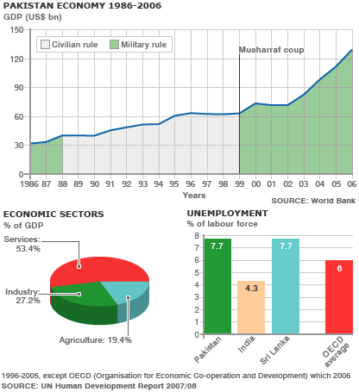
Cont.

Slide 9
Cont.
Historically, Pakistan's overall economic output (GDP) has grown every year since a 1951 recession. Despite this record of sustained growth, Pakistan's economy had, until a few years ago, been considered as unstable and highly vulnerable to external and internal shocks.
However, the economy proved to be unexpectedly resilient in the face of multiple adverse events concentrated into a four-year (1998–2002) period .
the Asian financial crisis;

Slide 10
Cont.
economic sanctions – according to Colin Powell, Pakistan was "sanctioned to the eyeballs";
The global recession of 2001–2002;
a severe drought – the worst in Pakistan's history, lasting about four years;
heightened perceptions of risk as a result of military tensions with India – with as many as 1 million troops on the border, and predictions of impending (potentially nuclear) war;

Slide 11
Cont.
the post-9/11 military action in neighboring Afghanistan, with a massive influx of refugees from that country;
Despite these adverse events, Pakistan's economy kept growing, and economic growth accelerated towards the end of this period.
This flexibility has led to a change in perceptions of the economy, with leading international institutions such as the IMF, World Bank, and the ADB praising Pakistan's performance in the phase of adversity.

Slide 12
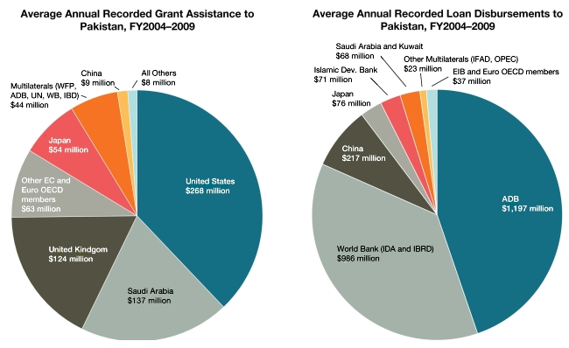
Cont.

Slide 13
Structure of Economy
The economy of the Islamic Republic of Pakistan is suffering with high inflation rates. Agriculture accounted for about 53% of GDP in 1947. While per-capita agricultural output has grown since then, it has been outpaced by the growth of the non-agricultural sectors, and the share of agriculture has dropped to roughly one-fifth of Pakistan's economy.
In recent years, the country has seen rapid growth in industries (such as ready made garments, textiles, and cement) and services (such as telecommunications, transportation, advertising, and finance).
***

Slide 14
Sectors: Agriculture, Industry
Agriculture:
Pakistan is one of the world's largest producers of the following commodities according to FAOSTAT, the statistical arm of the Food and Agriculture Organization of The United Nations, given here with the 2008 ranking:
Apricot (3rd)
Buffalo Milk (2nd)
Chickpea (3rd)
Cotton, lint (4th)
Cotton, Seed (3rd)
Dates (5th)
Mango (6th)
Onion, dry (4th)
Oranges (11th)
Rice (11th)
Sugarcane (5th)
orange (9th)
Wheat (10th)

Slide 15
Cont.
Pakistan's principal natural resources are fertile land and water. About 25% of Pakistan's total land area is under cultivation and is watered by one of the largest irrigation systems in the world. Pakistan irrigates three times more acres than Russia.
Agriculture accounts for about 23% of GDP and employs about 44% of the labor force. Zarai Taraqiati Bank Limited is the largest financial institution geared towards the development of agriculture sector through provision of financial services and technical expertise.
***

Slide 16
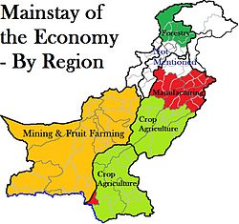
Cont.

Slide 17
Industries
Industries: textiles (8.5% of the GDP), fertilizer, cement, oil refineries, dairy products, food processing, beverages, construction materials, SME Sector, Automotive industry, CNG industry, Cement industry, IT industry, Textiles, Mining, Communication, Banking, finance and insurance, property sector, Public administration and defense, Social, community and personal services, Electricity, Chemicals and pharmaceuticals.

Slide 18
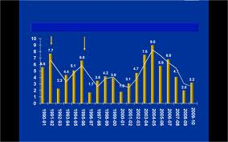
Economic growth

Slide 19
Prerequisites of Economic Development
Economic growth is dependent upon a number or factors such as natural resources, capital human resources, technology, attitude of the people, political condition in the country.
All the factors which have a strong bearing on economic growth are divided into two categories:
Economics factors
Non-economic factors
***

Slide 20
Economic Factors
Natural Resources: If a country is not rich in natural resources, it is then not in a position to develop rapidly.
As for as Pakistan is concerned, Pakistan is blessed with a plenty of natural resources, yet it is underdeveloped due to the fact that these resource have not been properly utilized.
Capital accumulation capital formation refers to the process of adding to the stock of capital over time.

Slide 21
Stock of capital
The stock of capital can be built up and increased through three different resources which are as under:
Role of capital: Capital plays a vital tile in the process of development a country.
Capital accumulation increases the efficiency of labor. Capital accumulations encourage the introduction of new technology.
Capital accumulation can make capital developing possible.
Capital formation :Capital formation in Pakistan is very low because saving rate is not satisfactory.

Slide 22
Labor and Manpower
Labor and Manpower: Labor is a key factor of production. In low income countries, the capital is the infrequent input, but the labor is plentiful. We can say the developing countries are capital poor and labor rich. Investment in human capital may take the following form:
Spread of education from literacy training to the university level.
The job training to workers. Providing information of job vacancies to potential candidates.
Increasing expenditure on health and nutrition for raising the productive capacity of the workers.

Slide 23
Power
Power: Power resources are the foundation of economic development. They are derived mainly from two types of sources:
Commercial
Non- commercial
Role of power in development: Giving an initial push to the raising of production in all sectors of the economy.

Slide 24
Cont.
Quickly bridging the development gap.
Providing economies of scale.
Ensuring high quality standard.
Reducing material wastages in all sectors of the economy.
Power in Pakistan: Pakistan is still running short of its energy resources. Govt. of Pakistan is trying to develop new energy resources to overcome the problem.
***

Slide 25
Transport and Communications
The availability of an efficient transport and communications network is a prerequisite for a meaningful economic cooperation amongst nations, particularly in the areas of trade and tourism for attracting foreign investment and realizing the potential gains from an outward oriented trade strategy.
Besides human capital (skill and education) a strong efficient and affordable means of transport and communications of the country contributes to the national economic growth by lowering domestic production cost, integrating markets, promoting economic opportunities and establishing links among the people.

Slide 26
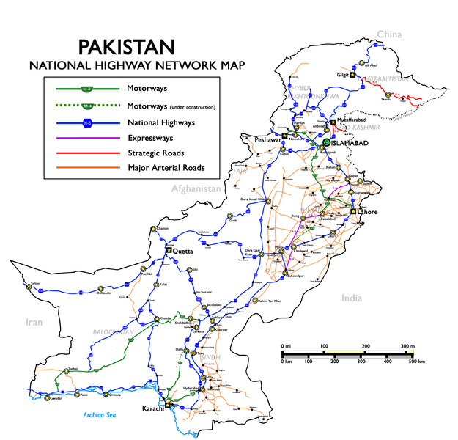
National Highway & road links

Slide 27
Cont.
The transport and communications sector generates a large number of employment opportunities, and acts as a significant tool in the fight against poverty.
The sector is also a major contributor to government’s revenue through taxes and duties on its production and imports, fees on ownership and operation of vehicles and licensing of modern communications facilities.
**

Slide 28
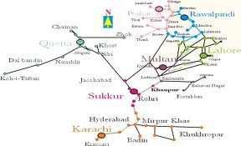
Railway Tracks map of Pakistan

Slide 29
Education & Training
There is certainly a close relationship between the volume of transport and communication and the level of growth.
Its bearing on economic growth can be considered from economic, social and political point of view.
Human capital formation: "Human capital refers to the level of education, skills, health and nutrition of the labor force”.
***

Slide 30
Non Economic Factors:Social Culture Factor
Non- economic factors are as much important as economic factors in economic development. According to Nurkse:“Economic development has much to do with human endowments, social attitudes, political conditions and historical accidents".
Social Culture Factor: Social attitudes, values and institutions strongly influence economic development of a country. People in LDC’s are mostly conservative in their habits. They feel pride in their native culture and are generally not receptive to new methods of production. Joint family system has also killed the sense of initiative and the incentive to work.

Slide 31
Political Factor
2.Peace and stable policies are necessary for eco-development. Trade and commerce activities would hurt in case of majority of the people are against t the policies of the government. Rapid change of government means change of policies and priorities, which create an uncertain state in the economy. A country can’t attract foreign investment in case of political disturbances.

Slide 32
Administrative Factors
3. The administrative factor has an important bearing on the economic progress of a country. If the administration of a country is efficient, honest and strong, it can give a big push to the economic development. In less developed countries, the administration is generally weak, inefficient and corrupt. The weak administration has failed to perform its duties and thus has considered to delay the economic growth.
****

Slide 33
Summary
Introduction to Economy of Pakistan
Economic history of Pakistan
Structure of Economy
Sectors: Agriculture, Industry
Industries
Prerequisites of Economic Development
Economic Factors
Stock of capital
Labor and Manpower

Slide 34
Cont.
Power
Transport and Communications
National Highway & road links
Railway Tracks map of Pakistan
Education & Training
Non Economic Factors: Social Culture Factor
Political Factor
Administrative Factors
***

Slide 35
Quotation
There can be Economy only where there is efficiency.
Benjamin Disraeli
Thank you

