Slide 1
Lecture # 24
Pakistan and the Muslim world I
Lecture # 23
Topic: Pakistan’s Role in Regional & International Organizations , Part II: SAARC, ECO
Definition and Types of Organizations
South Asian Association for Regional Cooperation(SAARC)
SAARC : Member-States
History, Objectives, organs
Role of Pakistan

Slide 2
Cont.
Economic Cooperation Organization (ECO)
History & background
Sustainable Economic Development of Member States
Activities
Pakistan’s role in ECO
Now today’s topic: Pakistan & Islamic World

Slide 3
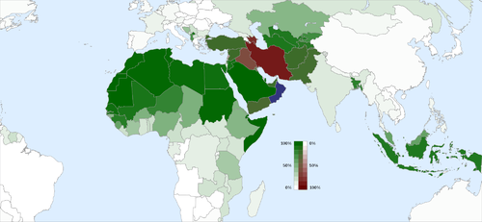
Pakistan and the Muslim world (MAP)

Slide 4
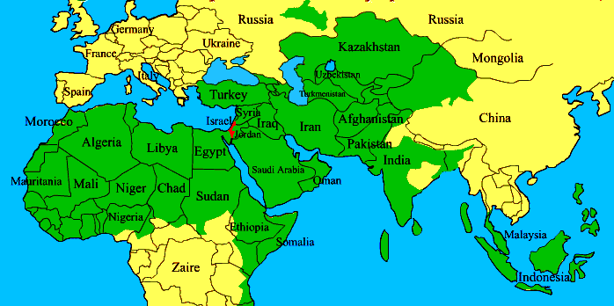
Muslim World (Map)

Slide 5
Pakistan- Saudi Arabia: Historical background
Arab traders were the main supplier for chain of silk, spices, cotton and other goods between Pakistan and Europe through the silk route, over centuries of history exist in relations between the two lands.
Importance of KSA
Two Holy Cities Makkah & Madina
1965 & 1971 Wars Domestic and Financial help
Golden Era of Shah Faisal

Slide 6
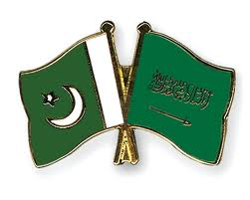
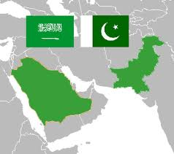
Cont.

Slide 7
Cont.
Role of Pakistan in development of Saudi Arabia.
Pakistan has provided assistance in the field of Science & Technology , infrastructure development and many more fields
Pakistan is providing training facilities to Saudi Armed forces.
Gulf War some 5,000 Pakistani troops were stationed in Saudi Arabia and the United Arab Emirates as part of the U.S.-led Persian Gulf War efforts in 1990

Slide 8
Cont.
Pakistan has provided military aid and expertise to the kingdom for decades-close ties between militaries
Saudi Arabia is one of the supporter of Afghan Mujahedeen during Afghan war against USSR and European and US arms suppliers, all were supporting Taliban however in 2001 Saudi broke ties with Taliban.
SA also supported Afghan Muhajreen during that War.

Slide 9
Cont.
2005 earthquake -Saudi Arabia topped the list of donor countries. Official aid followed by large investments from Saudi princes and from religious institutions.
Pakistani madrassa educational system, for instance, is Saudi funded by private donors.
The two countries Pakistan and Saudi Arabia shared views on major international and regional issues. Both countries consult each other on regional and international issues from time to time.

Slide 10
Cont.
They work together on Organization of Islamic Conference. Saudi Arabia supported Pakistan in all its wars with India and its position on Kashmir is supportive of Pakistan.
Saudi Arabia and Pakistan have an extensive economic relationship that expanded rapidly after 1972. SA had always provided economic assistance and loans to Pakistan and it had also invested capital in Pakistan in various projects. An important aspect of relationship is oil supply to Pakistan from Saudi Arabia.

Slide 11
Cont.
Since 1998 SA had been supplying crude oil to Pakistan on deferred payment bases which mean that to get the oil now but make the payment later on gradually.
This has help to ease economic pressure on Pakistan and Pakistan has been able to obtain oil.
SA is the biggest oil supplier to Pakistan at the moment. This relationship is going to expand over the years because both have been expanding the area of cooperation for example latest addition to this cooperation is counter terrorism and both countries are cooperating to contain terrorism in the region.
***

Slide 12
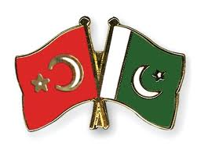
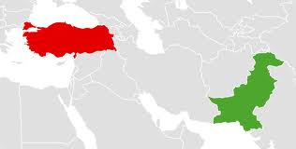
Pakistan and Turkey

Slide 13
PAKISTAN AND TURKEY
Turkey is another Muslim country with a long history of close and cordial relations with Pakistan. Turkey had stood by Pakistan in all kinds of situations in wars or in peace. Turkey has always supported Pakistan.
Turkey established diplomatic relations soon after the independence of Pakistan in 1947 and bilateral relations became increasingly close owing to cultural, religious and geopolitical links between the two countries.
Pakistan's founder Muhammad Ali Jinnah expressed admiration for Turkey's founding leader Mustafa Kemal Atatürk and also a desire to develop Pakistan on the Turkish model of modernism

Slide 14
Cont.
Pakistan, Turkey and Iran established the RCD in 1964. Turkey supports Pakistan on the Kashmir dispute and Pakistan supports them on the Cyprus conflict.
There have been high level civil and military visits, in fact their top military leaders visited Pakistan and Pakistani top military leaders responded to that and go back to Turkey for similar visits.
Both have great contribution in the multilateral arrangements of CENTO, RCD, ECO, etc.

Slide 15
Cont.
In 80’s the RCD was replaced by ECO (economic cooperation organization) in 1985. It was initiated by Pakistan, Iran and Turkey but now it has 10 members which includes 7 Asian and 3 Eurasian nations and it is an ad-hoc organization to UN.
In 90’s, present ECO cultural institute was signed at Islamabad in 1995 to foster rich culture heritage of Turkey, Iran and 10 other Asian states mid 1990’s.
The hero of the nation, Dr. A Q Khan visited turkey for technological cooperation.

Slide 16
Cont.
In 2004, President Gen Pervez Musharraf visited Turkey.
In 2005 Kashmir earthquake, Turkey stepped up its efforts to help the Pakistani people of the affected areas.
President Zardari visited Turkey in 2008. Turkish PM, Mr. Erdogan addressed a joint session of two houses of the parliament of Pakistan during his visit 2012.
Turkey and Pakistan are founding members of the Economic Cooperation Organization and part of the Developing 8 Countries (D-8) organization.

Slide 17
Cont.
Both nations have worked to negotiate on trading agreement, aiming to increase trade and investments, especially in transport, telecommunications, manufacturing, tourism and other industries.
Pakistani exports include rice, sesame seeds, leather, textiles, fabrics, sports goods, and medical equipment.
***

Slide 18
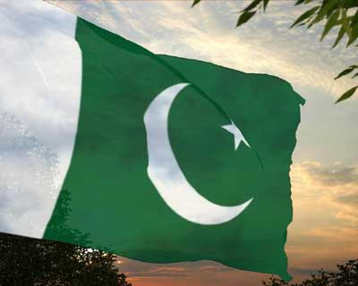

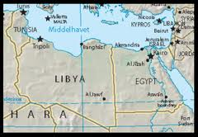
Pakistan and Egypt

Slide 19
Pakistan’s relations with Egypt
Egypt Pakistan relations are normal and cordial. currently they exchanged views on regional and international issues. However in the past in the 50s and 60s there was a problem in Pakistan’s relation with the Egypt. Egypt under Nasser had some reservations due to Pakistan’s ties with the West.
The relations began to improve and the cordiality has increased since 1967 and especially after the death of Nasser in 1970.
Pakistan supported Egypt when it was attacked by Israel in 1956, 1967, 1973.

Slide 20
Cont.
Pakistan and Egypt both are members of OIC.
During Arab-Israel wars Anwar Saddat recognized Pakistan’s services in OIC in 1974.
Egypt also played a vital role in Soviet war in Afghanistan where Egypt widely provided manpower (see Afghan Arabs) and military equipment to Afghan mujahedeen in their fight against the Soviets.
Al-AZHAR university is one of the first preference of Pakistani student for the education of Islamic Law, Sharia and Jurisprudence. Al-Azhar University continues to offer its 30 scholarships to the Pakistani students each year, this number will rise to 50 soon

Slide 21
Cont.
Since 2001, Egypt continues to support Pakistan in its war against terrorism.
In May 2009, Egyptian Assistant Foreign Minister visited Islamabad to show Egypt’s support and solidarity with the people and government of Pakistan.
Pakistan Prime Minister, Yusuf Raza Gilani, on assuming his office, made his first trip abroad to Egypt, within a year time, Gilani visited Egypt again in July 2009.
***

Slide 22

Pakistan and Libya

Slide 23
Cont.
The early 1970s were the first time the Pakistani populace began to notice Muammar Gaddafi. Gaddafi gave a speech at the Organization of the Islamic Conference meeting, where he declared support for Pakistan to pursue development of nuclear Power.
When he came to Pakistan to attend the second Islamic Summit Conference in 1974, he stated, "Pakistan is the fort of Islam."
Because of Gaddafi's support for Pakistan's nuclear deterrence program, he became a popular figure within the country. Gaddafi cricket stadium in Lahore, the largest in the country, was named after him.

Slide 24
Cont.
Libya-Pakistan relations refers to the bilateral and diplomatic relations between Libya and Pakistan. The relationship has been friendly throughout its history. Both countries share religious and cultural links, particularly their Islamic heritage. Libya’s head of state Col. Qazzafi was one of the great well wisher and supporter of Pakistan.
He and his govt. extended valuable support to Pakistan in the 70s, this support was not only diplomatic support but also economic support and in the 70s Libya invested in Pakistan.
When in 1986 American army launched air raids on Libya Pakistan despite its close ties with America condemned American air raids on Libya.

Slide 25
Cont.
After the removal of Zulfikar Ali Bhutto, the bonds with Pakistan became weak. General Zia hated and distrusted Colonel Gaddafi, therefore he immediately cut all the military aid to Libya.
Now the Libya is overcoming its problems with the United States Libya Pakistan relations are becoming friendly and activated.

Slide 26
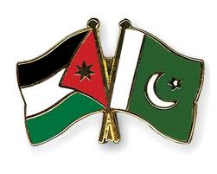
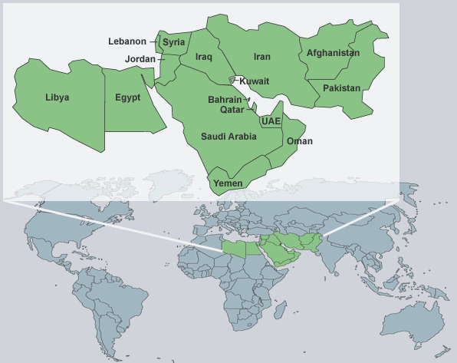
Pakistan and Jordan

Slide 27
Cont.
Pakistan-Jordan contacts began in the 1970s and 1980s, growing stronger since the mid-1990s.
In 2001, Pakistani leaders visited Amman to discuss full-scale cooperation. The King of Jordan lauded what he called "deep, strong and historical relations" between the two countries
Jordan, as the custodian of the Masjid-i-Aqsa, has always occupied a place of great affection in the hearts of Muslims of Pakistan and has attracted Pakistani pilgrims by the thousand.

Slide 28
Cont.
Pakistan’s relations with Jordan have always been very cordial and a large measure of political co-operation has existed between the two countries.
Hussein paid a State visit to Pakistan in 1955. His second visit to Pakistan.
In the joint Pakistan-Jordan communiqué issued after the Pakistan Prime Minister’s visit to Jordan in August 1957, the two countries pledged themselves to cooperate with each other in pursuance of their common policies and interests.

Slide 29
Cont.
The suggestion of Ch. Mohammad Zafrullah Khan, while he was Pakistan’s Foreign Minister, to convene a conference of Muslim countries at Jerusalem to evolve some positive policy for united action for countering the threat of the State of Israel is a manifestation of the keen interest of Pakistan in the welfare and security of Jordan.
***

Slide 30
Summary
Pakistan- Saudi Arabia
Pakistan and Turkey
Pakistan and Egypt
Pakistan and Libya
Pakistan and Jordon

Slide 31
Quotation
Observe good faith and justice toward all nations. Cultivate peace and harmony with all.
George Washington
Thank you

