Slide 1
Lecture # 23
Pakistan’s Role in Regional & International Organizations , Part II: SAARC, ECO
Recap of lecture # 22
Topic: Pakistan’s role in regional & International Organizations ,Part I
UNO, OIC & NAM
United Nations Organizations
Aims & Objectives
Organs of OIC
Pakistan’s role in UNO
The Organization of Islamic Cooperation

Slide 2
Cont.
Objectives
OIC organs
Conferences
Pakistan's Role In the OIC
Non-Aligned Movement
NAM Structure and Organization
NAM Summits at a glance
Pakistan’s role in NAM
Analysis

Slide 3
Definition and Types of Organizations
An international organization is an organization with an international membership, scope, or presence. There are three main types:
International nongovernmental organizations (NGOs): non-governmental organizations (NGOs) that operate internationally. There are two types:
International non-profit organizations. Examples include the World Organization of the Scout Movement, International Committee of the Red Cross

Slide 4
Cont.
International corporations, referred to as multinational corporations. Examples include The Coca-Cola Company and Toyota.
Intergovernmental organizations, also known as international governmental organizations (IGOs): the type of organization most closely associated with the term 'international organization', these are organizations that are made up primarily of sovereign states (referred to as member states).

Slide 5
Cont.
Notable examples include the United Nations (UN), Organization for Security and Co-operation in Europe (OSCE), Council of Europe (CoE), European Union (EU; which is a prime example of a supranational organization), and World Trade Organization (WTO). The UN has used the term "intergovernmental organization" instead of "international organization" for clarity.

Slide 6
Cont.
Regional integration is a process in which states enter into a regional agreement in order to enhance regional cooperation through regional institutions and rules.
The objectives of the agreement could range from economic to political, although it has generally become a political economy initiative where commercial purposes are the means to achieve broader socio-political and security objectives.

Slide 7

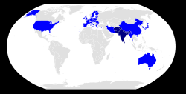
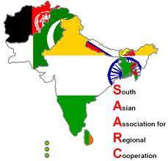
SAARC :Member-States
Member-States
Observers State

Slide 8
South Asian Association for Regional Cooperation
The South Asian Association for Regional Cooperation (SAARC) is an organization of South Asian nations, which was established on 8 December 1985.
The government of Bangladesh , Bhutan, India, Maldives, Nepal, Pakistan, and Sri Lanka formally adopted its charter.
The promotion of economic and social progress, cultural development within the South Asia region and also for friendship and cooperation with other developing countries.

Slide 9
Cont.
It is dedicated to economic, technological, social, and cultural development emphasizing collective self-reliance.
Its seven founding members are Sri Lanka, Bhutan, India, Maldives, Nepal, Pakistan, and Bangladesh.
Afghanistan joined the organization in 2007. Meetings of heads of state are usually scheduled annually; meetings of foreign secretaries, twice annually. It is headquartered in Kathmandu, Nepal.

Slide 10
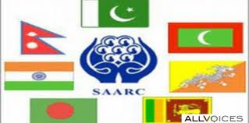
History
The first concrete proposal for establishing a framework for regional cooperation in South Asia was made by the late president of Bangladesh, Ziaur Rahman, on May 2, 1980.
Afghanistan
Bangladesh
Bhutan
India
Maldives
Nepal
Pakistan
Sri Lanka

Slide 11
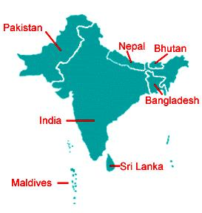
Founder Member States

Slide 12
Objectives
to promote the welfare of the people of South Asia and to improve their quality of life;
to accelerate economic growth, social progress and cultural development in the region and to provide all individuals the opportunity to live in dignity and to realize their full potential;
to promote and strengthen selective self-reliance among the countries of South Asia;
to contribute to mutual trust, understanding and appreciation of one another's problems;

Slide 13
Cont.
to promote active collaboration and mutual assistance in the economic, social, cultural, technical and scientific fields;
to strengthen cooperation with other developing countries;
to strengthen cooperation among themselves in international forums on matters of common interest; and
to cooperate with international and regional organizations with similar aims and purposes.

Slide 14
Organs
Secretariat: The SAARC Secretariat was established in Kathmandu on 16 January 1987 and was inaugurated by Late King Birendra of Nepal.
It is headed by a Secretary General appointed by the Council of Ministers from Member Countries in alphabetical order for a three-year term.
The Secretariat coordinates and monitors implementation of activities, prepares for and services meetings, and serves as a channel of communication between the Association and its Member States as well as other regional organizations.
In several recent meetings the heads of state or government of member states of SAARC have taken some important decisions and bold initiatives to strengthen the organization and to widen and deepen regional co-operation.

Slide 15
Cont.
The SAARC Secretariat and Member States observe 8 December as the SAARC Charter Day.
Regional Centers: The SAARC Secretariat has established various regional centers in member states. Each regional center is managed by a governing board.
SAARC has intentionally laid more stress on "core issues" rather than political issues like the Kashmir dispute and the Sri Lankan civil war.
However, political dialogue is often conducted on the margins of SAARC meetings. During the 12th and 13th SAARC summits, extreme emphasis was laid upon greater cooperation between the SAARC members to fight terrorism.

Slide 16
Cont.
South Asian Free Trade Area: Over the years, the SAARC members have expressed their unwillingness on signing a free trade agreement.
Though India has several trade pacts with Maldives, Nepal, Bhutan and Sri Lanka, similar trade agreements with Pakistan and Bangladesh have been delayed due to political and economic concerns on both sides.

Slide 17
Cont.
In 1993, SAARC countries signed an agreement to gradually lower tariffs within the region, in Dhaka. Eleven years later, at the 12th SAARC Summit at Islamabad, SAARC countries devised the South Asia Free Trade Agreement which went into force on January 1, 2006. Under this agreement, SAARC members will bring their duties down to 20 per cent by 2009.

Slide 18
Role of Pakistan
Since the Association's start, Pakistan has been a supporter of SAARC objectives and has remained an active player on the SAARC platform.
It has contributed meaningfully to the establishment institutions and progress of the Association.
Pakistan supported a step by step approach for enhancing cooperation and stresses the need for better coordination of programs and consolidation of the progress made so far.

Slide 19
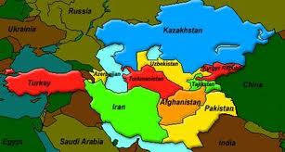
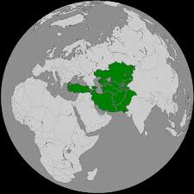
Economic Cooperation Organization (ECO)

Slide 20
Economic Cooperation Organization
The Economic Cooperation Organization (ECO) is an inter-governmental organization involving seven Asian and three Eurasian nations part of the South-central Asian Union.
It provides a platform to discuss ways to improve development and promote trade, and investment opportunities.
The common objective is to establish a single market for goods and services, much like the European Union.

Slide 21
History
ECO's secretariat and cultural department are located in Tehran, its economic bureau is in Turkey and its scientific bureau is situated in Pakistan.
The organization was founded by Turkey, Iran and Pakistan.
Economic Cooperation Organization is an inter-governmental regional organization established in 1985 by Iran, Pakistan and Turkey for the purpose of promoting economic, technical and cultural cooperation among the member states.

Slide 22
Background
It was the successor organization of what was the Regional Cooperation for Development (RCD), founded in 1964, which ended activities in 1979.
In the fall of 1992, the ECO expanded to include seven new members, namely Afghanistan, Azerbaijan, Kazakhstan, Kyrgyzstan, Tajikistan, Turkmenistan and Uzbekistan.

Slide 23
Cont.
The status and power of the ECO is growing. However, the organization faces many challenges.
Most importantly, the member states are lacking appropriate infrastructure and institutions which the Organization is primarily seeking to develop, to make full use of the available resources in the region and provide sustainable development for the member nations.

Slide 24
Cont.
The Economic Cooperation Organization Trade Agreement (ECOTA) was signed on 17 July 2003 in Islamabad. ECO Trade Promotion Organization (TPO) is a new organization for trade promotion among member states located in Iran (2009).
Under the agreement reached between ECO members, the common trade market should be established by 2015

Slide 25
Sustainable Economic Development of Member States
Progressive removal of trade barriers and promotion of intra- regional trade; Greater role of ECO region in the growth of world trade; Gradual integration of the economies of the Member States with the world economy;
Development of transport & communications infrastructure linking the Member States with each other and with the outside world;
Economic liberalization and privatization;

Slide 26
Cont.
Mobilization and utilization of ECO region's material resources;
Effective utilization of the agricultural and industrial potentials of ECO region;
Regional cooperation for drug abuse control, ecological and environmental protection and strengthening of historical and cultural ties among the peoples of the ECO region; and
Mutually beneficial cooperation with regional and international organizations.

Slide 27
Activities
Activities of ECO are conducted through Directorates under the supervision of Secretary General and his Deputies which considered and evolve projects and programs of mutual benefit in the fields of:
Trade and Investment
Transport and Telecommunications
Energy, Minerals and Environment
Agriculture, Industry and Tourism
Human Resources & Sustainable Development
Project & Economic Research and Statistics

Slide 28
Pakistan’s role in ECO
ECO currently is engaged in energy crisis resolution and meetings are being held in Tehran. And by resolving this problem all the members will facilitated by it specially Pakistan. Because besides the potentiality of the country in many a sectors still they are not operating at an efficient level which is required according to the current need of the scenario.
Pakistan’s potential in telecommunication, agriculture, food, industry, trade and many other sectors made it significant as it can play its role for the betterment of rest of the member nations by providing them with assistance financially and technically both.

Slide 29
Summary
Definition and Types of Organizations
South Asian Association for Regional Cooperation(SAARC)
SAARC : Member-States
History, Objectives, organs
Role of Pakistan
Economic Cooperation Organization (ECO)
History & background
Sustainable Economic Development of Member States
Activities
Pakistan’s role in ECO

Slide 30
Quotation
Without courage, wisdom bears no fruit.
Baltasar Gracian
Thank you

