Slide 1
Lecture # 20
Topic: Pakistan's relations with Neighboring Countries Part I: China & Iran
Recap of lecture # 19
Topic: Constitution 1962, 1973, III
Origins , Provisions, Salient Features, Islamic provisions of the constitution of 1962
Drawbacks, Expiry, Analysis and main features of the Constitution of Constitution of 1962
Constitution of 1973

Slide 2
Cont.
Salient Features of 1973 Constitution
Province-wise Distribution of NA Seats (342)
Distribution of seats in Senate (100)
Provincial Assemblies
Analysis of Constitution of 1973
Now today’s topic: Pakistan's relations with neighboring countries I: China & Iran

Slide 3
Steps for the Process of Islamization
Pakistan is an ideological state that was founded on the principle that Muslims would lead their lives according to Islam. All the laws made and implemented in this country have been designed keeping in view the teachings of Holy Quran and Sunnah. Quaid-e-Azam Muhammad Ali Jinnah said:
“Let us lay the foundation of our democracy on the basis of truly Islamic ideals and principles. Almighty Allah taught us that the decisions in the affairs shall be guided by discussion and consultation.”

Slide 4
Cont.
All the constitutions that have been implemented in our country (1956, 1965 and 1973) have Islamic Provisions. The Government of Pakistan has taken the following steps to introduce Islamic Laws in Pakistan:
1. Hudood Ordinance: Hudood Ordinance was introduced in the country in 1977. In the light of Hudood Ordinance, various punishments were prescribed for different crimes. The word Hudood means the punishment which has been prescribed in the light of Holy Quran.

Slide 5
Cont.
According to the Hudood Ordinance manufacture, export, import and use of alcohols has been prohibited. Any person found guilty is liable of punishment of 30 lashes and 5 years imprisonment.
The second Hadood Law is concerned with the crime of theft.
The third Hadood law is meant for adultery (Zina-bil-Raza) and rape (Zina-bil-Jabar), whose punishment is stoning the adulter to death.
2. Establishment of Federal Sharia Courts

Slide 6
Cont.
3. Zakat and Ushr Ordinance: Zakat and Ushr Ordinance was promulgated in the country on June 20, 1980. According to the ordinance, Zakat Fund was established to collect zakat donations. It was made compulsory for every Sahib-e-Nisab Muslim to pay Zakat by depositing 10 percent of money in one’s bank account.Ushr is the tax levied on yield of agricultural land in cash or kind. According to Ushr Ordinance, every owner who ploughs and cultivates land was made bound to deposit 10 percent of his earnings in cash or kind, as Ushr.
4. Teaching of Islamic and Pakistan Studies

Slide 7
Cont.
5. Interest Free Banking: In January 1981, interest free banking was introduced in Pakistan. According to this system, the account holder partners with the bank in profit and loss and shares risk according to one’s investment in the bank.
6. Establishment of Islamic University: Sharia faculties have been established in various universities for the promotion of Islamic teachings. The function of Jamia-e-Bahawalpur was streamlined and an Islamic University was established in Islamabad.
7.Nizam-e-Salat and Azan
Characteristics of an Islamic society. (Ref. Text book)

Slide 8
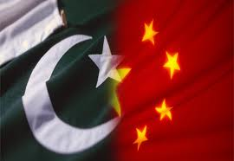
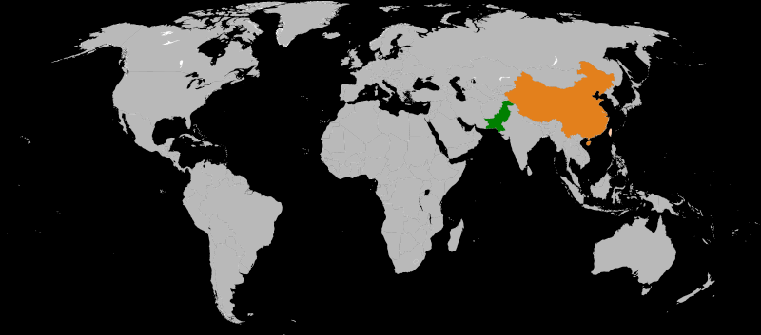

Slide 9
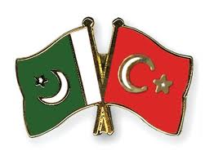
Pak- China Relations
People's Republic of China–Pakistan relations began in 1950 when Pakistan was among the first countries to recognized and started relations with the Republic of China.
Following the 1962 China-Indian War, both countries have placed considerable importance on the maintenance of an extremely close and supportive relationship.
Since then, the two countries have regularly exchanged high-level visits resulting in a variety of agreements.
China has provided economic, military and technical assistance to Pakistan.

Slide 10
Bilateral relations: Importance of China for Pakistan
Militarily Power: Bilateral relations have evolved from an initial Chinese policy of neutrality to a partnership that links a smaller but militarily powerful Pakistan, partially dependent on China for its military strength.
With China attempting to balance competing interests in the region.
Diplomatic relations were established in 1950, military assistance began in 1966.
A strategic alliance was formed in 1972.

Slide 11
Cont.
Economic co-operation began in 1979. China has become Pakistan’s largest sup­plier of arms and its third-largest trad­ing partner.
Recently, both nations have decided to cooperate in improving Pakistan's civilian nuclear program.
Favorable relations with China is a pillar of Pakistan's foreign policy. China supported Pakistan's opposition to the Soviet Union's intervention in Afghanistan and is perceived by Pakistan as a regional counterweight to NATO and the United States.

Slide 12
Cont.
China and Pakistan also share close military relations, with China supplying a range of modern armaments to the Pakistani defense forces.
China supports Pakistan's stand on Kashmir while Pakistan supports China on the issues of Tibet and Taiwan.
Lately. military cooperation has deepened with joint projects producing armaments ranging from fighter jets to guided missile frigates.

Slide 13
Cont.
Gwadar port project Chinese cooperation with Pakistan has reached economic high points, with substantial Chinese investment in Pakistani deep-water port at Gwadar. Both countries have an ongoing free trade agreement.
Pakistan has served as China's main bridge between Muslim countries.
Pakistan also played an important role in bridging the communication gap between China and the West by facilitating the 1972 Nixon visit to China.

Slide 14
Cont.
China is emerging economic power of the world.
Strongest , well trained and well equipped army
Nuclear power
China is the prominent country among Communist bloc and have say in an international forums
Pakistan is seeking support from China in education , trade, telecommunication, technical, nuclear and defense sectors.

Slide 15
Background
A close identity of views and mutual interests remain the hallmark of bilateral ties. Since the 1962 Sino-Indian War, Pakistan has supported China on most important issues like Taiwan and Tibet and other sensitive issues such as human rights.
China also has a reliable record of supporting Pakistan in regional issues. During the Pakistan-Indian tensions in 1965, 1971, and 2008, it declared that it would support Pakistan in the event of a war. Pakistan's military depends heavily on Chinese armaments, and joint economic projects.

Slide 16
History of Diplomatic Relations
Diplomatic relations between Pakistan and China were established on 21 May 1951, shortly after the independence of the Republic Of China in 1949.
Pakistan hoped that China would serve as a counterweight to Indian influence. India had recognized China a year before, and Indian Prime Minister Nehru also hoped for closer relations with the Chinese.
However, with escalating border tensions leading to the 1962 Sino-Indian war, China and Pakistan aligned with each other in a joint effort to counter perceived Indian encroachment.

Slide 17
Cont.
China also fully supported Pakistan in 1965 war against India. Chinese pressure on India enabled Pakistan to accept ceasefire in a better position than it would have been. China also supported Pakistan in the 1971 war. Soon after the war China wrote off some loans and it had given to Pakistan.
Since 1962, China has been a source of military equipment to the Pakistani Army, helping establish ammunition factories, providing technological assistance and modernizing existing facilities.

Slide 18
Cont.
With the war in Afghanistan there is a general sentiment in Pakistan to adopt a foreign policy which favors China. As Pakistan sees China a more reliable ally over the long term as compare to any other country of the world.
Consequently, the primarily geopolitical alliance between Pakistan and China has since 1990 branched out into military and economic cooperation.
Since 9/11, Pakistan has increased the scope of Chinese influence and support by agreeing to a number of military projects, combined with extensive economic support and investment from the Chinese.

Slide 19
Joint Ventures of Pak-China
Defense Projects :Pak- China are involved in the joint venture of several projects which include collaborating in the development of JF-17 Thunder fighter aircraft, K-8 Karakorum advance training aircraft, space technology, AWACS systems, Al-Khalid tanks and the Babur cruise missile. The armies have a schedule for organizing joint military exercises.
Silk route was completed in 1971
Heavy Mechanical complex Texila
Chashma power project
Gawadr port project etc

Slide 20
Cont.
China has become increasing concerned about al-Qaeda linked terrorism creating in Pakistan and is seeking to setup military bases on Pakistani soil to deal with the problem.
China – Pakistan Free Trade Agreement: Economic trade between Pakistan and China is increasing at a rapid pace and a free trade agreement has recently been signed.
China has pledged to increase their investment in Pakistan's economy and infrastructure.

Slide 21
Cont.
China has been helping to develop Pakistan's infrastructure through the building of power plants, roads and also promoting communication sector. Current trade between both countries is at $9 billion, making China the second largest trade partner of Pakistan.

Slide 22
A quick review of Pak-China relations
1950 – Pakistan becomes the third non-communist country, and first Muslim one, to recognize the People's Republic of China.
1951 – Beijing and Karachi establish diplomatic relations.
1963 – Pakistan and china resolved border disputes.
1970 – Pakistan helps the U.S. arrange the 1972 Nixon visit to China.
1978 – The Karakoram Highway linking the mountainous Northern Pakistan with Western China officially opens.

Slide 23
Cont.
1980s – China and the U.S. provide support through Pakistan to the Afghan guerrillas fighting Soviet occupational forces.
1986 – China and Pakistan reach a comprehensive nuclear co-operation agreement.
1996 – Chinese President Jiang Zemin pays a state visit to Pakistan.
1999 – A 300-megawatt nuclear power plant, built with Chinese help in Punjab province, is completed.
2001 – A joint-ventured Chinese-Pakistani tank, (Al-Khalid) is completed.

Slide 24
Cont.
2002 – The building of the Gwadar deep sea port begins, with China as the primary investor.
2003 – Pakistan and China signed a $110 million contract for the construction of a housing project on Multan Road in Lahore
2007 – The Sino-Pakistani joint-ventured fighter aircraft – the JF-17 Thunder is formally rolled out.
2008 – Pakistan welcomes the Chinese Olympic Torch in an Islamabad sports stadium, under heavy guard amidst security concerns.
2008 – China and Pakistan sign a free trade agreement.

Slide 25
Cont.
2008 – Pakistan and China to build a railway through the Karakoram Highway, in order to link China's rail network to Gwadar Port.
2008 – The F-22P frigate, comes into service with the Pakistani Navy.
2009 – The ISI arrest several suspected Uyghur terrorists seeking refuge in Pakistan.
2010 – Pakistan and China conduct a joint anti-terrorism drill.

Slide 26
Conclusion
2010 – Wen Jiabao visits Pakistan. More than 30 billion dollars worth of deals were signed.[39]
2011 – Pakistan is expected to buy air to air SD 10 missiles from China for its 250 JF 17 thunder fighter fleet.
The relations between Pakistan and China have been described as "higher than mountains deeper than oceans stronger than steel and sweeter than honey.

Slide 27
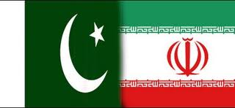

Pakistan – Iran Relations

Slide 28
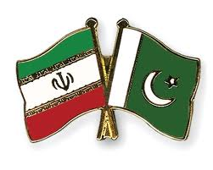
Background
Relations between Pakistan and Iran date back to the common prehistoric Indo-Iranian heritage (which connects all of Greater Persia with the Indo-Aryan Civilization of the Indus Valley) from 3000-2000 BC and Islamic empires in South-central Asia and the Greater Middle East in the 13th to 19th centuries.
There is a long history of contact and mutual influence between the two nations, with significant aspects of Pakistani culture and traditions are influenced from Iranian cultures.

Slide 29
Important of Iran for Pakistan
Iran is the largest Muslim country sharing its boundaries with Pakistan
Strategic position of Iran is very import
Iran is emerging nuclear power
Pakistan and Iran both countries are sharing common history and culture. Pakistan was also part of Greater Persia and both Pakistan and Iran are part of the Iranian Cultural Continent.
Iran is blessed with oil wealth

Slide 30
Cont.
Islamic brotherhood
Politically, Iran was the first country to officially acknowledge the newly formed state of Pakistan in 1947 as well.
Raza Shah Pahlivi was the first foreign ruler who visited Pakistan.
During the rule of 1970s, Iran's relations with Pakistan were at their peak. However, During the 1980s foreign policy of both countries experiences major shifts however both countries had good relations.
Pakistan and Iran also supported different sides during the Afghan Civil War and improved relations significantly since 1999

Slide 31
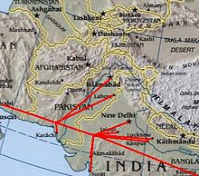
Proposed Gas pipeline project

Slide 32
Cont.
Pakistan and Iran have a number of areas of mutual interest on fighting drug trade along their common border as well as defeating Afghan supported tribal insurgency along their border. They are both members of the Developing 8 Countries group of countries as well as the Economic Cooperation Organization. Iran and Pakistan are also both observers of the Shanghai Cooperation Organization.
Baghdad pact, which was milestone in Pak-Iran geo-political geo- strategic relations was signed.
Both Pakistan and Iran joined CENTO and SECTO in 1955.
Iran's moral and political and diplomatic support to Pakistan during two Indo - Pak wars.

Slide 33
Cont.
The Regional Cooperation for Development, an agreement among Turkey, Iran and Pakistan for non-political cooperation was signed in 1964.
Iran support for Pakistan in the post war (1971 war) period was total. Iran supported Pakistan whole heartedly in the 93000 prisoners of war dispute. Iran assured Pakistan security and territorial integrity.
Iran welcomed the conclusion of Simla Agreement between India and Pakistan. The Shah of Iran appreciated Zulfiqar Ali Bhotto.

Slide 34
Cont.
Zia accession to power opened a new chapter in Pak-Iran relations during Iran – Iraq war.
Pakistan welcomed Islamic revolution in Iran which opened a new chapter in Pak-Iran relations.
Iran always act as a mediator between India and Pakistan over the Kashmir issue but the tilt was clearly in Pakistan's favor.
The real test of Iran- Pakistan friendship, however, The first instance of military assistance from Iran to Pakistan was the 1965 and 1971 Indo-Pak Wars. Iran considered the defense of Pakistan as its own defense.

Slide 35
Conclusion
The two Muslim countries have shown remarkable consistency in their relations with each other despite certain minor ups and downs. Their bilateral relations made them important for the other regional powers-specially India. Their individual strategic locations made them important for the superpowers for keeping their hold on the oil-rich region of Asia.
Today relations between Islamabad and Tehran are based on bilateral relations between the Islamic Republic of Pakistan and the Islamic Republic of Iran.

Slide 36
Summary
Steps for the Process of Islamization
Pakistan – China Relations
Background:
Importance of China for Pakistan
History of Diplomatic Relations
Joint Ventures of Pak-China
A quick review of Pak-China relations
Conclusion

Slide 37
Cont.
Pakistan – Iran Relations
Background
Important of Iran for Pakistan
Conclusion

Slide 38
Quotation
A diplomatic peace is not yet the real peace. It is an essential step in the peace process leading towards a real peace.
Yitzhak Rabin
Thank you

