Slide 1
Lecture # 12
Topic: Pakistan Movement Important events
Recap of lecture # 11
Topic :Emergence of Pakistan Movement
Round Table Conferences
Allama Iqbal’s presidential address
Government of India Act 1935
Elections 1935-36
Congress Ministries
Pakistan Resolution 1940
Cripps Mission

Slide 2
Cont.
Wavell Plan and Simla Conference
Elections 1945
Cabinet Mission Plan
Arrival of Lord Mountbatten & Partition Plan
June 3rd Plan
Radcliffe Award
And today’s topic is :Pakistan Movement – Post Independence events

Slide 3
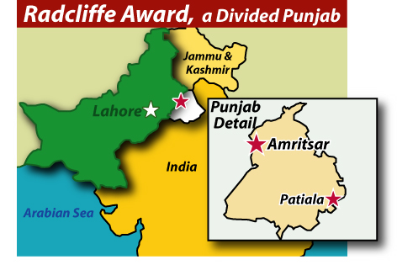
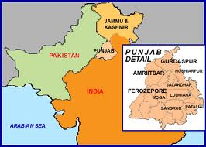
Cont.

Slide 4
Analysis :Radcliffe Award
Jinnah told the people of Pakistan that the awards were ‘Wrong, unjust and perverse’.
However partition had taken place two days earlier and there was little to be done. Besides there were many other problems which were pressing for the new country. It was time to establish Pakistan as a viable member of the world community.

Slide 5
Cont.
The two self governing countries of India and Pakistan legally came into existence at the stroke of midnight on 15 August 1947. The ceremonies for the transfer of power were held a day earlier in Karachi, at the time the capital of the new state of Pakistan, so that the last British Viceroy, Lord Mountbatten of Burma, could attend both the ceremony in Karachi and the ceremony in Delhi.
This is why Pakistan's Independence Day is celebrated on 14 August and India's on 15 August.

Slide 6
Cont.
The partition of India was set forth in the Indian Independence Act 1947 and resulted in the dissolution of the Indian Empire and the end of the British Raj.
It resulted in a struggle between the new states of India and Pakistan and displaced up to 12.5 million people in the former British Indian Empire, with estimates of loss of life varying from several hundred thousand to a million.
The violent nature of the partition created an atmosphere of mutual hostility and distrust between India and Pakistan that effects their relationship to this day.

Slide 7
Cont.
The partition included the geographical division of the Bengal province of British India into East Bengal, which became part of the State of Pakistan (from 1956, East Pakistan). People migrated from these areas to Pakistan and Hindus and Sikhs to India
Same happened in West Bengal which became part of India, and a similar partition of the Punjab province became West Punjab (later the Pakistani Punjab and Islamabad Capital Territory) and East Punjab (later the Indian Punjab, as well as Haryana and Himachal Pradesh).

Slide 8
Major Issues due to unfair partition
The main problems for Pakistan were:
Refugees
Accession of Princely States
Indus Water

Slide 9
Migration/Refugees
Pakistan came into existence with horrible loss of life and property, and the migration of millions of stunned and poor men, women, and children.
The cost was heavy in terms of human suffering. But what the Muslims wanted and what they achieved was a homeland of their own.
They now had the freedom to worship, practice their religious faith and develop their culture.

Slide 10
The majority of refugees who migrated after the independence were settled in the port city of Karachi in southern Sindh and in the cities of Hyderabad, Sukkur, Nawabshah and Mirpurkhas.
As well the above many settled in the cities of Punjab mainly in Lahore, Multan, Bahawalpur and Rawalpindi. The number of migrants in Sindh was placed at over 540,000 of whom two-third were urban. In case of Karachi, from a population of around 400,000 in 1947, it turned into more than 1.3 million in 1953.

Slide 11
Refugees settled in Pakistan
Former President of Pakistan, General Pervez Musharraf, was born in the Nahar Vali Haveli in Daryaganj, Delhi, India.
Several previous Pakistani leaders were also born in different regions of India.
Pakistan's first prime minister, Liaquat Ali Khan was born in Karnal (now in Haryana).

Slide 12
Cont.
The 7-year longest-serving Governor and martial law administrator of Pakistan's largest province, Balochistan, General Rahimuddin Khan, was born in the city near Uttar Pradesh.
General Muhammad Zia-ul-Haq, who came to power in a military coup in 1977, was born in Jalandhar, East Punjab. The families of all four men opted for Pakistan at the time of Partition.

Slide 13
Cont.
Moreover, independence had opened up a bright future for the Muslims, who hoped for a better standard of living, economic development, prosperity and a fuller life.
The partition agreement also included the division of Indian government assets, including the Indian Civil Service, the Indian Army, the Royal Indian Navy, the Indian railways and the central treasury, and other administrative services.

Slide 14
Issues of Princely States
In the outcome of the partition, the princely states of India, that had been left alone by the Indian Independence Act 1947 to choose whether to join India or to Pakistan or to remain outside them.
The British ruled India with two administrative systems. One was ‘Provinces’ and the other ‘Princely States’. About 60% of the Indian sub-continent's territory were Provinces and 40% were Princely States. Provinces were British territories completely under British control.

Slide 15
Cont.
Princely States were the states in British India with local ruler or king with honorary titles like Maharaja, Raja, Maharana, Rana, Nizam, Badshah and other such titles meaning king or ruler in different Indian languages.
These rulers were subjected to the British Empire. These two types of administrative systems were the result of the British East India Company's attempt to annex the whole of Indian sub-continent and make it into a British territory.
When the British gave the Indian sub-continent independence in 1947 there were 562 Princely States. Some of them like Kashmir, Mysore and Hyderabad were as large as England.

Slide 16
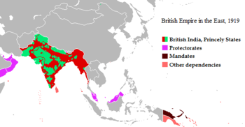
Cont.

Slide 17
Jammu & Kashmir
The Princely state of Kashmir and Jammu had a majority of Muslim population; Muslims were 80 percent of the whole state.
Kashmir, the bold states, was the reverse of Hyderabad. It had a Hindu ruler, Maharaja Hari Singh, but his subjects were mostly Muslims, accounting to 78 percent of the total population.
The Maharaja was reluctant to join either India or Pakistan. But Lord Mountbatten urged him to take a decision to join either of the states before August 15, 1947.

Slide 18
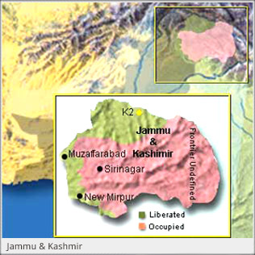
Cont.

Slide 19
Cont.
The Maharaja asked for more time to consider his decision. In the meantime he asked the Indian and the Pakistani government to sign a “standstill agreement” with him. Pakistan consented but India refused.
The Maharaja of Jammu and Kashmir consented to India at the outbreak of violence. This Kashmir conflict led to the 1947 war between India and Pakistan in that region.

Slide 20
Cont.
The choice between India and Pakistan made by the ruler of Jammu and Kashmir led to the Indo-Pakistani War of 1947 some two months after the partition and they became disputed territory.
All states were merged into one or another of the new states, whether voluntarily or by force, in all cases by the ruler signing an agreement.

Slide 21
Cont.
Other wars and conflicts between India and Pakistan have continued since then. As a result of the Bangladesh Liberation War and the Indo-Pakistani War of 1971, East Pakistan became the independent state of Bangladesh in 1971.

Slide 22
Issue of Hyderabad
Hyderabad, the second of the bold states was the largest and richest in India. Its population was 85 percent Hindu but the ruler (Nizam) was a Muslim.
He was reluctant to accede either to India or Pakistan but was dismissed by Mountbatten for adopting this course. The Nizam was forced by the Indian government and Lord Mountbatten to join India. A standstill agreement was concluded between India and Hyderabad.

Slide 23
Cont.
The Hindu subjects were encouraged to revolt against the Nizam’s desire to be independent. The whole province suffered chaos and violence. Hyderabad filed a compliant with the Security Council of the United Nations.
Before the hearing could be started, Indian troops entered Hyderabad to “restore order”, and under the pretext of “police action” Hyderabad was forced to join India. The Hyderabad army surrendered on September 17, 1948, and finally Hyderabad was annexed into the Indian Union.

Slide 24
Issue of Junagadh
Nawab Mohammad Mahabat of Junagadh, a princely state located on the south-western end of India decided to join Pakistan. India stated that Junagadh was not nearby to Pakistan and refused to accept the Nawab's choice of accession to Pakistan.
Nawab argued that Junagadh could access Pakistan by sea. India cut off supplies of fuel and coal to Junagadh, detached air and postal links, sent troops to the frontier, and occupied the principalities and acceded to India.

Slide 25
Cont.
Pakistan agreed to discuss a referendum, subject to the withdrawal of Indian troops, that condition India rejected and occupied rest of Junagadh by 9 Nov 1947. The Nawab and his family fled to Pakistan and appealed United Nations.

Slide 26
Issue of Jodhpur
Yet another prince, the Maharaja of Jodhpur, expressed a wish to join Pakistan but Mountbatten warned him that his subjects were mostly Hindus and his accession to Pakistan would create problems. As a result Jodhpur, too, acceded to India.

Slide 27
10 other states
Apart from the Kashmir issue, the issue of accession of 10 states within the boundaries of Pakistan was causing tension especially the Khan of Kalat. They needed to be convinced about the details of joining. These states were: Chitral, Amb, Swat, Dir, Makran, Kharan, Lasbella, Kalat, Khairpur, and Bahawalpur. Largest of these states was Bahawalpur.

Slide 28
Cont.
The Quaid played very important role in convincing the Rulers of these states to accede to Pakistan. These states acceded to Pakisan between 3 October 1947 and 31 March 1948. Thus this issue of great importance was settled during the life-time of Quaid-i-Azam.

Slide 29
The Indus Water
The most explosive of Indo-Pakistan disputes was the question of sharing the waters of the Indus basin.
On April 1, 1948, India cut off the supply of water from the two headworks under her control.
Fortunately, Mr.E. Black, President of the International Bank for Reconstruction and Development offered the offices of the Bank for the solution of the water problem in 1952.

Slide 30
Cont.
A solution acceptable to both governments was agreed upon in 1960 at the Indus Basin Development Fund Agreement at Karachi. This treaty is commonly known as the “Indus Water Treaty”.
The treaty allowed for a provisional period of 10 to 13 years, after which the three eastern rivers would fall exclusively to India’s share and the three western rivers to Pakistan.

Slide 31
Cont.
During the provisional period, Pakistan would construct a system of replacement works consisting of two dams, five barrages and seven link canals financed by the Indus Development Fund.

Slide 32
Summary
Analysis of Radcliffe Award
Major Issues due to unfair partition
Migration/Refugees
Refugees settled in Pakistan
Issues of Princely States
Jammu & Kashmir
Issue of Hyderabad
Issue of Junagadh
Issue of Jodhpur
10 other states
The Indus Water

Slide 33
Quotation
The only way in which these people can be put on their feet again is the rapid industrialization of the country which would provide new avenues of employment for them. Nature has blessed us with plenty of raw materials and it is now up to us to harness our resources to the best advantage of our State and its people.
Quaid-i-Azam
Speech on the Opening Ceremony of the Bengal Oil Mills on 2nd February, 1948.
Thank you

