Slide 1
Lecture # 11
Emergence of Pakistan Movement
Topic of lecture # 10:Evolution of Muslim Nationalism in India
Indian Councils Act of 1861 & The Indian Councils Act of 1892
Urdu-Hindi Controversy
Partition of Bengal
Formation of All India Muslim League
Minto-Morley Reforms 1909
The Lucknow Pact
Khalafat Movement

Slide 2
Cont.
Analysis: Change in Muslim politics
Muslim Politics in British India: 1924-1935
Delhi Proposals
Simon Commission
Nehru Report
Quaid-e-Azam,s Fourteen Points
Round Table Conference
Allama Iqbal’s Presidential address
Now today’s topic

Slide 3
Government of India Act 1935
After the failure of the Third Round Table Conference, the British government gave the Joint Select Committee the task of formulating the new Act for India.
The Committee comprised of 16 members each from the House of Commons and House of Lords, 20 representatives from British India and seven from the princely states

Slide 4
Cont.
The Bill was discussed in the House of Commons for 43 days and in the House of Lords for 13 days and finally, after being signed by the King, was enforced as the Government of India Act, 1935, in July 1935.
When Quaid-i-Azam Mohammad Ali Jinnah had returned from England in 1934-35, the Muslim League was almost dead and Muslims in India as a community lacked direction, objective, a leader and a platform.

Slide 5
Analysis
Both the Indian National Congress and the Muslim League opposed the Act, but participated in the provincial elections of winter 1936-37, conducted under provisos of the Act.
At the time of independence, both India and Pakistan accepted the Act of 1935, with few amendments, as their provisional constitution.
Government of India Act of 1935 was practically implemented in 1937.

Slide 6
Elections 1935-36
There were two major political parties in the Sub-continent , the Congress and the Muslim League.
Both parties did their best to motivate the masses before these elections and put before them their manifesto.
The political manifestos of both parties were almost identical, although there were two major differences.
Congress stood for joint electorate and the League for separate electorates; Congress wanted Hindi as official language with Deva Nagri script of writing while the League wanted Urdu with Persian script.

Slide 7
Cont.
The results of the elections were shocking for the Muslims of India and Muslim League as well, which could not get mentionable support from the voters.
Congress achieved a big victory and managed to get clear majority in five provinces.
After four-month delay, Congress formed their ministries in July 1937.

Slide 8
Congress Ministries
The Congress proved to be a pure Hindu party and worked during its rule only for the betterment of the Hindus.
Twenty-seven months of the Congress rule were like a nightmare for the Muslims of South Asia. Some of the Congress leaders even stated that they would take revenge from the Muslims for the last 700 years of their slavery

Slide 9
Cont.
Bande Matram
Wardha Scheme
Raising of three- colored flag
Widdia Mander Scheme
Hindi Muslim riots Muslim Mass contract Campaign
At the outbreak of the World War II, the Viceroy proclaimed India’s involvement without prior consultations with the main political parties. When Congress demanded an immediate transfer of power in return for cooperation of the war efforts, the British government refused. As a result Congress resigned from power.

Slide 10
Cont.
Muslim League remained very active during the terrible rule of the Congress.
It continued drawing attention of the masses, through it resolutions, to anti-Muslim polices of the Congress.
And appealing to the congress to change its biased attitude towards the Muslims.
With the resignation of the Congress ministers the Muslims of India observed the Day of Deliverance on 22nd December, 1939.

Slide 11
Pakistan Resolution 1940
From March 22-24, 1940, the All India Muslim League held its annual session at Minto Park, Lahore. This session proved to be historical.
Having passed the Pakistan Resolution, the Muslims of India changed their ultimate goal.
Instead of seeking alliance with the Hindu community, they set out on a path whose destination was a separate homeland for the Muslims of India.

Slide 12
Cripps Mission
The British government wanted to get the cooperation of the Indian people in order to deal with the war situation. The divergence between the two major representative parties of the country harassed the British government. It found it difficult to make the war a success without the cooperation of both the Hindus and the Muslims.
On March 22, 1942, Britain sent Sir Stafford Cripps with constitutional proposals.

Slide 13
Cont.
The important points of the declaration were as follows:
General elections in the provinces would be arranged as soon as the war ended.
A new Indian dominion, associated with the United Kingdom would be created.
Those provinces not joining the power could form their own separate union.
Minorities were to be protected.
However, both the Congress and the Muslim League rejected these proposals. Jinnah opposed the plan, as it did not acknowledge Pakistan. Thus the plan came to nothing.

Slide 14
Wavell Plan and Simla Conference
However, both the Congress and the Muslim League rejected these proposals. Jinnah opposed the plan, as it did not acknowledge Pakistan. Thus the plan came to nothing.
In May 1945, Lord Wavell, the Viceroy of India, went to London and discussed his ideas about the future of India with the British administration
To discuss these proposals with the leadership of major Indian parties, Wavell called for a conference at Simla on June 25, 1945.

Slide 15
Cont.
Leaders of both the Congress and the Muslim League attended the conference, which is known as the Simla Conference.
However, differences arose between the leadership of the two parties on the issue of representation of the Muslim community. The Muslim League claimed that it was the only representative party of the Muslims in India
Congress, which had sent Maulana Azad as the leader of their delegation, tried to prove that their party represented all the communities living in India

Slide 16
Elections 1945
All this resulted in a deadlock. Finally, Wavell announced the failure of his efforts on July 14. Thus the Simla Conference couldn’t provide any hope of proceeding further.
Provincial and General Elections [1945-46]
With the failure of the Simla Conference, Lord Wavell announced that the Central and Provincial Legislature elections would be held in the winter of 1945, after which a constitution-making body would be set up.

Slide 17
Cont.
He also announced that after the elections, the Viceroy would set an Executive Council that would have the support of the main Indian political parties. Both the Muslim League and the Congress opposed the proposal.
Quaid-i-Azam declared that Muslims were not ready to accept any settlement less than a separate homeland.

Slide 18
Cont.
The WWII finally came to an end in1945.
Jinnah declared on behalf of the Muslim League that no settlement would be acceptable except on the basis of Pakistan.
While the All Indian Congress Committee considered the proposals as " unsatisfactory“
The elections were held in two stages. In December 1945 the central legislative assembly was elected and Provincial elections were held in early 1946.

Slide 19
Cont.
Congress won a total of 930 seats, gaining an absolute majority in eight provinces.
The Muslim League captured 428 out of the possible 492 Muslim seats.
The elections of 1945-46 proved that Muslim League alone represented the Muslims of India. The sweeping majority of ML increased Congress hostility towards the ML.

Slide 20
Cabinet Mission Plan
All of the British Government’s attempts to establish peace between the Congress and the Muslim League had failed.
The results of the general elections held in 1945-46 served to underline the urgency to find a solution to the political deadlock.
which was the result of non-cooperation between the two major parties. To end this, the British government sent a special mission of cabinet ministers to India.

Slide 21
Cont.
The mission consisted of Lord Pethic Lawrence, the Secretary of State for India, Sir Stafford Cripps, President of the Board of Trade, and A. V. Alexander, the First Lord of the Admiralty.
The purpose of the mission was:
Preparatory discussions with elected representatives of British India and the Indian states in order to secure agreement as to the method of framing the constitution.
Setting up of a constitution body.
Setting up an Executive Council with the support of the main Indian parties.

Slide 22
Cont.
The mission arrived on March 24, 1946. After extensive discussions with Congress and the Muslim League, the Cabinet Mission put forward its own proposals on May 16, 1946.
The Muslim League accepted the plan on June 6 1946. Earlier, the Congress had accepted the plan on May 24, 1946, though it rejected the interim setup.
The Viceroy should now have invited the Muslim League to form Government as it had accepted the interim setup; but he did not do so.

Slide 23
Cont.
Meanwhile Jawaharlal Nehru, addressing a press conference on July 10, said that the Congress had agreed to join the constituent assembly, but saying it would be free to make changes in the Cabinet Mission Plan.
Under these circumstances, the Muslim League disassociated itself from the Cabinet Plan and resorted to “Direct Action” to achieve Pakistan. As a result, Viceroy Wavell invited the Congress to join the interim government, although it had practically rejected the plan.

Slide 24
Cont.
However, the Viceroy soon realized the ineffectiveness of the scheme without the participation of the League. Therefore, on October 14, 1946, he extended an invitation to them as well.
On March 22, 1947, Lord Mountbatten arrived as the last Viceroy. It was announced that power would be transferred from British to Indian hands by June 1948.

Slide 25
Arrival of Lord Mountbatten & Partition Plan
Lord Mountbatten entered into a series of talks with the Congress and the Muslim League leaders.
Quaid-i-Azam made it clear that the demand for Pakistan had the support of all the Muslims of India and that he could not withdraw from it.
With reliable activists as Patel agreeing to the Muslim demand for a separate homeland, Mountbatten now prepared for the partition of the Sub-continent and announced it on June 3, 1947.

Slide 26
June 3rd Plan
When all of Mountbatten’s efforts to keep India united failed, he asked to chalk out a plan for the transfer of power and the division of the country. It was decided that none of the Indian parties would view it before the plan was finalized.
The plan was finalized in the Governor’s Conference in April 1947, and was then sent to Britain in May where the British Government approved it.

Slide 27
Cont.
The plan was made public on June 3, and is thus known as the June 3rd Plan.
June 3 Plan (1947) was comprised of the following main points on the basis of which Britain, after dividing it, was to quit India:
1. Two separate states will be established in India.
2. The present constitution assembly will to act but its constitution will not be applicable on the areas which will not accept it.

Slide 28
Cont.
3. The power will be transferred the same year (1947) to the representatives of India.
4. The Muslim majority areas and the Hindu majority distinct of Bengal and Punjab will decide in separate meeting to accept or not to accept the division of the provinces. If anyone of the two groups will opt division, the province will be divided.
5. The Muslim majority areas which will not opt to join present constituent assembly, will create their separate constituent assembly.

Slide 29
Radcliffe Award
It was provided in the June 3 plan that as soon as the legislatures of Punjab and Bengal decided in favor of partition, a boundary commission should be set up to demarcate the boundaries.
The legislatures of Bengal and Punjab voted in favor of partition. Boundary commissions were set up for Punjab and Bengal under the chairmanship of Sir Radcliffe. Each commission was to consist of an equal number of representatives of India and Pakistan and one or more impartial members.

Slide 30
Cont.
The final award was announced on 17 August, 1947. The Radcliffe Award was unfair to Pakistan because it awarded many Muslim majority areas in Punjab and Bengal to India. Calcutta was given to India.
Muslim majority tehsils of Gurdaspur and Batala were given to India along with Pathankot tehsil. The Muslim majority tehsil Ajnalain in Amritsar district was also handed over to India.
In Jullundur district the Muslim majority areas in Ferozpur district were also given to India. All of these areas were attached to western Punjab. This unfair award resulted in India's occupation of Kashmir and snatching from Pakistan important head works and giving them to India.

Slide 31
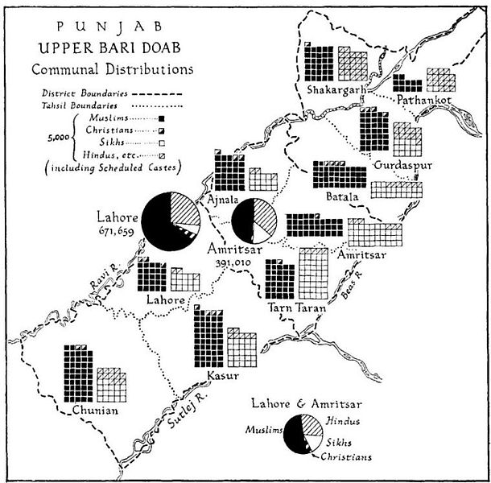
Cont.

Slide 32
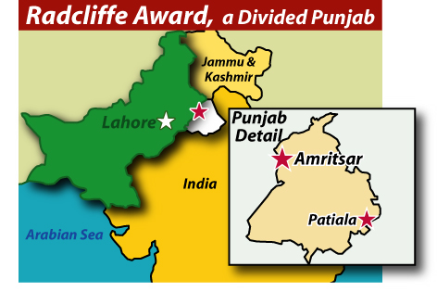
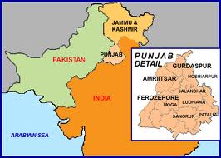
Cont.

Slide 33
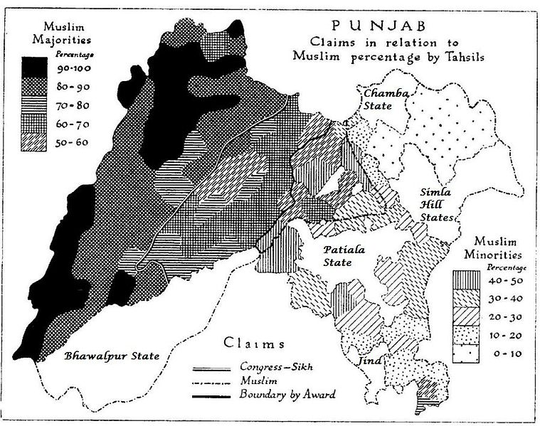
Cont.

Slide 34
Summary
Emergence of Pakistan Movement
Government of India Act 1935
Elections 1935-36
Congress Ministries
Pakistan Resolution 1940
Cripps Mission
Wavell Plan and Simla Conference
Elections 1945
Cabinet Mission Plan
Arrival of Lord Mountbatten & Partition Plan
June 3rd Plan
Radcliffe Award

Slide 35
Quotation
“Come forward as servants of Islam, organize the people economically, socially, educationally and politically and I am sure that you will be a power that will be accepted by everybody.”
Quaid I Azam
Presidential Address at the All India Muslim League, Lahore
March 23, 1940
Thank you

