Slide 1
Lecture 8
Giving Classroom Instructions
&
Writing Instruction Manuals

Slide 2
Review of Lecture 7
In lecture 7, we learnt how to
  Carry out instructions
  Structure clear instructions
  Use time connective words
  Use action words
  Set conditions for actions
  Give oral instructions

Slide 3
Objectives of Lecture 8
After completing lecture 8, you should be able to
  Evaluate classroom instructions
  Give clear classroom instructions
  Order classroom instructions
  Check classroom instructions
  Analyze instruction manuals
  Write instruction manuals

Slide 4
Why and how to give clear instructions?
How often do you conduct classroom activities?
When you set up activities, do your students sometimes look confused?

Slide 5
Task 1 – Simon’s instructions
Simon is teaching a group of pre intermediate students.
Simon: ‘So what I would like you to do is this. First of all, I’d like you to imagine you’re a waiter. Well, that’s student A. If you were the waiter what would you do? And student B if you were the customer what would you say? Oh that’s right, guys, you’ll all need to look at the menu. Actually you both will. OK, so you do that and talk together. All right? OK, so what do you have to do?
Students: [silence]
a. Do you think Simon’s instructions are clear and easy to understand?
b. Can you improve Simon’s instructions? Rewrite them on a piece of paper.

Slide 6
Task 1 Feedback
a. Do you think Simon’s instructions are clear and easy to understand?
No, they are likely to be difficult for pre intermediate level learners. Simon realizes at the end he needs to check his instructions and this is a positive thing. However, his way of checking is asking students to repeat the whole instruction sequence and this is difficult.
b. Can you improve Simon’s instructions? Rewrite them on a piece of paper.
There are many possible ways of rewriting Simon’s instructions. The following example would be easier for students to understand:
Simon: OK, student A – you are all waiters. Student B – you are all customers. So who are the waiters? [the A’s raise their hands] And who are the customers? [the Bs raise their hands] Great! All the waiters and all the customers read the menu. Customers - think about what you are going to say. Waiters, think about what you will reply. Now, what will you do first, read the menu or speak?

Slide 7
Learning Point of Task 1
When teachers can give clear instructions, learners feel more secure in the lesson.
It also means learners can begin tasks more quickly, which increases time for learning.

Slide 8
Task 2 – Hints for giving clear instructions
Look at each pair of sentences and choose the one that is TRUE.
1. a) You should use polite language otherwise students will get offended.
b) You should use simple language so the instructions are clear.
2. a) You shouldn’t do a demonstration because it takes far too much time.
b) You should do a demonstration so students can see the activity in action.
3. a) You should use questions to check key aspects of the instructions.
b) You should use questions to check all aspects of the instructions.
4. a) You should hold up worksheets when giving instructions so that students look at you.
b) You should hand out worksheets and then give instructions so students can read what they have to do.

Slide 9
Task 2 – Hints for giving clear instructions (Cont.)
5. a) You shouldn’t use gesture as this will distract students from what you are saying.
b) You should use gesture because visual information can support what you are saying.
6. a) You should never use the OHP (overhead projector) to help you give instructions because it is awkward and it is really a bit like cheating if you do.
b) You could sometimes use an OHP to help you give instructions because you can show a transparency of a worksheet clearly to your learners.

Slide 10
Learning Point of Task 2
It is helpful for students if teachers plan their instructions. Good instructions use simple language and are often supported by clear gestures or demonstrations. The whiteboard or OHP may also be used to help give instructions. Remember to ask questions to check your students have understood the instructions correctly.

Slide 11
Task 3 – Getting instructions in the right order
Teacher actions Order [1- 6]
a. give instructions
b. hand out the work sheet
c. hold up the work sheet
d. gesture the interaction pattern to be used (e.g. work in pairs)
e. get the students’ attention
f. check the instructions
Key:
e
c
a
d
f
b

Slide 12
Learning Point of Task 3
In class, before you begin giving your instructions, ensure that all the students are looking at and listening to you. It’s important not give out the worksheet too early otherwise you will lose your students attention. Only give out the worksheet once you have finished giving and checking your instructions.

Slide 13
Task 4 – Checking instructions
Each number below 1 – 6 is a learning activity. After each activity, there are 2 questions a) and b) that could be used to check the instructions. One question is effective, but the other is not. Choose the question that you think is most effective.
1. role play a) Are you going to write or speak together?
b) Who speaks first?
2. mingle a) Do you ask your partner or other students?
b) Do you mingle around?
3. gist reading a) Are you going to read or listen?
b) How much time have you got?
4. information gap activity a) Are you going to show your sheet to each other?
b) So what are you going to talk about?
5. gap fill a) Are you going to fill in the gap?
b) Do you use only one word or more than one word?
6. dictation a) How many times will I read the text?
b) Who is going to write down the words?

Slide 14
Instruction Manuals
What are instruction manuals?
Can you think of any examples?
  How to install a software? (Operating manuals)
  How to assemble a toy? (Instruction Manuals)
  How to use a gadget? (User Manuals)
  How to apply for a visa? (Policy and procedure manuals)
  Workplace Safety (Saftey Manuals)
  Course Handbook (Training Manuals)

Slide 15
Writing Effective instructions

Slide 16


Audience and purpose
Instructions help the reader perform a task.
novice:
first-time user
experienced:
has performed a similar task
Notes:
Instructions are written to help the reader perform a task, so writing for the reader’s understanding is critical.
Readers can be novice, that is, a first-time user. Even a highly educated, specialized reader can be “novice” if they have never performed the task.
An experienced reader is one who has performed a similar task.
Sometimes you will need to write one set of instructions with a mixed audience in mind.
Each kind of audience will require different levels of explanation.

Slide 17

What audiences want to know
Why am I doing this?
How do I do it?
What material or equipment do I need?
Where do I begin?
What do I do next?
What could go wrong?
Notes:
Once you’ve considered who your audience is, keep in mind the kinds of questions they’ll be asking when they approach your instructions:
Why am I doing this? They may not be questioning the overall process, but rather the steps of the process. For example, Why am I supposed to open this in Firefox instead of Internet Explorer? Why am I using this tool instead of a screwdriver?
Readers also ask “How do I do it?” How do I open Firefox? How do I use this tool?
Audiences need to know what material or equipment is necessary to complete the task.
Readers need to know the chronology of the process: Where do I begin? What do I do next?
They also need to know what could go wrong. Will I get an error message if I do it one way instead of another? Can I hurt myself if I use the screwdriver instead of the tool provided? Can I hurt the product?

Slide 18

Effective and excellent instructions
Clear and limiting title
Informed content
Visuals
Appropriate level of detail and technicality
Logically ordered steps
Notes and hazard notices
Readability
Effective design
Notes:
Because the purpose of instructions is to help someone perform a task successfully, there are high expectations for excellence.
These elements will help you create effective instructions, but you can also test them for effectiveness when you are finished. Don’t forget to revise and proofread your instructions as well. It’s unlikely you’ll get them perfect the first time.

Slide 19
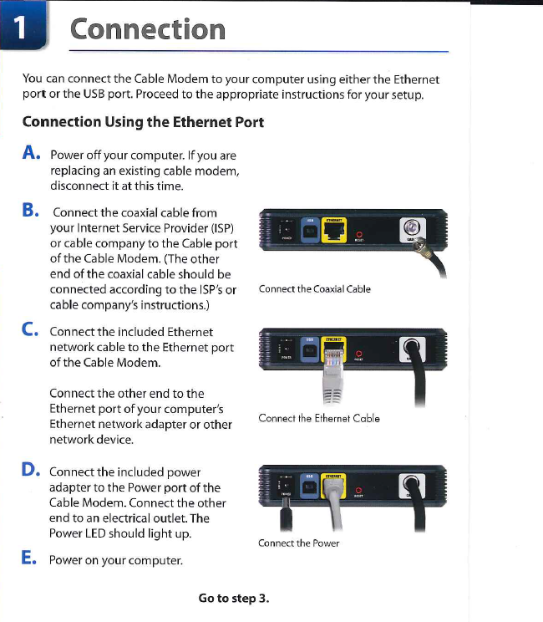

Notes:
Let’s look at an example to see how some of these elements work.
This is an instruction manual for a Linksys brand cable modem with USB and ethernet connections.
Note the clear and limiting title -- “Connection.” It is easy to see and it stands out as bigger and more prominent than the other text, so we recognize it as a heading.
See how the visuals complement the text by illustrating what is explained? Each visual has a caption to clarify EXACTLY what it represents. For example, step C says to connect the included Ethernet cable. The picture shows how and where to connect it on the modem.
These instructions are written at the level of detail and technicality that a novice audience would need. Someone accustomed to working with computer parts knows to turn off the computer before adding or removing peripherals, but step A tells the reader to turn off the computer and disconnect the old modem (if there is one).
The steps are presented in a spatial and chronological sequence. First, step B has the reader connect the coaxial cable, the one connected to the cable outlet on the wall, to the modem, then connect the modem to the computer. Finally, step D has the reader connect the modem to electrical power. Because this is a simple instruction manual, it uses letters to differentation between sub-steps, but sub-steps in technical instructions often appear in decimal form such as step 3.1, 3.2, etc.
This page does not have any notes or hazard notices, but the final page, or “step 3” does. This note is marked by a visual symbol that indicates something special, but not necessarily danger, by the horizontal lines that sandwich it, and its indentation.
The design of the instruction manual follows these guidelines: use informative headings, arrange all steps in a numbered list (each step is numbered, but the sub-steps are listed by letter to avoid confusion), separate each step visually (note the white space surround each step), let the visual repeat, restate, or reinforce the prose, keep the visual and step close together, consider a multicolumn design, and keep it simple.

Slide 20




notices
note – clarifies a point, emphasizes vital information, or describes options or alternatives
caution – prevents possible mistakes that could result in injury or equipment damage
warning – alerts users to potential hazards to life or limb
danger – identifies an immediate hazard to life or limb
Notes:
It is very important to highlight cautionary information in instructions. Notices need to appear immediately before the step or steps in which a problem could occur. Sometimes you will also find warning and danger notifications listed at the beginning of the instructions as well.
A note simply points out useful, but not critical, information that should stand out from the rest of the text. This note from the cable modem instructions just reminds the reader that the modem itself does not give access to the internet. The reader must subscribe to a service provider.
A caution notice is meant to prevent mistakes that could injure the user or equipment. This notification in the instructions for a hook that sticks to the wall indicates that the hook could damage wallpaper, valuable items, or cause injury by using it to hang objects where a fall could injure a person. The red text, bold print, underlining, and capitalization make it stand out from the rest of the black text.
A warning indicates potential harm to a person. This warning for a potty-training seat warns that the seat needs to be used under supervision and placed on the floor in order to prevent harm to the child. The exclamation symbol, bold text, capitalization, the surrounding box and placement at the beginning of the instructions make this warning stand out from the rest of the instructions.
Danger indicates immediate harm. This warning against danger appears on the instructions for a laser level. It indicates a severe danger to the eye if it is exposed to the laser.
These labels are important, not only because they help clarify critical points about the instructions, but because without them, the person or organization responsible has a legal obligation to include them.

Slide 21
Practice Situations
Design an instruction guide for new students enrolling in the school.
Design a guidebook on how to apply for a library membership card?
Prepare instruction list for using the chemistry Lab.
Design an instruction guide for students on how to evacuate the building in case of an emergency.

Slide 22
Summary of Lecture 8
In lecture 8, we learnt how to
  Evaluate classroom instructions
  Give clear classroom instructions
  Order classroom instructions
  Check classroom instructions
  Analyze instruction manuals
  Write instruction manuals

