Slide 1
Lecture 7
Giving Instructions

Slide 2
Review of Lecture 6
In lecture 6, we learnt how to
  Follow directions
  Structure clear directions
  Read a city map
  Use vocabulary related to transitions
  Use imperative form of sentences
  Use prepositions of place and motion

Slide 3
Objectives of Lecture 7
After completing lecture 7, you should be able to
  Carry out instructions
  Structure clear instructions
  Use time connective words
  Use action words
  Set conditions for actions
  Give oral instructions

Slide 4
Questions to Consider
What are instructions?
  A step by step guide on how to make or do something
  Instructions can be spoken or written
Why are instructions important?
  They save time
  They save confusion
  They help maintain uniformity / standard
  They are easy to evaluate
Can you name some common types of instructions?
  Recipe books, computer games, gardening guides, craft books, science experiments, instruction manuals, religious rites, safety manuals, traffic rules, public awareness campaigns etc.
How often do you follow or give instructions?

Slide 5

How to make Porridge

Slide 6
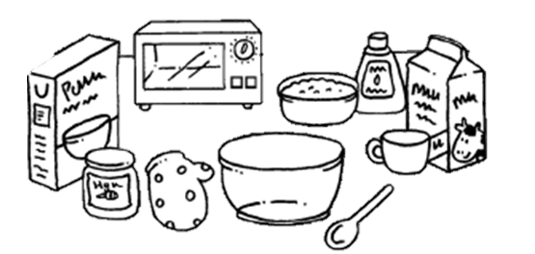
You will need
1 cup of porridge oats
2 cups of milk
cup
bowl
spoon
microwave

Slide 7
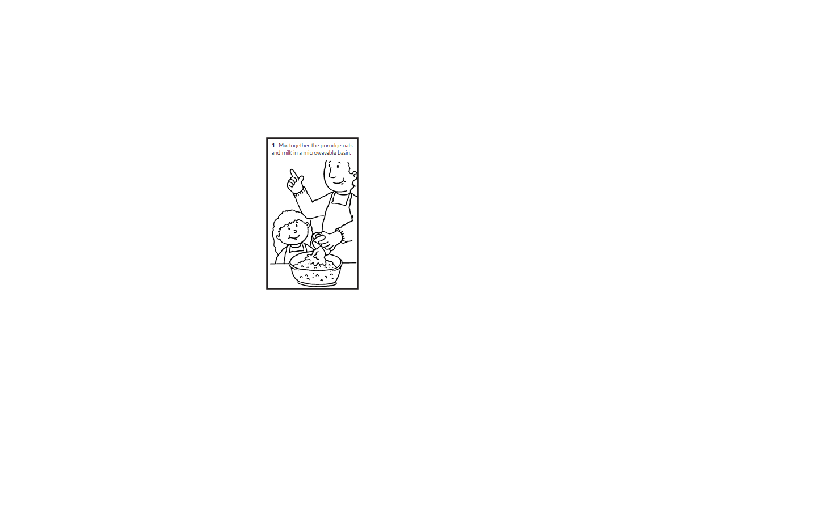

Slide 8
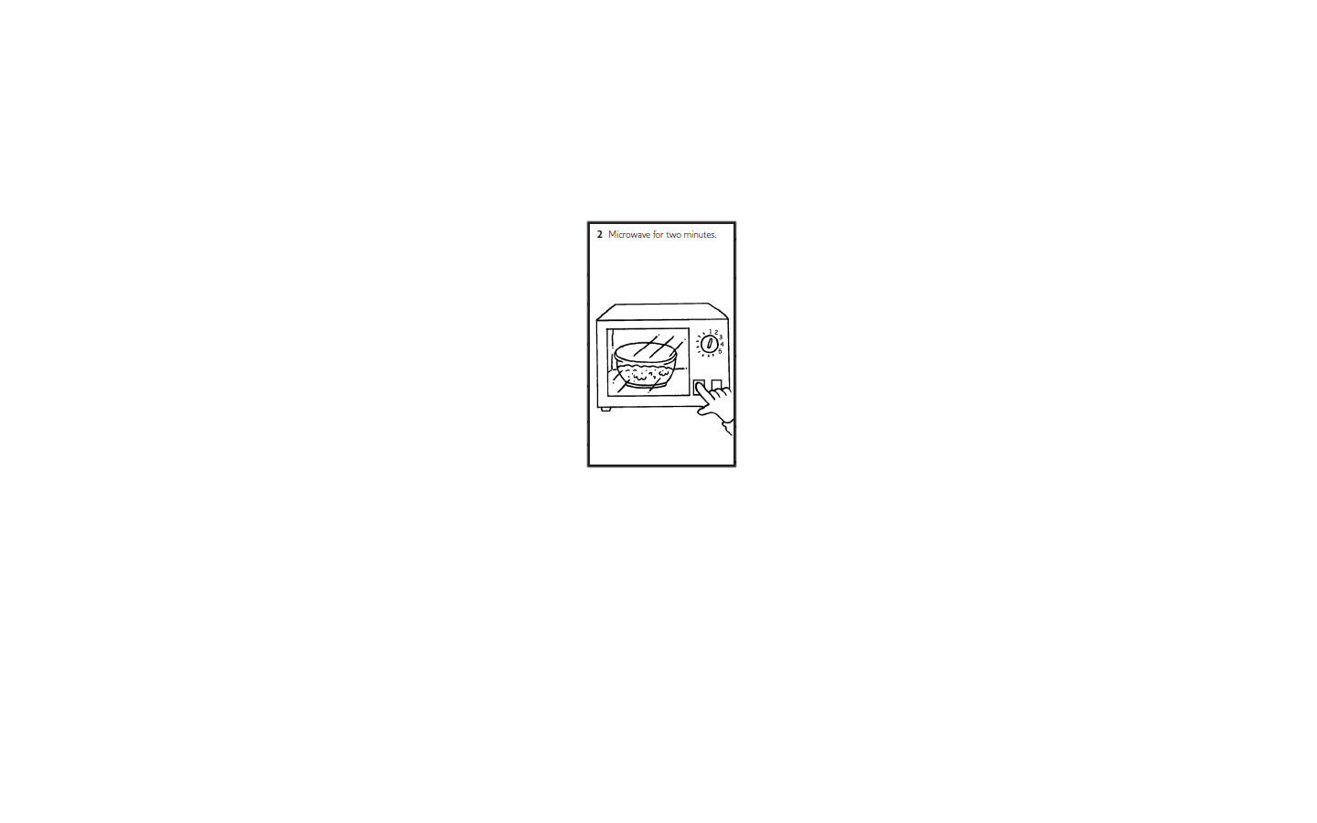

Slide 9
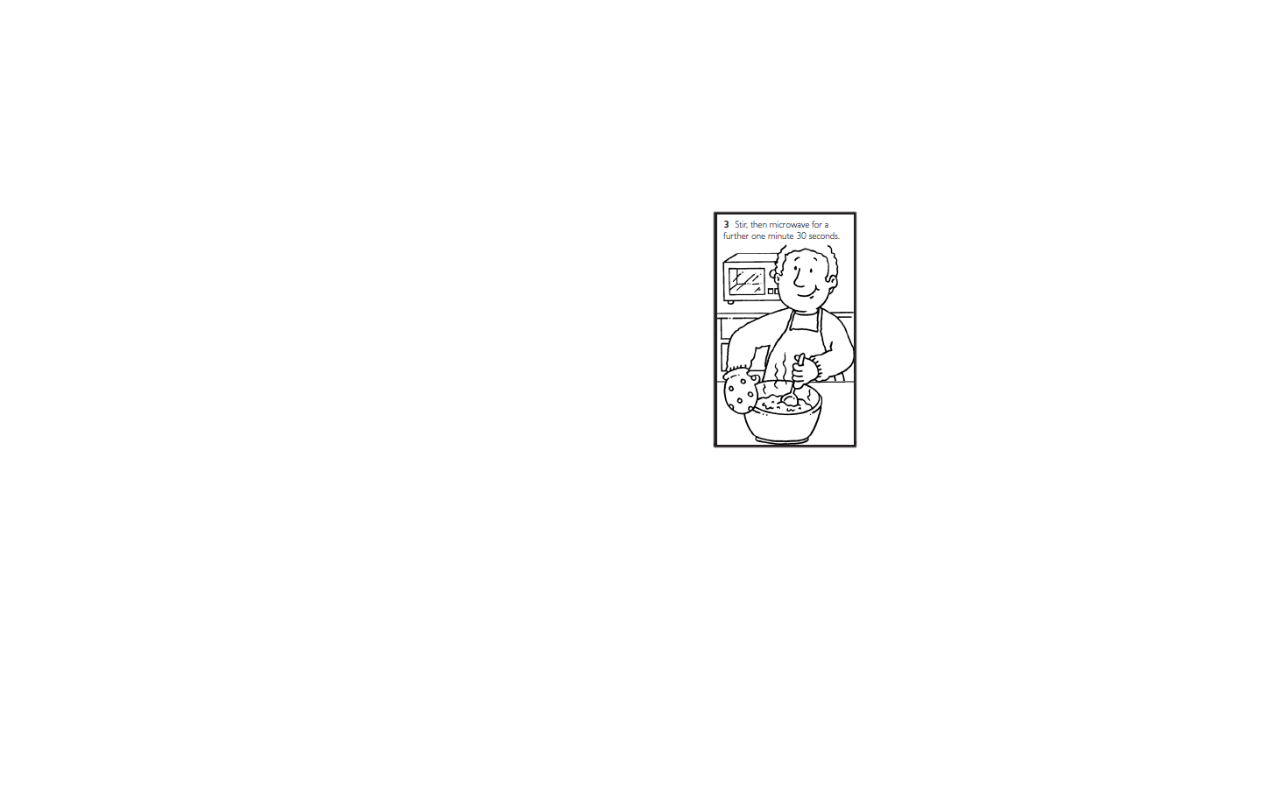

Slide 10
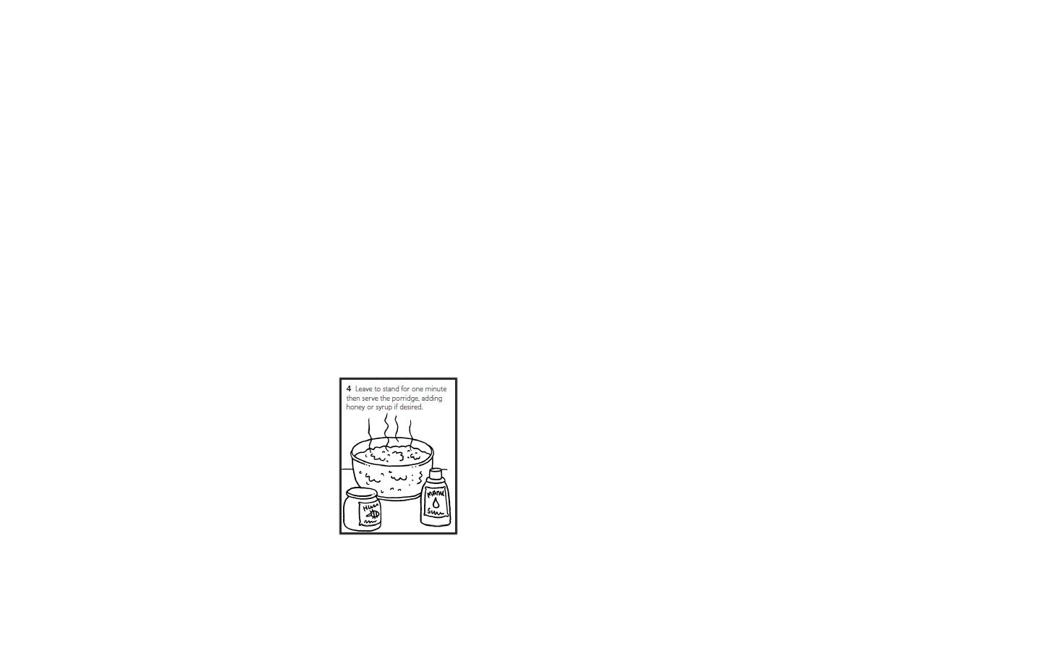

Slide 11
5. Eat and enjoy!

Slide 12
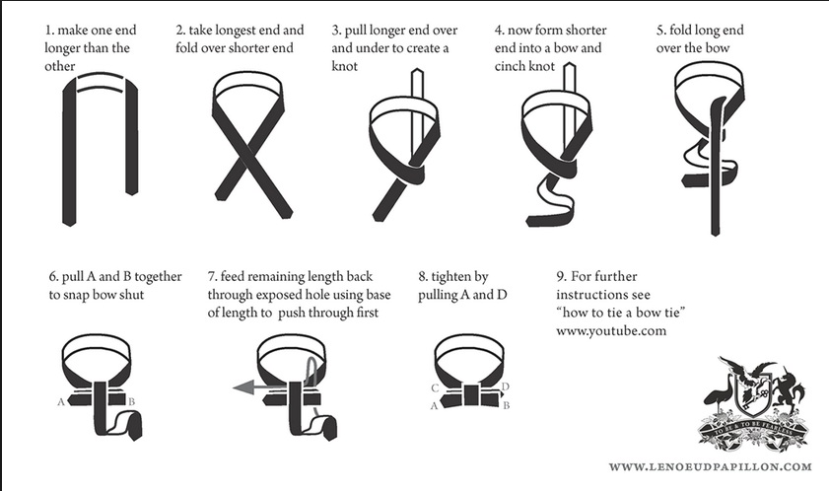
Instructions:
How to tie a Bow Tie?

Slide 13
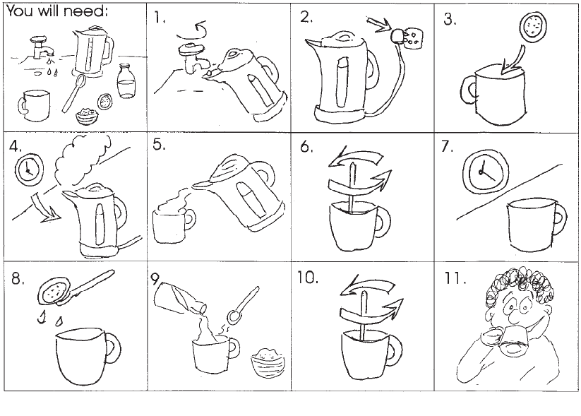
How to make a cup of tea?

Slide 14
Instruction checklist
T o write, simple and clear instructions, make sure, you have
Included a title for instructions
  How to boil an egg? / Boiling eggs / Instructions on boiling eggs, etc.
Included a list of things required (optional)
  You will need / equipment / ingredients / material, etc.
Ordered your instructions
  Bullet points, lettered list, numbered list, etc.
Used action words
  Cook, stir, boil, rinse, paint, cut, etc.
  Added any conditions for actions (optional)
    Carefully, with a glove, stirring gently , etc.
Used short, clear sentences
  ‘Rinse’, instead of ‘put the ingredients into water and rub’.
Used time connectives
  First, second, then, lastly, until, after, before, etc.
Used Illustrations

Slide 15
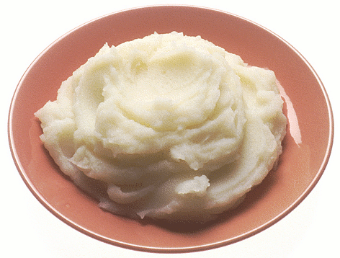
How to make Mashed Potato
Go into the kitchen and open the cupboard door.
Take out a large pan. Take out a pan lid as well.
Go to the fridge, or wherever you keep your potatoes, and get some potatoes out.
One large potato for each person should be just about the right amount.
Take a potato peeler and peel all of the brown skin off the potato. Mind you don’t
cut your fingers or anything.
With a knife that is sharp, cut the potatoes up into bits that are quite small.
Put the bits of potato into the pan you got out of the cupboard before.
Put some water into the pan so that the potatoes are all covered over with water.
Carry the pan over to the cooker and put it on the cooker. Turn the cooker on.
The potatoes need to boil for quite a while, probably somewhere around 15
minutes or so. You will know they are ready when you prick them with a fork
and they are soft-ish.
Keep the lid on the pan, hold it carefully. It will be hot so it might be a good idea
put a tea towel on your hand. Let all of the water come out of the pan and go
down the sink.
Get the potato masher and use it to squash up all of the big bits of potato.
If you think it will taste nice, you can put some milk and butter into the mashed
potato.

Slide 16
How to make Mashed Potato
Go into the kitchen and open the cupboard door.
Take out a large pan. Take out a pan lid as well. Go to the fridge, or
wherever you keep your potatoes, and get some potatoes out.
One large potato for each person should be just about the right amount.
You will need; a pan with a lid a peeler potato masher
a knife 1 lge potato per person milk and butter to taste.
peel
1. Take a potato peeler and peel all of the brown skin off the potato. Mind you don’t
cut your fingers or anything.
1. Carefully peel the potatoes.
cut
2. With a sharp knife, cut the potato into small pieces.
2. With a knife that is sharp, cut the potatoes up into bits that are quite small.
place
3. Put the bits of potato into the pan you got out of the cupboard before.
3. Place the potatoes in the pan.
cover
4. Put some water into the pan so that the potatoes are all covered over with water.
4. Cover with water.
place
5. Carry the pan over to the cooker and put it on the cooker. Turn the cooker on.
5. Place on the cooker.
boil
6. Boil for 15 mins, until soft.
6. The potatoes need to boil for quite a while, probably somewhere around 15
minutes or so. You will know they are ready when you prick them with a fork
and they are soft-ish.
drain
7. Keep the lid on the pan, hold it carefully. It will be hot so it might be a good idea
put a tea towel on your hand. Let all of the water come out of the pan and go
down the sink.
7. Drain the water off the potatoes.
mash
8. Mash the potatoes.
8. Get the potato masher and use it to squash up all of the big bits of potato.
add
9. Add milk and butter to taste.
9. If you think it will taste nice, you can put some milk and butter into the mashed
potato.

Slide 17
Time Connective Words
Firstly / First
Secondly
Thirdly
During
Finally / Lastly
Following that
After that
Meanwhile
Next
Now
Then
Subsequently
In the end

Slide 18
Action Words for Cooking
bake
beat
blend
boil
chop
crush
fry
grate
heat
mash
mix
peel
pour
season
simmer
stir
whisk

Slide 19
Setting conditions for Actions
Present Participle
  Holding one end of the string, …
  Stirring the soup gently, …
  After waiting for five minutes, …
Adverbs
  Gradually …
  Slowly …
  Carefully …

Slide 20
Practice Situations
Give oral instructions on how to
  Make a paper plane
  Perform ablution (Wudu)
  Make mango milk shake
  Plant a rose
  Change a flat tyre
  Deliver a presentation
  Clean a water tank

Slide 21
Summary of Lecture 7
In lecture 7, we learnt how to
  Carry out instructions
  Structure clear instructions
  Use time connective words
  Use action words
  Set conditions for actions
  Give oral instructions

