Slide 1
Lecture 6
Following and Giving Directions

Slide 2
Review of Lecture 5
In lecture 5, we learnt to
  Differentiate between regrets and apologies
  Use expressions of regrets
  Use expressions of apology
  Accept an apology graciously
  Write a letter of apology

Slide 3
Objectives of Lecture 6
After completing lecture 6, you should be able to
  Follow directions
  Structure clear directions
  Read a city map
  Use vocabulary related to transitions
  Use imperative form of sentences
  Use prepositions of place and motion

Slide 4
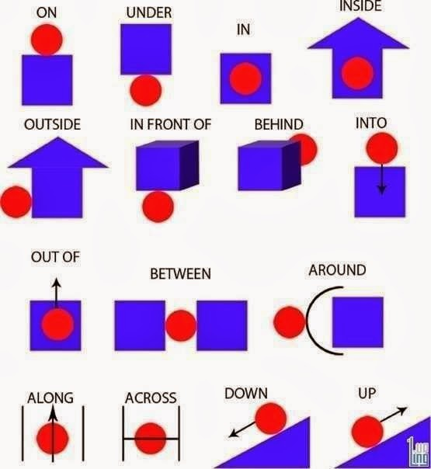
Prepositions

Slide 5
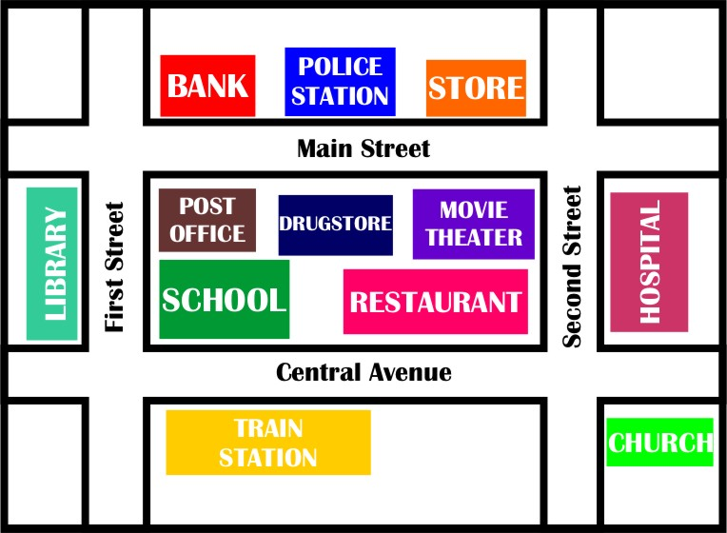
Location

Slide 6
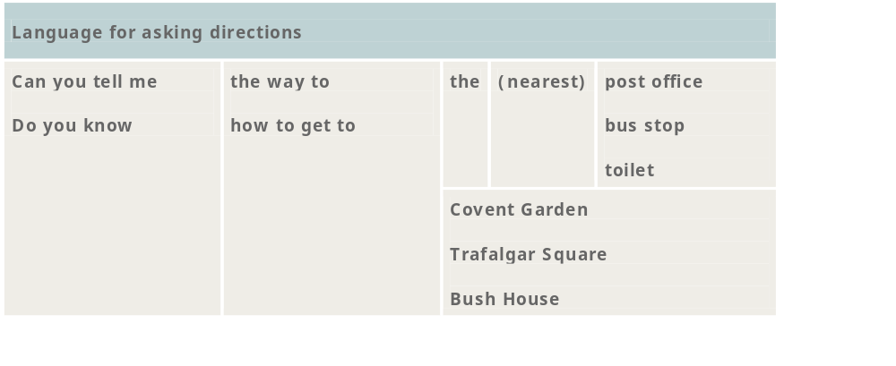
Useful Expressions

Slide 7
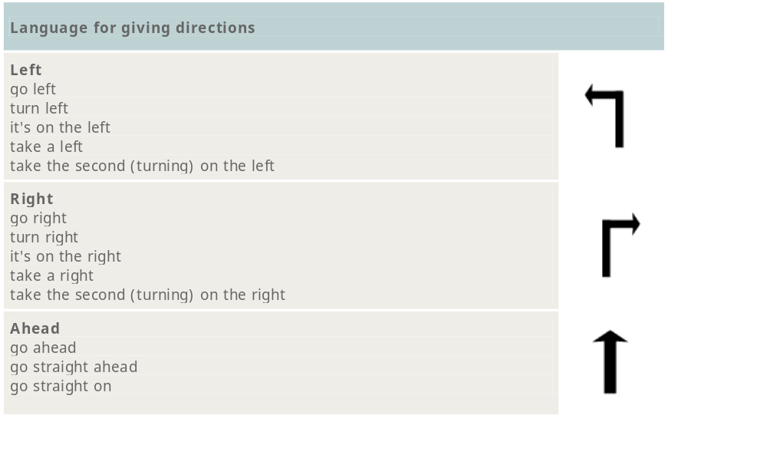
Useful Expressions

Slide 8
Transition Words
First
Then
Next
After that
Wait a second….
No, sorry….
Note: Transition words are like road signposts.

Slide 9
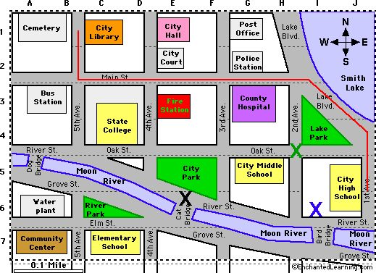
Directions

Slide 10
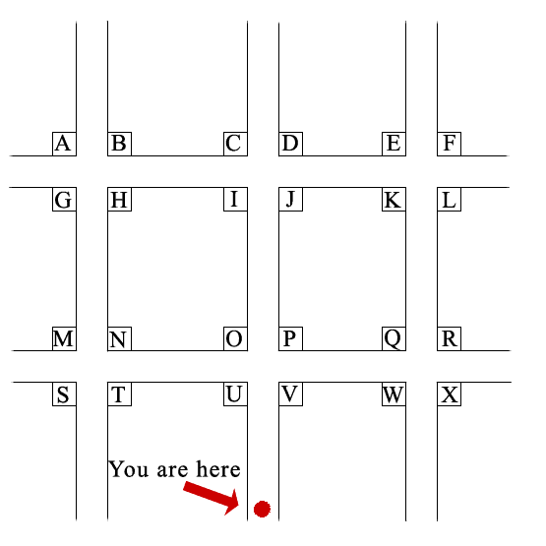
Listening Activity

Slide 11
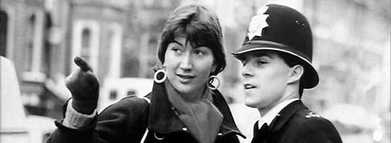
Listen to the Native Speakers
Listen to this audio clip taken from BBC Learning English.
In this programme, we look at language you can use when asking for and giving directions.
We listen to our reporter Helen as she tries to find her way around London and the office and we look at different expressions she hears on her journeys.

Slide 12
Practice Situations
Download the handout “Giving Directions” and follow the instructions to practice asking and giving directions.
Download the handout “Directions” and practice giving and following directions with a partner.

Slide 13
Summary of Lecture 6
In lecture 6, you learnt how to
  Follow directions
  Structure clear directions
  Read a city map
  Use vocabulary related to transitions
  Use imperative form of sentences
  Use prepositions of place and motion

