Slide 1
Lecture 32
End of Course Revision
Part 2

Slide 2
Objectives of Lecture 32
In lecture 32, you will
  Recall the course contents of the last 15 lectures
  Revisit and practice key skills
  Revise major structures and vocabulary items

Slide 3
Revision of Lecture 16
Planning Ahead
  Match the functions with appropriate structures.
Function | Structure
Sudden decision | Be going to
Planned future / intention | Future Simple
Known arrangement | Present Simple
Fixed schedule | Present Continuous
Function | Structure
Sudden decision | Future Simple
Planned future / intention | Be going to
Known arrangement | Present Continuous
Fixed schedule | Present Simple

Slide 4
Revision of Lecture 17
Asking and Responding to Questions
  Can you recall the four question types that you have studied?
    Yes / No questions
    Wh- questions
    Tag questions
    Embedded questions
  What’s the difference between a positive and a negative Yes / No question?
  Which question word would you use for seeking the following information?
    Distance
    Price
    Frequency
    Choice
    Person (possession)

Slide 5
Revision of Lecture 18
Reading Riddles and Jokes
  What is a ‘pun’? Can you recall any riddle with a ‘pun’?
    What has a head and a tail but no body?
    What has ears but can’t hear?
  Can you tell a joke in English?

Slide 6

Revision of Lecture 19
Describing People
  Can you describe the people in the following picture?

Slide 7
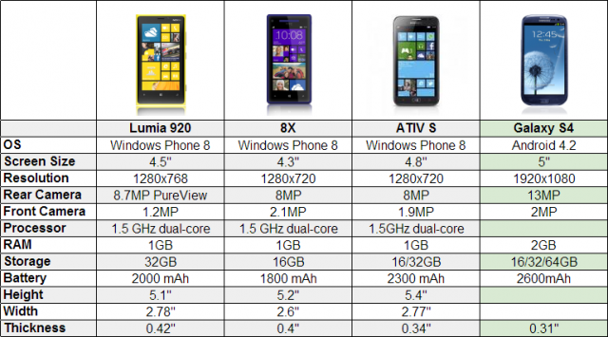
Revision of Lecture 20
Describing Pictures and Places
  Compare the following mobiles.

Slide 8
Revision of Lecture 21
Listening to Songs and Analyzing Lyrics
  Look at the following lyrics. Now listen to the song called “Billy Boy” and fill in the blanks:
    1. Oh, where have you been, Billy Boy, Billy Boy, Oh, where have you been charming Billy? I have been to seek a wife, she’s the ………………, She’s a young thing and cannot leave her mother.
    2. Did she ask you to come in, Billy Boy, Billy Boy, Did she ask you to come in, charming Billy? Yes, she asked me to come in, there’s a ………… on her chin, She’s a young thing and cannot leave her mother.
    3. Can she make a cherry pie, Billy Boy, Billy Boy, Can she make a cherry pie, charming Billy? She can make a cherry pie, ……… as you can wink an eye, She’s a young thing and cannot leave her mother.

Slide 9
Revision of Lecture 21 (Cont…)
4. Can she make a feather bed, Billy Boy, Billy Boy, Can she make a feather bed, charming Billy? She can make a feather bed, while ………………, She’s a young thing and cannot leave her mother.
5. How tall is she, Billy Boy, Billy Boy, How tall is she, charming Billy? She is tall as ……………, and straight as a pumpkin vine, She’s a young thing and cannot leave her mother.
6. How old is she, Billy Boy, Billy Boy, How old is she, charming Billy? She is ……….., twenty-eight and forty- seven, She’s a young thing and cannot leave her mother!
Sixty times eleven

Slide 10
Revision of Lecture 22
Writing an Effective Paragraph
  Pick out the topic sentence from the following paragraph.
    This summer, my friend and I sailed his boat from England to France and back again through rough seas and high winds. The constant strain from leaning over the side of the boat to keep an even keel and fight the pull of the wind was counteracted by the breeze, which kept us soaked with spray and wide awake. Sailing the boat through bad weather was one of the best experiences I ever had. It is for this reason that I say sailing is a tough and enjoyable sport.
  Can you think of three supporting details for each of the following topic sentences?
    Having a first child is difficult because of the significant adjustments in your life.
    There are many possible contributing factors to global warming.

Slide 11
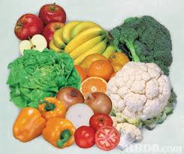
Revision of Lecture 23
Writing a Recipe
  Can you name the following food items?
  Can you name some action words for pre and post cooking process?
  What’s the difference between the use of ‘some’ and ‘any’?

Slide 12
Revision of Lecture 24
Writing Short Reports
  Can you name some common types of reports?
  What are the usual parts of a short report?
    Overview / Summary
    Introduction / Background
    Discussion
    Conclusion / Recommendations
  What’s the difference between overview and background section of a report?
  How would you show poor attendance and tardiness in your student’s report card?

Slide 13
Revision of Lecture 25
Talking about Weather
  How would you ask someone to describe today’s weather?
    How’s the weather today?
    What’s the weather like today?
  Can you describe today’s weather?
  How is the weather in Islamabad different from your city?

Slide 14
Revision of Lecture 26
Discussing Ideas: Agreeing and Disagreeing
  What’s the difference between a fact and opinion?
  Can you think of some pros and cons for the following topics?
    Mobile phones should be allowed in the classroom.
    Children become what their parents want them to be.
    Capital punishment should be banned.

Slide 15
Revision of Lecture 27
Writing Argumentative Essays
  How is an argumentative essay different from other types of essays?
    Narrative
    Descriptive
    Expository
    argumentative
  What’s the usual 5 paragraph structure for an argumentative essay?
    Thesis statement:
    PRO idea 1
    PRO idea 2
    CON(s) + Refutation(s)
    Conclusion

Slide 16
Revision of Lecture 28
Making and Giving Simple Presentations
  What things should we keep in mind while planning a presentation?
    MAP
    Time
    Tools
    Structure / format
  What are the three steps of oral presentations?
  What is signposting and why is it important for presentations?

Slide 17
Revision of Lecture 29
Writing Short Book Reviews
  Can you name some types of review reports?
    Film review
    Concert review
    Peer review
  What’s the difference between a book report and a book review?
    Summarizing Vs. Analyzing or Evaluating
    Personal Preference Vs. Reasoned Argument

Slide 18
Revision of Lecture 30
Describing Visual Organizers
  Can you name some common visual organizers?
  What are the following visual organizers good for:
    Tree diagram
    Flow chart
    Line graph
  Can you describe this bar graph?

Slide 19
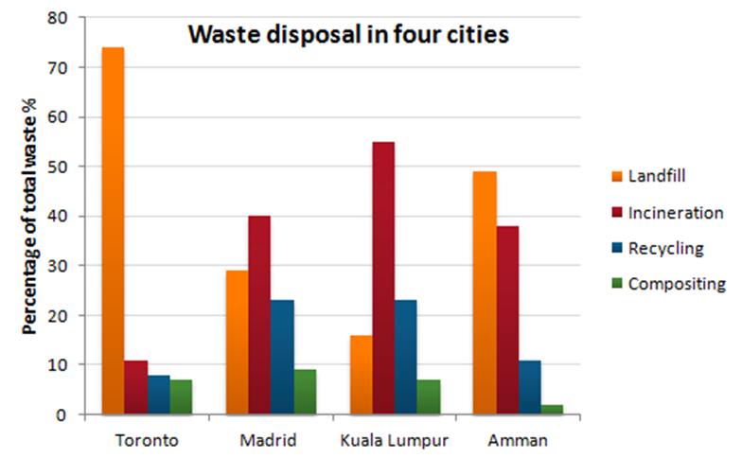
Revision of Lecture 30 (Cont…)
Can you describe the following visual organizer?

Slide 21
Summary of Lecture 32
In lecture 32, We
  Recalled the course contents of the last 15 lectures
  Revisited and practiced key skills
  Revised major structures and vocabulary items

