Slide 1
Lecture 30
Describing Visual Organizers

Slide 2
Review of Lecture 29
In lecture 29, we learnt how to
  Identify various kinds of review
  Read and analyze a book review
  Identify essential elements of book review
  Write a short book review

Slide 3
Objectives of Lecture 30
After completing lecture 30, you should be able to
  Identify and interpret visual organizers
  Convert visual information into verbal
  Use common expressions for describing
  Write short descriptive reports using visual organizers

Slide 4
Visual Organizers
What is a visual organizer?
  A visual organizer, also known as graphic organizer, is a communication tool that uses visual symbols to express knowledge, concepts, thoughts, or ideas, and the relationships between them. The main purpose of a visual organizer is to provide a visual aid to facilitate learning and instruction
Common Examples
  Outlines
  Tables
  Charts
  Illustrations / Diagrams
  Maps
  Graphs

Slide 5
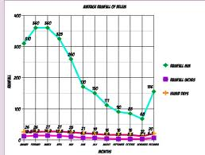
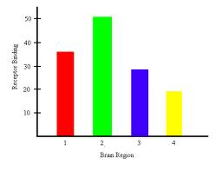
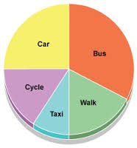
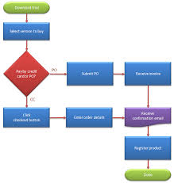
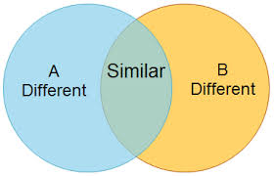
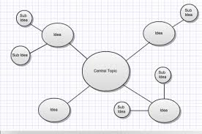
Visual Organizers
Can you name these visual organizers?

Slide 6
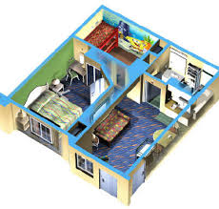
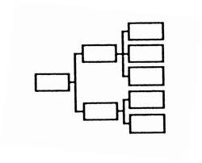
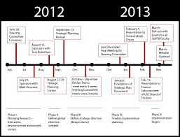
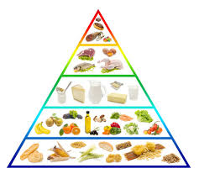
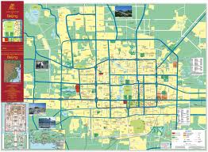
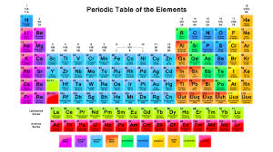
Visual Organizers (Cont…)
Can you name these visual organizers?

Slide 7
Importance of Visual Organizers
As a basic literacy skill
As a tool for academic reading and writing
As a tool for addressing multiple intelligences

Slide 8
Interpreting Visual Organizers
Table Conventions
  Columns
  Rows
  Sections
Graph Conventions
  Axis
  Scale
Map Conventions
  Scale
  Directions
  Legend
Flowchart Conventions
  Shapes
  arrows

Slide 9
Reading a Table
The table below shows the average temperature highs and lows in Jamaica each month.
Which month of the year had the highest average daytime temperature in Jamaica?
  August
What is the difference between the highest average daytime temperature in December and the lowest average nighttime temperature in December?
  10°C.
Month of the year | Average daytime temperature °C | Average night-time temperature °C
January | 30 | 19
February | 29 | 20
March | 30 | 21
April | 31 | 21
May | 31 | 22
June | 32 | 23
July | 32 | 23
August | 33 | 27
September | 32 | 23
October | 32 | 23
November | 31 | 22
December | 31 | 21

Slide 10
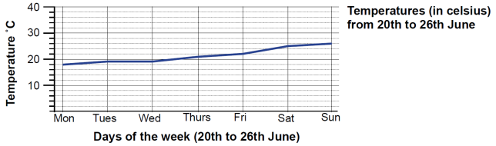
Reading a Line Graph
Which day was the warmest?
  Sunday
Which was the coldest?
  Monday
What was the temperature on Saturday?
  25 C
When was the biggest change in temperature?
  Between Saturday and Sunday

Slide 11
Reading a Bar Graph
Watch this video clip from Khan Academy to find out how we can interpret a bar graph.

Slide 12
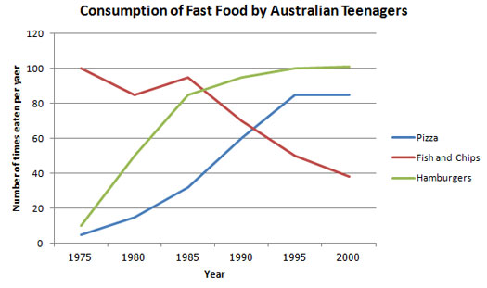
Writing Task 1
The line graph below shows changes in the amount and type of fast food consumed by Australian teenagers from 1975 to 2000.
Write a descriptive report in 150 words. Summarize the information by selecting and reporting the main features and make comparisons where relevant.

Slide 13
Model Answer to Task 1
The line graph illustrates the amount of fast food consumed by teenagers in Australia between 1975 and 2000, a period of 25 years. Overall, the consumption of fish and chips declined over the period, whereas the amount of pizza and hamburgers that were eaten increased.
In 1975, the most popular fast food with Australian teenagers was fish and chips, being eaten 100 times a year. This was far higher than Pizza and hamburgers, which were consumed approximately 5 times a year. However, apart from a brief rise again from 1980 to 1985, the consumption of fish and chips gradually declined over the 25 year timescale to finish at just under 40 times per year.
In sharp contrast to this, teenagers ate the other two fast foods at much higher levels. Pizza consumption increased gradually until it overtook the consumption of fish and chips in 1990. It then leveled off from 1995 to 2000. The biggest rise was seen in hamburgers, increasing sharply throughout the 1970’s and 1980’s, exceeding fish and chips consumption in 1985. It finished at the same level that fish and chips began, with consumption at 100 times a year.

Slide 14
Vocabulary for Describing Trends
Nouns
a rise
an increase
a surge
a growth
a peak
a fluctuation
a variation
a period of stability
a plateau
a fall
a decrease
a decline
a dip

Slide 15
Vocabulary for Describing Trends
Verbs
to rise
to increase
to surge
to grow
to peak
to skyrocket
to fluctuate
to vary
to fall
to decrease
to decline
to dip
to dive
to plunge

Slide 16
Vocabulary for Describing Trends
Phrases
to show an upward trend
to show a downward trend
to hit the highest point
to hit the lowest point
to reach a peak
to show some fluctuation
to fluctuate wildly
to remain stable
to remain static
to remain unchanged
to stay constant
to reach a plateau
to level off
to flatten out
the highest
the lowest
the second highest
the third highest
compared to
compared with
relative to

Slide 17
Vocabulary for Describing Trends
Adverbs
sharply
suddenly
rapidly
abruptly
dramatically
significantly
steadily
considerably
markedly
slightly
gently
gradually
wildly

Slide 18
Vocabulary for Describing Trends
Adjectives
sharp
sudden
rapid
abrupt
dramatic
steep
significant
steady
considerable
marked
slight
gentle
gradual

Slide 19
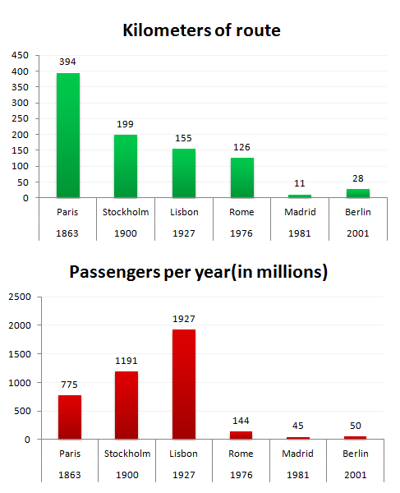
Writing Task 2
The bar charts below give information about the railway system in six cities in Europe.
Summarise the information by selecting and reporting the main features, and make comparisons where relevant.
Write at least 150 words.

Slide 20
Model Answer to Writing Task 2
The bar charts illustrate comparable information related to railway systems in six capital cities in Europe; Paris, Stockholm, Lisbon, Rome, Madrid and Berlin.
In general, railway systems in different cities vary in terms of the start dates of each system, the sizes, and the numbers of passengers using the systems in a year.
As far as the ages are concerned, Paris has the oldest railway system among the six cities. It was opened in the year 1863, which is incomparable to the other cities. On the other hand, Berlin has the newest railway system which was opened in Europe 2001.
In terms of the sizes, Paris, for certain, has the longest route, 394km, which is nearly twice the figure for Stockholm. Madrid, in contrast, has the shortest route in its railway system, only 28km.
When it comes to the numbers of people using the railway system in each, Lisbon shows the largest number of 1927 million passengers in a year while Madrid serves the smallest number of railway users, 45 millions.

Slide 21
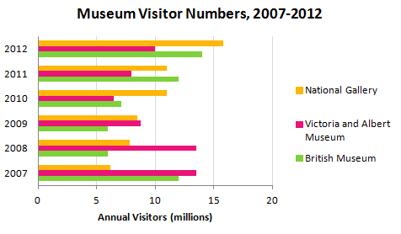
Practice Situation
The bar chart shows the number of visitors to three London Museums between 2007 and 2012.
Summarize the information by selecting and reporting the main features, and make comparisons where relevant.
Write at least 150 words

Slide 22
Summary of Lecture 30
In lecture 30, we learnt how to
  Identify and interpret visual organizers
  Convert visual information into verbal
  Use common expressions for describing
  Write short descriptive reports using visual organizers

