Slide 1
Lecture 25
Talking about Weather

Slide 2
Review of Lecture 24
In lecture 24, we learnt how to
  Identify various kinds of reports
  Analyze a short report for its elements
  Plan and write a short report

Slide 3
Objectives of Lecture 25
After completing lecture 25, you should be able to
  Listen to and comprehend weather reports
  Use weather related words and phrases
  Use Comparative and superlative degrees of adjectives
  Use ‘will’ for forecasts and predictions
  Ask about and describe weather in your own words

Slide 4
Questions to Consider
What’s the weather like today? What was the weather like yesterday? In your opinion, what will the weather be like tomorrow?
What’s the difference between weather, season and climate?
Do you listen to weather reports and forecasts in English?
How much do you understand these weather reports?

Slide 5
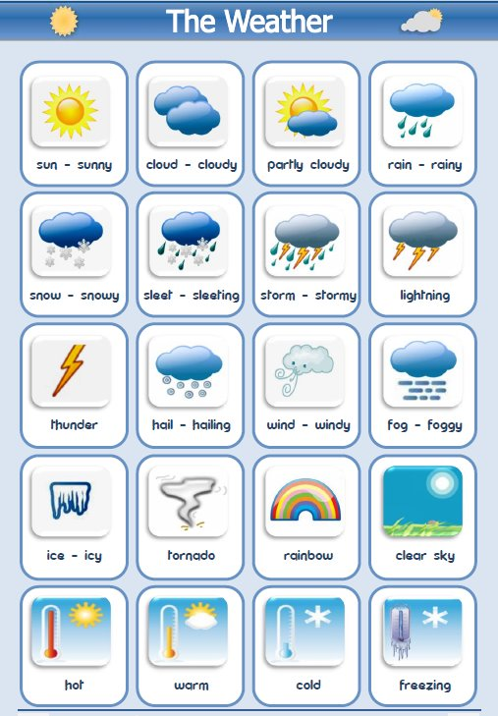

Slide 6
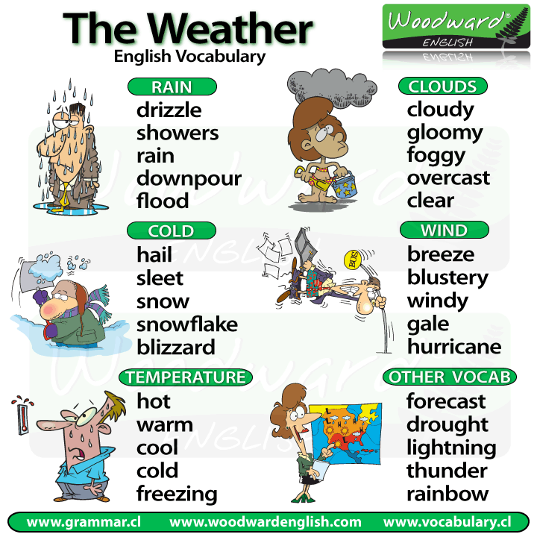

Slide 7
Asking about Weather
How’s the weather today?
What’s the weather like today?

Slide 8
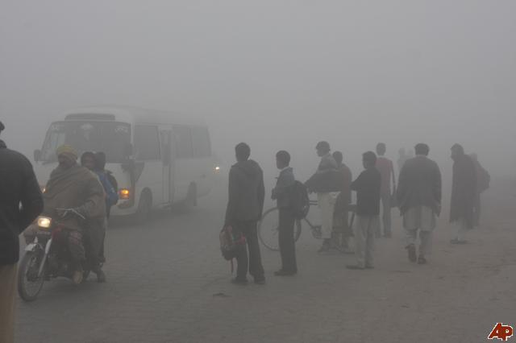
What’s the weather like today?

Slide 9
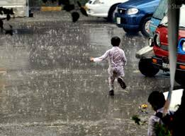
What’s the weather like today?

Slide 10
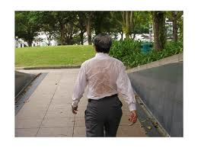
What’s the weather like today?

Slide 11
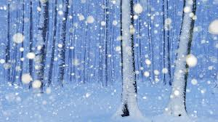
What’s the weather like today?

Slide 12
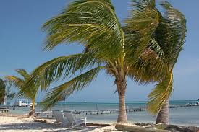
What’s the weather like today?

Slide 13
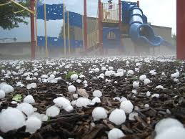
What’s the weather like today?

Slide 14
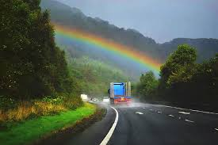
What’s the weather like today?

Slide 15
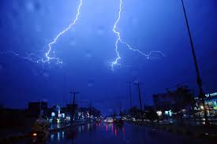
What’s the weather like today?

Slide 16
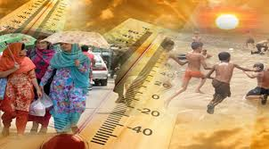
What’s the weather like today?

Slide 17
Listening Task 1
Listen to this Weather Forecast and answer the following questions?
  Who’s presenting the weather?
  Which country is this weather forecast about?

Slide 18
Weather Forecast
Well, it's an unsettled picture as we head towards the end of the week. This afternoon it'll be cold, wet and windy across most of Scotland. We're under the influence of low pressure, and this weather front pushing northwards is bringing cloud and outbreaks of rain. The rain, of course, will be heaviest over the borders and around Edinburgh, where it could lead to difficult conditions on the roads. In the west, rain will be lighter and patchier. There'll be maybe a few drier interludes over Dumfries House in Ayrshire.
Aha! There'll be snow for the higher ground of the Highlands and Aberdeenshire, the potential for a few flurries over Balmoral - who the hell wrote this script? - as the afternoon goes on. The best of the drier and brighter weather will, of course, be over the northern isles and the far north of the mainland. So, a little hazy sunshine for the Castle of Mey in Caithness, but a cold day everywhere, with temperatures of just eight Celcius and a brisk northeasterly wind. Thank God it isn't a bank holiday.

Slide 19
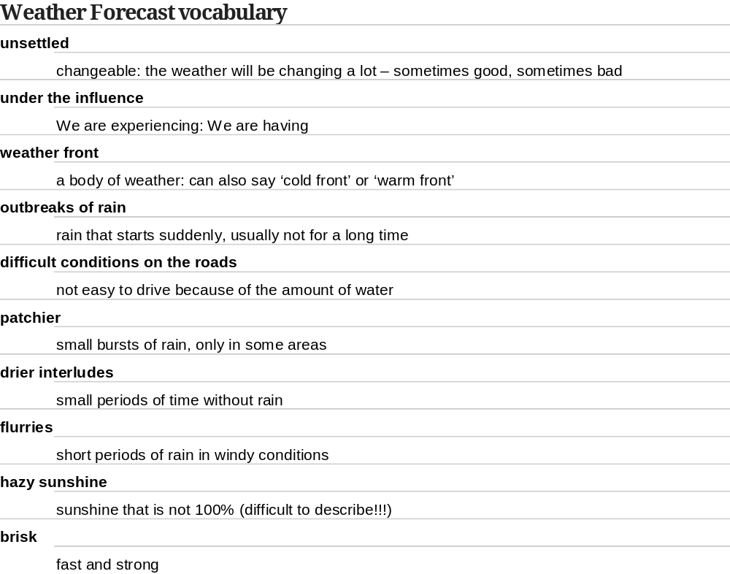

Slide 20
Grammar Check
Well, it's an unsettled picture as we head towards the end of the week. This afternoon it'll be cold, wet and windy across most of Scotland. We're under the influence of low pressure, and this weather front pushing northwards is bringing cloud and outbreaks of rain. The rain, of course, will be heaviest over the borders and around Edinburgh, where it could lead to difficult conditions on the roads. In the west, rain will be lighter and patchier. There'll be maybe a few drier interludes over Dumfries House in Ayrshire.
Aha! There'll be snow for the higher ground of the Highlands and Aberdeenshire, the potential for a few flurries over Balmoral - who the hell wrote this script? - as the afternoon goes on. The best of the drier and brighter weather will, of course, be over the northern isles and the far north of the mainland. So, a little hazy sunshine for the Castle of Mey in Caithness, but a cold day everywhere, with temperatures of just eight Celcius and a brisk northeasterly wind. Thank God it isn't a bank holiday.

Slide 21
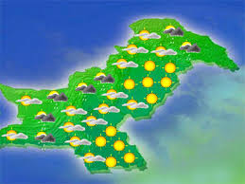
Can you Present the Weather Forecast?

Slide 22
Summary of Lecture 25
In lecture 25, we learnt how to
  Listen to and comprehend weather reports
  Use weather related words and phrases
  Use Comparative and superlative degrees of adjectives
  Use ‘will’ for forecasts and predictions
  Ask about and describe weather in your own words

