Slide 1
Lecture 23
Writing a Recipe

Slide 2
Review of Lecture 22
In lecture 22, we learnt how to
  Identify elements of effective paragraphs
  Analyze types and structure of various paragraphs
  Write unified, cohesive and coherent paragraph

Slide 3
Objectives of Lecture 23
After completing lecture 23, you should be able to
  Use food vocabulary
  Use action verbs
  Use some / any
  Write recipes

Slide 4
Questions
What’s your favorite dish?
Do you know how to cook? If yes, what can you cook well? Who taught you to cook?
Have you ever tried something from the recipe books / magazines?
What are the important parts of a recipe?

Slide 5
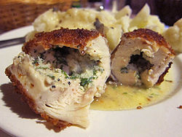
Chicken Kiev
Ingredients:
  4 whole chicken breasts
  1/2 cup bread crumbs
  1/2 cup grated parmesan cheese
  1 1/2 teaspoons oregano leaves
  1/2 teaspoon crushed garlic
  1/4 teaspoon pepper
  4 tablespoons softened butter
  1 tablespoon chopped parsley
  4 ounces cheese (any sharp cheese) cut into strips
  5 ounces melted butter

Slide 6
Preperation
Pound chicken breasts until 1/4 inch thin
Mix together in a bowl bread crumbs, grated Parmesan cheese, 1 teaspoon of oregano, crushed garlic, and pepper.
In small bowl, stir together 4 tablespoons of melted butter, parsley and 1/2 teaspoon of oregano
Spread melted butter mixture across the middle of each chicken breast
Lay a strip of cheese into the mixture
Fold the edges of the chicken breast over and roll the chicken breast
Dip each chicken breast into the melted butter
Roll each chicken breast in the bread crumb mixture
Place chicken breasts in a 9 by 13 inch baking pan
Cover and refrigerate for at least 4 hours
Bake, uncovered, in a preheated 425° oven for 20 minutes

Slide 7
Learn the Lingo
Food vocabulary
  Vegetables
  Fruits
  Meat
  Dairy
  Spices
Kitchen utensils
  Pots and pans
  Spoons and knives
  Electric gadgets
Cooking verbs
  Pre-cooking
  Cooking
  Post-cooking

Slide 8
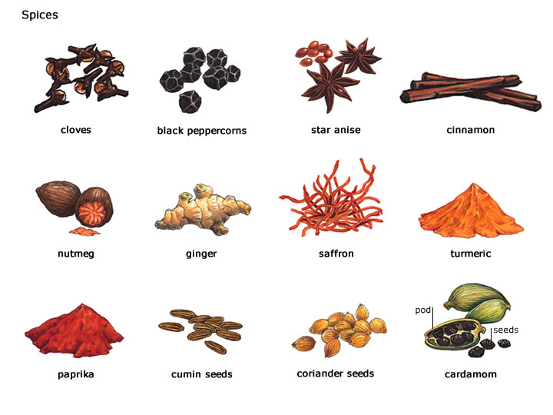
Ingredients

Slide 9
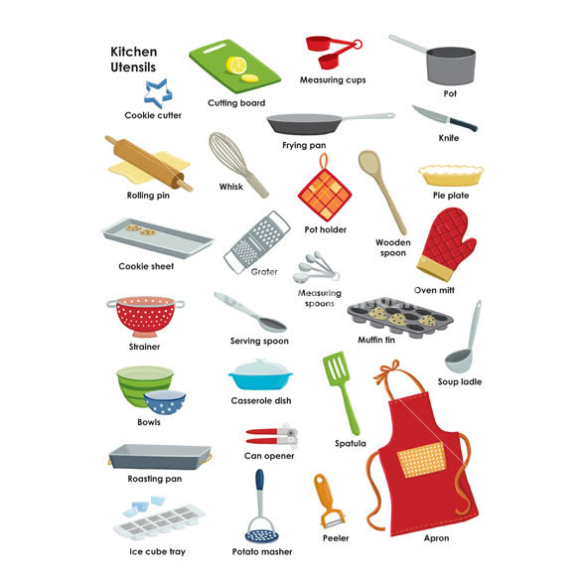

Slide 10
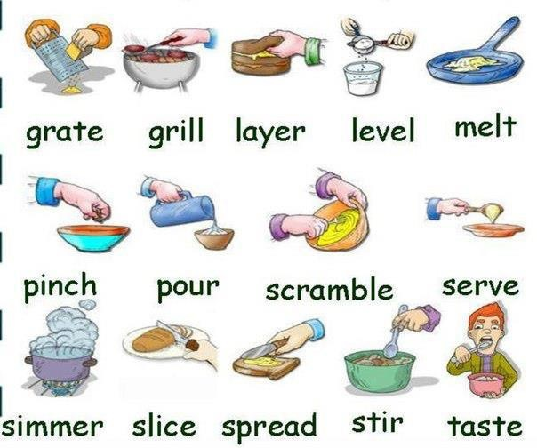
Cooking Verbs

Slide 11
Task 1
Source: bbc.co.uk/skillwise
Here is a set of instructions for making a pudding. Each step has several options. Choose the best option from each step and write out the recipe.
1. Crush two packets of ginger biscuits with a rolling pin and put them in a bowl.
1. The first step is to put two packets of ginger biscuits into a bowl and then to crush them using a rolling pin.
1. A rolling pin should be used to crush the ginger biscuits in a bowl.
2. Following that, the biscuits should be mixed with some orange juice so that the mixture is sticky.
2. Then pour in some orange juice (enough to make the mixture sticky) and stir.
2. Orange juice must be added to the biscuits so that they form a sticky mixture.

Slide 12
Task 1 (Cont…)
3. The next step is to place a layer of the biscuit mixture at the bottom of a glass bowl.
3. The bottom of a glass bowl should be covered with a layer of the biscuit mixture.
3. Next, put a layer of the biscuit mixture into a glass bowl.
4. Then cover the mixture with a layer of satsumas.
4. Satsumas should be placed in a layer, over the biscuit mixture.
4. Following that, the biscuit mixture should be covered with a layer of oranges.
5. On top of that, put a layer of whipping cream.
5. Put a layer of whipping cream on top of the satsumas.
5. A layer of whipping cream should then be placed on top of the satsumas.

Slide 13
Task 1 (Cont…)
6. Then you need to cover with a layer of biscuits, a layer of satsumas, a layer of cream, and so on, until all of the ingredients are used up.
6. Repeat the layers until you have used up all of the ingredients.
6. Make sure you use up all of the ingredients by repeating the layers.
7. The final layer of cream must be decorated with a further layer of satsumas.
7. A decorative layer of satsumas should be placed on top of the final layer of cream.
7. Finish with a layer of cream and decorate with more satsumas

Slide 14
How to make a pudding?
Crush two packets of ginger biscuits with a rolling pin and put them in a bowl.
. Then pour in some orange juice (enough to make the mixture sticky) and stir.
Next, put a layer of the biscuit mixture into a glass bowl.
Then cover the mixture with a layer of satsumas.
Put a layer of whipping cream on top of the satsumas.
Then you need to cover with a layer of biscuits, a layer of satsumas, a layer of cream, and so on, until all of the ingredients are used up.
Finish with a layer of cream and decorate with more satsumas

Slide 15
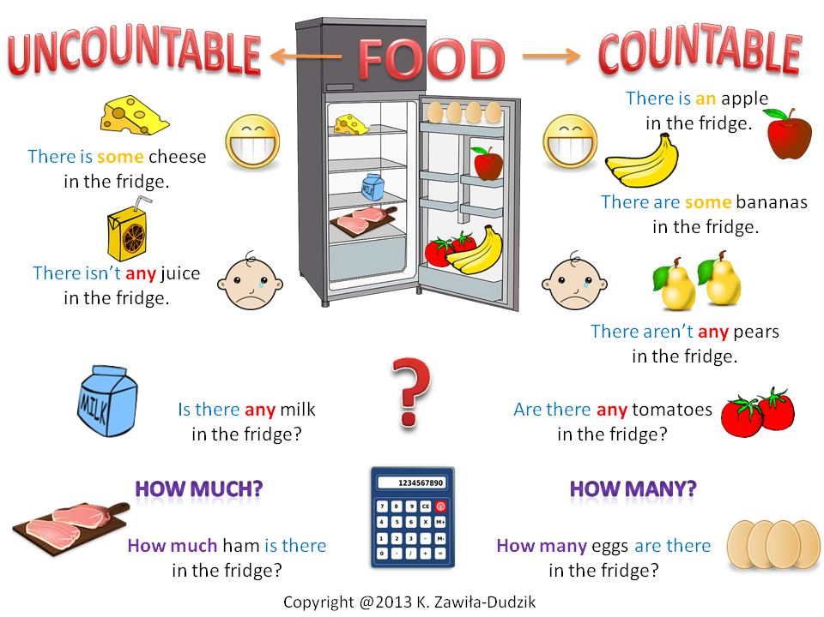

Slide 16
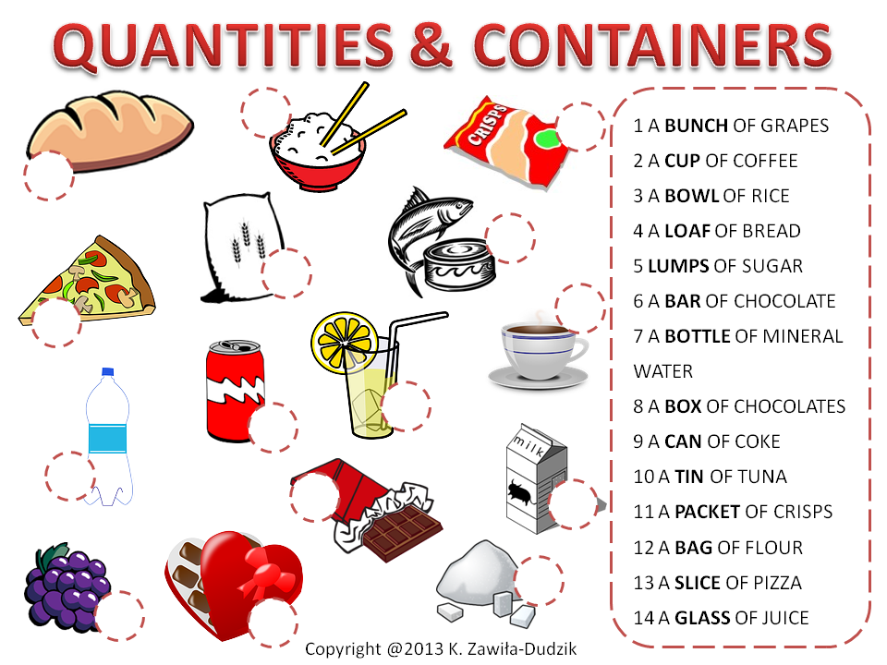

Slide 17
Practice Situation
Write a detailed recipe of your favourite dish.
Do not copy from any recipe book or magazine.
Do not look for something simple, take it as a challenge.

Slide 18
Summary of Lecture 23
In lecture 23, you learnt how to
  Use food vocabulary
  Use action verbs
  Use some / any
  Write recipes

