Slide 1
Lecture 20
Describing Pictures and Places

Slide 2
Review of Lecture 19
In lecture 19, we learnt how to
  Describe people’s physical appearances
  Describe personalities
  Use descriptive adjectives and phrases
  Comprehend natural conversation about describing people

Slide 3
Objectives of Lecture 20
After completing lecture 20, you should be able to
  Describe pictures and places
  Use prepositions to state locations
  State the differences between two pictures
  Use descriptive adjectives and phrases
  Write a short descriptive text

Slide 4
Describing a Picture
1) Introduction
The photo/picture shows ...
It was taken by/in ...
It's a black-and-white/coloured photo.
2) What is where?
In the foreground/background you can see ...
In the foreground/background there is ...
In the middle/centre there are ...
At the top/At the bottom there is ...
On the left/right there are ...
Behind/In front of ... you can see ...
Between ... there is ...

Slide 5
Describing a Picture
3) Who is doing what?
Here you describe the persons in the picture or you say what is happening just now. Use the Present Progressive Continuous Tense.
Example: (There is a man begging in the street)
4) What I think about the picture
It seems as if ...
The lady seems to ...
Maybe ...
I think ...
... might be a symbol of ...
The atmosphere is peaceful/depressing ...
I (don't) like the picture because ...
It makes me think of ...

Slide 6
Describe a Photo or Picture in an Exam
Watch this short video by British Council. The video will help you do well in exams that include describing a picture or photo.

Slide 7
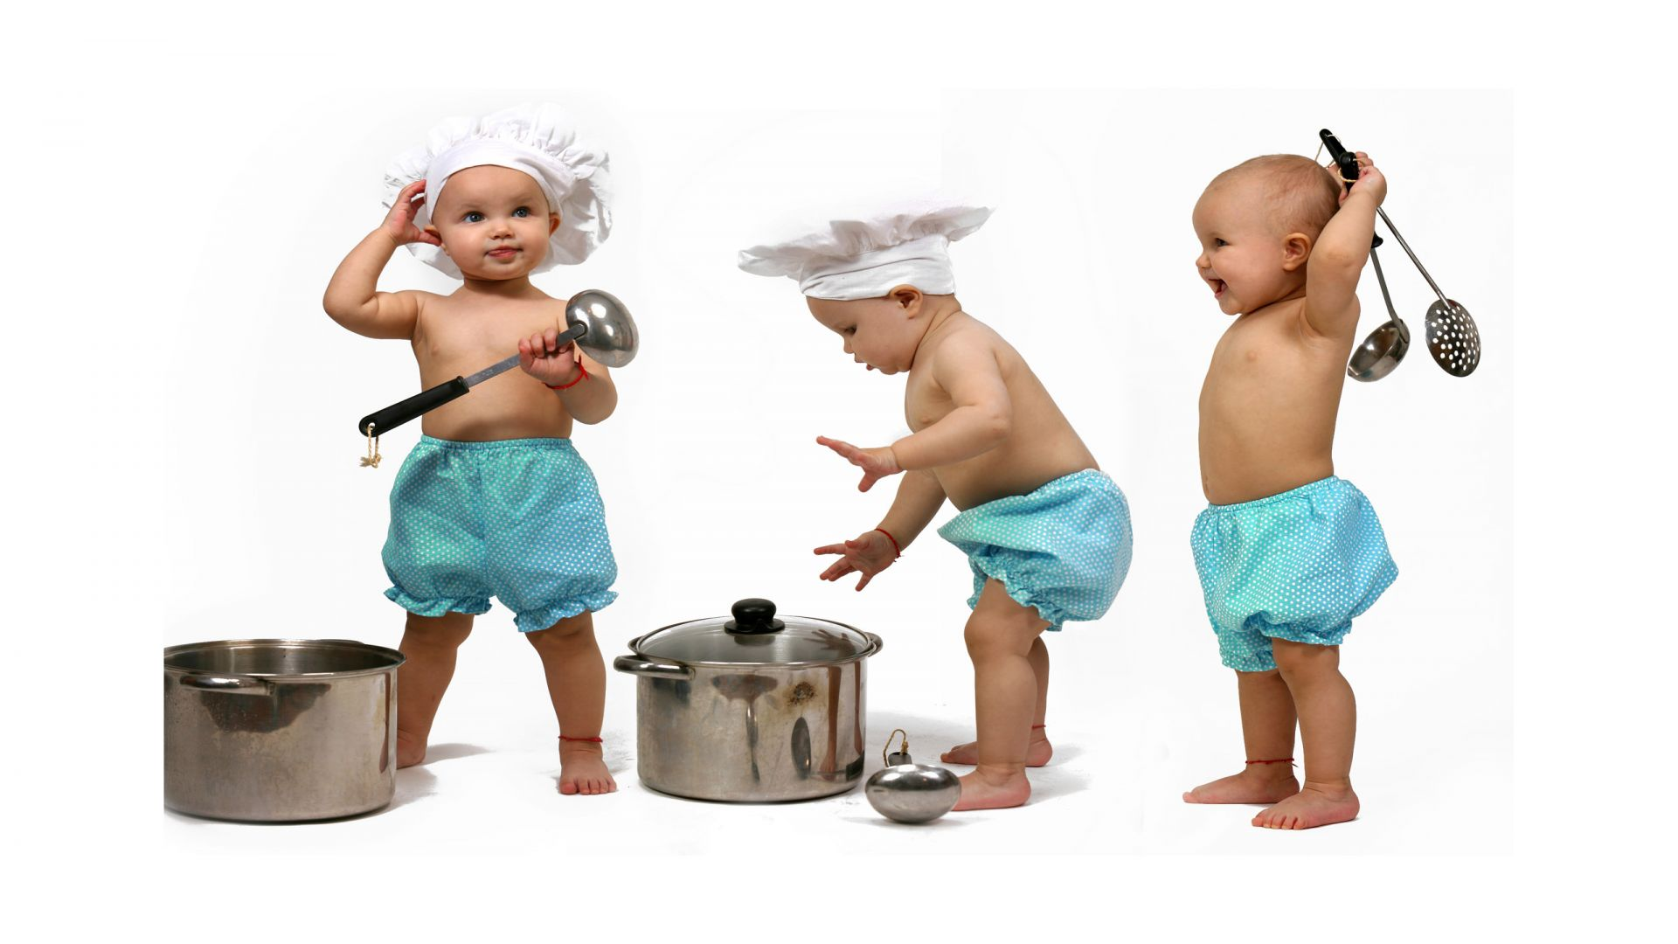
Describe the Picture

Slide 8
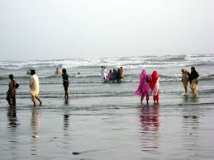
Describe the Picture

Slide 9
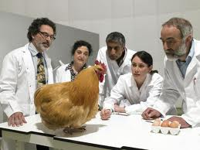
Describe the Picture

Slide 10
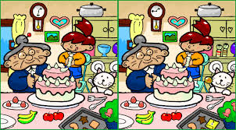
Find the Differences

Slide 11
Let’s Describe London
Adjectives: it's exciting, busy, hectic, cosmopolitan, multicultural, unique. It's historic but modern at the same time, it's a thriving, prosperous city, it's fashionable, lively, fun...
Activities: London is famous for its history, culture, art, museums. Tourists go there to see Big Ben, The Tower of London, Buckingham Palace, Trafalgar Square etc. You can get a fantastic view of the city from the 'London Eye'. It's also famous for its theatres and shows in the West End, its shops, restaurants and nightlife. There are endless things to see and do.
Negatives: London is expensive, crowded, stressful, polluted. The underground system is dirty, travel is overpriced and unpleasant. The cost of living is high (shopping, house prices etc.), the locals are always in a hurry and can be unfriendly, there are social problems (like you can find in most big cities).

Slide 12
Desert Adjectives
Desert: harsh, dry, arid, sparse, severe, hot
Rock: sharp, rough, jagged, angular
Grasses: windblown, bent, dry, pale green, brown
Sand: coarse, fine, glittering, shifting, rippling, sifting, white, golden
Sky: pale, intense, cloudless, azure, purple, crimson
Cactus: tall, short, squatty, spiny, prickly, thorny
Date palm: tall, bent, leather (leaves), frayed (leaves)

Slide 13
City Adjectives
City: active, bustling, noisy, busy, clean, dirty, windy
Traffic: loud, congested, snarled
Buildings: old, shabby, rundown, crumbling, modern, futuristic, sleek, towering, squat
Buildings (walls): brick, stone, marble, glass, steel, graffiti-covered
Monuments, statues: stone, copper, carved, ancient, moss-covered, faded, green, bronze
Sidewalk: concrete, cement, slick, cracked, tidy, littered, swept
Paint: fresh, weathered, peeling
Signs: neon, weathered, worn, bright, welcoming, flashing
Buses, cars, taxis: belching, crawling, speeding, honking, waiting, screeching
People: hurried, bundled, smiling, frowning, eager, rushed

Slide 14
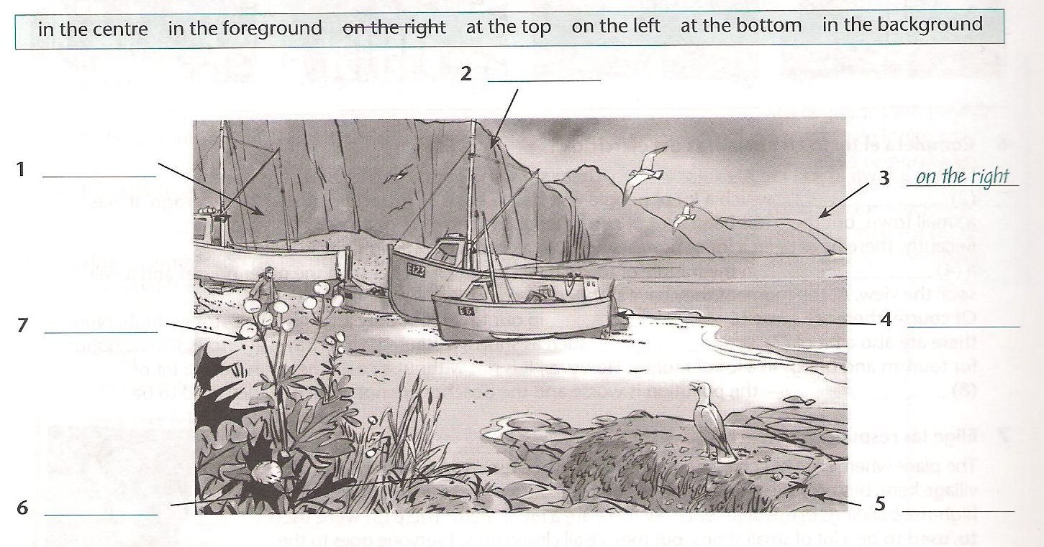
Where are the Things?

Slide 15
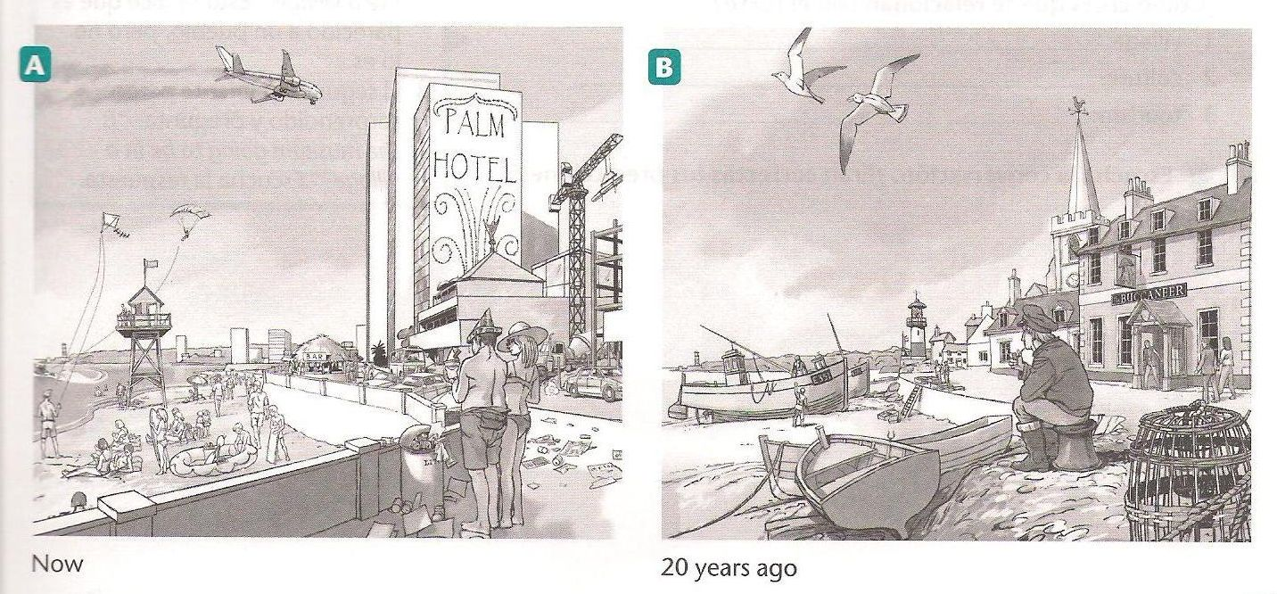
Describe and Compare the Pictures

Slide 16
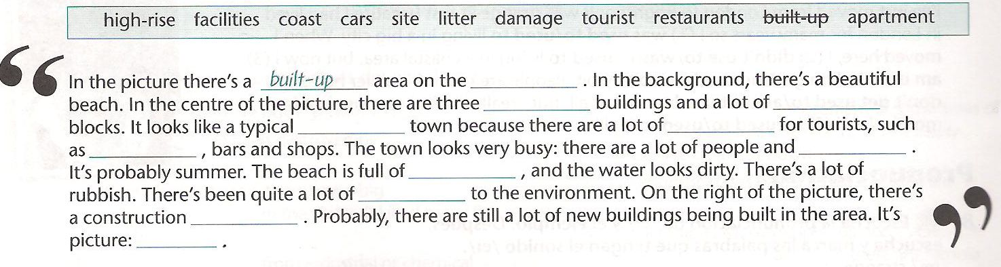
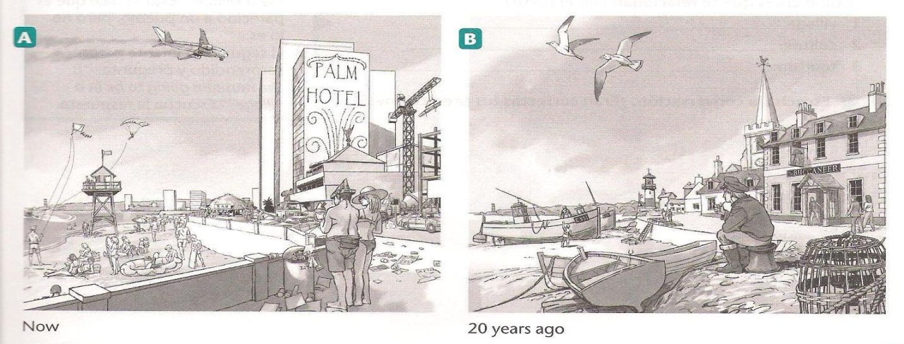
Which Picture is Being Described?

Slide 17
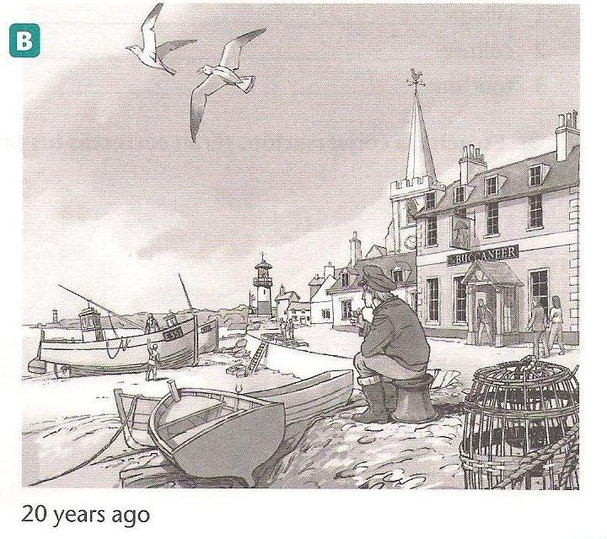
Describe Picture B
There used to be…
It didn’t use to be so…
There weren’t any…
There was less…
There were fewer…

Slide 18
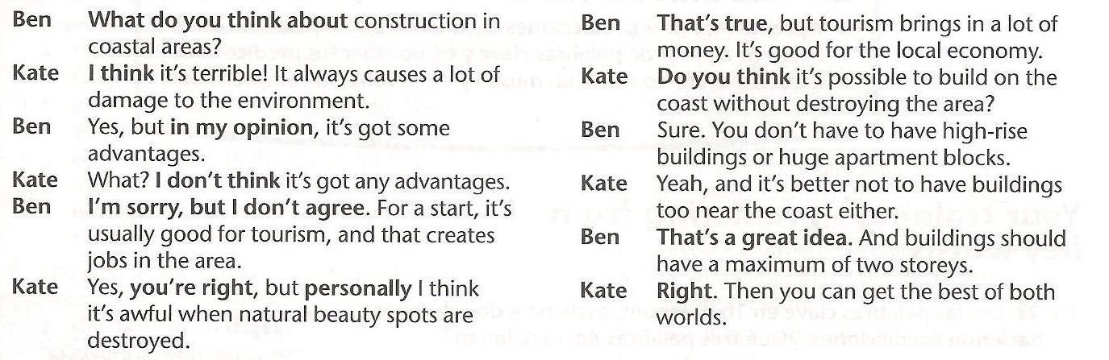
Read the Dialogue.

Slide 19
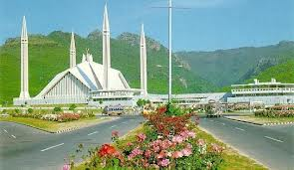
Practice Situation
Which city is this?
What is there to see and do?
Write a short essay to describe this place to a visitor.

Slide 20
Summary of Lecture 20
In lecture 20, we learnt how to
  Describe pictures and places
  State locations
  State the differences between two pictures
  Use descriptive adjectives and phrases
  Write a short descriptive text

