Slide 1
Lecture 19
Describing People

Slide 2
Review of Lecture 18
In lecture 18, we learnt how to
  Comprehend riddles
  Read funny texts
  Use puns and idioms

Slide 3
Objectives of Lecture 19
After completing lecture 19, you should be able to
  Describe people’s physical appearances
  Describe personalities
  Use descriptive adjectives and phrases
  Comprehend natural conversation about describing people

Slide 4
Describing Appearances
Hair
Eyes
Face
Skin
Height and Build
Clothing
General Appearance

Slide 5
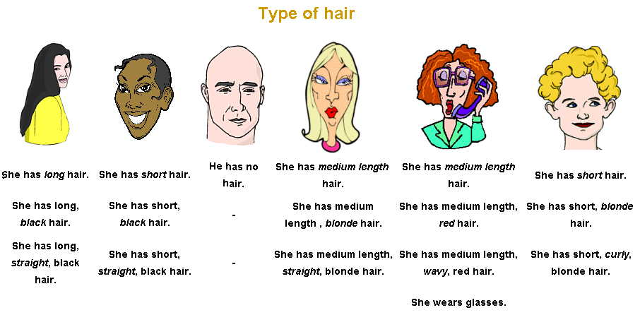
Hair

Slide 6
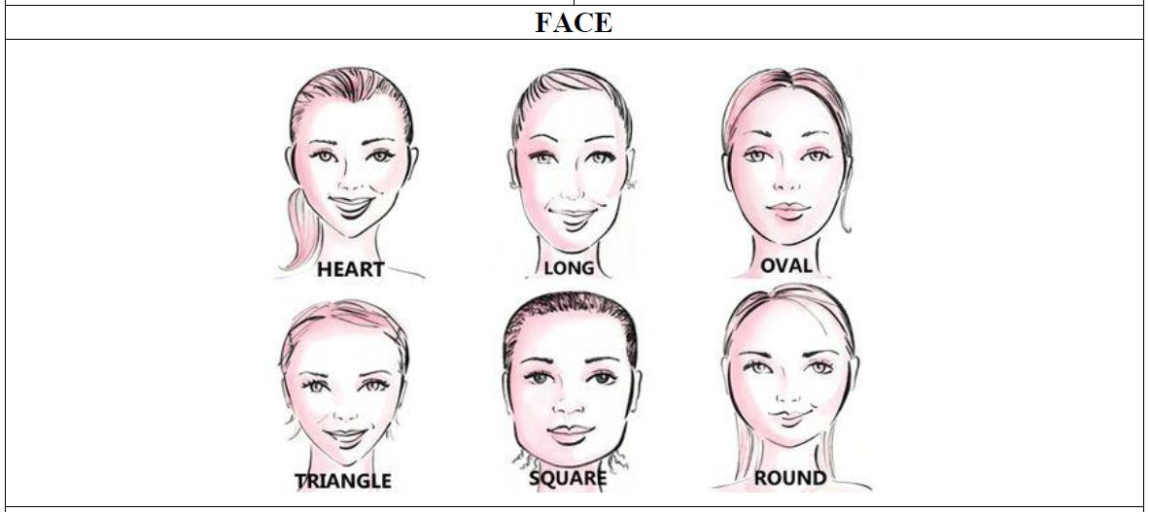
Face

Slide 7
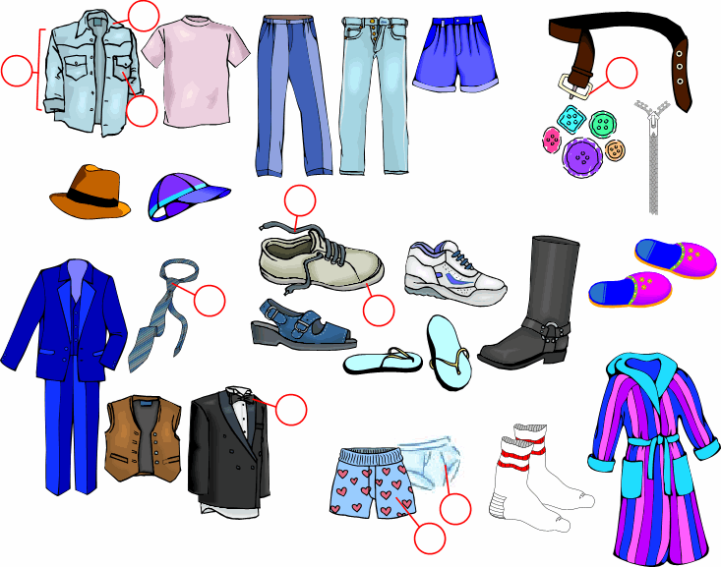
Clothing

Slide 8
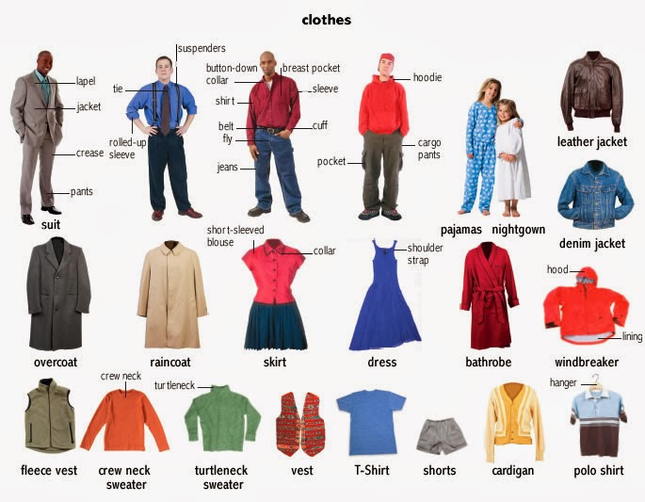
Clothing

Slide 9
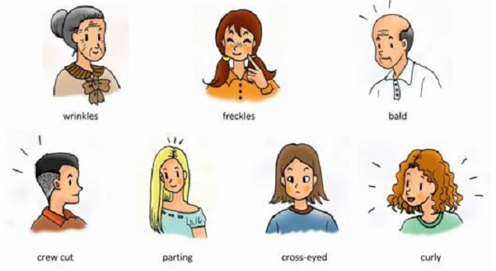
Describing Words

Slide 10
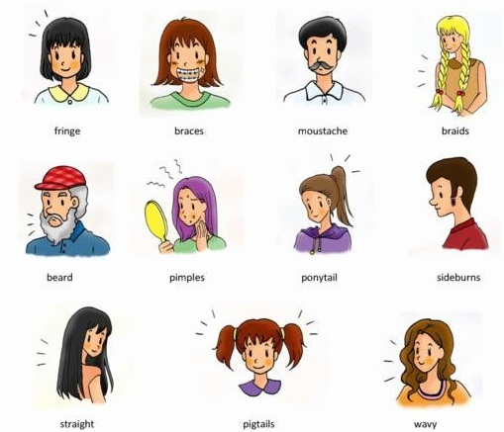
Describing Words

Slide 11
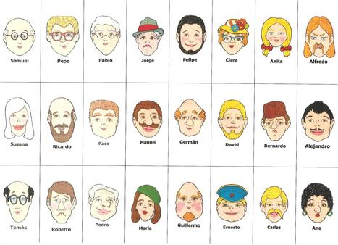
Let’s Describe People

Slide 12
Listening Task 1
Listen to Sarah and write down the answers to the following questions?
  What kind of person is her father?
  What does he look like?
  What does her mother look like?
  How does her little sister look like?

Slide 13
Listening Task 1: Answers
Listen to Sarah and write down the answers to the following questions?
  What kind of person is her father?
    He’s very friendly, smart and funny.
  What does he look like?
    He’s young, short and handsome. He has straight black hair and green eyes.
  What does her mother look like?
    She’s tall, thin and beautiful. She has blonde hair and wears glasses.
  How does her little sister look like?
    She has curly red hair and a cute smile. Everybody likes her.

Slide 14
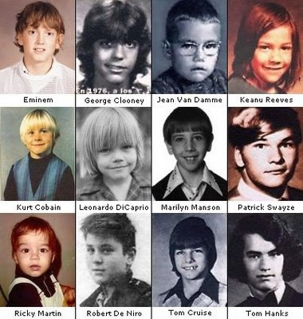
Guess who?

Slide 15
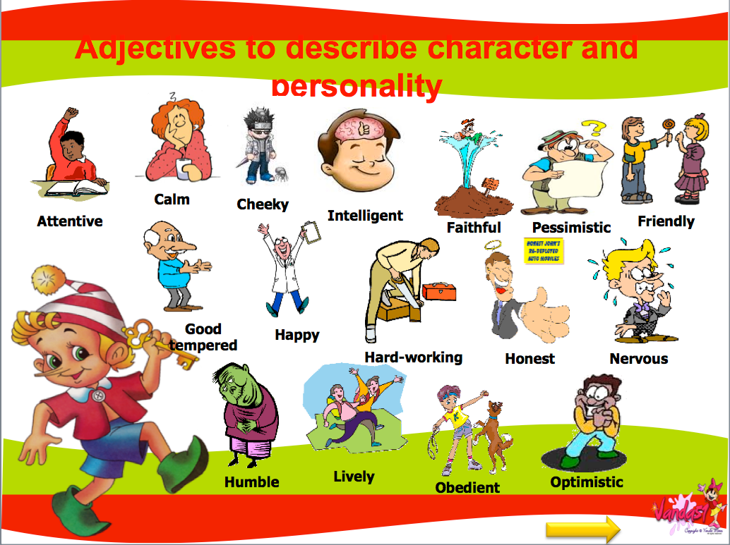
Describing Personalities

Slide 16
Listening Task 2
Listen to Sandra talking about the characteristics of a friend and Nicholas talking about a boss. Which words or expressions do they use to describe these people?

Slide 17
Listening Task 2: Answers
Sandra thinks friends are very important and she wants her friends to be:
  Fun
  Good at listening
  Interested in doing things
  Sharing
Nicholas talks about good bosses being:
  Motivating
  Understanding
  Encouraging

Slide 18
Listening Task 3
Think about the kind of personalities you dislike the most. Maybe it’s people who are unkind or maybe you don’t like lazy people.
Now listen to a conversation on the same topic between Sybil and Cattie and note down what kind of people they don’t like.

Slide 19
Listening Task 3: Answers
Sybil and Cattie dislike people who are:
  Rude / impolite
  Pretentious
  Unkind

Slide 20
Practice Situation
Find a partner to work in pairs.
Make a list of your favourite celebrities.
Orally describe them to your partner. Can he /she guess the celebrity?

Slide 21
Summary of Lecture 19
In lecture 19, we learnt how to
  Describe people’s physical appearances
  Describe personalities
  Use descriptive adjectives and phrases
  Comprehend natural conversation about describing people

