Slide 1
Lecture 18
Reading Riddles and Jokes

Slide 2
Review of Lecture 17
In lecture 17, we learnt how to
  Identify types of questions
  Form appropriate questions
  Use appropriate intonation patterns

Slide 3
Objectives of Lecture 18
After completing lecture 18, you should be able to
  Comprehend riddles
  Read funny texts
  Use puns and idioms

Slide 4
Riddles
Can you think of a word that changes both number and gender when you add the letter 'S'?
  Princes to Princess
Can a Kangaroo jump higher than the Saudi Pak Tower?
  Yes, because Saudi Pak Tower cannot jump.
Why can’t a leopard hide?
  Because it is spotted.

Slide 5
Riddles with Puns
What has a neck but no head, and wears a cap?
  A bottle
What has an eye but can’t see?
  A needle
What has two hands and a face, but no arms and legs?
  A clock
What can run but never walks, has a mouth but never talks, has a bed but never sleeps?
  A river
What has a head and a tail but no body?
  A coin
What has ears but can’t hear?
  corn
What has a tongue, cannot walk, but gets around a lot?
  Shoe

Slide 6
Word Riddles
I know a word of letters three. Add two and fewer there will be. What is the word?
  few
What word looks the same upside down and backwards?
  swims
What 8-letter word has one letter in it?
  envelope
What word becomes shorter when you add two letters to it?
  short
What is the only word in the English language that ends in mt?
  dreamt
How do you spell "hard water" with only 3 letters?
  ice
What is in seasons, seconds, centuries and minutes but not in decades, years or days?
  The letter ‘n’
What English word has three consecutive double letters?
  bookkeeper

Slide 7
What am I?
I get wet when drying. I get dirty when wiping. What am I?
  towel
I can be cracked, made, told, and played. What am I?
  joke
I shrink smaller every time I take a bath. What am I?
  soap
I am always around you but often forgotten. I am pure and clean most time, but occasionally rotten. What am I?
  air
I will disappear every time you say my name. What am I?
  silence
I run around the house but don't move? What am I?
  fence
I start with "T", end with "T", and within me is "T". What am I?
  teapot
I go up when the rain comes down. What am I?
  umbrella

Slide 8
Jokes – Why?
Why do cows have bells?
Because their horns don't work!
Why shouldn't you put the letter "M" into the refrigerator?
Because it turns ice into mice!
What's the definition of a pessimist?
A pessimist is a well-informed optimist.
Why was the crab sent to prison?
Because he kept pinching things!
Why are Saturday and Sunday strong days?
Because they are not weekdays!

Slide 9
Not my Job
This is a story about four people named Everybody, Somebody, Anybody and Nobody.
There was an important job to be done and Everybody was sure that Somebody would do it. Anybody could have done it, but Nobody did it. Somebody got angry about that, because it was Everybody's job. Everybody thought that Anybody could do it, but Nobody realized that Everybody wouldn't do it.
It ended up that Everybody blamed Somebody when Nobody did what Anybody could have done.

Slide 10
Capitalism or Communism?
What's the difference between capitalism and communism?
Under capitalism, Man exploits Man. Under communism, it is exactly the opposite.

Slide 11
A Good Teacher
One day, a teacher was attempting to teach the names of animals to a class of 5-year-olds. She held up a picture of a deer, and asked one boy, "Billy, what is this animal?". Little Billy looked at the picture with a disheartened look on his face andresponded, "I'm sorry Mrs. Smith, I don't know.". The teacher was not one to give up easily, so she then asked Billy, "Well, Billy, what does your Mommy call your Daddy?" Little Billy's face suddenly brightened up, but then a confused look came over his face, as he asked, "Mrs. Smith, is that really a pig?"

Slide 12
Idioms
Why did the boy throw the clock out the window?......To see if time really flies.
what did the horses say to each other before they went to sleep? ……. I guess its time to hit the hay!

Slide 13
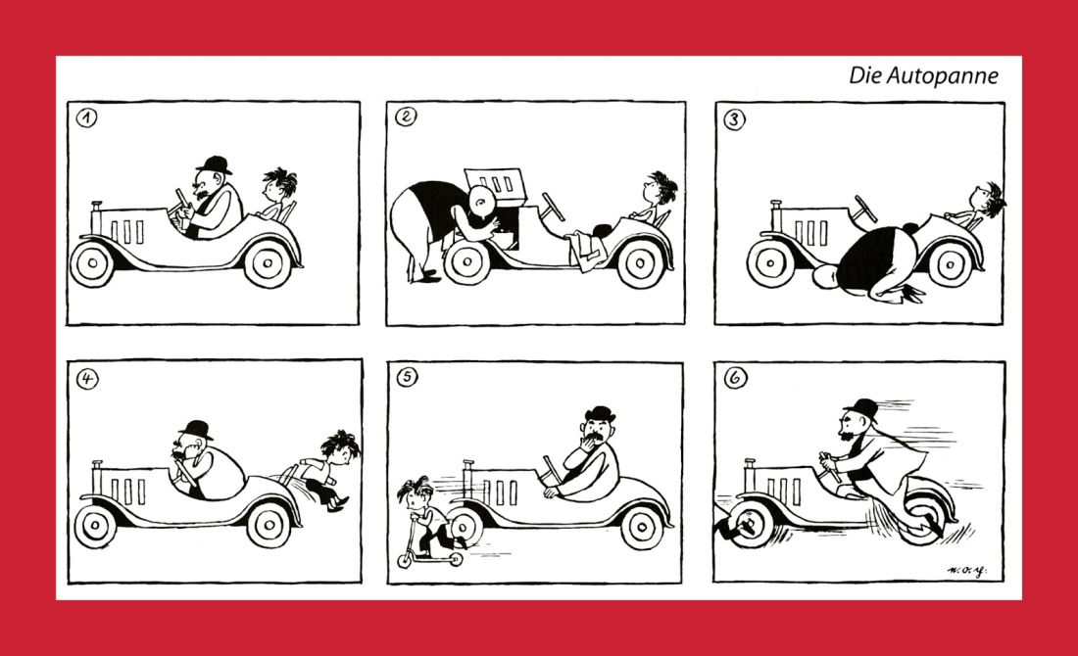
Practice Situation
Share some jokes in English.
Read a joke and tell in English why it is funny.
Describe the pictures below.

Slide 14
Summary of Lecture 18
In lecture 18, we learnt how to
  Comprehend riddles
  Read funny texts
  Use puns and idioms

