Slide 1
Lecture 14
Summarizing Non-fiction

Slide 2
Review of Lecture 13
In lecture 13, we learnt how to
  Share life experiences
  Use Simple Past Tense for narrating past events
  Use Present Perfect Tense for experiences
  Differentiate between the two tenses

Slide 3
Objectives of Lecture 14
After completing lecture 14, you should be able to
  Differentiate between fiction and nonfiction
  Analyze paragraph structure
  Summarize paragraphs
  Summarize essays and articles

Slide 4
What is nonfiction?
Non-fiction is a narrative, account, or other communicative work whose assertions and descriptions are believed by the author to be factual. (Wikipedia)
Non-fiction include:
  Essays
  Diaries
  Journals
  Memoirs
  Documentaries
  Biographies
  Science books
  Newspaper and Magazine Articles

Slide 5
What is a summary?
A summary is your opinions about a text
A summary is a shortened form of a text, with all of the main ideas
A summary is all of the ideas from a text, written in your own words
A summary is a review of a text, with main ideas and your opinions

Slide 6
What makes a good summary?
Here are four basic rules for writing a summary of nonfiction:
Include the important ideas from the text
Put ideas in your own words
Leave out little details and repeated information
Use the text structure of the text

Slide 7
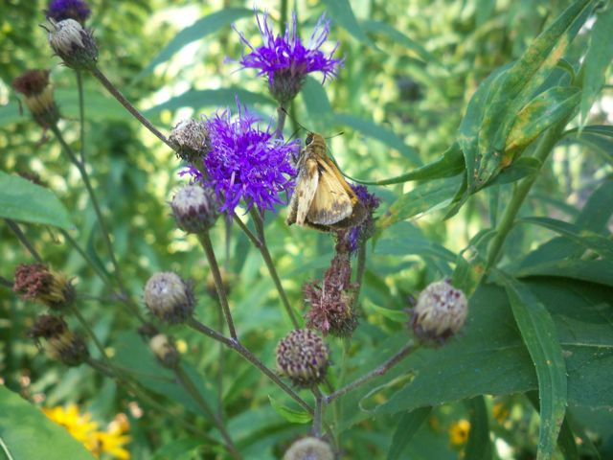
Include important ideas from the text
Many butterflies depend on certain plants to survive. As adults, butterflies drink nectar. But caterpillars eat leaves. Some caterpillars only eat the leaves of specific plants. Monarch caterpillars, for example, eat only milkweed.
If butterflies cannot find the food source they need for their eggs, the next generation will not survive. When habitats are changed, such as when wetlands are drained or forests are cleared, butterfly populations may drop dramatically. According to the Xerxes Society, an invertebrate conservation group, over 50 kinds of U.S. butterflies are at risk.

Slide 8
Include important ideas from the text
Many butterflies depend on certain plants to survive. As adults, butterflies drink nectar. But caterpillars eat leaves. Some caterpillars only eat the leaves of specific plants. Monarch caterpillars, for example, eat only milkweed.
If butterflies cannot find the food source they need for their eggs, the next generation will not survive. When habitats are changed, such as when wetlands are drained or forests are cleared, butterfly populations may drop dramatically. According to the Xerxes Society, an invertebrate conservation group, over 50 kinds of U.S. butterflies are at risk.

Slide 9
Putting ideas in your own words
Putting ideas in your own words is also called paraphrasing
Instead of just copying down the author’s words, we need to use our own words

Slide 10
Putting ideas in your own words
Can you paraphrase this sentence from the text?
Many butterflies depend on certain plants to survive

Slide 11
Putting ideas in your own words
Hint: Try using synonyms for important words
Many butterflies depend on certain plants to survive

Slide 12
Putting ideas in your own words
Hint: Try changing the order of ideas
Many butterflies depend on certain plants to survive

Slide 13
Putting ideas in your own words
Here’s one way to paraphrase the sentence. How does it compare to yours?
Many butterflies depend on certain plants to survive
Butterflies need specific plants to live

Slide 14
Using text structure
When you look at the text structure of a text, you can find the big ideas and see how to organize your summary
Description
Cause and Effect
Chronological Order
Problem/Solution
Compare and Contrast

Slide 15
Analyze the Text Structure
Many butterflies depend on certain plants to survive. As adults, butterflies drink nectar. But caterpillars eat leaves. Some caterpillars only eat the leaves of specific plants. Monarch caterpillars, for example, eat only milkweed.
If butterflies cannot find the food source they need for their eggs, the next generation will not survive. When habitats are changed, such as when wetlands are drained or forests are cleared, butterfly populations may drop dramatically. According to the Xerxes Society, an invertebrate conservation group, over 50 kinds of U.S. butterflies are at risk.

Slide 16
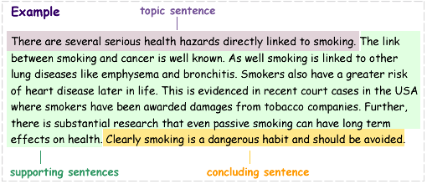
Paragraph Structure

Slide 17
Practice Situation
Read a newspaper article or an essay and write its summary following the guidelines in this lecture.

Slide 18
Summary of Lecture 14
In lecture 14, we learnt how to
  Differentiate between fiction and nonfiction
  Analyze paragraph structure
  Summarize paragraphs
  Summarize essays and articles

