Slide 1
Lecture 13
Sharing Life Experiences

Slide 2
Review of Lecture 12
In lecture 12, we learnt how to
  Summarize a story
  Determine important ideas and information
  Narrate events in a sequence
  Retell a story in your own words

Slide 3
Objectives of Lecture 13
After completing lecture 13, you should be able to
  Share life experiences
  Use Simple Past Tense for narrating past events
  Use Present Perfect Tense for experiences
  Differentiate between the two tenses

Slide 4
My Life Experiences
I’ve lived in various cities of Sindh and Punjab.
I’ve been to China and the US.
I’ve coauthored National English Curriculum for class 1 to 12.
I’ve learnt French for eight months.
I’ve taught Chinese to university teachers.
I’ve gone bungee jumping.
I’ve translated some poems of Sylvia Plath into Urdu.
I’ve visited the Great Wall of China.
I’ve developed a website for my students.

Slide 5
What’s your professional Experience?
Qualification
Short courses
Professional experience
Achievements / awards

Slide 6
Have you ever …?
(see) a live puppet show Yes, I have / No, I haven’t
(cook) biryani
(be) to Karachi
(ride) a camel
(kill) a snake
(visit) abroad
(play) flute
(swim) in a river
(perform) Hajj
(write) a poem
(tell) a lie
(fly) a kite

Slide 7
Structure of Present Perfect Tense
Subject + has / have + 3rd form of the verb + (Object)
  He has won many awards.
Subject + has / have not + 3rd form of the verb + (Object)
  They have not informed us.
Has / have + Subject + 3rd form of the verb? + (Object)
  Have you seen him lately?
Has / have + Subject + not + 3rd form of the verb? + (Object)
  Have you not paid the fee?
Question Word + has / have + Subject + 3rd form of the verb + (Object)
  How long have you been living here?

Slide 8
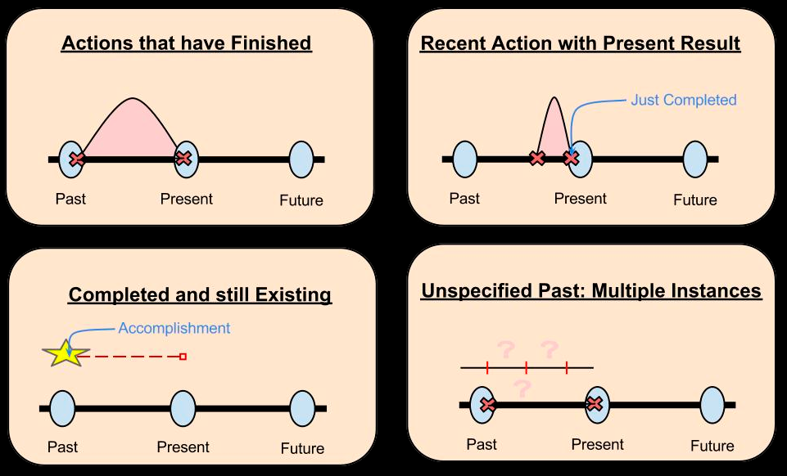
Use of Present Perfect Tense

Slide 9
Structure of Simple Past Tense
Subject + 2nd form of the verb + (Object)
  The elephant crossed the river.
Subject + did not + 1st form of the verb + (Object)
  He did not wait for us.
Did + (Subject) + 1st form of the verb + (object)
  Did you try this shirt on?
Question word + did + (Subject) + 1st form of the verb + (Object)
  Why did you come late?

Slide 10
Present Perfect Vs. Past Simple
Present Perfect Simple | Past Simple
Unfinished actions that started in the past and continue to the present: I've known Ahmed for ten years (and I still know him). | Finished actions: I knew Ahmed for ten years (but then he moved away and we lost touch).
A finished action in someone's life (when the person is still alive: life experience): My brother has been to Mexico three times. | A finished action in someone's life (when the person is dead): My great-grandmother went to Mexico three times.

Slide 11
Present Perfect Vs. Past Simple
Present Perfect Simple | Past Simple
A finished action with a result in the present: I've lost my keys! (The result is that I can't get into my house now). | A finished action with no result in the present: I lost my keys yesterday. It was terrible! (Now there is no result. I got new keys yesterday).
With an unfinished time word (this week, this month, today): I've seen John this week. | With a finished time word (last week, last month, yesterday): I saw John last week.

Slide 12
Which Tense
Q1 - He ..... there when he was a child
  has lived
  lived
Q2 - I ........ her since last year
  haven't seen
  didn't see
Q3 - They ......... a few minutes ago
  Left
  have left
Q4 - She .......... unemployed since she left school
  has not been
  was not
Q5 - They ....... the contract last week
  Finalised
  have finalised

Slide 13
Which Tense (Cont.)
Q6 - The film .......... yet
  hasn't started
  didn't start
Q7 - She ........ ill since Thursday
  Was
  has been
Q8 - I ........ the project last night
  have finished
  finished
Q9 - Look- someone ....... their handbag in the room
  Left
  has left
Q10 - ............ to Rome?
  Did you ever go
  Have you ever been

Slide 14
Combining the Two Tenses
Henry: | Hello Sheila. I didn't expect to see you here.
Sheila: | Oh, I've been here for quite a while.
Henry: | When did you arrive?
Sheila: | Just after lunch.
Henry: | Did Patrick pick you up from the station?
Sheila: | No, it was a nice day so I walked.
Henry: | Have you eaten anything since you've been here?
Sheila: | Yes, I had afternoon tea with the girls.
Henry: | What did you think of Penny?
Sheila: | She's grown up a lot since I last saw her.
Henry: | And how did you find Rebecca?
Sheila: | She didn't join us. I haven't seen her yet.

Slide 15
Practice Situations
Suppose you are a TV anchor. Introduce a celebrity by giving a list of his / her achievements.
Write and act out a dialogue combining the Present Perfect and Past Simple.

Slide 16
Summary of Lecture 13
In lecture 13, we learnt how to
  Share life experiences
  Use Simple Past Tense for narrating past events
  Use Present Perfect Tense for experiences
  Differentiate between the two tenses

