Slide 1
Lecture 10
Reading and Responding to Narrative Texts

Slide 2
Review of Lecture 9
In lecture 9, we learnt how to
  Ask for advice
  Give advice
  Give recommendations
  Offer help

Slide 3
Objectives of Lecture 10
After completing lecture 10, you should be able to
  Recognize a narrative text
  Analyze the structure of narrative texts
  Comprehend the contents of the narrative texts
  Reflect on and share personal response to the narrative texts

Slide 4
Characteristics of Narrative Texts
It is told in the form of a story. The story could be fiction or nonfiction.
It describes in details the experiences that changed the way someone felt, thought or acted.
It isn’t merely an interesting story, but it conveys some underlying point or idea.
It often includes descriptive writing – observations of people, places, or events.
It is based on some sort of conflict.

Slide 5
Types of Narrative Texts
Fiction
  Folktales
  Fables
  Myths
  Short Stories
  Novels
  Comics
Nonfiction
  Diaries
  Autobiographies / biographies
  Anecdotes
  Memoirs
  Personal Narratives

Slide 6
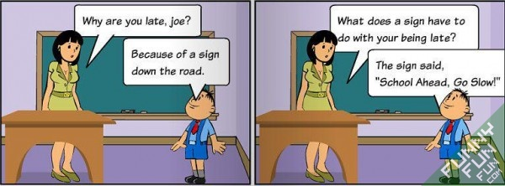
Comics

Slide 7
Elements of a Narrative text
Setting
Plot
Characters
Point of View
Theme

Slide 8
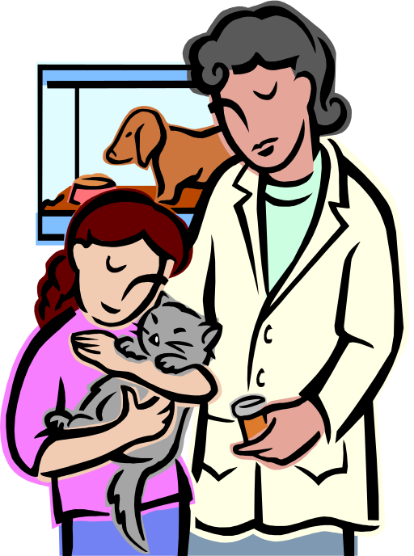
CHARACTERIZATION
The description of the personalities of the characters in the story and the way in which an author reveals their personalities.

Slide 9
PLOT
The sequence or order of events in a story. The plot includes:
  Exposition Statement - The part of the plot that tells how the story begins.
  Rising Action - The action in the story leading up to the climax.
  Conflict - Struggles or problems between opposing forces.

Slide 10
More PLOT
  Climax - The point of crisis in the plot. It may be the reader’s point of highest interest.
  Falling action - The action in the story after the climax is revealed.
  Resolution - The part of the plot that reveals the final outcome.

Slide 11
PLOT DIAGRAM
Climax
Rising Action
Conflict
Falling Action
Exposition
Resolution

Slide 12
The Purse of Gold
A beggar found a leather purse that someone had dropped in a market place. Opening it, he discovered that it contained 100 pieces of gold. Then he heard a merchant shouted, "A reward! A reward for the one who finds my leather purse!"
Being an honest man, the beggar came forward and handed the purse to the merchant saying, "Here is your purse. Will you keep your word to give a reward now?"

Slide 13
The Purse of Gold - 1
"Reward?" scoffed the merchant greedily counting the amount of gold. "The purse I dropped had 200 pieces of gold in it. You've already stolen more than the reward I'll give to you! Go away or I'll tell you to the police."

Slide 14
The Purse of Gold - 2
"I'm an honest man," said the beggar defiantly. "Let's take this matter to the court!" In the court, the judge patiently listened to both sides of the story and said, "I believe you both. Justice is possible! Merchant, you stated that the purse you lost contained 200 pieces of gold. Well, that's a considerable cost. But the purse the beggar found had only 100 pieces of gold. Therefore, it couldn't be the one you lost."
And, with that, the judge gave the purse and all the gold to the beggar.

Slide 15
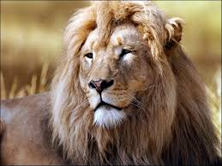
Listen to the Story

Slide 16
Answer these Questions
What kind of narrative text did you listen to?
What was the title?
Why did the lion seek the wolf’s help?
How did the wolf bring the stag to the den?
Why did the stag run away?
How did the wolf persuade the stag the second time?
Who ate the brains?
What message can you draw from the story?

Slide 17
Summary of Lecture 10
In lecture 10, we learnt how to
  Recognize a narrative text
  analyze the structure of narrative texts
  Comprehend the contents of the narrative texts
  Reflect on and share personal response to the narrative texts

